Slide 1

MatLab Project
Brain Tumor Detection From MRI using MatLab
Name: Aditi Mishra
Scholar No: 23U01042
Topic: Brain Tumor Detection From MRI
Batch: ECE
Section: 1
Subject: MatLab Programming Lab
Submitted to: Dr. Prince Kumar Singh

Slide 2
Introduction
Brain Tumor is a fatal disease which cannot be confidently detected without an MRI. In the project, it is aimed to detect whether patient has a brain tumor or not from MRI image using MATLAB simulation.
To pave the way for morphological operation on MRI image, the image was first filtered using Anisotropic Diffusion Filter to reduce contrast between consecutive pixels. After that the image is resized and utilizing a threshold value of intensity image is converted to a black and white image manually. This primary action filters the plausible locations of tumor presence.

Slide 3
On this semi processed image, further morphological operations have been applied and information on solidity and areas of the plausible locations are obtained. A threshold value for both of these characteristics has been already determined from a statistical average of different MRI images containing tumor. Then it is used to deliver final detection result. Though this simulation routine can give correct result most of the time, it fails to perform when size of the tumor is too small or the tumor is hollow.
The larger goal of the project is to build a data base of 2D images of MRI with tumor presence from the taken from different angle of a particular human and by analyzing them to point out the exact 3D location of the tumor. To fulfill this, 2D tumor detection and segmentation has been developed for better accuracy so that 3D detection can be more reliable. This is the primary target of this project.

Slide 4
%Code:-
close all;
clear all;
clc;
img = imread(‘R.jpeg');
bw = im2bw(img,0.7);
label = bwlabel(bw);
stats = regionprops(label,'Solidity','Area’);
density = [stats.Solidity];
area = [stats.Area];
high_dense_area = density>0.5;
max_area = max(area(high_dense_area));
tumor_label = find(area == max_area);
tumor = ismember(label,tumor_label);
se = strel('square',5);
tumor = imdilate(tumor,se);
figure(1);
subplot(1,3,1);
imshow(img,[]);
title('Brain');
subplot(1,3,2);
imshow(tumor,[]);
title('Tumor Alone');
[B,L] = bwboundaries(tumor,'noholes');
subplot(1,3,3);
imshow(img,[]);
hold on
for i = 1:length(B)
plot(B{i}(:,2),B{i}(:,1), 'y' ,'linewidth',1.45);
end
title('Detected Tumor');
hold off;

Slide 5
Algorithm
1) To clear the workspace beforehand →
close all; clear all; clc;
2) Import the image→ img = imread('pn.jpg’);
3) Convert image to binary image, based on threshold→
BW = im2bw(I,level)
-> converts the grayscale image I to binary image BW, by replacing all pixels in the input image with luminance greater than level (0.7) with the value 1 (white) and replacing all other pixels with the value 0 (black).

Slide 6
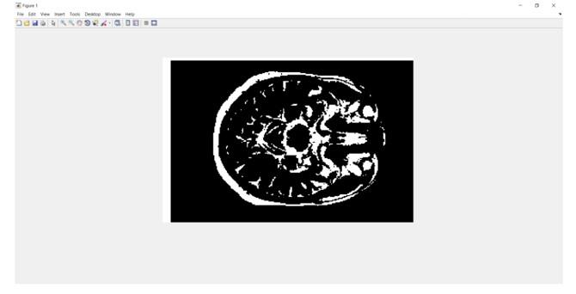
4)To group the dense regions of the image → stats=regionprops(label,'Solidity','Area’);
-> regionprops finds unique objects in binary images using 8-connected neighborhoods for 2-D images and maximal connectivity for higher dimension images.
5) The fundamental idea is detecting max intensity area identification from a binary image →

Slide 7
6) To return the maximum density region→ tumor=ismember(label,tumor_label);
-> returns an array containing logical 1 (true) where the data in A is found in B. Elsewhere, the array contains logical 0 (false).
It will return a matrix containing logical 1 (true) where the max intensity part is found in original image. Elsewhere, the array contains logical 0 (false).
7) To locate the maximum area region in the label matrix→
tumor = ismember(label,tumor_label);
-> ismember(A,B) returns an array containing logical 1 (true) where the data in A is found in B. Elsewhere, the array contains logical 0 (false).
8) To add pixels to the boundary of the tumor → tumor=imdilate(tumor,se);
-> dilates the grayscale, binary, or packed binary image I using the structuring element SE.
Dilation adds pixels to the boundaries of objects in an image. For that imdilate is used.
9) The rest of the code simply plots all the images to display results.

Slide 8
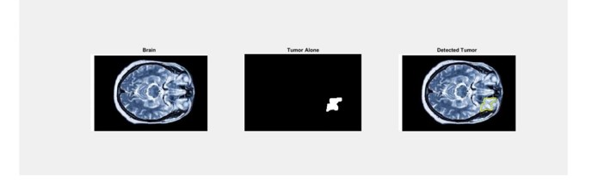
Results

Slide 9
References
For more details about the project, check this link→
https://in.mathworks.com/help/images/segment-3d-brain-tumor-using-deep-learning.html
https://www.matlabcoding.com/2019/09/3d-image-segmentation-of-brain-tumors.html
bwlabel function study →
https://in.mathworks.com/help/images/ref/bwlabel.html
regionprops function study →
https://in.mathworks.com/help/images/ref/regionprops.html
ismember study→
https://in.mathworks.com/help/matlab/ref/ismember.html

Slide 10
THANK YOU!

