Slide 1

Blockchain-Based Land Registry System
Tamper-proof land records with Ethereum smart contracts and cloud storage
Team BlockCodeM
Aditya Dhabhai · RA2512055010013
Ishan Roy Barman · RA2512055010018
Final Project Review · 11 November 2026
Guide: Kavi Priya D
Cloud Computing and Blockchain · M.Tech CSE · SRMIST
Notes:
Introduce the team and the project: a land registry where ownership records live on Ethereum and documents live in the cloud.

Slide 2




Problem: centralised land records can be tampered
Insider edits
Forged deeds
Admins can change ownership data with no reliable audit trail
Edited sale deeds are hard to spot, enabling double-selling
Opaque history
Single point of failure
Chain of title is scattered across paper registers
One server or archive can be lost or made unavailable
Notes:
Problem statement: record land ownership and transactions securely on blockchain, keep documents off-chain, and give a transparent ownership history.

Slide 3






Objectives
Immutable records
Full history
Tamper detection
Stored on Ethereum
Append-only owner timeline
SHA-256 hash comparison
Cloud storage
Access control
AWS deployment
PDF deeds kept off-chain
JWT login for registrars
Hosting, S3 and monitoring

Slide 4
Literature survey
Work | Key idea | What we take from it
Nakamoto, 2008 | Hash-linked append-only ledger | Immutability of records
Buterin / Wood, 2014 | Ethereum smart contracts | Registry logic in Solidity
Lantmäteriet, Sweden, 2017 | National land-transfer pilot on blockchain | Real-world value of on-chain history
Thakur et al., 2020 | Blockchain land titling in India | Indian context, hash-on-chain design
Krishnapriya & Sarath, 2020 | Ethereum land registration | Register / transfer workflow
Benet, 2014 (IPFS) | Content-addressed off-chain storage | Store files off-chain, hash on-chain
Gap: most prototypes stop at the contract — no full web workflow with cloud storage and verification.

Slide 5


Hybrid design: hash on-chain, file in the cloud
On-chain (Ethereum)
Off-chain (Cloud)
Land ID, owner, location
SHA-256 document hash
Block timestamp
Full ownership history[]
Immutable, publicly verifiable
Original PDF sale deeds
Cloudinary now → AWS S3
Registrar accounts
Cheap, scalable storage
Linked by hash + secure URL

Slide 6
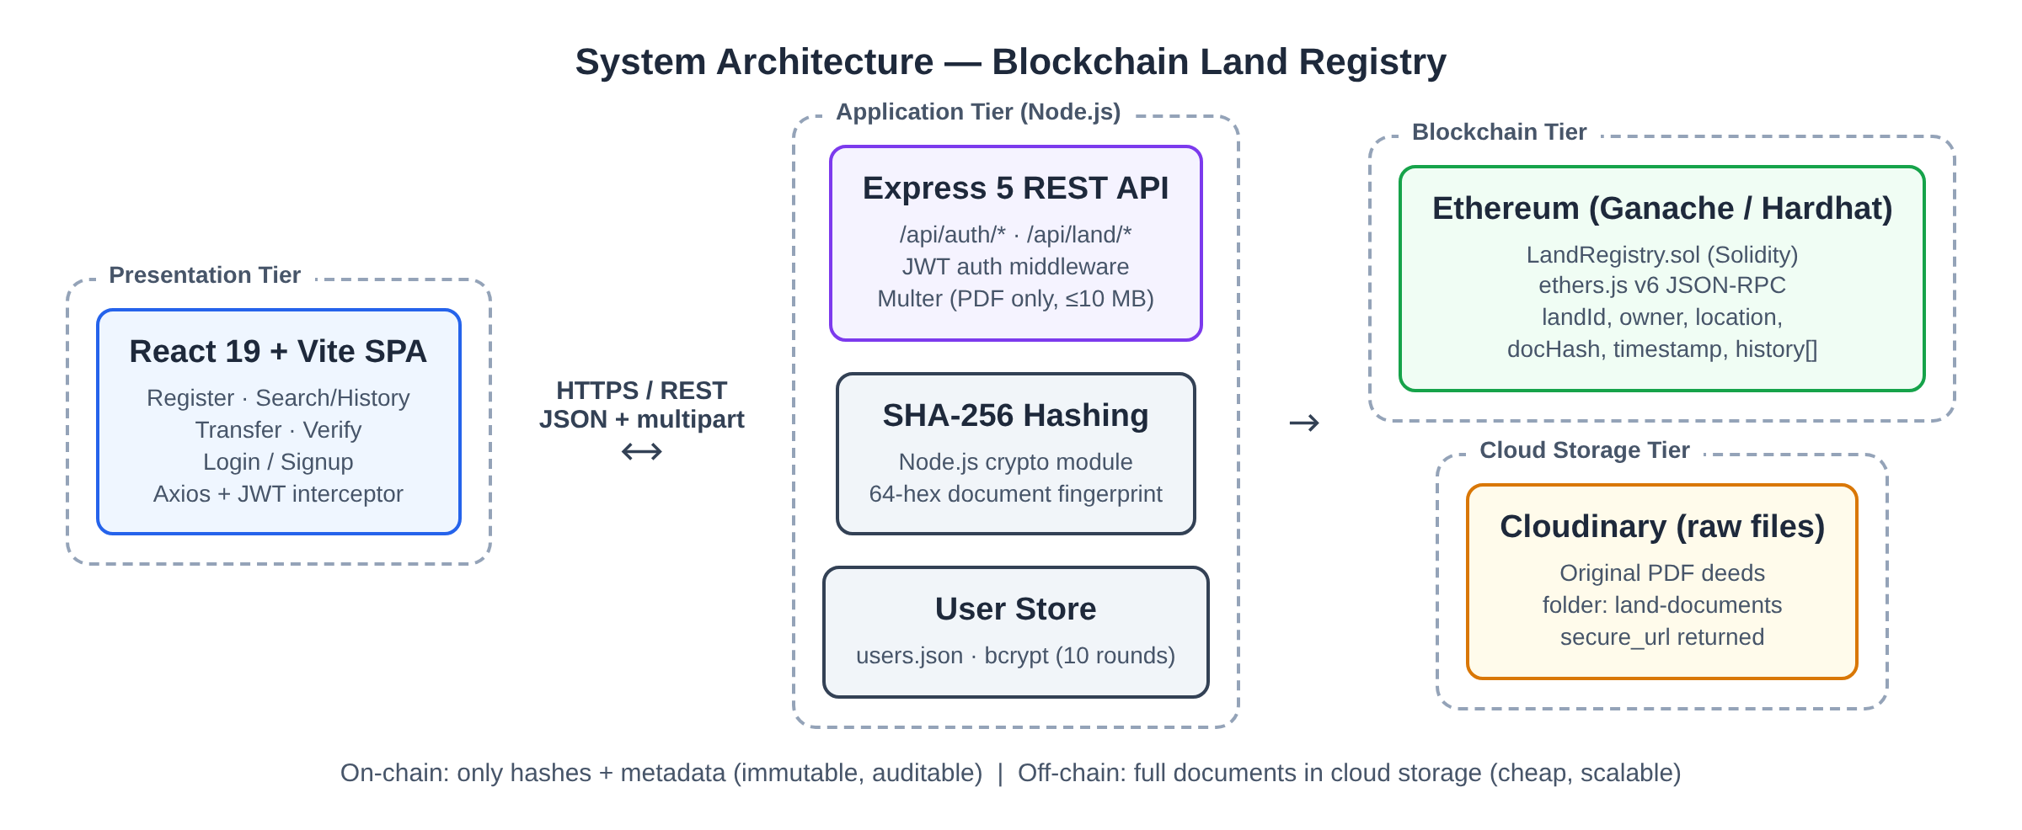
System architecture

Slide 7
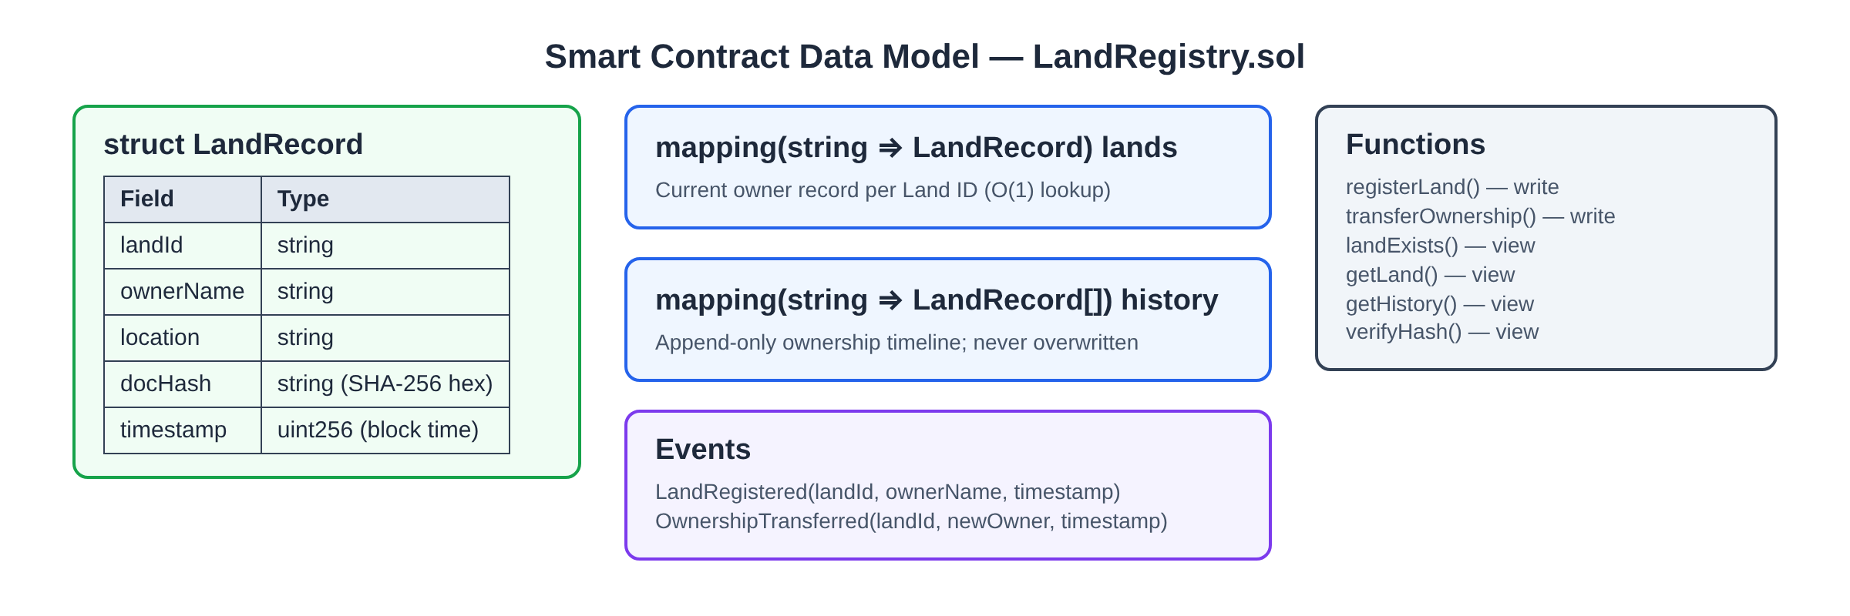
Smart contract: LandRegistry.sol
require() rules: no duplicate Land ID on register; Land ID must exist for transfer, history and verify. verifyHash() compares keccak256 of the stored and supplied hash — a free view call.

Slide 8
Registration flow in five steps
1
2
3
4
5
Upload
Validate
Hash
Store
Record
Registrar submits Land ID, owner, location and PDF (JWT)
Multer: PDF only, ≤10 MB; landExists() duplicate check
Server computes SHA-256 of the file bytes
PDF uploaded to cloud; secure URL returned
registerLand() tx mined; txHash sent to UI
Transfer uses the same path with transferOwnership(); the old record stays in history.

Slide 9



Technology stack
Blockchain
Solidity · Ganache · Hardhat · ethers.js v6 · MetaMask / Remix
Backend
Node.js 22 · Express 5 · Multer · crypto SHA-256 · bcrypt · JWT
Frontend
React 19 · Vite 8 · Axios
Cloud
Cloudinary (current) · AWS S3, EC2, CloudWatch (final)

Slide 10
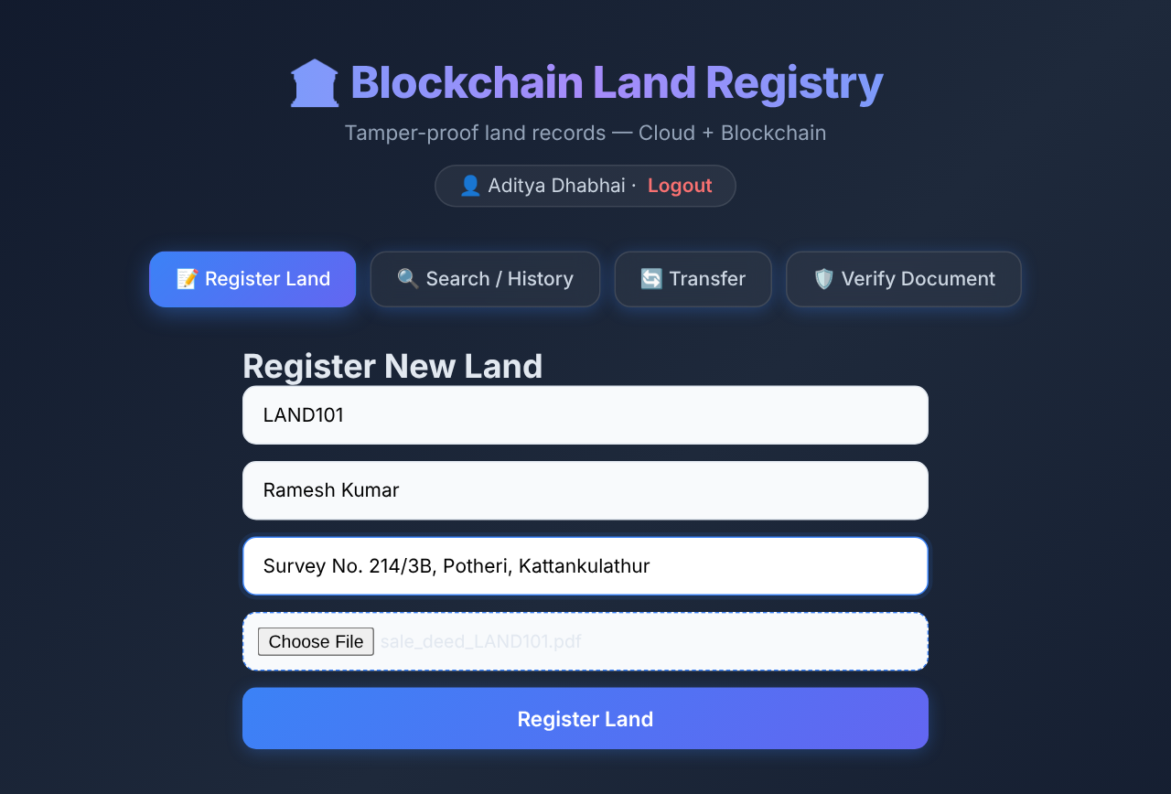
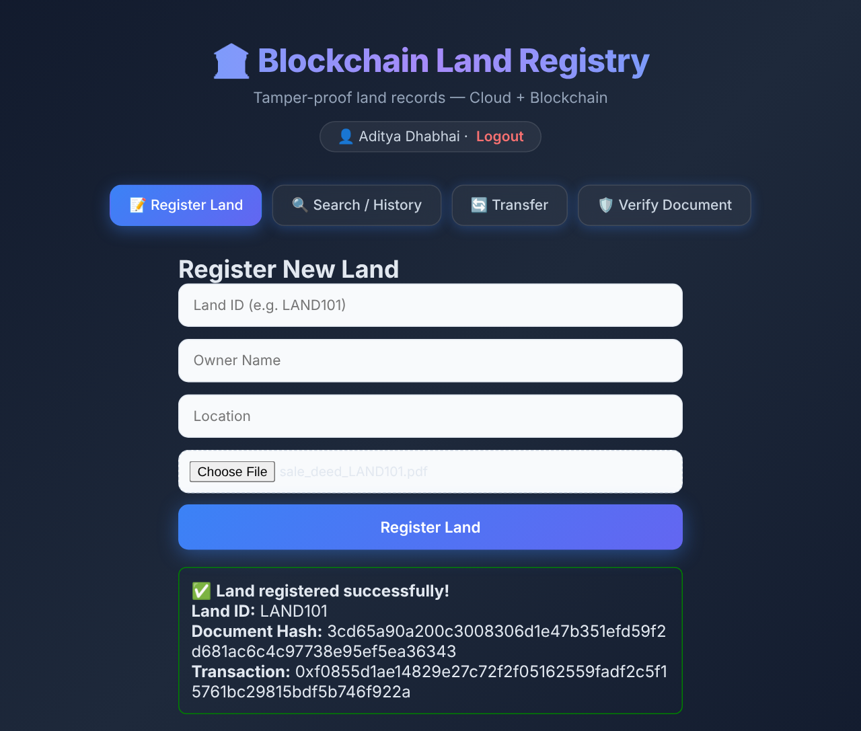
Demo: registering LAND101 on the blockchain
Registrar fills the form and attaches the sale deed
Document hash and transaction hash returned

Slide 11
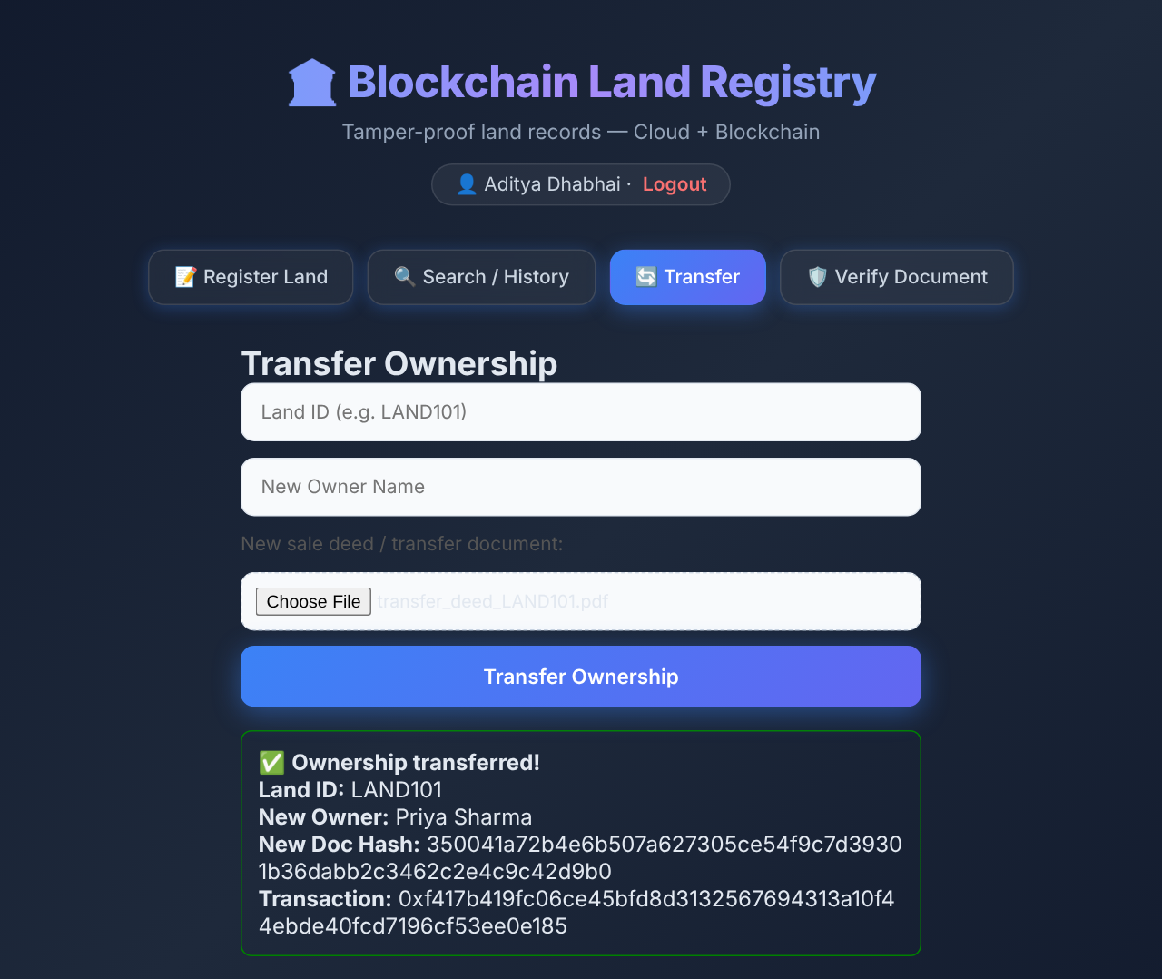
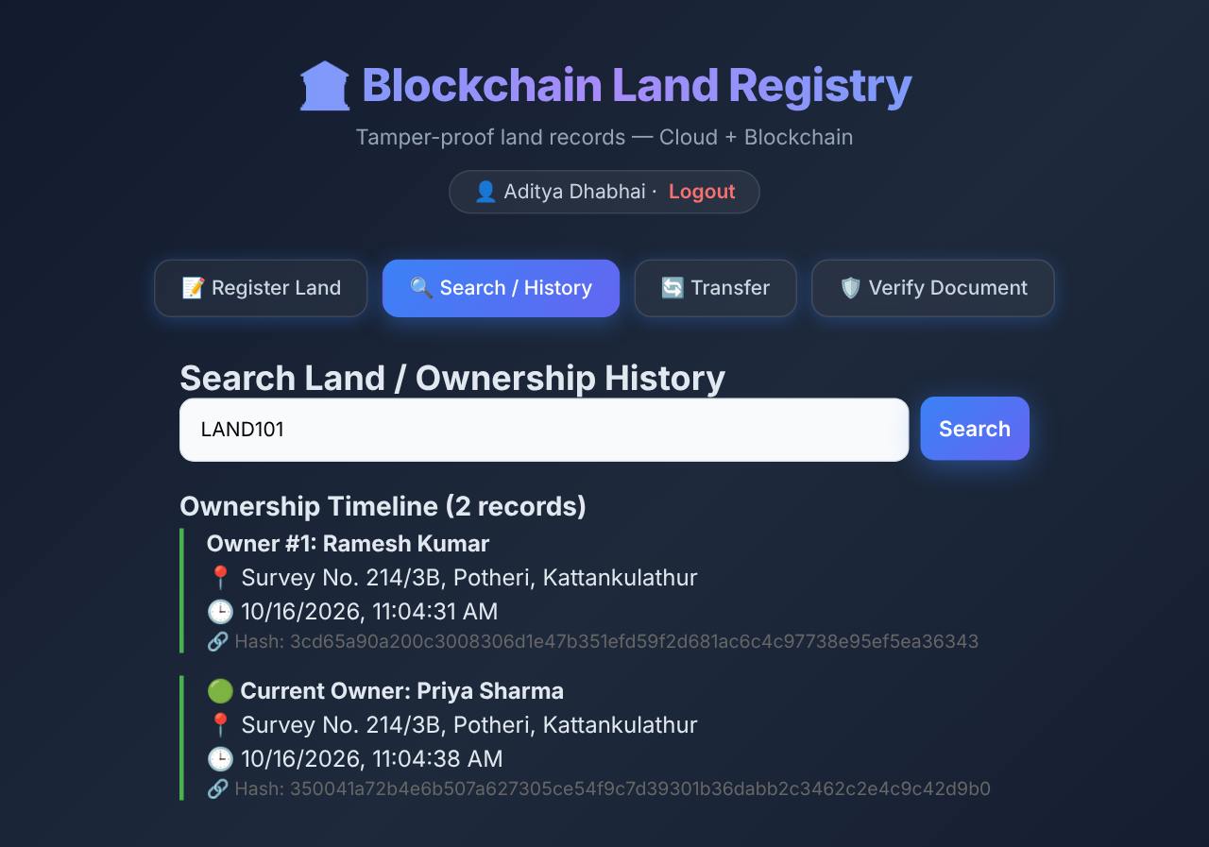
Demo: transfer keeps the full ownership history
Ownership transferred to Priya Sharma
Timeline shows both owners with their deed hashes

Slide 12
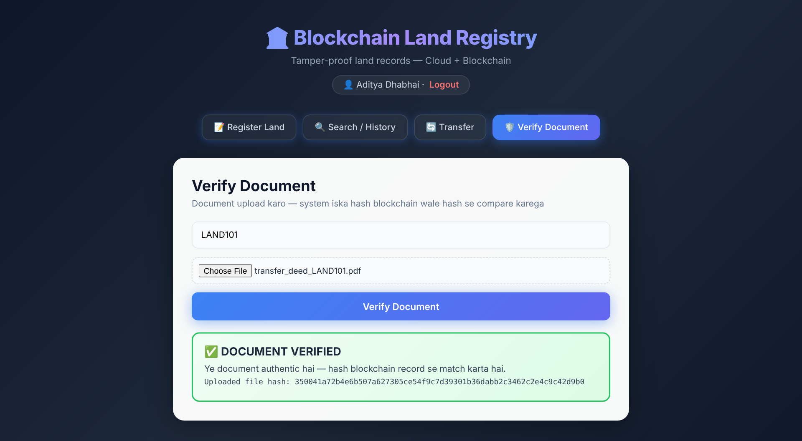
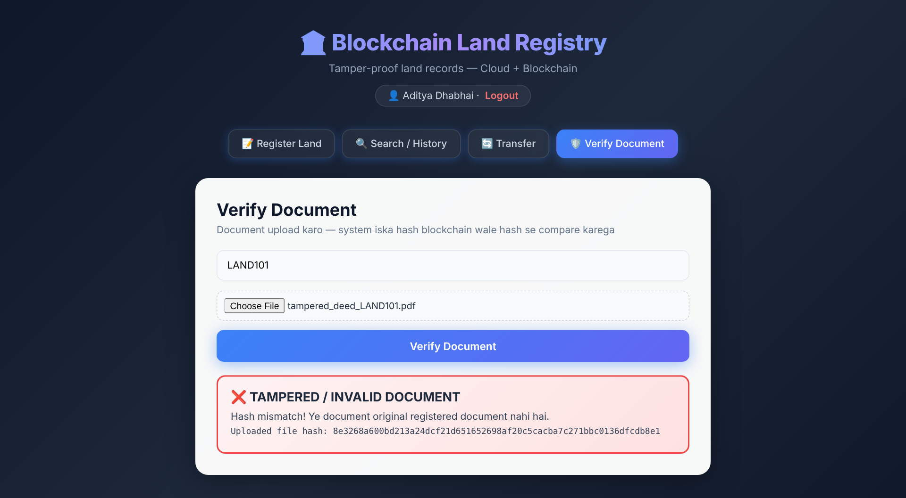
Demo: one changed byte is caught instantly
Genuine deed → DOCUMENT VERIFIED
Edited buyer and amount → TAMPERED

Slide 13
Testing: 16 test cases, 100% tamper detection
14
30/30
30/30
of 16 test cases passed
tampered deeds detected
genuine deeds verified
Found during testing — fixes planned
Request without a file returns HTTP 500 → return 400 "Document is required"
Unknown Land ID on history/verify returns 500 → check landExists() and return 404
Two writes within ~250 ms fail with "nonce too low" → use ethers NonceManager
Multer temp files remain in uploads/ → delete after hashing and upload

Slide 14
Performance: reads ~15 ms, writes ~115 ms
0.37 M
gas per registerLand()
0.22 M
gas per transferOwnership()
1.43 M
gas to deploy (one-time)
Notes:
Measured on the local Hardhat/Ganache chain with automine. Cloud upload time is excluded. Reads are free eth_call requests, so they are much faster than writes. On a public network write latency would be about one block time.

Slide 15
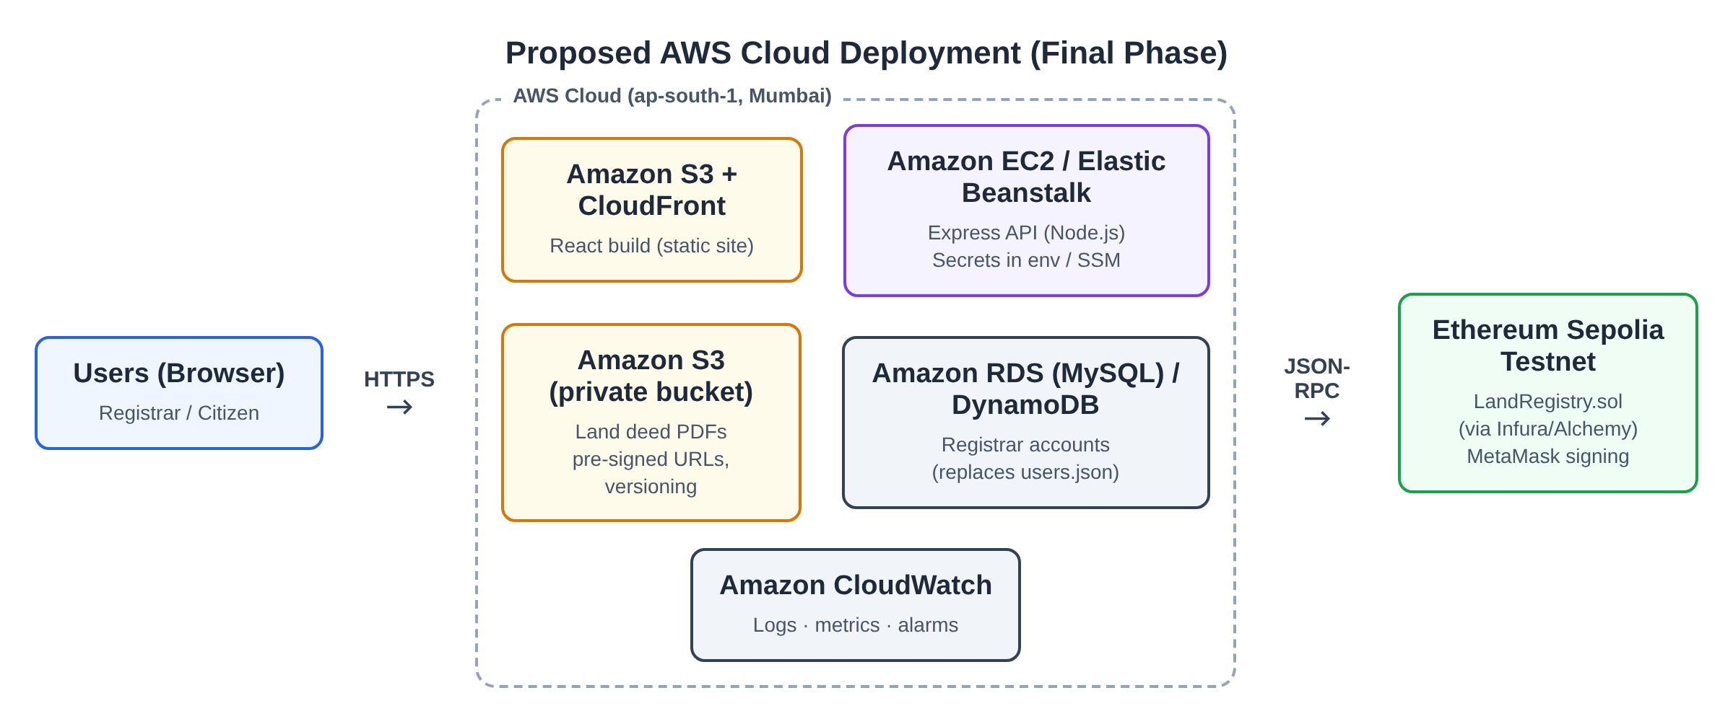
Final phase: deploying on AWS
S3 + CloudFront host the React build
EC2 / Elastic Beanstalk runs the Express API
Private S3 bucket stores deeds with versioning
RDS / DynamoDB replaces users.json
CloudWatch for logs and alarms
Contract on Sepolia testnet via MetaMask

Slide 16



Conclusion
A low-cost, transparent and tamper-evident land registry built from Ethereum smart contracts and cloud storage
Immutable owner history on Ethereum
Every tampered deed detected in tests
Under 0.5 M gas per write

Slide 17
Thank you
Questions and live demo
github.com/adi-2602/blockchain-land-registry

