Slide 1

Department of Computer Science And Engineering

Slide 2
SOLEMATE ELECTRONIC SHOES TO ASSIST VISUALLY CHALLENGED
Prepared By:-
Aaditya Raj(1ME20CS001)
Tasmia Kowsar(1ME20CS046)
Thaseen S(1ME20CS047)
Under the guidance of :
Dr. Malatesh S H
Prof. and H.O.D. CSE Department

Slide 3
Table of contents
02
Literature Survey
Problem Statement
01
Introduction
03
05
System Architecture
Algorithms Used
04
Objectives
06
System Requirements
References and Conclusion
07
08
Modules
09

Slide 4
Introduction
01

Slide 5
Imagine navigating the world without sight, where every step holds uncertainty. Now, imagine a future where electronic shoes become your eyes, guiding you with invisible whispers and vibration. This is the promise of SoleMate, a revolutionary project crafting intelligent footwear that empowers visually challenged individuals to walk with newfound confidence and independence.

Slide 6
Literature Survey
02

Slide 7
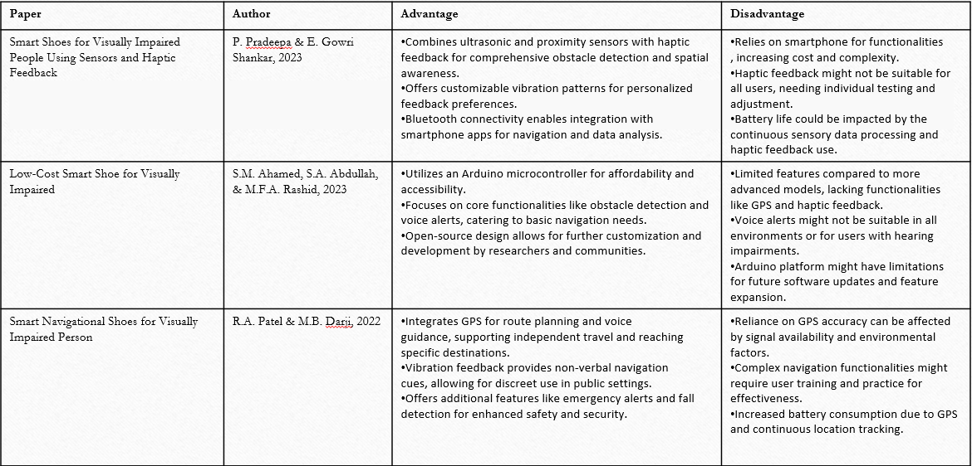
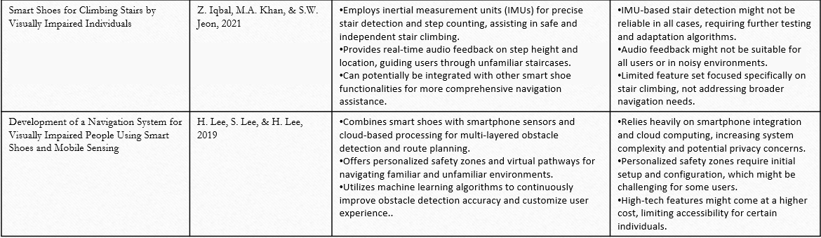

Slide 8
Problem Statement
03

Slide 9
Problem statement
We want a system that eliminates these challenges and provides awareness of surrounding , accessibility information , feedback to guide which provides confidence to navigate alone

Slide 10
Objectives
04

Slide 11
Enhance Situational Awareness: Equip users with real-time perception of their surroundings through advanced sensors and AI algorithms.
Empower Independent Navigation: Enable users to navigate familiar and unfamiliar environments confidently without relying on external assistance.
Promote Safe and Secure Movement: Minimize potential risks by providing timely warnings and guidance to avoid collisions, falls, and other hazards.
Prioritize User Privacy and Security: Ensure user data is protected and responsibly managed.

Slide 12
Methodology
05

Slide 13
Methodology
GPS Module Integration (SIM808)
Requirement analysis
SMS-Based GPS Communication
Hardware Integration
Software Development for YOLO and GPS
Remote Monitoring System
YOLO Object Detection
User Permissions and Preferences
Testing and Calibration

Slide 14
System Architecture
06

Slide 15
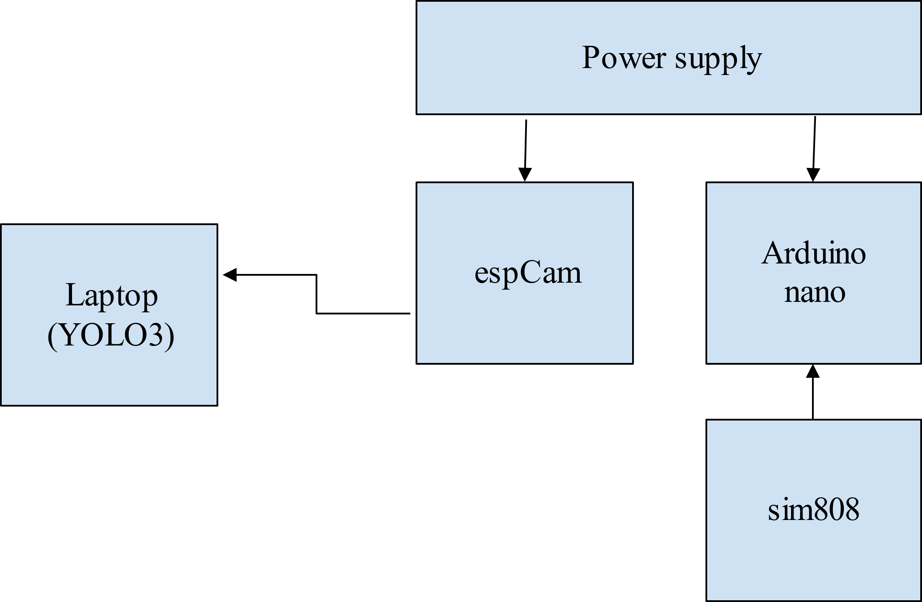
System Architecture

Slide 16
Modules
07

Slide 17
Modules
Dataset Collection
Data Pre-Processing
Training Network
Hardware Integration
Arduino Programing

Slide 18
System Requirements
08

Slide 19
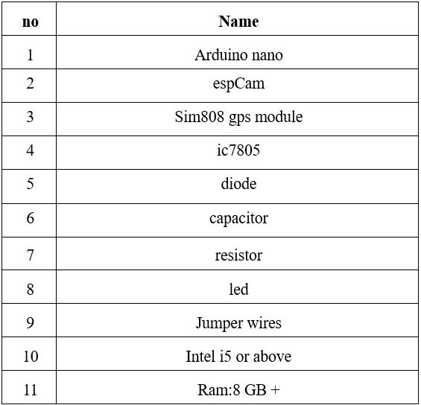
Hardware Requirements

Slide 20
Software Requirements
Language used:- Python
Language used
Libraries
Algorithms
OpenCV
pyttsx3
YOLO

Slide 21
Reference and Conclusion
09

Slide 22
Reference
[1] Calder, David J, Curtin, “An obstacle signaling sytem for the blind, Digital Ecosystems and Technologies,”Confrence (DEST), 2011 Proceedings of the 5 th IEEE International Confrence on 30 June 2011.
[2] ShrutiDambgare, Prof.A.Sakhare,”Smart Stick for Blind: Obstacle Dection,Artificial Vision and Real- Time assistance via GPS” Confrence (NCICT)2011, Proceedings 2nd National Conference on Information and Communication Technology 2011.
[3] Rohithseth “Smart White Cane- an elegant and economic walking aid”.

Slide 23
Conclusion
SoleMate isn't just a pair of shoes; it's a revolutionary leap towards a more inclusive and empowered future. It's a whisper of possibility for millions who navigate a world designed for sight, a technological bridge towards independent mobility and confident strides.
This isn't just a project; it's a movement. Every individual who joins, every challenge overcome, every step taken with confidence paves the way for a brighter tomorrow. A future where everyone can walk with their heads held high, their own internal cartographer guiding them, their soles whispering the secrets of a world waiting to be explored.

Slide 24
Thanks!

