Slide 1

RealFact
OpenMP-Accelerated, Independence-Aware Real-Time News Verification
Adithya Shyam D (241IT005) · Krishna (241IT039) · P Suman (241IT049) · Saurabh (241IT072)
IT 301 Parallel Computing · Department of Information Technology, NIT Karnataka, Surathkal
Notes:
Good morning. Our project is RealFact: a system that checks whether a news claim is supported by live news, and does the heavy similarity work in parallel with OpenMP. It answers with one of four verdicts: Supported, Contradicted, Conflicting Evidence, or Unverified.

Slide 2
Problem Statement
Checking a claim means comparing it against thousands of live articles in real time, and many of those “confirmations” are copies of a single wire story.
1
What is broken today
2
Stakeholders
3
How they benefit
Style classifiers judge the tone, not the truth
Evidence systems count every copy as a new source
Speed and scalability are never measured
Readers checking what they see online
Journalists and fact-checking desks
Platforms and content moderators
A cited verdict in about 0.1 s
Each independent source counted once
Honest “Unverified” and “Conflicting” answers
13.1%
23
6.6M
of live articles have a near-copy
copies of one story across 10 outlets
article pairs to compare
Notes:
The problem has two parts. First, verifying a claim against live news is a large similarity-search problem: every claim is compared with every article. Second, outlets republish the same wire report, so ten 'confirmations' can be one story. In our own live corpus, 13 percent of articles have a near-copy, and one story appeared 23 times across 10 outlets. The stakeholders are readers, journalists and fact-checkers, and platforms. They get a cited answer in about a tenth of a second, independent sources are counted once, and the system says 'I don't know' when it should.

Slide 3
Methodology Block Diagram
BUILD THE INDEX
Live RSS
42 feeds, every 20 min
Clean + dedupe
English, exact-copy hash
Embed (BGE)
384-d vectors
Embedding matrix
N × 384, in memory
Kernel 2
syndication map
Web search
Google News + Wikipedia
every claim scans the whole matrix
VERIFY A CLAIM
Claim
embed the text
Kernel 1
OpenMP scan, top-M
Kernel 3
cluster duplicates
NLI model
support / contradict
Weighted vote
w = 1 + λ·log₂n
Verdict
4-way, with sources
Blue = this project’s contribution (three C++/OpenMP kernels + weighted voting)
Key idea: retrieve wide (10,000 candidates), group copies of the same story, then let each story vote with a weight that grows only logarithmically with its copies.
Notes:
This is the whole system. The top row builds the evidence index: articles from 42 RSS feeds, and optionally a live web search for the claim, are cleaned, de-duplicated, embedded into 384-number vectors and kept in one big matrix. The bottom row verifies a claim. Kernel 1 scans the entire matrix in parallel to find the 10,000 most similar articles. Kernel 3 groups copies of the same story. An NLI model reads one article per story and says support, contradict or neutral. Then each story votes, with weight one plus half log-two of its number of copies, and we return one of four verdicts with sources. Kernel 2 runs over the whole corpus and finds all syndicated copies.

Slide 4
How RealFact Differs from Existing Solutions
 | Existing (FEVER-style pipelines) | RealFact
Evidence | Static Wikipedia dump | Live news + web search
Duplicate copies | Each copy is one vote | One story, weighted vote
Verdicts | True / false (3-way) | 4-way, every source cited
Conflicting evidence | Folded into “not enough info” | Its own verdict
Speed reported? | Accuracy only | Speedup, efficiency, load balance
16 copies of one report count as 3 votes, not 16
Reference: Guo, Schlichtkrull & Vlachos, “A Survey on Automated Fact-Checking,” TACL 2022
Notes:
Compared with the standard FEVER-style pipeline from our reference survey, RealFact differs in five ways. It uses live news instead of a frozen Wikipedia dump. It groups copies of one story instead of counting each copy as a vote. It has four verdicts and cites every source. Conflicting evidence is a verdict of its own, which the survey lists as an open problem. And we measure speed and scalability, which the surveyed systems do not report. The chart shows the weighting: naive counting grows linearly with copies, ours grows logarithmically, so 16 copies count as 3 votes.

Slide 5
Parallel Design: Three OpenMP Kernels
1
Exact similarity scan
2
All-pairs syndication
3
Duplicate clustering
Compares the claim with every article and keeps the top 10,000
Compares every article with every other one and groups copies
Groups the retrieved articles into independent stories
parallel for, schedule(runtime)
Private top-M heap per thread, padded to 64 B (no false sharing)
16 independent sums per dot product (ILP)
Triangular loop: early rows carry more work
dot4 register blocking, lock-free edge buffers
dynamic vs static scheduling decides balance
The algorithm is sequential by definition
Block speculation: parallel similarity, short serial pass
Output identical to the sequential algorithm
Memory-bound
Compute-bound
Sequential → parallel
Correctness: each kernel is compiled twice (with and without OpenMP); every parallel run must return results bit-identical to the serial build. 14 automated checks.
Notes:
The parallel computing part has three kernels, and each shows a different lesson from the course. Kernel 1 is the scan: a parallel for over all articles, with a private heap per thread padded to a cache line so threads don't fight over memory. It is limited by memory bandwidth. Kernel 2 compares every pair of articles. The work forms a triangle, so the first rows have far more work than the last; that makes the OpenMP schedule matter. It is limited by computation. Kernel 3 parallelises an algorithm that is sequential by nature, using block speculation, and still gives exactly the same answer. Every kernel is checked against a serial build, bit for bit.

Slide 6
Results 1: Parallel Speedup
6.92×
all-pairs kernel, dynamic, 11 threads (static only 4.98×)
4.61×
similarity scan at 500K articles, 16 threads
2.6×
faster serial scan after the ILP rewrite (96 GB/s ceiling)
5.8×
parallel clustering, identical output
Why static loses: each thread gets one block of rows, and early rows have the most pairs, so the busiest thread does 1.9× the average work.
Notes:
Here are the parallel results on our Apple M3 Pro with 11 cores. The chart is kernel 2 on the live corpus. Dynamic and guided scheduling reach almost 7 times speedup; plain static stops at 5, because with contiguous blocks the first thread gets the rows with the most pairs and does 1.9 times the average work. On the right: the similarity scan reached 4.6 times at half a million articles; rewriting the dot product for instruction-level parallelism made the serial version 2.6 times faster and moved the kernel to the memory-bandwidth ceiling of about 96 GB/s; and the parallel clustering reached 5.8 times with exactly the same output. The ceiling near 7 times is the hardware: 6 of the 11 cores are slower efficiency cores.

Slide 7
Results 2: Verification Accuracy
81.0%
accuracy (macro F1 0.807)
92.4%
correct page ranked first
114 ms
per claim, end to end
Fair tuning: settings chosen on 180 other claims; the 179 test claims were scored once.
LIAR (2007–2016 claims vs today’s news): 99% correctly answered “Unverified”. That test measures corpus coverage, not reasoning.
Notes:
To measure accuracy we need claims whose evidence is in the corpus, so we built a FEVER demo corpus: 179 test claims against 25,000 Wikipedia pages. With a small NLI model we got 59 percent; with a model trained on FEVER, 74; after checking evidence sentence by sentence and tuning, 81 percent, with the correct page ranked first 92 percent of the time. Importantly, all tuning was done on 180 different claims, and the test claims were scored only once, so the number is not inflated. On LIAR, whose claims are from 2007 to 2016, the system correctly says 'Unverified' for almost everything, because today's news simply doesn't cover them.

Slide 8
Results 3: Comparison and Metric Adequacy
Same evidence, one story copied ×10
Are our metrics good enough?
Aggregation method | Verdict | Votes
RealFact (log-weighted) | Conflicting | 6.2
One vote per story | Conflicting | 4.0
Naive counting | Contradicted | 15.0
Plain top-K (FEVER-style) | Contradicted | 10.0
✓
Speed
speedup, efficiency, Karp–Flatt, load balance, Wilcoxon test
✓
Correctness
bit-identical to serial in every configuration
✓
Accuracy
accuracy, macro F1, Recall@K on a held-out split
The claim had genuinely mixed sources. Copying one contradicting article 10 times flips naive and FEVER-style counting to “Contradicted”; RealFact still reports the real disagreement.
!
Limit
no labelled live-news dataset; FEVER set is curated
Notes:
This slide compares our approach with existing aggregation methods on exactly the same evidence. The claim had mixed evidence: one supporting and one contradicting source. When we copy the contradicting article ten times, naive counting and the plain top-K approach used by FEVER-style systems both flip to 'Contradicted'. RealFact counts the eleven copies as 2.7 votes and correctly still reports conflicting evidence. On whether our metrics are adequate: for speed we use the standard parallel metrics plus a significance test; for correctness every run is compared with the serial build; for accuracy we report accuracy, F1 and recall on a held-out split. The honest limit is that no labelled dataset exists for today's news.

Slide 9
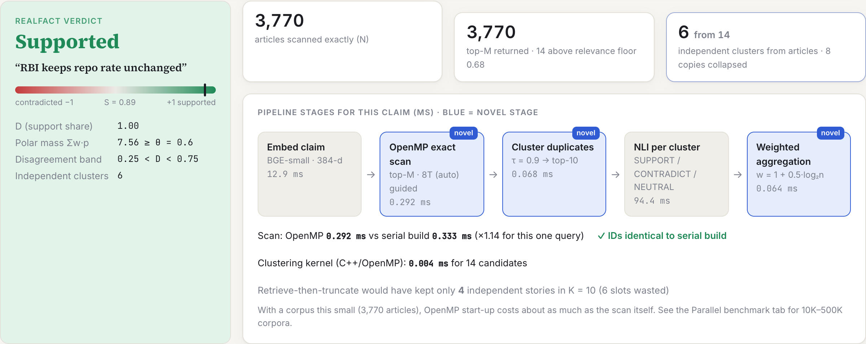
What We Achieved
Working system: web app with verify, benchmark, corpus, evaluation and history views
Live evidence: 42 RSS feeds every 20 min, plus on-demand web search
Practical use: newsroom fact-check desk, classroom media literacy, platform moderation
Deployment: runs locally on a laptop; open source on GitHub
Deliverables: IEEE-format report, 14 automated tests, reproducible benchmarks
The running web app: verdict, timed pipeline, OpenMP vs serial check
42
~0.1 s
14
news feeds, refreshed every 20 min
per verified claim
automated correctness checks
Notes:
What we achieved: a complete working system, not just a benchmark. The screenshot is the real app: it shows the verdict, the time spent in each stage, and confirms the OpenMP result matches the serial build. It ingests 42 news feeds every 20 minutes and can search the web for a specific claim. Practical uses are a newsroom fact-check desk, media-literacy teaching, and platform moderation. It runs locally on a laptop and the code is open source on GitHub, with an IEEE-format report and automated tests.

Slide 10
Conclusion
1
Count stories, not copies
Grouping syndicated copies and weighting them logarithmically keeps one wire story from outvoting independent sources.
Future work
Index the full FEVER dump and FakeNewsNet
Run on a pinned multi-socket server
float16 / int8 vectors to lift the bandwidth ceiling
Generated explanations from cited sources
2
Three parallel regimes, measured
Memory-bound scan (bandwidth ceiling), compute-bound all-pairs (6.92×, schedule matters), sequential clustering made parallel.
3
Fast, correct and honest
About 0.1 s per claim, bit-identical to serial, 81.0% on held-out FEVER claims, and “Unverified” when evidence is missing.
Research question answered: multi-source evidence retrieval runs efficiently on a multicore CPU with OpenMP, without counting duplicates as independent evidence.
Notes:
To conclude, three takeaways. One: counting stories rather than copies matters; it changes verdicts exactly when syndication is present. Two: our three kernels show three regimes from the course, a memory-bound scan, a compute-bound all-pairs kernel where scheduling decides the speedup, and a sequential algorithm made parallel. Three: the system is fast, provably correct against the serial build, and honest about what it doesn't know. Future work is a bigger evidence corpus, a server-class machine, compressed vectors, and generated explanations. So our research question is answered: yes, this runs efficiently on a multicore CPU without counting duplicates.

Slide 11
Thank You
Notes:
Thank you.

