Slide 1


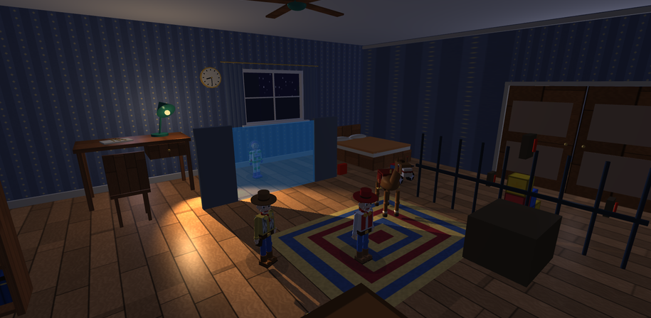
01 INTRODUCTION
THE MIDNIGHT MISSION
A haunted toy room. An interactive graphics story.
Adiba Tahsin · Roll 2107031
CSE-4102 · Computer Graphics and Image
Processing Laboratory
Md Tajmilur Rahman, Lecturer
Md Mubtashim Abrar Nihal, Lecturer
ROOM NIGHT
Adiba Tahsin · 2107031 · CSE-4102 · KUET
01 / 10
Notes:
Introduce the project as a primitive-built interactive room. Mention the arrival, rescue mission, and independently switchable rendering techniques.

Slide 2

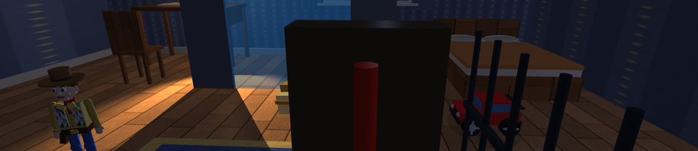

02 FEATURES + PROJECT DEMO
EXPLORE, CONTROL, COMPARE
The proposal is realised as a complete arrival, puzzle, rescues and outdoor escape.
Five driveable toys; ball and lamp
controls
TRS + hierarchy; mounting and
dismounting
Three light types; Gouraud and Phong
HOUSE
22 surface maps; analytic BVH ray tracing
PLAY PROJECT DEMO
MOUNTED
Adiba Tahsin · 2107031 · CSE-4102 · KUET
02 / 10
Notes:
Play the embedded Project-Demo.mp4. Explain features using the timed narration guide; continue with individual screenshots afterward.

Slide 3
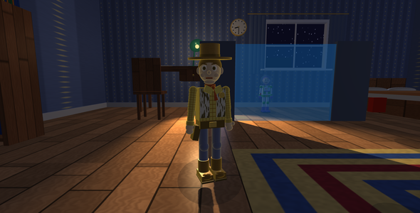
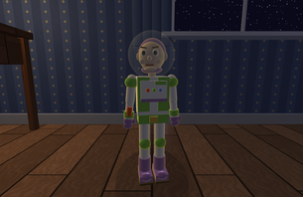
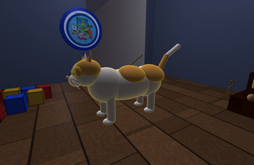
03 GEOMETRY + OBJECTS
PRIMITIVES BECOME CHARACTERS
Position, normal and UV data define five indexed mesh families.
Plane 4 vertices / 2 triangles; cube 24 / 12
Sphere: 24 × 36 → 925 vertices / 1656
triangles
Cylinder: 134 / 128; cone: 99 / 64
BUZZ
The scene uses shared buffers and
instance transforms
WOODY
PENNY
Adiba Tahsin · 2107031 · CSE-4102 · KUET
03 / 10
Notes:
Explain why a cube needs 24 vertices and why the sphere duplicates its seam. Point to curved heads, wheels and scaled ellipsoids. The models are authored from primitives.

Slide 4
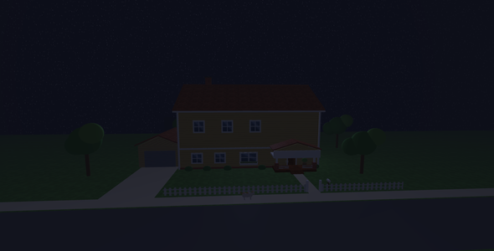
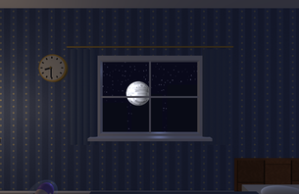
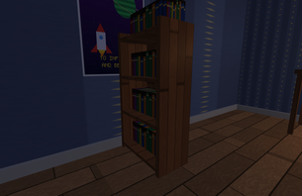
04 ENVIRONMENT + TEXTURES
A WORLD WITH SURFACE DETAIL
The house, garden, room and furniture belong to one connected scene.
Wood grain, wallpaper, cloth, moon
craters and book rows
UV repeats multiply material colour by
sampled RGB
Picket alpha cuts holes and replaces
repeated geometry
WINDOW
22 maps plus white in one texture array
serves the ray tracer
HOUSE
BOOKCASE
Adiba Tahsin · 2107031 · CSE-4102 · KUET
04 / 10
Notes:
Identify the house, garden, poster, bed, curtains and bookcase. Colour maps add detail without changing geometry; alpha coverage is different from transparency blending.

Slide 5
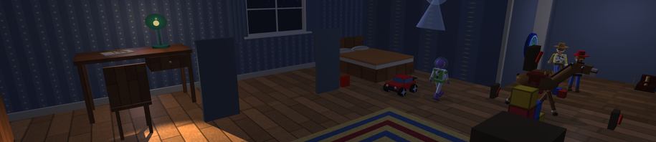
05 TRANSFORMS + INTERACTION
ONE PARENT MOVES THE RIDER
Mworld(child) = Mworld(parent) × Mlocal(child)
R: mount/dismount within 2.2 units
1–5 + W/S/A/D: choose and drive a toy
Select: live takeover; 0 release; N full
manual
LIVE CONTROL
F: inspect; C: Free / Orbit / Follow
Normal matrix = inverse transpose of
world linear part
MOUNTED
Adiba Tahsin · 2107031 · CSE-4102 · KUET
05 / 10
Notes:
Explain independent per-actor ownership and world-to-local conversion during mounting. Demonstrate one parameter change in the inspector. F2 selects raster mode for an actual Gouraud/Phong comparison.

Slide 6
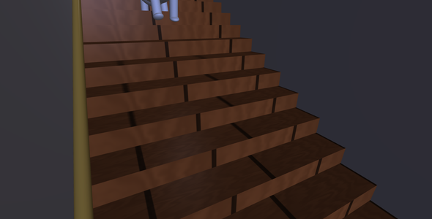
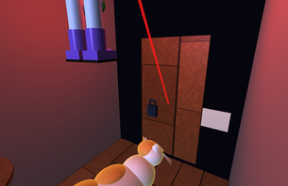
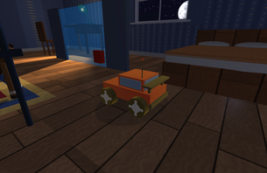
06 ANIMATION
EVERY MOTION HAS A RULE
Delta time connects displacement, gait, wheel rotation and camera motion.
Gait angle = sin(distance phase) ×
amplitude
Wheel angle = distance / radius
Doors rotate at hinges; Penny follows 3D
waypoints
DOOR IMPACT
O: ghost, ball and lamp ambience
Fan rotor: 110°/s; clock hands follow
scene hour
STAIR DESCENT
CAR
Adiba Tahsin · 2107031 · CSE-4102 · KUET
06 / 10
Notes:
Explain matching rendered treads and grounded support, Buzz's actual entrance hit, debris motion, wheel rotation and bounded physics substeps.

Slide 7
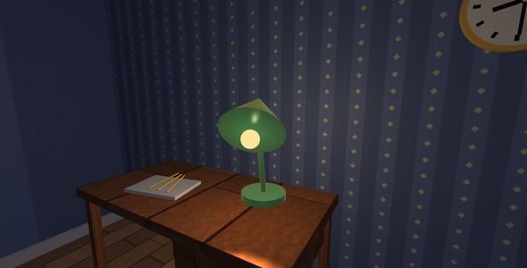
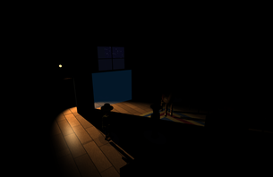
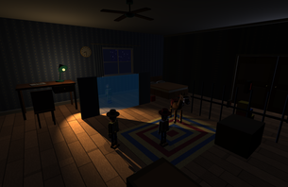
07 LIGHTING
THREE LIGHT TYPES
Ambient + diffuse + specular + emission
Directional: sun/moon; parallel rays
Point: lamp bulb; 1/(kc + kl d + kq d²)
Spot: lamp/headlights; smooth
inner/outer cone
SPOT
Diffuse = kd max(N·L,0)
Specular = ks max(R·V,0)^n
LAMP
DIFFUSE
Adiba Tahsin · 2107031 · CSE-4102 · KUET
07 / 10
Notes:
Move/tilt the lamp and explain how its light anchor and head axis follow the hierarchy. Toggle F5/F6/F7. The lamp's 22°/34° cone has a smooth edge.

Slide 8
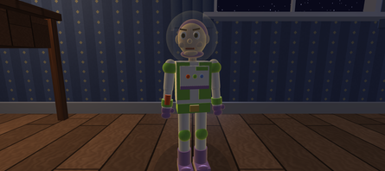
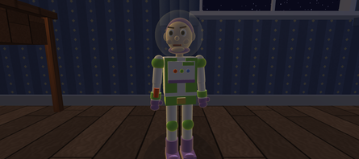

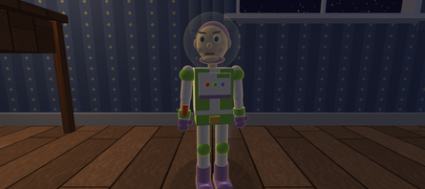
08 SHADING
WHERE IS LIGHT EVALUATED?
Matched views expose the difference between vertex and pixel illumination.
Flat: triangle normal from position
derivatives
Gouraud: vertex lighting → interpolated
colour
Phong: interpolated normal → pixel
lighting
FLAT
GOURAUD
Blinn: half-vector H = normalize(L+V)
F2 cycles raster modes; F4 returns to ray
tracing
PHONG
BLINN
Adiba Tahsin · 2107031 · CSE-4102 · KUET
08 / 10
Notes:
Distinguish illumination from shading. Gouraud can miss a narrow highlight between vertices. Phong normalizes the interpolated normal and evaluates the reflection-vector term per fragment.

Slide 9
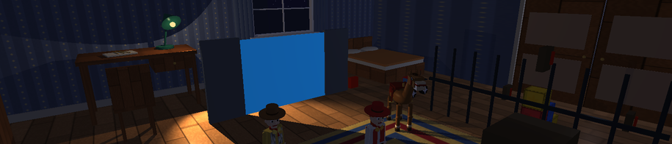
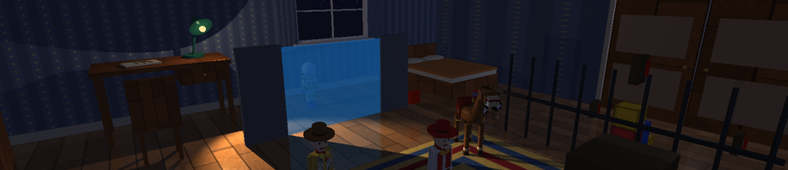
09 RAY TRACING + SHADOWS
RAYS REVEAL A SECOND VIEW
Primary ray → nearest analytic hit → illumination → bounded continuation
BVH median split; world-space boxes;
near child first
Five analytic primitive intersection
equations
Shadow rays test visibility to selected
lights
RAY ZERO
Mirror floor/ball; straight transparency
Raster lamp: 2048² depth map + 3 × 3
PCF
ROOM RAY
Adiba Tahsin · 2107031 · CSE-4102 · KUET
09 / 10
Notes:
Show the polished-floor reflection. Explain unnormalised object-space ray directions and the invariant t. State that transparency is straight-through, with no physical refraction or diffuse indirect bounces.

Slide 10
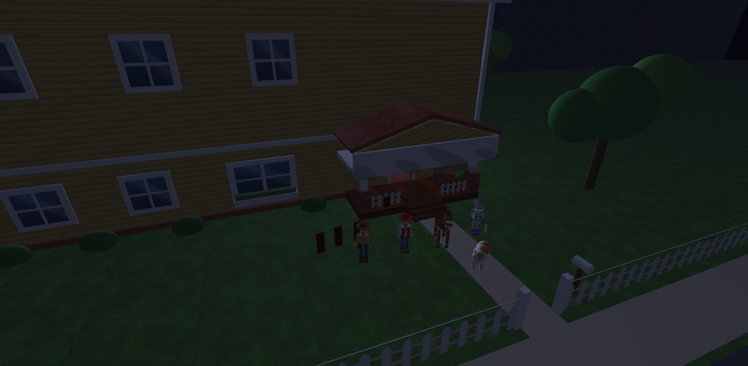
10 THE TOYS ARE SAFE
THANK YOU
All five escape. The scene remains open to inspection.
Adiba Tahsin · Roll 2107031
CSE-4102
Geometry · hierarchy · motion ·
interaction
Lighting · shading · textures · ray tracing
STORY END
Adiba Tahsin · 2107031 · CSE-4102 · KUET
10 / 10
Notes:
Invite questions. Be ready to change shininess, light attenuation, lamp cone, movement speed, scale, or ray bounce count and explain the observed effect.

