Slide 1
SMART INDIA HACKATHON 2025
TITLE PAGE - IDEA SUBMISSION
• Problem Statement Title :
Automated Attendance & Student Identity Verification System using AI and Multimodal Biometrics
• Theme :
Smart Education / Campus Automation & Governance
• PS Category :
Software
• Proposed Solution Name :
SnapClass AI - Making Attendance Faster Using AI
• Team Name :
SnapClass Innovators (Registered on Google Form)
• Target Users :
Universities, Colleges, Schools, Educators & Students
CORE CAPABILITIES
⚡ Sub-2s Attendance
Instant classroom group photo face recognition replaces 15 min manual roll call.
🎙️ Multimodal Verification
Facial recognition + voice biometric fallback prevents proxy check-ins.
🔒 Privacy-First Architecture
Stores only 128-d encrypted vector embeddings, no raw faces retained.
📱 Zero Hardware Barrier
Operates entirely over browser webcams and mobile phones via Supabase cloud.

Slide 2
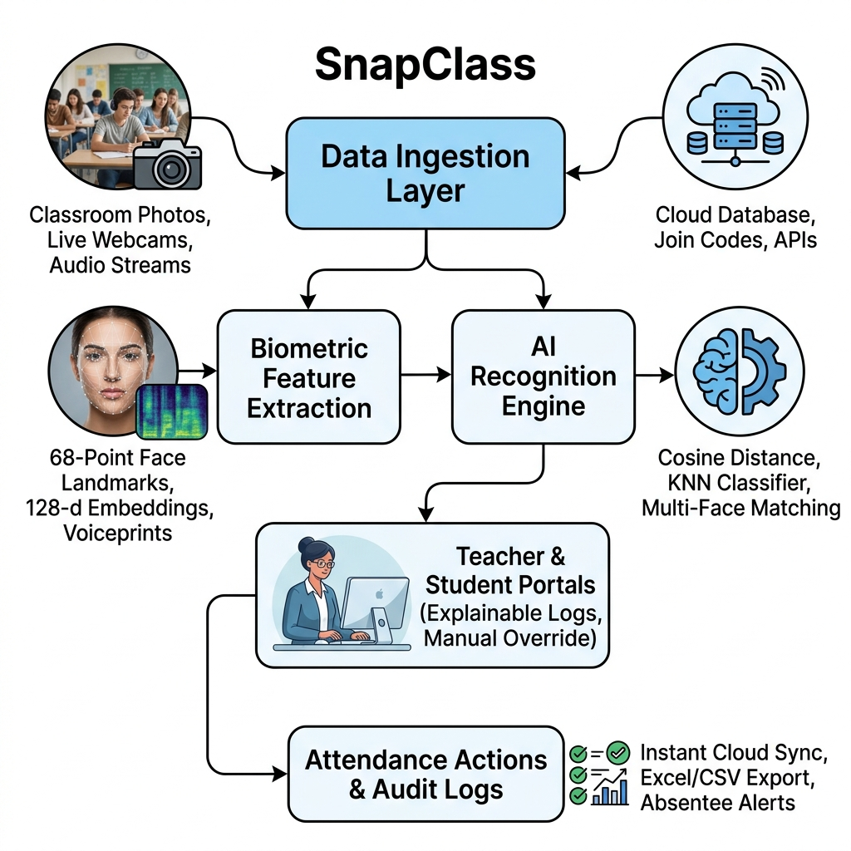
PROPOSED SOLUTION
SnapClass AI
❑ SnapClass: AI-Powered Smart Attendance Optimizer
• Touchless Biometric Attendance:
Sub-second verification via FaceID without physical contact.
• One-Shot Classroom Group Scanning:
A single photo detects and concurrently marks all attending students.
• Dual Portal Architecture:
Dedicated student hub (check-in & enrollment) & teacher workspace.
• Encrypted Vector Embeddings:
Stores 128-d mathematical landmark vectors, safeguarding privacy.
❑ Innovation & Uniqueness:
• Multimodal Biometrics:
Face recognition + voiceprint verification prevents proxy check-ins.
• Zero Dedicated Hardware:
Operates seamlessly on commodity webcams and mobile phones.
• Explainable Audit Reports:
Complete visual audit logs with source stamps & Excel/CSV exports.
@SIH Idea submission - Template 2

Slide 3
TECHNICAL APPROACH & SYSTEM ARCHITECTURE
SnapClass AI
❑ Implementation Methodology & Pipeline
• Data Ingestion Layer:
Live webcam streams & high-res classroom photos ingested via HTML5 / Streamlit camera APIs.
[Tech: OpenCV, WebSockets, PIL]
• Biometric Feature Extraction:
dlib 68-point facial landmark alignment + FaceNet 128-d Euclidean vector encodings.
[Tech: PyTorch, dlib, face_recognition]
• Multimodal Voice Verification:
Acoustic voiceprint spectral analysis to verify identity & prevent visual proxy.
[Tech: Resemblyzer, Librosa]
• Classification Engine:
k-Nearest Neighbors (KNN) & Cosine Distance thresholding for real-time multi-student matching.
[Tech: Scikit-Learn, NumPy]
• Cloud Infrastructure & Security:
Relational roster mapping, attendance timestamp logging & BCrypt encrypted credentials.
[Tech: Supabase (PostgreSQL), BCrypt]
• Educator & Student Portals:
Faculty dashboard (batch analysis, CSV exports) & student portal (FaceID check-in & join codes).
[Tech: Streamlit, Flask, Pandas]
@SIH Idea submission - Template 3

Slide 4
FEASIBILITY AND VIABILITY
SnapClass AI
FEASIBILITY
• Seamless Hardware-Free Deployment:
Uses standard laptops, webcams, or smartphones already present in classrooms.
• Scalable Cloud Backend:
Cloud-native Supabase PostgreSQL database handles thousands of concurrent lecture requests.
• Instant Model Execution:
Pre-trained deep embedding extractors execute inference in milliseconds without dedicated GPU servers.
VIABILITY
• Time & Productivity ROI:
Eliminates 10-15 minutes of wasted roll-call per lecture, saving ~40 faculty teaching hours/year.
• Paperless Institutional Audits:
Tamper-proof digital records replace error-prone manual paper attendance sheets.
• Scalable SaaS Campus Model:
Ready for single-school pilots, college campuses, and university-wide deployments.
CHALLENGES & RISKS
• Classroom Lighting & Pose Variance:
Shadows and partial occlusions in large lecture halls.
• Proxy & Image Spoofing:
Possibility of using printed photographs or phone screens.
• Student Data Privacy:
Apprehensions regarding sensitive student biometrics.
STRATEGIES & MITIGATION
• Multi-Angle Burst & Histogram Normalization:
Normalizes illumination variations and verifies multiple angles.
• Multimodal Voice + Facial Liveness:
Audio verification and dynamic camera interaction eradicate proxy attempts.
• Mathematical Vector Storage:
Zero raw photos stored permanently; 128-d vectors are irreversibly encrypted.
@SIH Idea submission - Template 4

Slide 5
IMPACT AND BENEFITS
SnapClass AI
BENEFITS ACROSS STAKEHOLDERS
🎓 Educators & Professors:
Reclaim 15% of active lecture time previously wasted on manual calling; generate instant CSV/Excel attendance sheets with zero paperwork.
🎓 Students:
100% transparent attendance logging; zero disputes; seamless self-enrollment via course join codes and contact-free biometric check-in.
🎓 Institutions & Universities:
Tamper-proof academic audit records; real-time visibility into attendance shortages; automated compliance with UGC / AICTE regulations.
🎓 Campus Administration:
Centralized attendance analytics across departments; early warning indicators for at-risk students with low attendance.
MEASURED IMPACT & QUANTITATIVE GAINS
⚡ 95% Time Reduction
Attendance time slashed from 10-15 minutes down to <2 seconds per lecture.
🚫 100% Proxy Elimination
Multimodal facial biometrics + voice verification eradicate fake student proxies.
⏰ 40+ Hours Saved / Year
Over 40 instructional hours returned to each educator every academic year.
🌱 100% Paperless & Green
Zero physical paper attendance registers, aligning with Digital India eco-friendly goals.
📊 Instant Audit Readiness
1-click generation of official attendance reports, saving administrative verification time.
@SIH Idea submission - Template 5

Slide 6
RESEARCH AND REFERENCES
SnapClass AI
RESEARCH PAPERS & TECHNICAL FOUNDATIONS
• Google FaceNet (CVPR):
Schroff et al., 'FaceNet: A Unified Embedding for Face Recognition and Clustering' - 128-d Euclidean space vector representation.
• dlib Landmark Localization:
Davis E. King, 'Dlib-ml: A Machine Learning Toolkit' - 68-point facial landmark detection and pose alignment.
• Generalized Voice Biometrics:
Wan et al., 'Generalized End-to-End Loss for Speaker Verification' (Google AI) - Acoustic voiceprint representation.
• Resemblyzer & Librosa Studies:
Voice feature extraction, Mel-frequency spectral analysis, and cosine similarity for speaker verification in noisy environments.
• National Education Policy (NEP 2020):
Aligns with Digital India and NEP 2020 mandates for smart, paperless campus governance and tech-enabled classrooms.
PROJECT DELIVERABLES & DEMONSTRATION LINKS
▶️ Video Demonstration (YouTube)
Walkthrough of live facial recognition attendance, classroom group scan, and student onboarding.
Link: https://youtu.be/your-demo-link
💻 GitHub Repository
Complete open-source codebase containing Streamlit application, Flask landing page, and Supabase integration.
Link: https://github.com/your-username/SnapClass-AI-Attendance
🌐 Live Deployment / Web Application
Interactive cloud deployment of SnapClass AI Attendance System.
Link: http://localhost:8501 (Local) / https://snapclass.streamlit.app
📄 Schema & Architecture Specification
PostgreSQL schema, database security policies, and facial embedding classification pipelines.
Link: Included in project repository (schema.sql)
@SIH Idea submission - Template 6

