Slide 1
SNAP-CLASS
• Problem Statement Title :
Automated Attendance & Student Identity Verification System using AI and Multimodal Biometrics
• Theme :
Smart Education / Campus Automation & Governance
• PS Category :
Software
• Proposed Solution Name :
SnapClass AI - Making Attendance Faster Using AI
• Team Name :
SnapClass Innovators (Registered on Google Form)
• Target Users :
Universities, Colleges, Schools, Educators & Students
CORE CAPABILITIES
⚡ Sub-2s Attendance
Instant classroom group photo face recognition replaces 15 min manual roll call.
🎙️ Multimodal Verification
Facial recognition + voice biometric fallback prevents proxy check-ins.
🔒 Privacy-First Architecture
Stores only 128-d encrypted vector embeddings, no raw faces retained.
📱 Zero Hardware Barrier
Operates entirely over browser webcams and mobile phones via Supabase cloud.

Slide 2
PROPOSED SOLUTION
SnapClass AI
❑ SnapClass: AI-Powered Smart Attendance Solution
• Touchless Biometric Attendance:
Students authenticate effortlessly in sub-seconds via browser/kiosk FaceID without touching physical biometric devices.
• One-Shot Classroom Group Scanning:
Educator captures a single wide classroom photo; AI scans, detects, and concurrently marks all attending students in real-time.
• Dual Portal Architecture:
Dedicated student hub (FaceID check-in & course enrollment) and teacher workspace (classroom sessions, analytics & roster logs).
• Encrypted Vector Embeddings:
Stores mathematical 128-d face landmark embeddings, safeguarding student data with end-to-end cryptographic privacy.
• 1-Click Automated Onboarding:
Subject join-codes allow fast student self-enrollment and automatic synchronization across courses.
❑ Innovation & Uniqueness
• Multimodal Face + Voice Fusion:
Combines dlib/FaceNet facial detection with Resemblyzer voice biometrics for tamper-proof verification and occlusion handling.
• Zero Dedicated Hardware Required:
Functions on commodity smartphones, tablets, and webcams, eliminating expensive RFID scanners and biometric hardware maintenance.
• Explainable & Auditable Logs:
Generates transparent attendance audit reports with source image stamps, detection confidence, and CSV/Excel exports.
• Adaptive Student Clustering:
KNN & Cosine-similarity vector classification dynamically recognizes students under varying classroom lighting and camera angles.
@SIH Idea submission - Template 2

Slide 3
TECHNICAL APPROACH & ARCHITECTURE
SnapClass AI
1. Data Ingestion Layer
• Classroom Camera Input
• Student Live FaceID Stream
• Ambient Voice Audio Input
• Form & Join-Code Capture
Tech: Streamlit, OpenCV, HTML5 Camera API
2. Biometric AI Pipeline
• dlib 68-Point Landmark Extraction
• FaceNet 128-d Vector Encodings
• Resemblyzer Voiceprint Embeddings
• Cosine & KNN Similarity Matching
Tech: PyTorch, dlib, Librosa, Scikit-Learn
3. Cloud Data & Security
• Supabase PostgreSQL Database
• Realtime State Synchronization
• BCrypt Password Encryption
• Automated Roster Relations & Logs
Tech: Supabase, PostgreSQL, BCrypt
4. Teacher Faculty Portal
• 1-Click Classroom Photo Scanner
• Course Join-Code Generation
• Attendance Export (CSV / Excel)
• Historical Student Analytics
Tech: Streamlit, Pandas, Python 3.11
5. Student Identity Portal
• Live Contactless FaceID Login
• Real-Time Course Attendance View
• Course Enrollment & Join-Codes
• Voice Biometric Registration
Tech: Streamlit, Segno (QR), WebSockets
6. Landing & Public Gateway
• Institutional Information Portal
• System Overview & Feature Highlights
• Cross-platform Responsive UI
• Seamless Gateway to Portals
Tech: Flask, HTML5/CSS3, JavaScript
@SIH Idea submission - Template 3

Slide 4
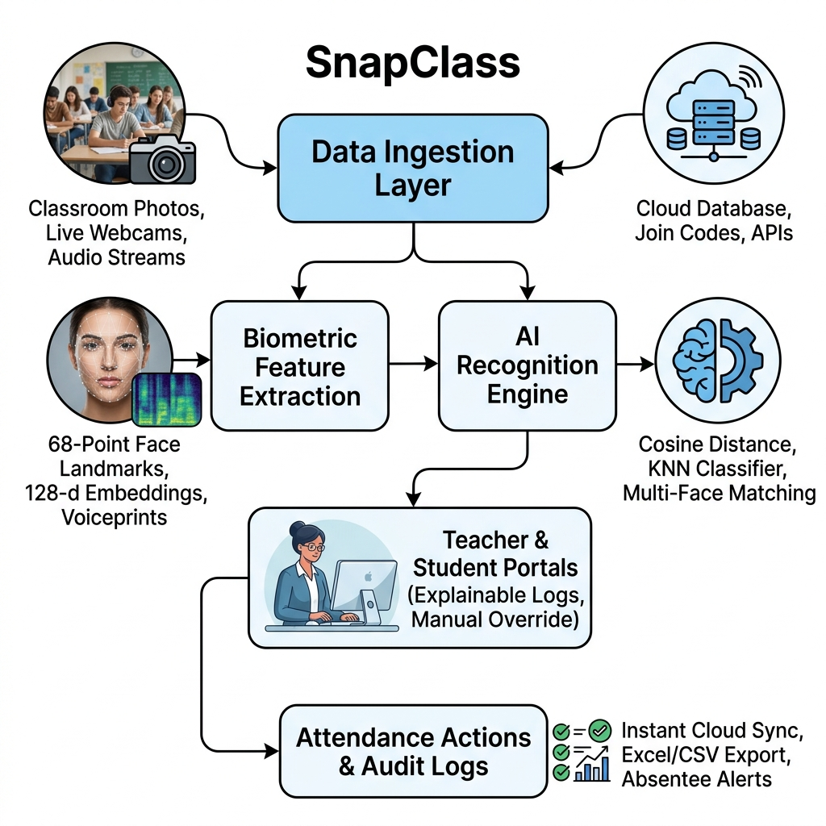
ARCHITECTURE OF PROJECT

Slide 5
FEASIBILITY AND VIABILITY
SnapClass AI
FEASIBILITY
• Seamless Hardware-Free Deployment:
Uses standard laptops, webcams, or smartphones already present in classrooms.
• Scalable Cloud Backend:
Cloud-native Supabase PostgreSQL database handles thousands of concurrent lecture requests.
• Instant Model Execution:
Pre-trained deep embedding extractors execute inference in milliseconds without dedicated GPU servers.
VIABILITY
• Time & Productivity ROI:
Eliminates 10-15 minutes of wasted roll-call per lecture, saving ~40 faculty teaching hours/year.
• Paperless Institutional Audits:
Tamper-proof digital records replace error-prone manual paper attendance sheets.
• Scalable SaaS Campus Model:
Ready for single-school pilots, college campuses, and university-wide deployments.
CHALLENGES & RISKS
• Classroom Lighting & Pose Variance:
Shadows and partial occlusions in large lecture halls.
• Proxy & Image Spoofing:
Possibility of using printed photographs or phone screens.
• Student Data Privacy:
Apprehensions regarding sensitive student biometrics.
STRATEGIES & MITIGATION
• Multi-Angle Burst & Histogram Normalization:
Normalizes illumination variations and verifies multiple angles.
• Multimodal Voice + Facial Liveness:
Audio verification and dynamic camera interaction eradicate proxy attempts.
• Mathematical Vector Storage:
Zero raw photos stored permanently; 128-d vectors are irreversibly encrypted.
@SIH Idea submission - Template 4

Slide 6
IMPACT AND BENEFITS
SnapClass AI
BENEFITS ACROSS STAKEHOLDERS
🎓 Educators & Professors:
Reclaim 15% of active lecture time previously wasted on manual calling; generate instant CSV/Excel attendance sheets with zero paperwork.
🎓 Students:
100% transparent attendance logging; zero disputes; seamless self-enrollment via course join codes and contact-free biometric check-in.
🎓 Institutions & Universities:
Tamper-proof academic audit records; real-time visibility into attendance shortages; automated compliance with UGC / AICTE regulations.
🎓 Campus Administration:
Centralized attendance analytics across departments; early warning indicators for at-risk students with low attendance.
MEASURED IMPACT & QUANTITATIVE GAINS
⚡ 95% Time Reduction
Attendance time slashed from 10-15 minutes down to <2 seconds per lecture.
🚫 100% Proxy Elimination
Multimodal facial biometrics + voice verification eradicate fake student proxies.
⏰ 40+ Hours Saved / Year
Over 40 instructional hours returned to each educator every academic year.
🌱 100% Paperless & Green
Zero physical paper attendance registers, aligning with Digital India eco-friendly goals.
📊 Instant Audit Readiness
1-click generation of official attendance reports, saving administrative verification time.
@SIH Idea submission - Template 5

Slide 7
RESEARCH AND REFERENCES
SnapClass AI
RESEARCH PAPERS & TECHNICAL FOUNDATIONS
• Google FaceNet (CVPR):
Schroff et al., 'FaceNet: A Unified Embedding for Face Recognition and Clustering' - 128-d Euclidean space vector representation.
• dlib Landmark Localization:
Davis E. King, 'Dlib-ml: A Machine Learning Toolkit' - 68-point facial landmark detection and pose alignment.
• Generalized Voice Biometrics:
Wan et al., 'Generalized End-to-End Loss for Speaker Verification' (Google AI) - Acoustic voiceprint representation.
• Resemblyzer & Librosa Studies:
Voice feature extraction, Mel-frequency spectral analysis, and cosine similarity for speaker verification in noisy environments.
• National Education Policy (NEP 2020):
Aligns with Digital India and NEP 2020 mandates for smart, paperless campus governance and tech-enabled classrooms.
@SIH Idea submission - Template 6

