Slide 1
Predictive Sales Analytics Engine
Leakage-safe repeat-purchase prediction on the Olist e-commerce dataset
Aditya Kammati

Slide 2
Problem Statement
Predict whether a customer buys again within 180 days after the first delivered order.
This is a retention-focused, business-relevant CRM problem.
The goal is ranking high-potential repeat customers, not just maximizing accuracy.

Slide 3
Dataset and Target Design
Source: Olist Brazilian e-commerce dataset with orders, reviews, items, payments, products, and sellers.
One row per customer using only the first delivered order.
Score time = max(delivery time, review creation time) to prevent future leakage.

Slide 4
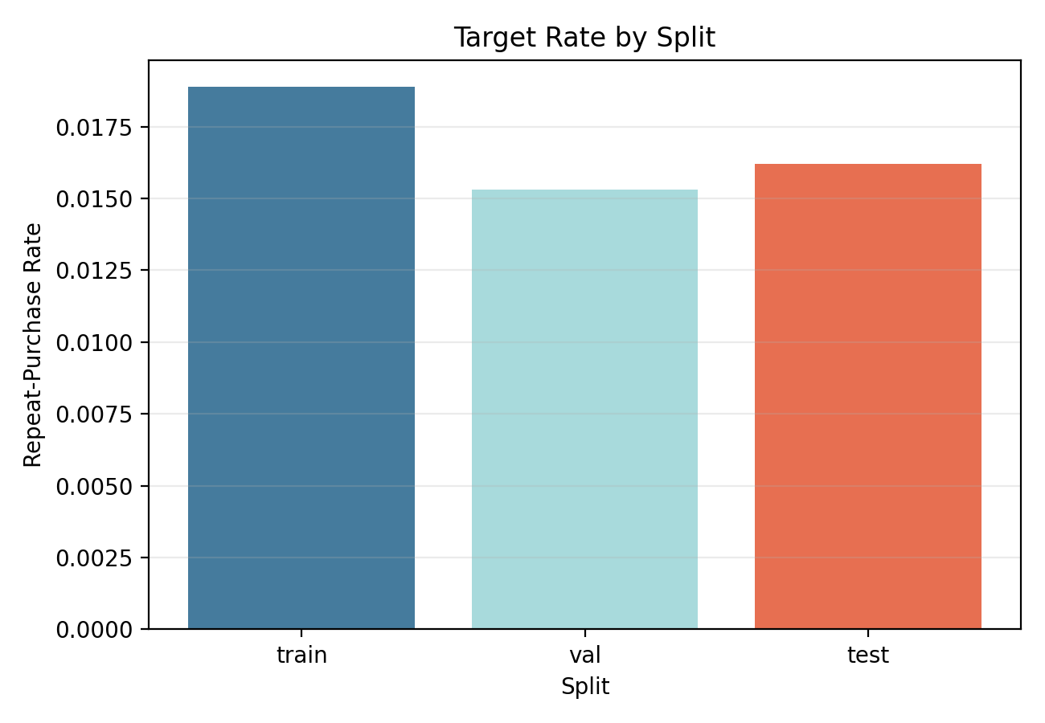
EDA Highlights
The positive class is rare, so accuracy is misleading.
Review text is missing for many customers.
EDA showed that delivery quality and customer experience matter.

Slide 5
Feature Engineering
Review features: score, text presence, text length, punctuation counts.
Business features: price, freight, payments, delivery, item count, seller and customer context.
Log transforms were used for skewed numeric variables.

Slide 6
Modeling Strategy
Dummy prior, logistic baselines, random forest, TF-IDF text model, combined model, advanced HGB, and late fusion.
Temporal split used instead of random split.
Main metrics: PR-AUC, ROC-AUC, Precision@10%, Lift@10%.

Slide 7
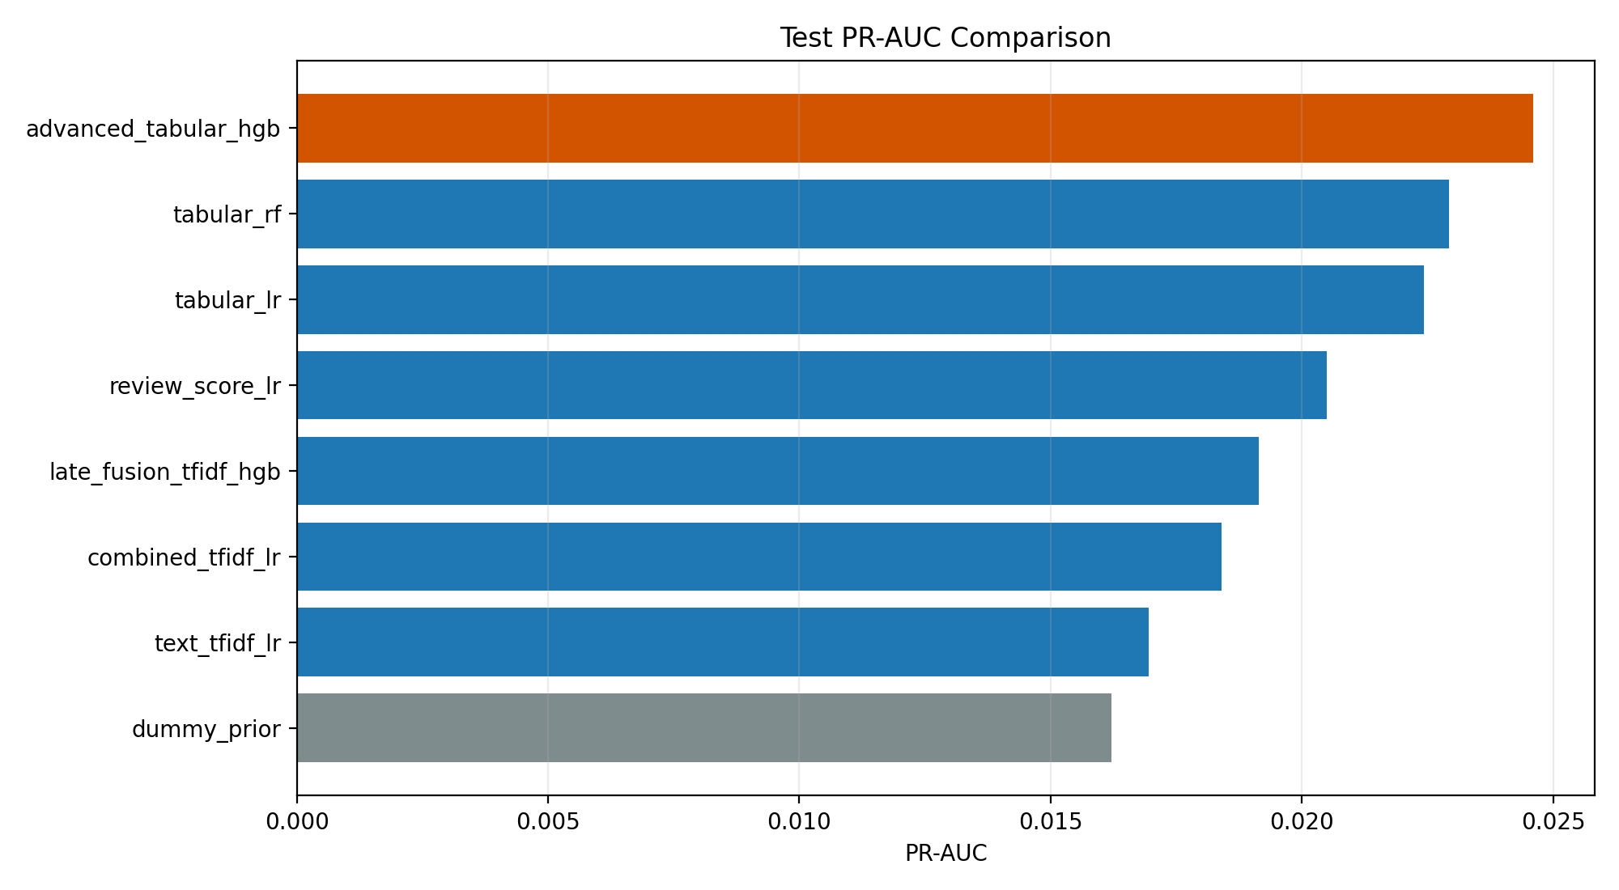
Model Comparison
Best model: advanced_tabular_hgb
Test PR-AUC: 0.0246
Structured business features outperformed sparse review text.

Slide 8
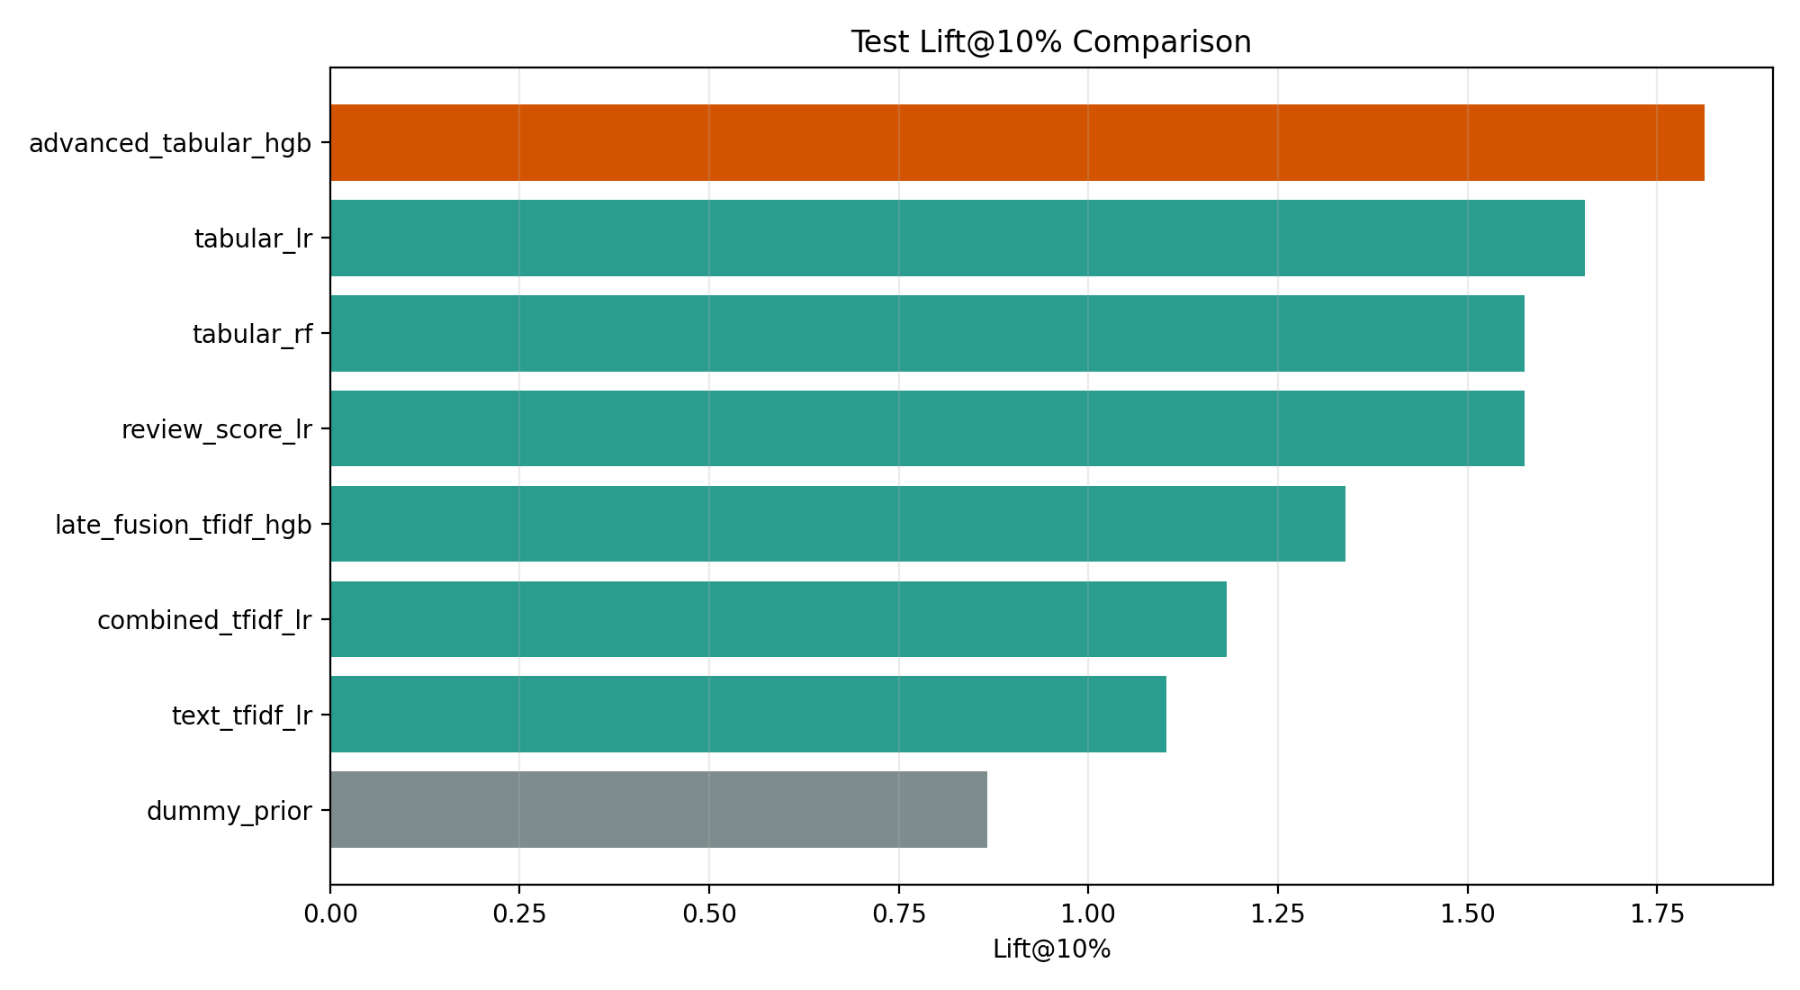
Operational Value
Lift@10% = 1.8119
The top-ranked customer segment is much richer in positives than the base rate.
This is directly useful for CRM targeting.

Slide 9
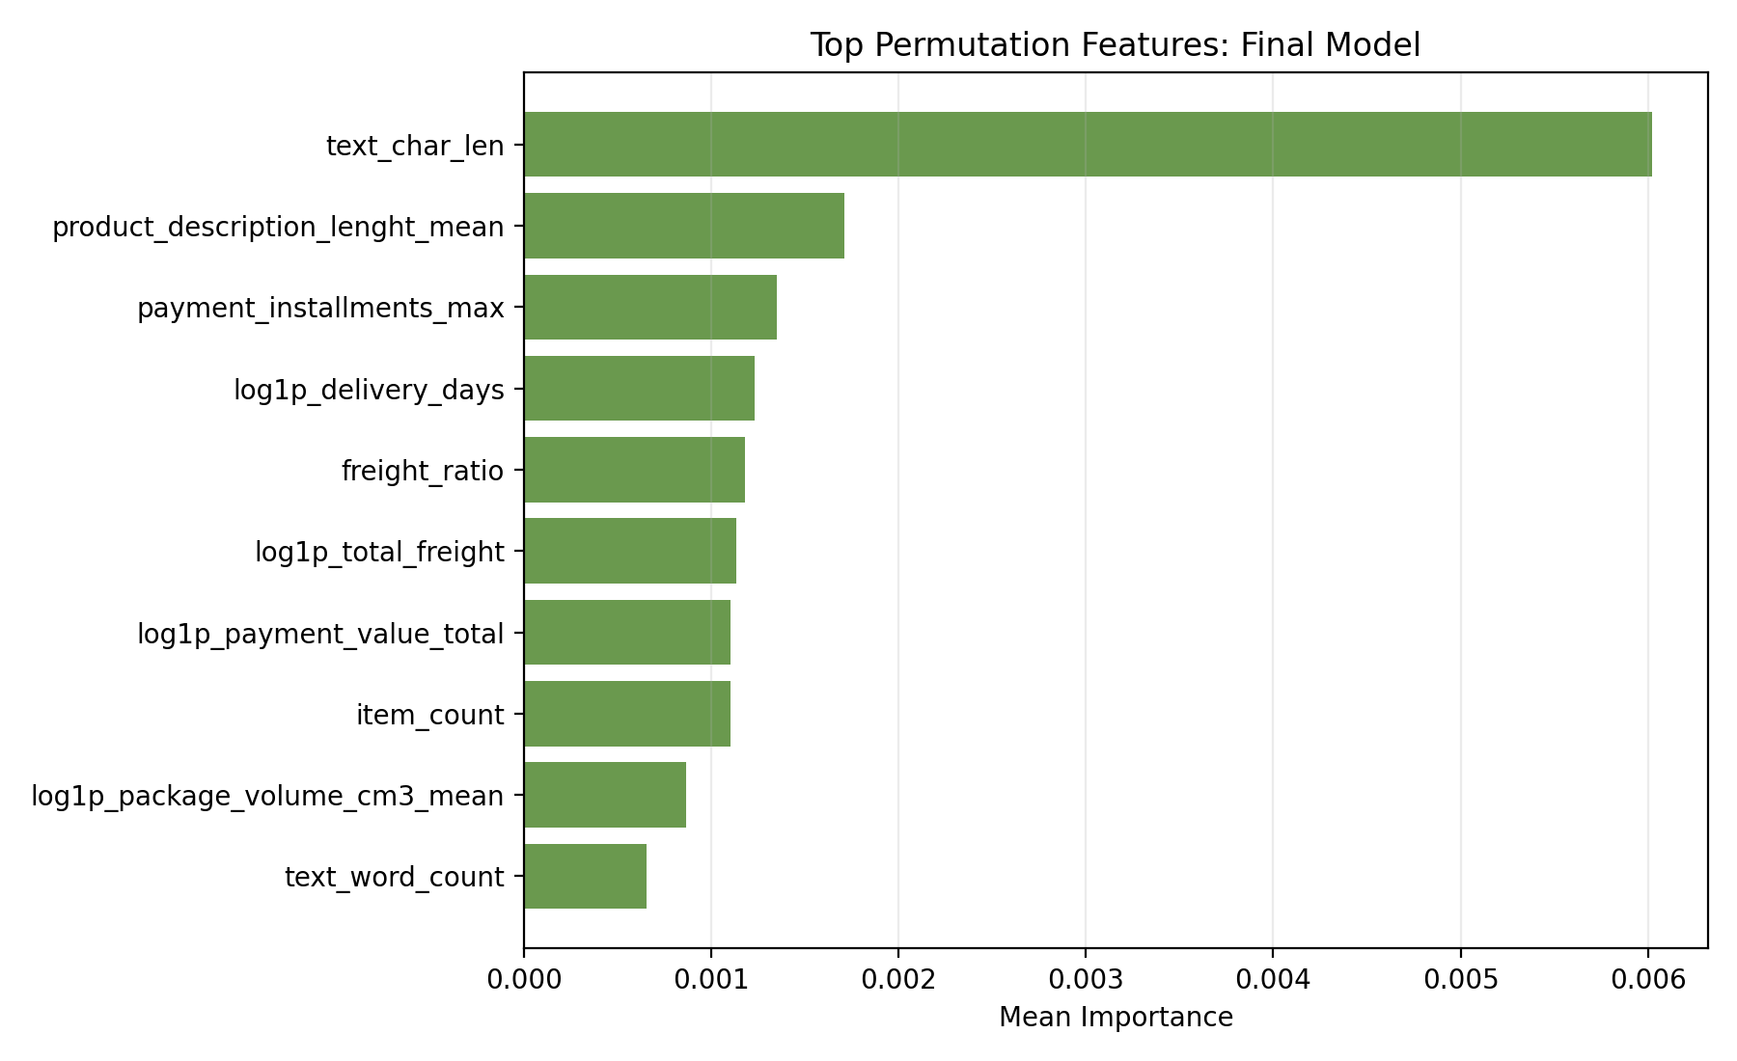
Explainability
Key signals include text length, review score, freight burden, payment value, and delivery-related features.
The feature importance pattern is business-interpretable.

Slide 10
Conclusion
The project delivers a leakage-safe retention-prediction pipeline.
Advanced tabular histogram gradient boosting was the strongest model.
Main conclusion: structured first-order business signals are stronger than sparse review text on this dataset.

