Slide 1
Welcome to Week 10
Natural Language Processing (NLP)
Prof. Swapnil Kangralkar

Slide 2
Natural Language Processing
Natural language processing is a field concerned with the ability of a computer to understand, analyze, manipulate, and potentially generate human language.
A few examples of NLP applications you may see on a day to day basis -
Email spam filter: Whether an incoming email is spam or not, based on the content of the body, the subject, and the email domain.
Auto-complete: in Google search or Gmail

Slide 3
Natural Language Processing
NLP involves several tasks, including text classification, named entity recognition, sentiment analysis, language translation, speech recognition, and text summarization.
It uses various techniques such as machine learning, deep learning, and statistical methods to analyze and process language data.
NLP applications are used in a variety of industries, including healthcare, finance, customer service, and e-commerce.
Notes:
Natural Language Processing (NLP) is increasingly being used in healthcare to help process and analyze vast amounts of medical data, including clinical notes, medical records, and patient feedback
In finance to help process and analyze large volumes of financial data, news articles, and social media posts, and improve customer service by analyzing customer feedback

Slide 4
Python Tools for NLP
The natural language toolkit (NLTK) is the most utilized package for handling natural language processing tasks in Python.
NLTK provides tools and resources for tasks such as tokenization, stemming, tagging, parsing, and sentiment analysis.
NLTK includes a suite of datasets and corpora for training and testing NLP models.

Slide 5
NLP Data Cleaning
Text lowercase:
Consistency
Vocabulary Reduction
Canada canadA CAnada | canada
Notes:
Consistency: By converting all text to lowercase, we can ensure that the text is consistent and that the same word is always represented the same way. This is important because words with different capitalization may have different meanings (e.g., "apple" vs. "Apple").
Vocabulary Reduction: Lowercasing text reduces the vocabulary size, which can make the analysis more manageable and efficient.

Slide 6
NLP Data Cleaning
Text lowercase:
Consistency
Vocabulary Reduction
Canada canadA CAnada | canada
Notes:
Consistency: By converting all text to lowercase, we can ensure that the text is consistent and that the same word is always represented the same way. This is important because words with different capitalization may have different meanings (e.g., "apple" vs. "Apple").
Vocabulary Reduction: Lowercasing text reduces the vocabulary size, which can make the analysis more manageable and efficient.

Slide 7
NLP Data Cleaning
Remove punctuations and special characters
The quick, brown fox jumps over the lazy dog! | The quick brown fox jumps over the lazy dog
Punctuations or special characters are all characters except digits and alphabets. List of all available special characters are [!"#$%&'()*+,-./:;<=>?@[\]^_`{|}~].

Slide 8
NLP Data Cleaning
I have 5 courses in level 1 and 7 courses in level 2 | I have five courses in level one and seven courses in level two
Numbers to words:

Slide 9
NLP Data Cleaning
The butler accomodated the guests. | The butler accommodated the guests.
Spelling correction

Slide 10
NLP Data Cleaning
Accented character to ASCII characters:
Compatibility
José is a café owner in São Paulo. | Jose is a cafe owner in Sao Paulo.

Slide 11
NLP Data Cleaning
Expanding acronyms
LOL | Laughing Out Loud

Slide 12
NLP Data Cleaning
Stemming
Stemming is a common technique in NLP that involves reducing words to their base or root form.
Vocabulary Reduction

Slide 13
NLP Data Cleaning
Lemmatization
Lemmatization does not only trim the suffix characters; instead, use lexical knowledge bases to get original words.
When accuracy matters more than speed.
Notes:
Lemmatizing uses a more sophisticated algorithm to find root words at the expense of speed.

Slide 14
NLP Data Cleaning
Stop words
Stop words are words that are commonly used in a language but are usually not meaningful for most NLP tasks as they do not carry significant semantic or contextual information. By removing stop words, we can reduce the size of the text .
During the summer, I like to go to the beach and swim in the ocean.
Summer, like, beach, swim, ocean.

Slide 15
Transform Unstructured Text to Structured Format
Common Methods:
Bag of Words
N-grams
TF-IDF
Part Of Speech (POS) Tagging
Word2Vec

Slide 16
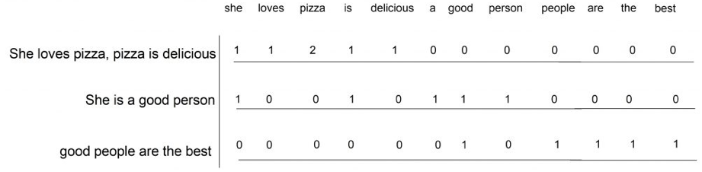
Bag of Words
This method represents text as a set of words and their frequency in a given document. It ignores the order of words and only considers their frequency.

Slide 17
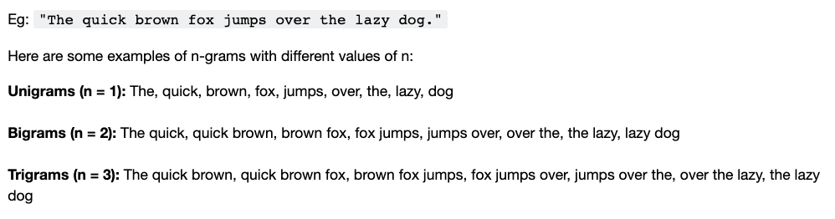
N-grams
N-grams are sequences of n words in a given text. They can be used to represent the context of a word or phrase.

Slide 18
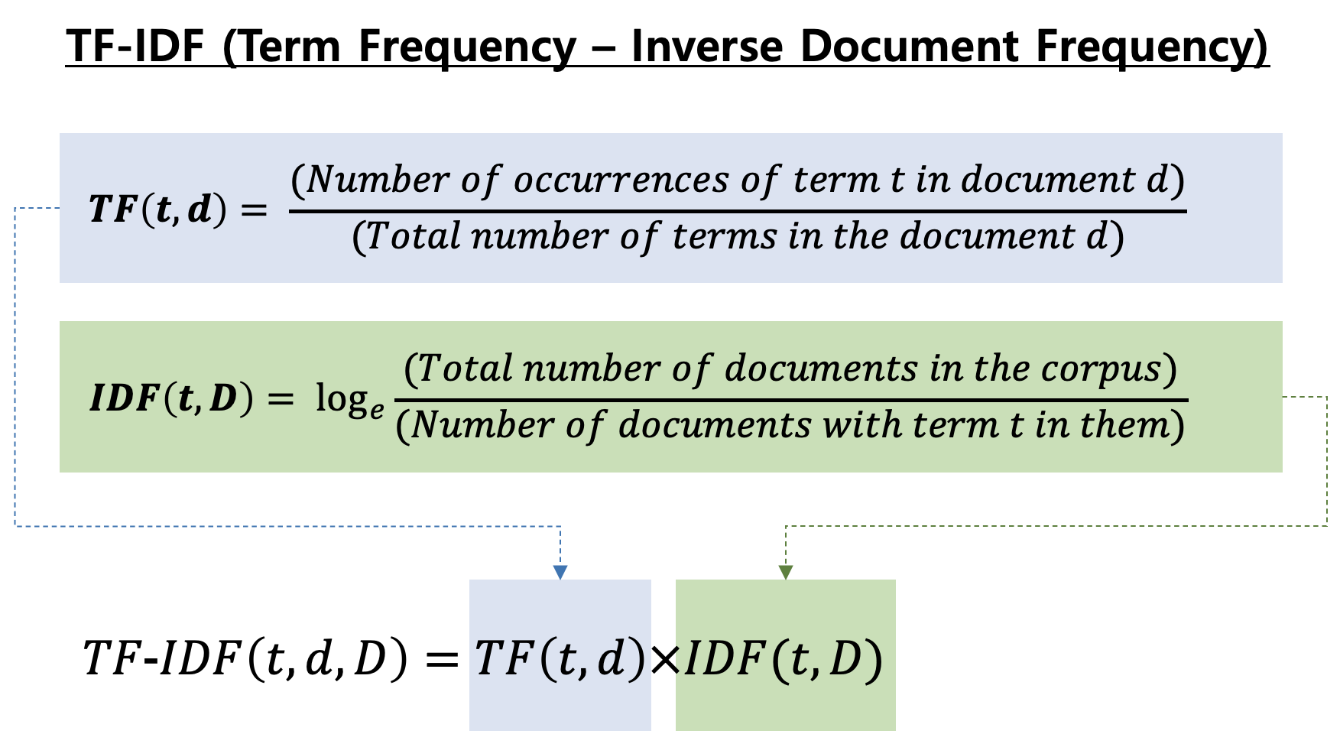
TF-IDF
TF-IDF is a numerical statistic that reflects the importance of a word in a given document and its frequency in a collection of documents.

Slide 19
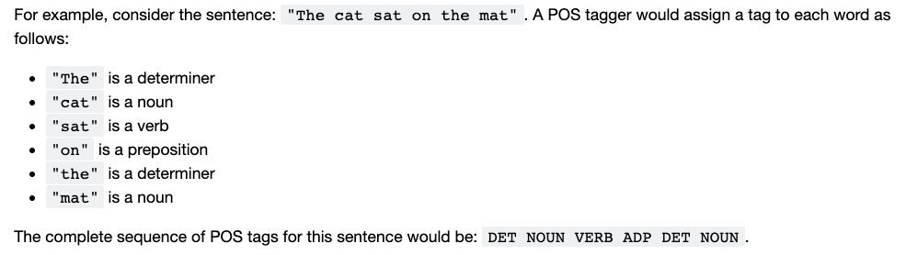
Part of Speech (POS) Tagging
Process of labeling each word in a sentence with its corresponding part of speech, such as noun, verb, adjective, adverb, preposition, pronoun, conjunction, and interjection. It provides important information about the grammatical structure of a sentence

Slide 20
Word2Vec
Word2vec is a popular algorithm used for generating word embeddings. Word embeddings are a way to represent each word by a vector.
The Word2vec algorithm can be trained using two approaches: Continuous Bag of Words (CBOW) and Skip-gram. In the CBOW approach, the algorithm takes a context of words as input and predicts the target word. In the Skip-gram approach, the algorithm takes a target word as input and predicts the context words.
Notes:
In mathematics, a vector is an object that has both magnitude and direction. It can be represented by an arrow or line segment pointing from an initial point to a terminal point. In high-dimensional space, a vector can be represented by a set of numbers (coordinates) that describe its position relative to a reference point or origin.

Slide 21
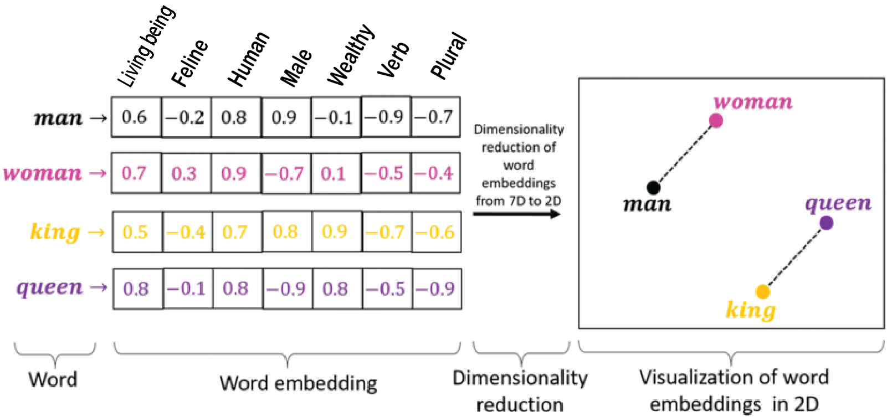
Word2Vec

Slide 22
Thank you!

