Slide 1
Welcome to Week 6
Time Series Analysis
Prof: Swapnil Kangralkar

Slide 2
Agenda
Fundamentals of Time Series
Time Series and it’s applications
Characteristics of Time Series
Forecasting using a Time Series Model

Slide 3
Time Series Analysis
Time Series is a set of observations taken at specified times, usually at equal intervals.
e.g. daily stock prices or weekly sales data
With time series, we try to establish a relationship between the “cause” and “effects” and model the behaviour of the series.
When modelling with time series you would have an independent variable “Time”, and a dependant variable “Data”

Slide 4
Why Time Series Analysis
Methods of modelling time series assume that history repeats itself—if not exactly, then closely enough that by studying the past, you can make better decisions in the future.
Forecasts are an essential tool in many planning processes which help you make informed decisions.

Slide 5
Time Series Analysis
Day | Breads sold
Monday | 100
Tuesday | 90
Wednesday | 80
Thursday | 75
Friday | 70
Saturday | 82
Sunday | 90
Year | Stock Price ($)
2000 | 68
2001 | 75
2002 | 83
2003 | 92
2004 | 110
2005 | 117
2006 | 140
From table 1 we can observe the sales of bread goes down during the weekday and increases on the weekend.
From table 2 we can observe the stock price increasing since 2000 through 2006.

Slide 6
Endogenous vs Exogenous Variables
Endogenous variables have values that are determined by other variables in the system.
(these “other” variables are called exogenous variables)
An exogenous variable is a variable that is not affected by other variables in the system.
Date | crop production | soil pH | weather | pests
independent
Endogenous
Exogenous

Slide 7
Characteristics
Trend - Trend is a pattern in data that shows the movement of a series to relatively higher or lower values over a long period of time. In other words, a trend is observed when there is an increasing or decreasing slope in the time series.

Slide 8
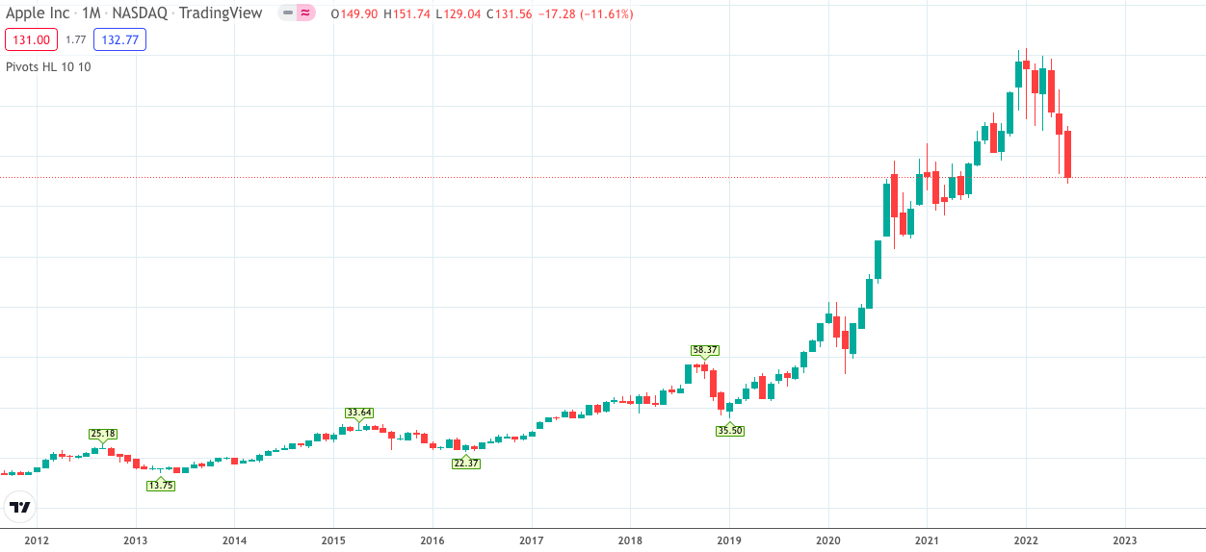
Upward trend

Slide 9
Seasonality - Seasonal variation, or seasonality, are cycles that repeat regularly over time.

Slide 10
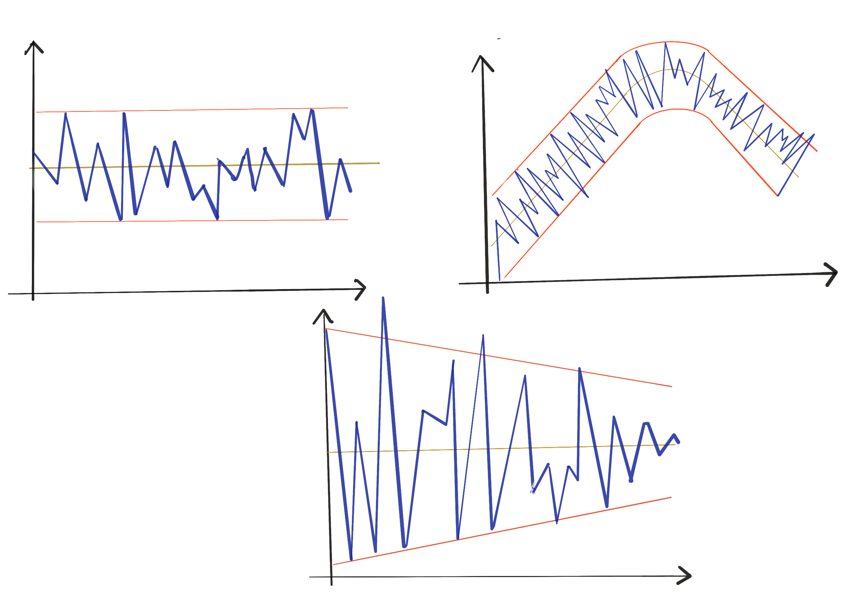
Stationarity - Stationary data refers to the time series data for which the mean and variance do not vary across time. The data is considered non-stationary if there is a strong trend or seasonality observed from the data. Stationarity is important because many useful analytical tools and statistical tests and models rely on it.
stationary mean
stationary variance
non-stationary mean
stationary variance
stationary mean
non- stationary variance

Slide 11
Converting Nonstationary Time Series to Stationary Time Series
Monthly accidental deaths data – Non stationary
stationary

Slide 12
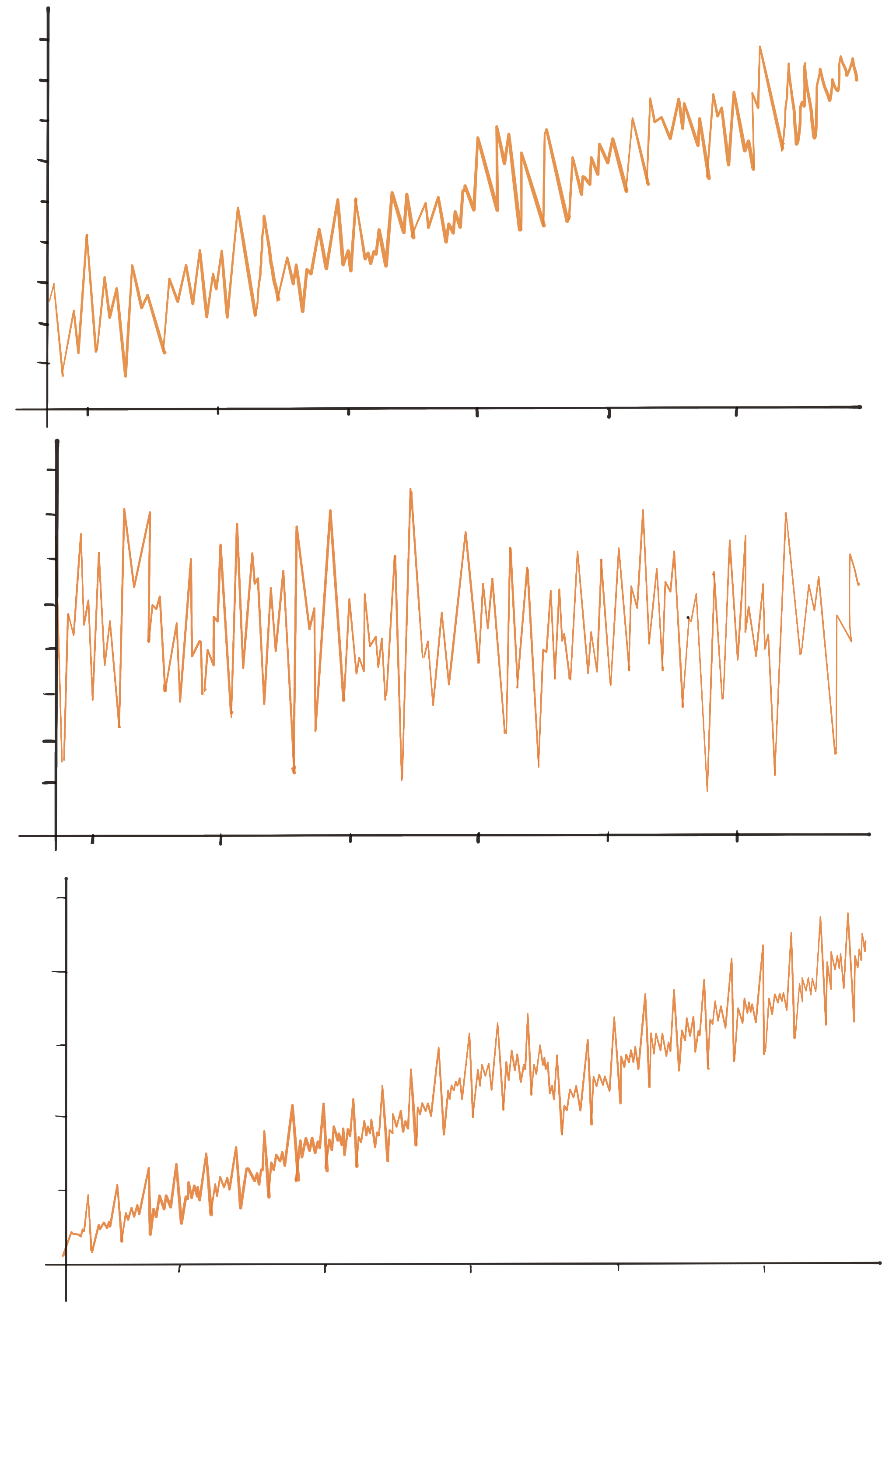
Identify Trend and Seasonality
5
4
3
2
1
0
-1
-2
-3
Trend
Seasonality
Price in $1000
1960 1970 1980 1990 2000 2010
year

Slide 13
Identify Trend and Seasonality
5
4
3
2
1
0
-1
-2
-3
Trend
Seasonality
Price in $1000
1960 1970 1980 1990 2000 2010
year

Slide 14
Identify Trend and Seasonality
4
3
2
1
0
-1
Trend
Seasonality
Price in $1000
year
1960 1970 1980 1990 2000

Slide 15
Time Series Forecasting
Below are some types of time series forecasting:
1. Point and Interval
2. Ex-post (in sample) and Ex-ante (out of sample)
3. Conditional (exogenous) and Unconditional

Slide 16
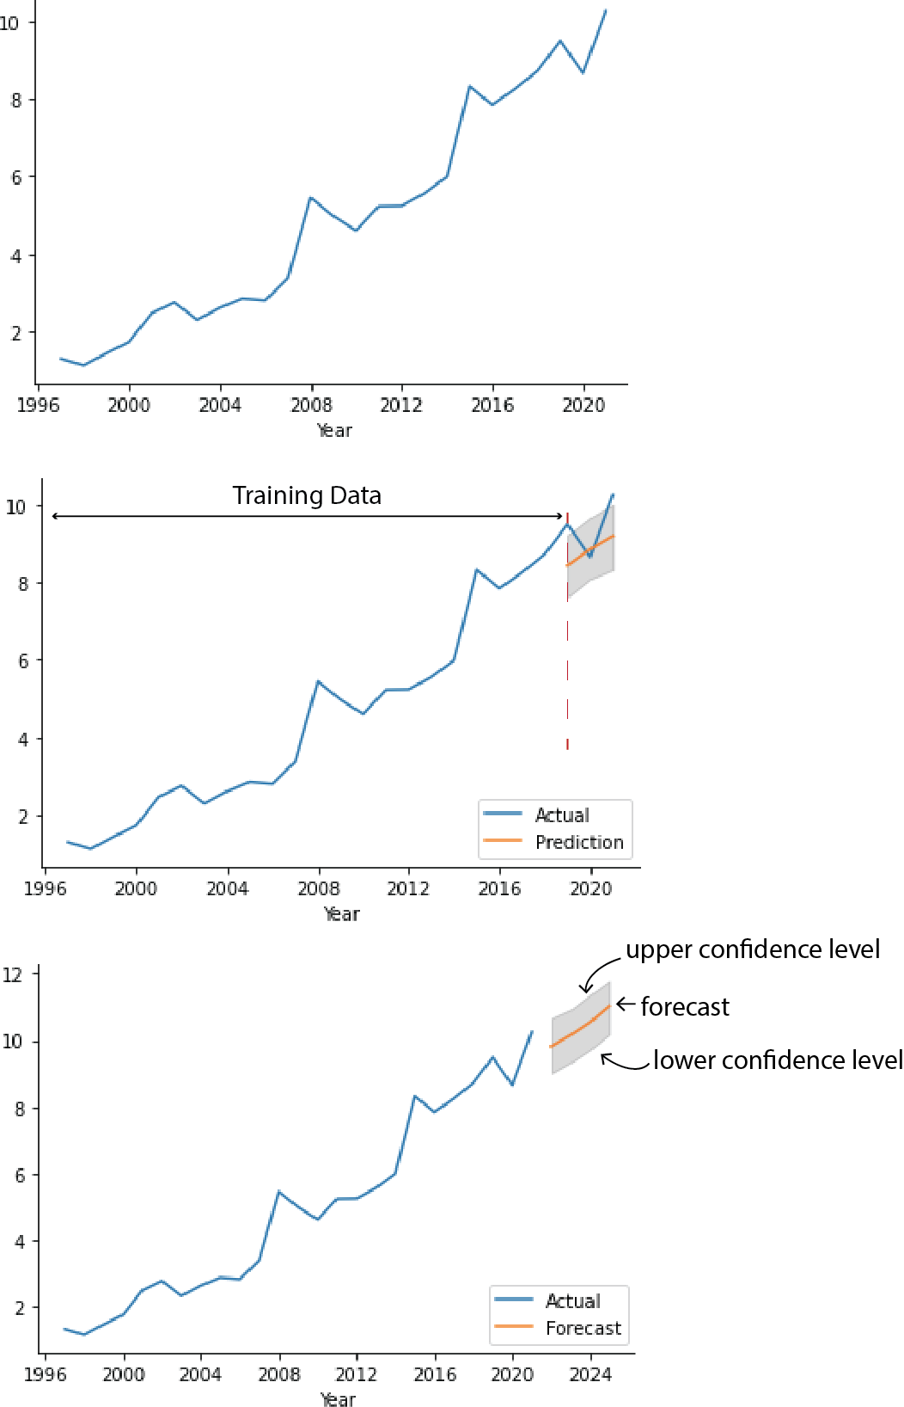
How do you Forecast?

Slide 17
Applications of Time Series
Economics – Imports and exports, Stock price forecasting
Meteorology – Daily rainfall, temperature, wind speed
Demography – Census of a country
Marketing – Product sales

Slide 18
Thank you!

