Slide 1
the meal-dash
A PROJECT PRESENTATION ON:

Slide 2
Project submitted by:
Aditya Vishwakarma- 201500042
B.Tech CSE IIIrd year Student
GLA UNIVERSITY

Slide 3
Acknowledgement
A successful work is always raised by many hands:
We are thankful to the :
CSE Department
Mr. Bhanu Kapoor
All faculties and our Friends

Slide 4
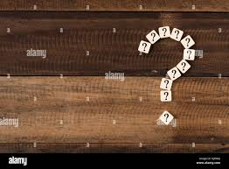
WHY THIS IDEA?
FOR FUTURE SCOPE:
TO TARGET MAXIMUM AUDIENCE
REGARDLESS OF ANY AGE GROUP
TO SOLVE A DAY-TO DAY LIFE PROBLEM
VISION TO TARGET IT AS A MAJOR PROJECT TOO

Slide 5
AFTER A LONG DISCUSSION !!!
IT’S A EUREKA!!!!!!!!!
LETS “ORDER THE FOOD FROM OUR COMFORT”

Slide 6
BASIC IDEA OF THE PROJECT
CREATING ACCOUNT
SIGN IN
CHECKING RESTAURANTS
SELECT CATEGORY
ORDER FOOD

Slide 7
LETS SEE WHAT WE HAVE IN THE PROJECT!

Slide 8
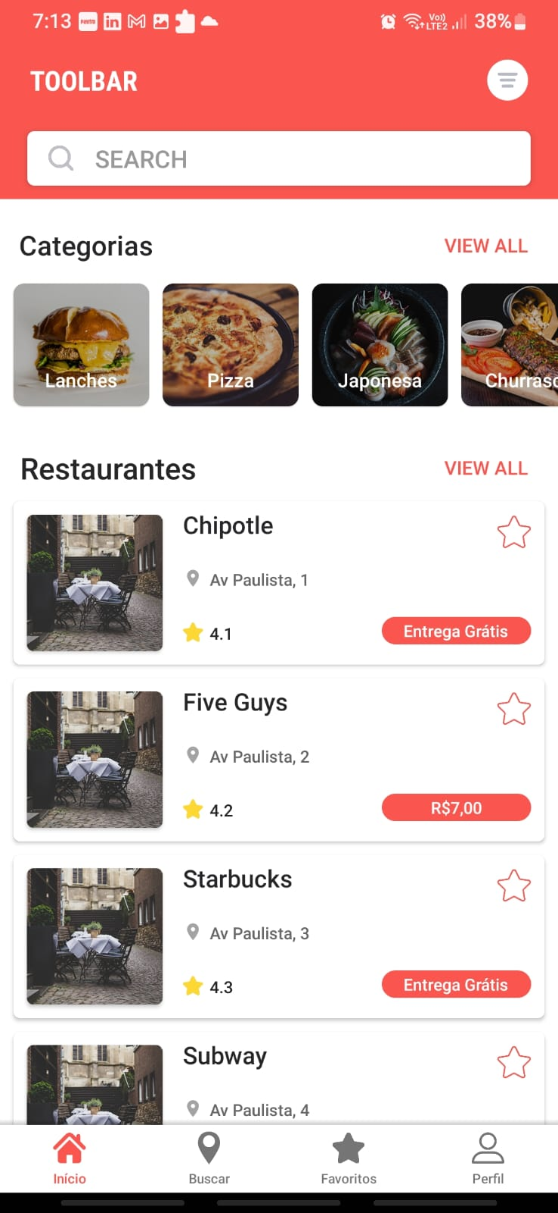
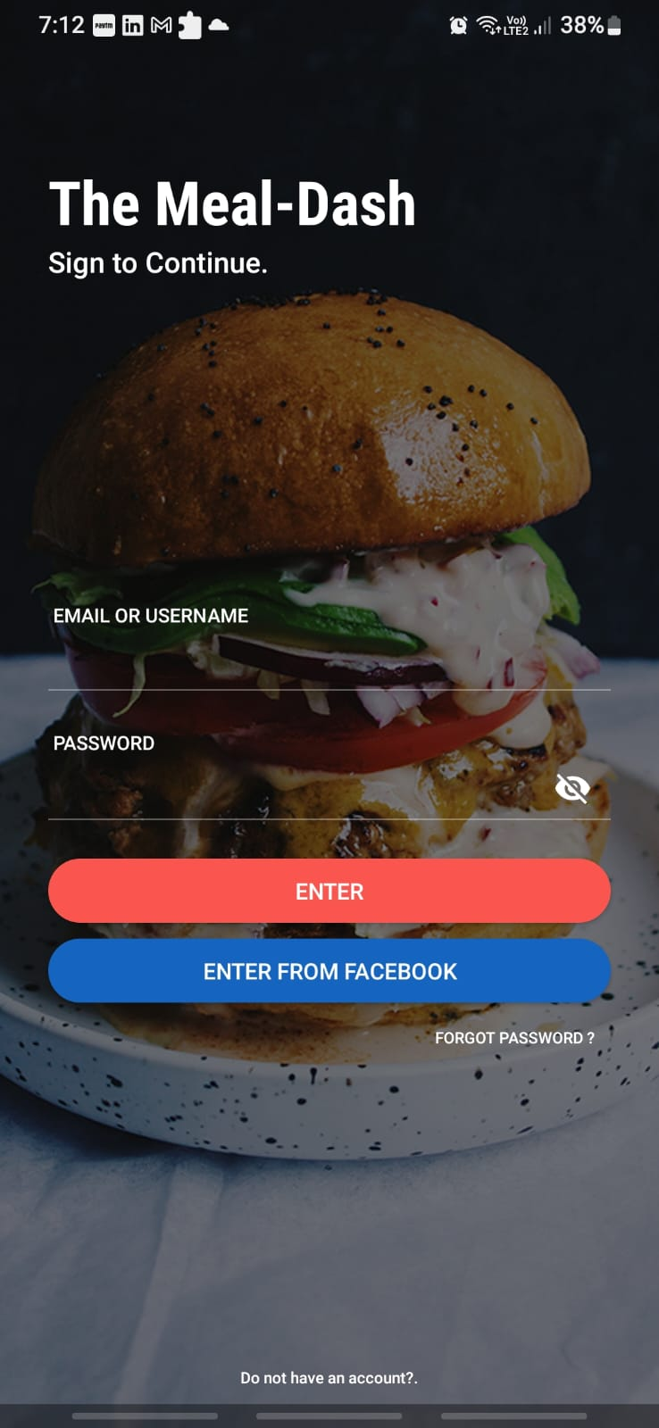
Home SCREEN

Slide 9
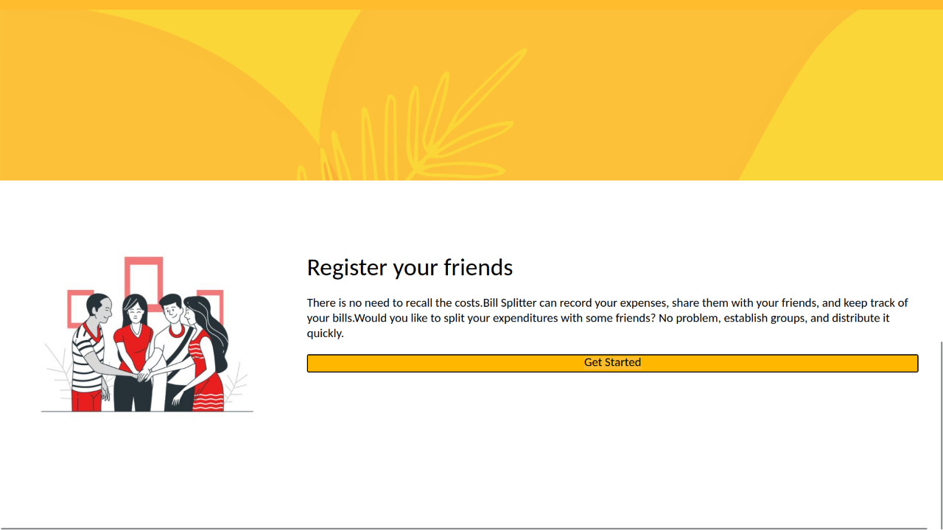
Get started…
YOU CAN REGISTER WITH YOUR FRIENDS IN THE MEAL-DASH TO GET REFERRAL POINT SO THAT ON YOUR NEXT ORDER YOU GET DISCOUNT

Slide 10
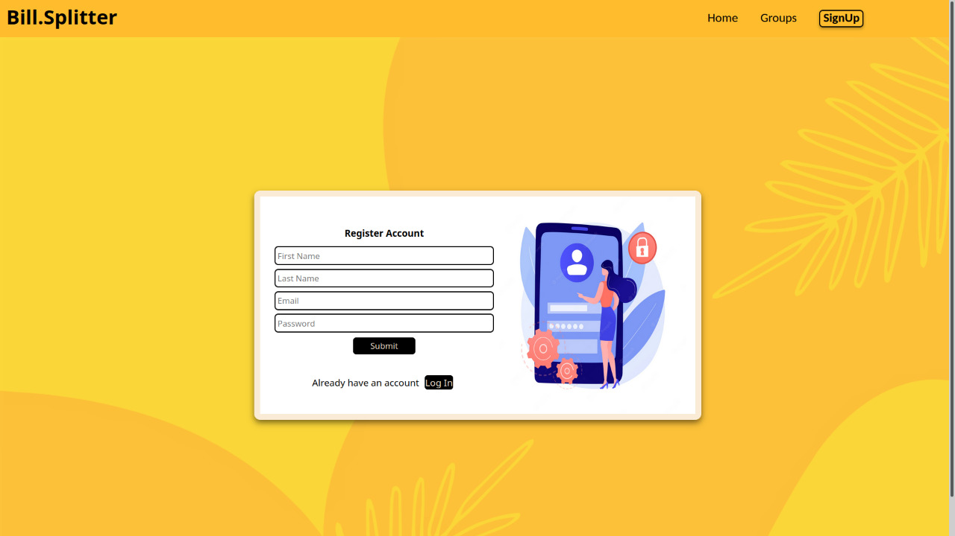
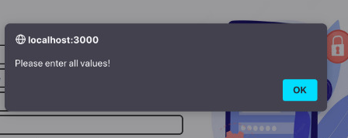
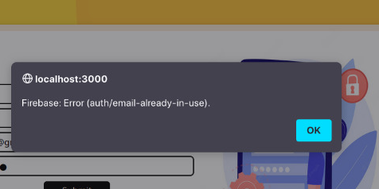
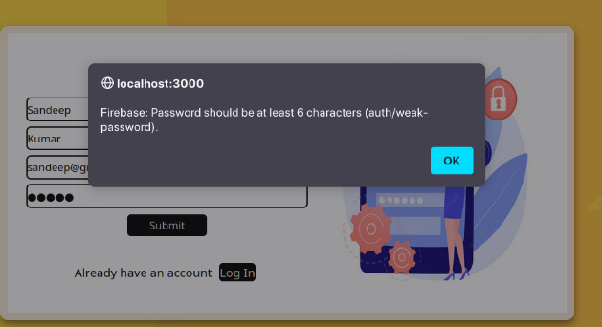
Sign up page
All fields are mandatory
ALREADY A USER
If you are already a user
FILL THE DETAILS
Password should be minimum of 6 characters

Slide 11
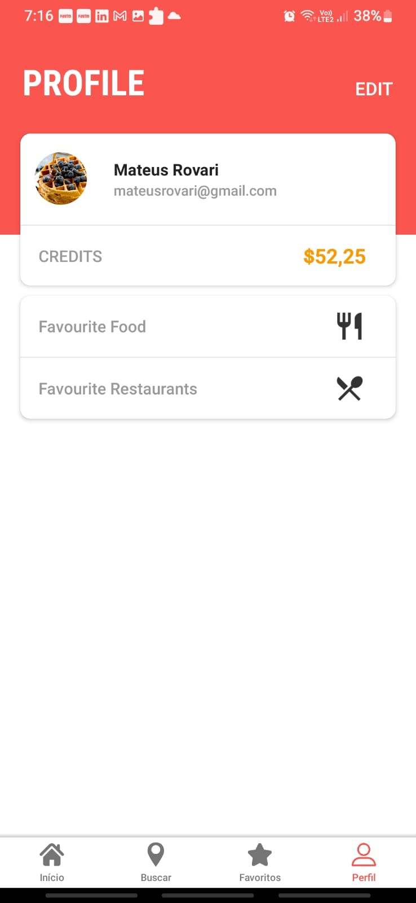
Login page

Slide 12
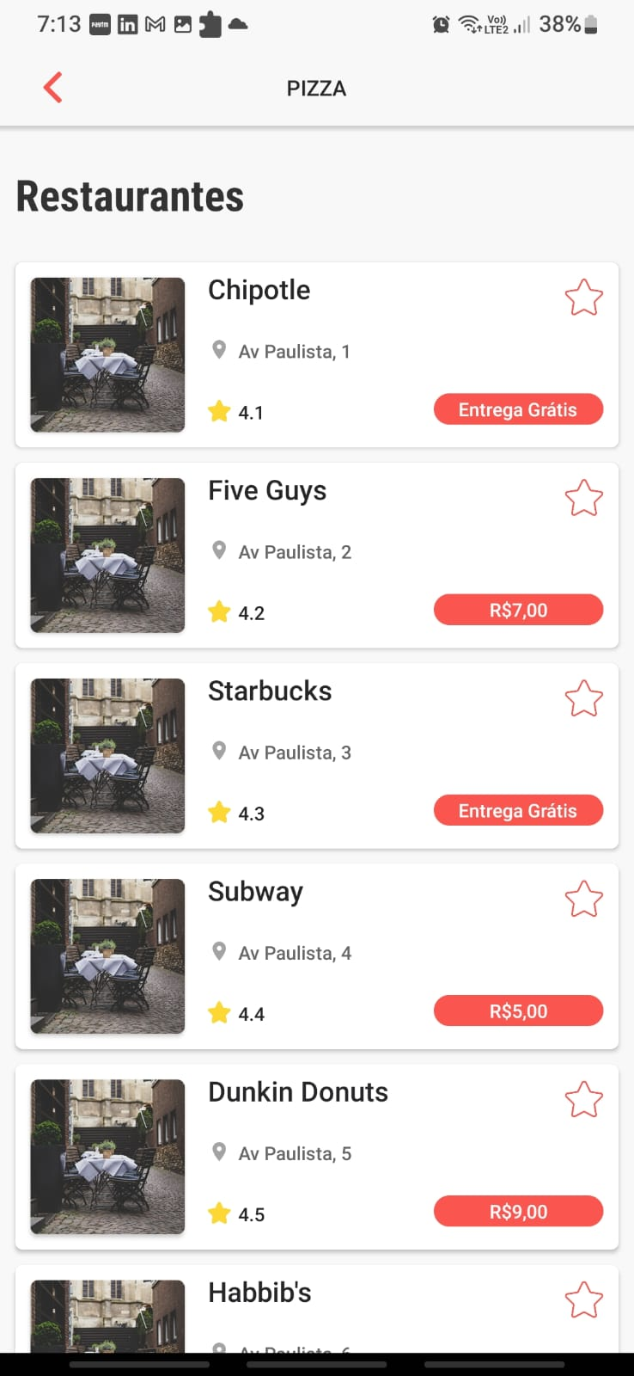
SEARCH RESTAURANTS

Slide 13
Add ANY FOOD OF ANY RESTAURANT

Slide 14
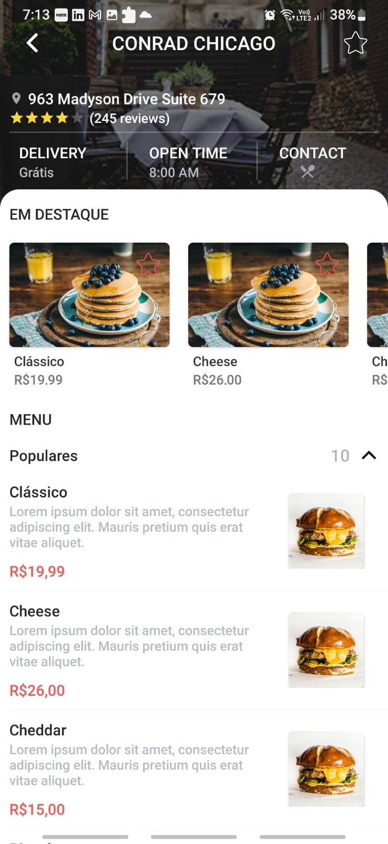
Amount and PRICE OF SELECTED FOOD

Slide 15
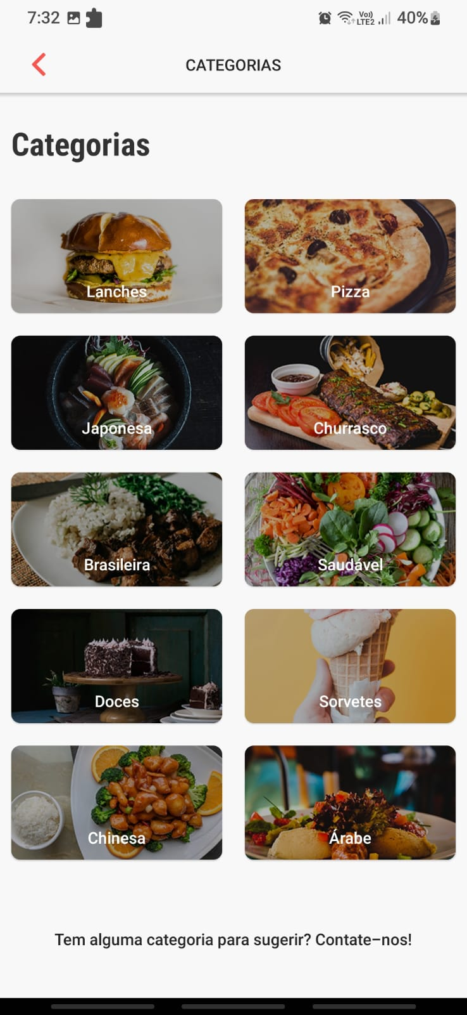
ALL CATEGORIES

Slide 16
USER PROFILE

Slide 17
FUTURE WORK
We welcome suggestions for the project!!!
Add google signing.
Associate payment gateway links.
History sections.
Forgot password option will be added ,etc.

Slide 18

Thankyou
LETS GO THE LIVE DEMONSTRATION OF THE PROJECT

