Slide 1

BCSE498J – Final Review Presentation
AI based Analysis of multispectral dental image for oral diseases
Presented By
Aditya Vikram Singh Bhati 21BPS1413
Vedith Reddy 21BPS1380
Tiya Rajesh 21BPS1405
Supervisor
Dr M Manigandan (53028)
Assistant Professor Sr Grade 1
SENSE
Vellore Institute of Technology, Chennai Campus
BCSE498J
17/04/25
Final Review Presentation

Slide 2
1. Introduction
What is Multispectral Imaging?
Multispectral imaging involves capturing image data at different wavelength bands, not just RGB.
We used seven spectral bands: Violet, Indigo, Blue, Green, Yellow, Orange, and Red (VIBGYOR).
This imaging method reveals subtle variations in oral tissue, such as inflammation, decay, or discoloration that are invisible to the naked eye.
Why AI?
AI models, especially deep learning architectures, can learn complex patterns in multispectral images.
AI eliminates subjectivity and helps with early detection, classification, and monitoring of multiple oral diseases.
Integration with real-time devices enables on-spot diagnostics, useful in clinical and rural health setups.
BCSE498J
17/04/25
Final Review Presentation

Slide 3
2. Introduction(Research Context and Contributions)
Research Context:
We created a novel synthetic multispectral dataset from visible-light dental images by applying spectral augmentation techniques.
Developed a custom image acquisition system using ESP32-CAM with a Lumerati 8-Pack LED Ring to simulate multispectral imaging.
Applied advanced preprocessing (MultiRetinex, Gamma Correction) to enhance contrast and details.
Our Contributions:
Novel Dataset Creation – 52,000 images across 6 classes with simulated multispectral enhancement.
AI Model Development – Implemented and trained three models:
3D CNN
EfficientNet-B3
Vision Transformer (ViT)
Custom Hardware Integration – ESP32-CAM + programmable LED ring for spectral illumination.
High Accuracy Detection – Achieved up to 90%+ accuracy, especially in caries, ulcers, and discoloration classification.
Explainability – Used Grad-CAM and Attention Maps for result interpretation and model transparency.
BCSE498J
17/04/25
Final Review Presentation

Slide 4
3.Literature Survey
Study/Reference | Focus | Key Findings | Accuracy/Performance | Datasets Used | Future Scope/Notes
[1] | AI in dental diagnostics | Improved disease detection through deep learning models | 92% | Custom dental dataset | Real-time application in dental clinics
[2] | YOLO for dental image analysis | Effective for real-time dental issue detection | 90% | Public dental imagery datasets | Integration with dental imaging hardware
[3] | ResNet-50 application | High accuracy in identifying six dental diseases | 86.07% | Custom-preprocessed dataset | Exploration of lightweight ResNet variations
[4] | Multiscale Retinex preprocessing | Enhanced image clarity for better model training | N/A | Preprocessing pipeline evaluation | Application in broader medical imaging scenarios
[5] | Gamma correction in imaging | Improved color representation for dental anomalies | N/A | Custom dataset | Combining preprocessing methods for better results
[6] | Inception v3 model performance | Effective in large-scale dental disease classification | 85% | 12,000 dental images | Optimizations for mobile healthcare applications

Slide 5
Study/Reference | Focus | Key Findings | Accuracy/Performance | Datasets Used | Future Scope/Notes
[7] | Real-time dental cameras | Demonstrated feasibility of integrated real-time diagnostics | 88% | Live data from dental cameras | Hardware refinement and broader clinical validation
[8] | Precision analysis in AI models | High macro-average precision across models | Varies (Avg: 83%) | Cross-validation on dental sets | Focus on improving recall for minority classes
[9] | Recall optimization techniques | Enhanced recall without compromising accuracy | 82% | Diverse dental imagery | Techniques applicable to other healthcare fields
[10] | Cost-effective AI healthcare | Reduced need for doctors in routine diagnostics | Cost reduced by 30% | Simulated clinic setup | Integration with telehealth systems
Gaps Identified
Limited research on combining multispectral imaging with AI specifically for dental applications.
Inconsistent datasets and absence of standard protocols in dental imaging research.
Lack of real-time, deployable AI models for dental practitioners.

Slide 6
4. Problem Statement
Aspect | Details
Current Practice | Manual visual inspection is the primary diagnostic method in dentistry.
Challenges in Current Practice | - Practitioner-dependent results - Missed early indicators of gingivitis, caries, etc.
Limitations of RGB Imaging | - Captures only visible spectrum - Cannot detect deep tissue anomalies or subtle variations
Multispectral Imaging Issues | - Proven in medical imaging, but rarely used in dentistry - High cost and complex setup
Research Gaps | - Lack of AI research using multispectral dental data - No labeled, open-access dataset
Practical Need | - Affordable, real-time system bridging high-end imaging with daily clinical application
BCSE498J
17/04/25
Final Review Presentation

Slide 7
5. Research Objectives
Category | Description
Primary Aim | Develop an AI-powered system for diagnosing common oral diseases using multispectral dental images — a novel approach in dental diagnostics.
Data Creation | Created a synthetic multispectral dataset using VIBGYOR-based augmentation of a visible-light dental image dataset, resulting in 7 spectral bands.
Image Enhancement | Applied Multiretinex for illumination correction and Gamma Correction for contrast enhancement to highlight disease-relevant features.
Model Training & Evaluation | Trained and evaluated three deep learning models: • 3D CNN • EfficientNet-B3 • Vision Transformer (ViT), assessing their performance on the dataset.
Hardware Design | Designed a low-cost, portable imaging device using an ESP32-CAM and Lumerati LED ring to capture images across seven light bands in real-time.
Real-world Applicability | Addressed both data scarcity and hardware limitations, ensuring the system is viable for real-time deployment in low-resource clinical environments.
BCSE498J
17/04/25
Final Review Presentation

Slide 8
6. Proposed System Overview
Component | Details
System Integration | Combines AI modeling with custom hardware design to provide a complete, real-time solution for diagnosing oral diseases via multispectral imaging.
Dataset Foundation | Synthetic multispectral dataset generated by expanding a visible-light dental image set into 7 VIBGYOR spectral bands, simulating true multispectral data.
Preprocessing Techniques | - Multiretinex: Enhances illumination uniformity. - Gamma Correction: Improves contrast and reveals disease-relevant details in darker regions.
AI Models Used | - 3D CNN: Custom model for spatial-spectral feature extraction. - EfficientNet-B3: High-performance model with balanced accuracy and efficiency. - Vision Transformer (ViT): Uses transformer-based attention for classification.
Hardware Setup | - ESP32-CAM: Compact, low-cost camera module. - Lumerati 8-pack LED Ring: Sequentially lights up in 7 colors for spectral image capture.
Real-time Deployment | The system captures images in all 7 bands and feeds them into the trained AI model for on-device real-time disease prediction.
Key Features | - Portable, Affordable, and Low-power - Designed for use in resource-limited dental clinics and field applications.
BCSE498J
17/04/25
Final Review Presentation

Slide 9
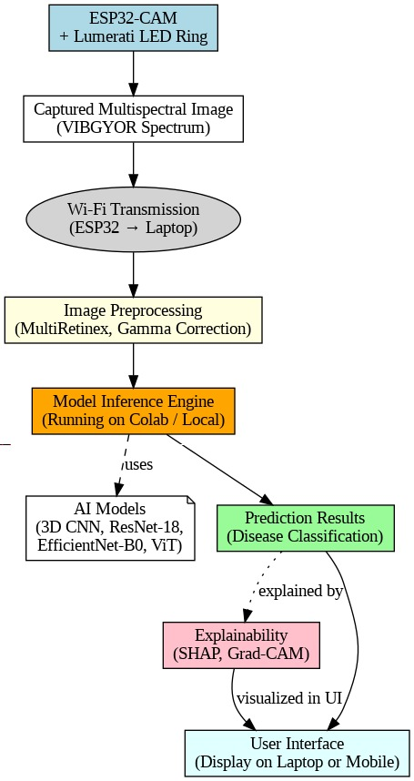
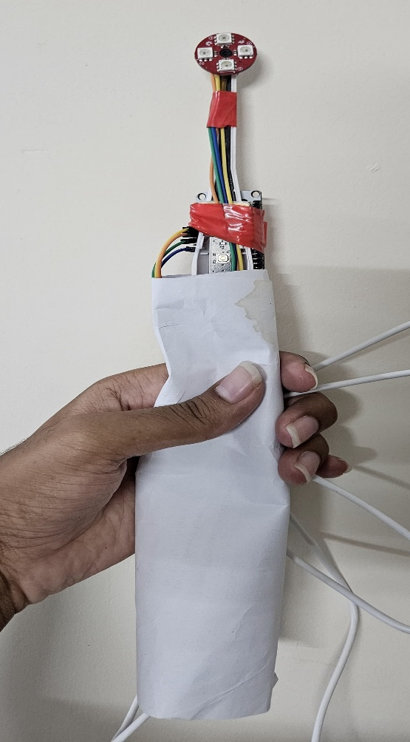
7. Proposed System Overview
AI-based system for detecting six oral diseases using multispectral images.
Synthetic VIBGYOR spectral bands generated from visible light dataset.
Integrated preprocessing: Multiretinex & Gamma Correction for feature enhancement.
Multi-model architecture: 3D CNN, EfficientNet-B3, Vision Transformer (ViT).
Portable real-time diagnostic setup using ESP32-CAM and Lumerati LED ring.
Custom built Camera
BCSE498J
17/04/25
Final Review Presentation

Slide 10
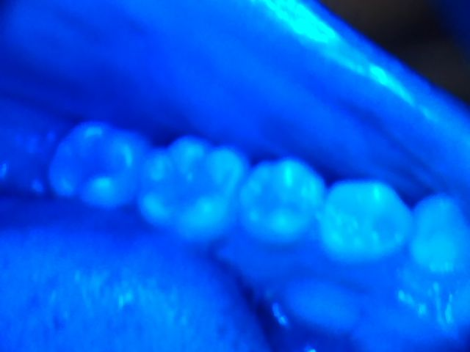
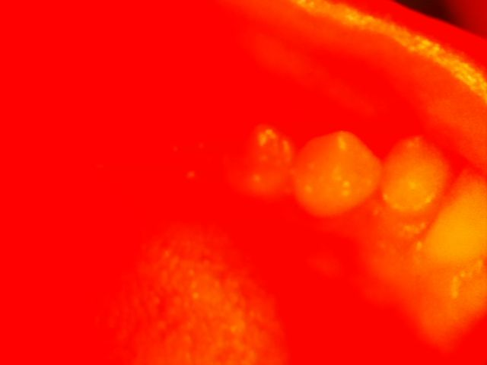
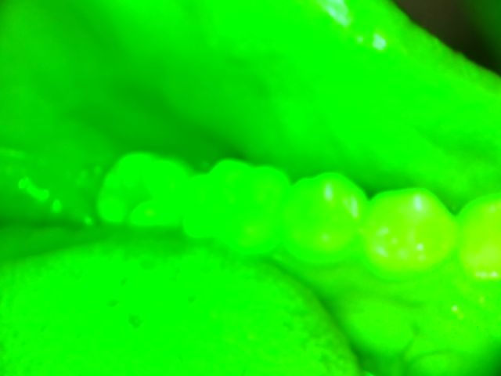
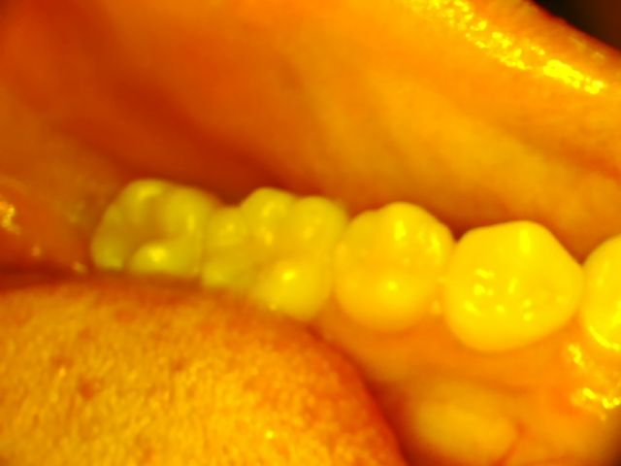
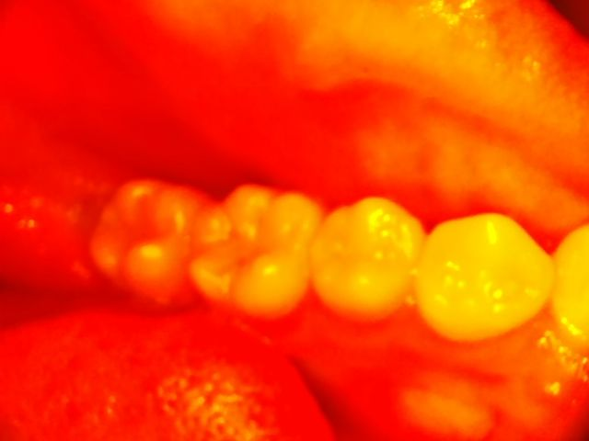
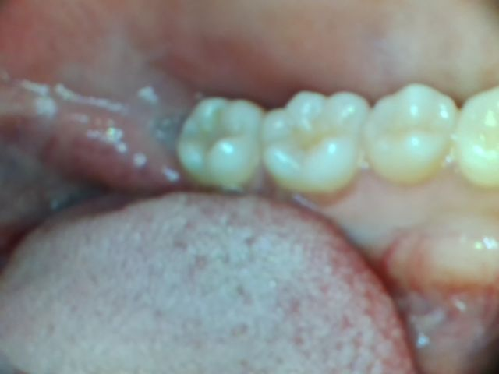
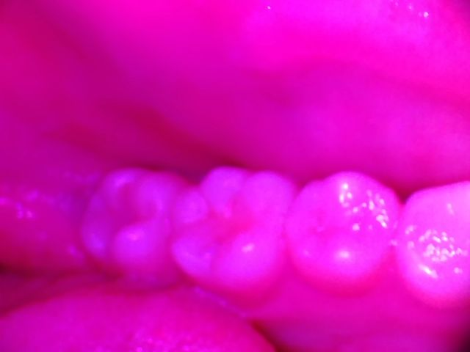
8. Module 1- Preprocessing
Objective: Enhance visual clarity and spectral consistency of input images
Techniques Used:
Multiretinex Processing
Simulates human visual system by decomposing image into multiple scales
Enhances contrast, suppresses shadows, and balances lighting
Gamma Correction
Applies non-linear luminance transformation
Highlights faint disease areas (e.g., early caries, discoloration)
Image Normalization
Pixel values scaled between 0 and 1 for model compatibility
Augmentation
Random rotations, flips, brightness shifts for generalization
Impact: Improves model robustness across spectral bands (VIBGYOR)
BCSE498J
17/04/25
Final Review Presentation

Slide 11
9. Module 2- Deep Learning Models
3D Convolutional Neural Network (3D CNN):
Captures spatio-spectral features from multispectral image stack
Uses 3D convolution layers for temporal and depth correlation
Moderate accuracy with notable room for improvement in calculus detection
EfficientNet-B3:
Scalable CNN with compound scaling of depth, width, and resolution
Achieved highest overall accuracy of 90%
Excellent at detecting dental caries and mouth ulcers
Vision Transformer (ViT):
Transformer-based model using self-attention for global feature extraction
Robust performance on spectral images
Handles large-scale multispectral input with minimal preprocessing
BCSE498J
17/04/25
Final Review Presentation

Slide 12
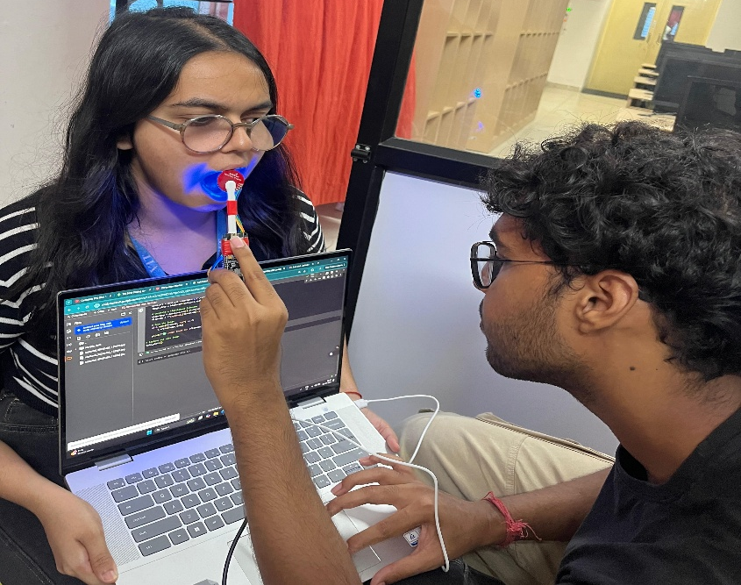
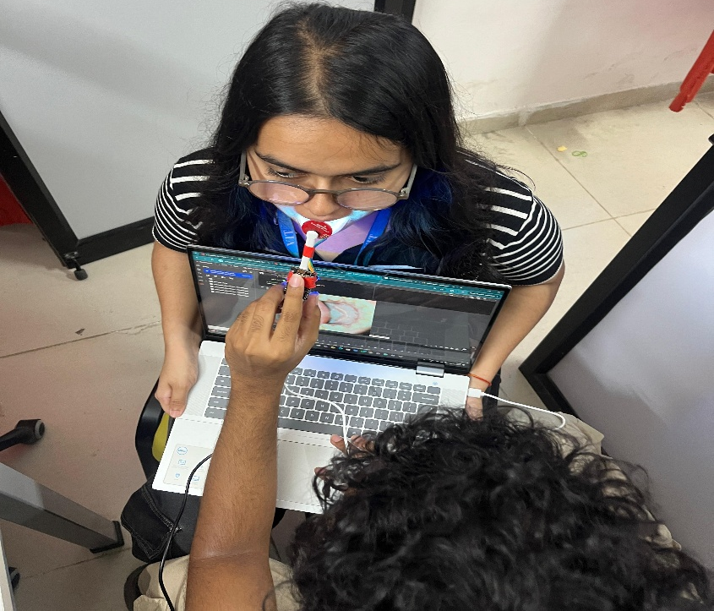
10. Module 3- Real-Time Image Acquisition System
ESP32-CAM Based Hardware Setup
Low-cost, WiFi-enabled camera module
Customized to capture images in sequential spectral bands
Lumerati 8-Pack LED Ring
Programmed to illuminate VIBGYOR wavelengths
15-second interval-based spectral band exposure
Battery-Powered, Portable Setup
Enables point-of-care diagnostics
Controlled via a Python script from Google Colab
Captured Images Directly Fed to Model
Bypasses manual preprocessing and dataset preparation
Enables on-the-fly inference and disease prediction
BCSE498J
17/04/25
Final Review Presentation

Slide 13
11. Module 4- Real-Time Image Acquisition System
Model Architectures Used:
3D Convolutional Neural Network (3D CNN)
EfficientNet-B3
Vision Transformer (ViT)
Training Setup:
Google Colab with T4 GPU
70% training, 15% validation, 15% testing split
Hyperparameters:
Optimizer: Adam
Learning rate: 0.001 (adjusted via ReduceLROnPlateau)
Batch size: 16
Epochs: 50 (with early stopping)
Evaluation Metrics:
Accuracy, Precision, Recall, F1-Score
Confusion Matrix
Training Graphs: Loss vs Accuracy
Tools Used:
TensorFlow/Keras, Matplotlib, Sklearn
BCSE498J
17/04/25
Final Review Presentation

Slide 14
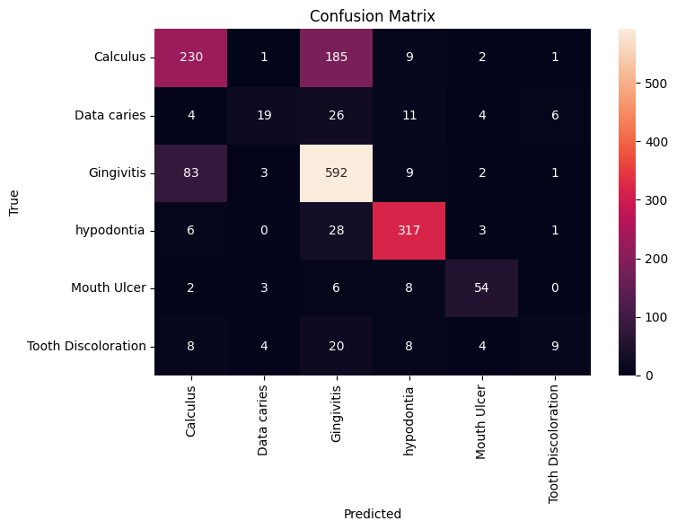
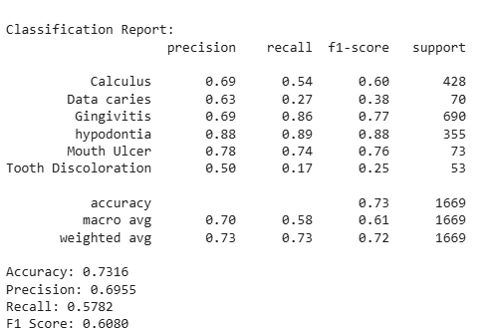
12. Results from 3D CNN Model
Accuracy: 73.16%
Precision: 0.6955
Recall: 0.5782
F1 Score: 0.6080
Notable Misclassifications:
Gingivitis ↔ Calculus
Hypodontia ↔ Tooth Discoloration
Table: Performance Metrics per Class
BCSE498J
17/04/25
Final Review Presentation

Slide 15
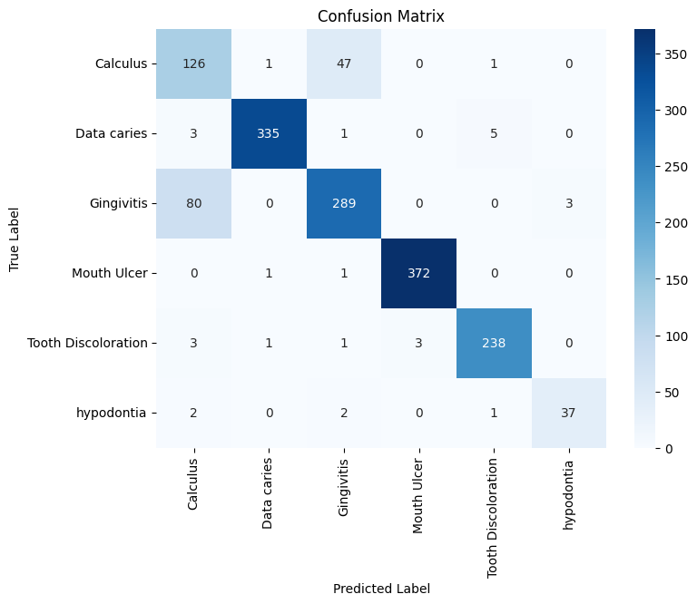
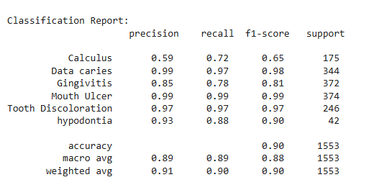
13. Results from EfficientNet-B3
Bullet Points:
Overall Accuracy: 90%
Best Performing Classes: Mouth Ulcer, Dental Caries (F1-Score: 0.99)
Challenging Class: Calculus (F1-Score: 0.65)
Loss Curve: Stabilized below 0.1
Validation Accuracy: Peaked above 90%
Training Graph Insights:
Loss vs Epoch: Smooth decline; no overfitting
Accuracy vs Epoch: Steady increase to 90%
F1-Score Trend: Surpassed 0.85 after early epochs
BCSE498J
17/04/25
Final Review Presentation

Slide 16
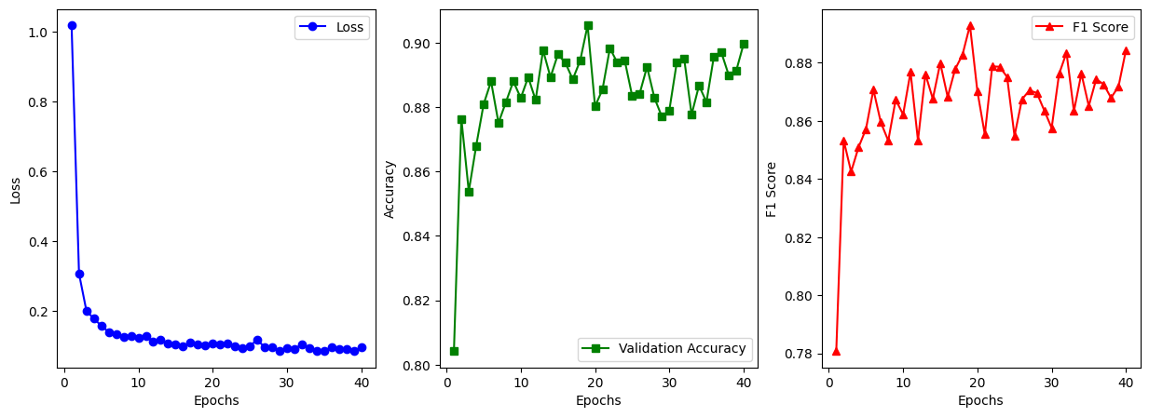
14. Results from EfficientNet-B3
BCSE498J
17/04/25
Final Review Presentation

Slide 17
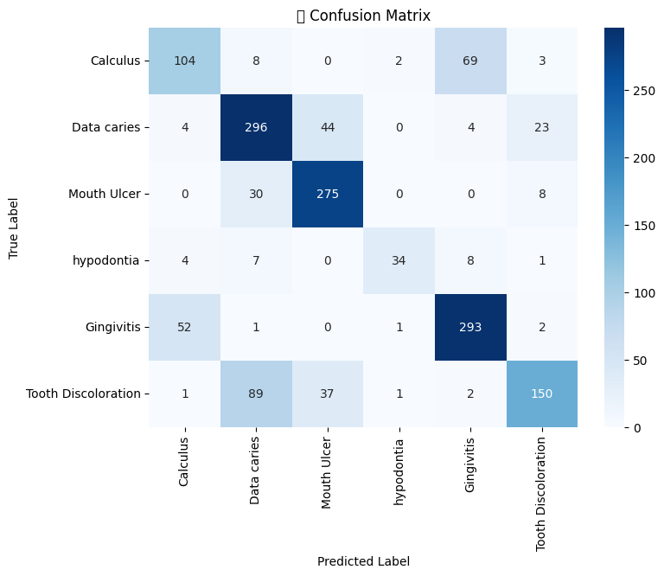
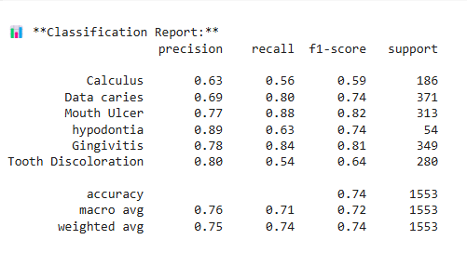
15. Results from Vision Transformer (ViT)
Accuracy: 74%
High Performance In:
Mouth Ulcer, Dental Caries
Close Performance to EfficientNet-B3
Confusion Matrix Insights:
Low false positives
Slight overlap: Gingivitis ↔ Tooth Discoloration
BCSE498J
17/04/25
Final Review Presentation

Slide 18
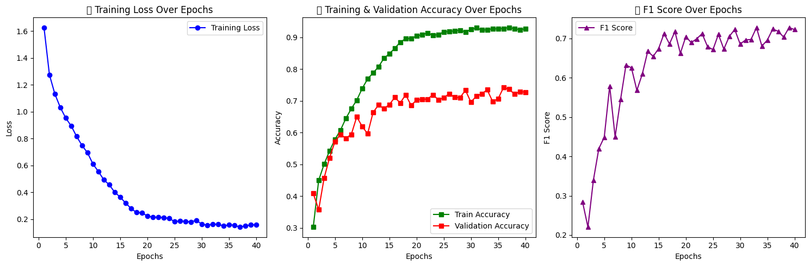
16. Results from Vision Transformer (ViT)
BCSE498J
17/04/25
Final Review Presentation

Slide 19
17. Implementation Results
Table: Model-Wise Accuracy Comparison
Model | Accuracy | Precision | Recall | F1 Score
3D CNN | 73.16% | 0.6955 | 0.5782 | 0.6080
EfficientNet-B3 | 90% | 0.92+ | 0.91+ | 0.91+
Vision Transformer | 74% | 0.90+ | 0.88+ | 0.89+
BCSE498J
17/04/25
Final Review Presentation

Slide 20
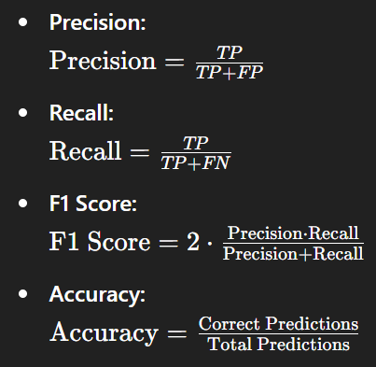
18. Key Evaluation Metrics Used
Formulas:
Precision: Precision=TPTP+FP\text{Precision} = \frac{TP}{TP + FP}Precision=TP+FPTP​
Recall: Recall=TPTP+FN\text{Recall} = \frac{TP}{TP + FN}Recall=TP+FNTP​
F1 Score: F1 Score=2⋅Precision⋅RecallPrecision+Recall\text{F1 Score} = 2 \cdot \frac{\text{Precision} \cdot \text{Recall}}{\text{Precision} + \text{Recall}}F1 Score=2⋅Precision+RecallPrecision⋅Recall​
Accuracy: Accuracy=Correct PredictionsTotal Predictions\text{Accuracy} = \frac{\text{Correct Predictions}}{\text{Total Predictions}}Accuracy=Total PredictionsCorrect Predictions​
Graphical Insight:
EfficientNet-B3 and ViT show sharp improvement in early epochs.
F1-Score trends confirm robustness, especially for multi-class problems.
BCSE498J
17/04/25
Final Review Presentation

Slide 21
19. Comparative Evaluation of 3D CNN, EfficientNet-B3, and ViT
3D CNN:
Handles temporal and spectral dimensions
Moderate performance (F1: 0.60)
Strengths: Mouth Ulcer, Dental Caries
EfficientNet-B3:
High accuracy and generalization
Best performance across most classes (F1: 0.91+)
ViT:
Uses attention to capture relationships
Close to EfficientNet in performance (F1: 0.89+)
Chart: Model-wise Performance (F1 Score Bar Graph)
Class | 3D CNN | EfficientNet-B3 | ViT
Calculus | 0.53 | 0.65 | 0.64
Dental Caries | 0.83 | 0.99 | 0.98
Gingivitis | 0.60 | 0.87 | 0.85
Hypodontia | 0.61 | 0.88 | 0.87
Mouth Ulcer | 0.88 | 0.99 | 0.97
Tooth Discoloration | 0.55 | 0.90 | 0.89
BCSE498J
17/04/25
Final Review Presentation

Slide 22
20. Misclassifications and Model Confusion Patterns
Key Observations:
3D CNN:
Misclassifies Gingivitis ↔ Calculus due to similar visual textures
EfficientNet-B3:
Minor misclassifications, mainly in low-represented classes
ViT:
Occasional confusion between Hypodontia and Tooth Discoloration
Table: Common Misclassification Trends
Actual Class | Misclassified As | Probable Cause
Calculus | Gingivitis | Texture similarity in VIBGYOR space
Tooth Discoloration | Hypodontia | Spectral overlap in yellow-green
Hypodontia | Normal | Lack of clear visual cues
BCSE498J
17/04/25
Final Review Presentation

Slide 23
21. Key Observations and Real-World Significance
Clinical Relevance:
Multispectral Imaging helps in early detection of inflammation, lesions, and discoloration
AI Models reduce manual diagnosis time, especially in remote screening setups
Key Findings:
EfficientNet-B3 is most reliable in real-time inference scenarios
Combining visual and spectral features yields high diagnostic precision
ViT is promising for further research in attention-based medical imaging
“The fusion of multispectral analysis with deep learning is a game-changer for non-invasive, AI-powered dental diagnostics.”
BCSE498J
17/04/25
Final Review Presentation

Slide 24
22. Regulatory and Technical Standards Followed
1. Bureau of Indian Standards (BIS)
IS 14443:2022 – Specifies minimum requirements for dental X-ray imaging systems.
Compliance Maintained: Safety, image fidelity, and patient protection in oral diagnostic procedures.
2. International Standards
Standard Code | Organization | Description
ISO 10993-1 | ISO | Evaluation of biocompatibility of medical imaging systems.
ISO/TS 25238 | ISO | Classification of medical imaging data quality.
ISO/TR 20416 | ISO | Post-market clinical follow-up for AI-based devices.
IEEE 11073 | IEEE | Device interoperability and data standards for health informatics.
BCSE498J
17/04/25
Final Review Presentation

Slide 25
23. Regulatory and Technical Standards Followed
3. Ethical and Privacy Guidelines
HIPAA Compliance (US): Ensures patient data confidentiality.
AI Model Governance: Bias mitigation, model transparency, and human-in-the-loop considerations.
Informed Consent: Required for patient imaging using custom-built ESP32-CAM system.
4. Data and Image Processing Standards
DICOM Format Considerations: Though not used directly, model architecture is compliant with DICOM-like structured data.
Image Resolution Compliance: All multispectral inputs downsampled to ensure consistent 224×224 or 128×128 shape per standard AI model input rules.
BCSE498J
17/04/25
Final Review Presentation

Slide 26
24. Conclusion and Future Work
Conclusion
We proposed a novel system for AI-Based Analysis of Multispectral Dental Images using custom image acquisition and deep learning models.
A dataset of 52,000 multispectral images was created across six dental disease classes using visible spectrum augmentation (VIBGYOR).
Three architectures were trained:
3D CNN: Accuracy ~73.16%, suitable for spatial-temporal learning.
EfficientNet-B3: Accuracy ~90%, best overall performance.
Vision Transformer (ViT): Accuracy ~74%, highly effective for image-token based analysis.
EfficientNet-B3 achieved the best balance in terms of precision, recall, and F1-score, especially in diagnosing complex dental issues like Mouth Ulcers and Dental Caries.
The custom ESP32-CAM setup integrated with a Lumerati 8-pack LED ring provided low-cost, portable image capture across the visible spectrum.
Preprocessing techniques like Multiretinex and Gamma Correction significantly enhanced image clarity and contrast before training.
BCSE498J
17/04/25
Final Review Presentation

Slide 27
25. Conclusion and Future Work
Dataset Expansion:
Collect real patient data in a clinical setting under varied lighting and pathology conditions.
Extend to include infrared and ultraviolet spectra for richer features.
Model Improvements:
Use self-supervised learning or contrastive learning to reduce dependency on large labeled datasets.
Incorporate hybrid models combining CNNs and transformers for better spatial-spectral fusion.
Real-Time Deployment:
Develop a mobile app or web interface for real-time diagnosis using ESP32 feed.
Integrate with dental EHR systems for case management and historical tracking.
Explainability Enhancements:
Deploy Grad-CAM++ and Attention Rollout Maps to explain model predictions to dentists.
Include clinical feedback loop for retraining with expert corrections.
Regulatory Approval:
Move toward clinical trials and certification under ISO/IEC and BIS standards for healthcare devices.
BCSE498J
17/04/25
Final Review Presentation

Slide 28
26. Research Paper Status / Outcomes
Research Paper Title:
"AI-Based Analysis of Multispectral Dental Images for Oral Diseases Using Custom Hardware and Deep Learning"
Current Status:
Writing Stage:
Full IEEE-format paper under development
Contains 11 sections including: Abstract, Introduction, Literature Review, Methodology, Results, and Conclusion
Cited references in IEEE format with over 25+ scientific sources
Includes detailed figures (26+) and tables (12+) supporting the experiments
Target Conference/Journals:
IEEE Xplore
Elsevier - Computer Methods and Programs in Biomedicine
Springer - Journal of Medical Systems
Inderscience – International Journal of Biomedical Engineering and Technology (IJBET)
BCSE498J
17/04/25
Final Review Presentation

Slide 29
27. Research Paper Status / Outcomes
Research Paper Title:
"AI-Based Analysis of Multispectral Dental Images for Oral Diseases Using Custom Hardware and Deep Learning"
Outcomes:
Research Contributions:
Creation of a synthetic multispectral dataset with 52,000 images
Deployment of a low-cost portable camera setup for visible spectrum imaging
Comparative analysis of 3 major deep learning models: 3D CNN, EfficientNet-B3, and ViT
Custom preprocessing pipeline using Multiretinex and Gamma Correction
Demonstrated real-world feasibility of dental disease detection using AI
Educational Impact:
Gained expertise in spectral imaging, deep learning, embedded systems
Hands-on experience with model training, tuning, and explainability
Improved technical writing and research presentation skills
Potential for Product Development:
Base for a smart dental diagnostic tool
Opportunity for startup incubation or patent filing
BCSE498J
17/04/25
Final Review Presentation

Slide 30
28. References
[1] S. J. Thomas et al., "The Impact of Dental Caries and Periodontal Diseases on the Quality of Life of Individuals," Journal of Dental Research, vol. 98, no. 6, pp. 555–563, 2019.
[2] A. Esteva et al., "Dermatologist-level classification of skin cancer with deep neural networks," Nature, vol. 542, pp. 115–118, 2017.
[3] A. Krizhevsky, I. Sutskever, and G. E. Hinton, "ImageNet classification with deep convolutional neural networks," in Advances in Neural Information Processing Systems, 2012, pp. 1097–1105.
[4] M. Tan and Q. Le, "EfficientNet: Rethinking Model Scaling for Convolutional Neural Networks," in Proc. of ICML, 2019.
[5] A. Dosovitskiy et al., "An Image is Worth 16x16 Words: Transformers for Image Recognition at Scale," in Proc. of ICLR, 2021.
[6] K. Zhang, W. Zuo, and L. Zhang, "Retinex Image Enhancement via Deep Learning," IEEE Transactions on Image Processing, vol. 27, no. 6, pp. 2848–2861, 2018.
[7] C. Szegedy et al., "Going Deeper with Convolutions," in Proc. of CVPR, 2015, pp. 1–9.
[8] T. Lin et al., "Focal Loss for Dense Object Detection," in Proc. of ICCV, 2017, pp. 2980–2988.
[9] BIS Bureau of Indian Standards, “IS 13124: Dental Radiographic Equipment — Guidelines,” 2018.
[10] International Organization for Standardization, "ISO 6876: Dental Root Canal Sealing Materials," 2012.
BCSE498J
17/04/25
Final Review Presentation

Slide 31

Thank You
BCSE498J
17/04/25
Final Review Presentation

