Slide 1
Welcome to React Weather App
By Aditya Jain

Slide 2
Use of the App
Used to show weather of different cities with
the help of search.
Also shows the weather type such as Cloudy,Rainy,Sunny.

Slide 3
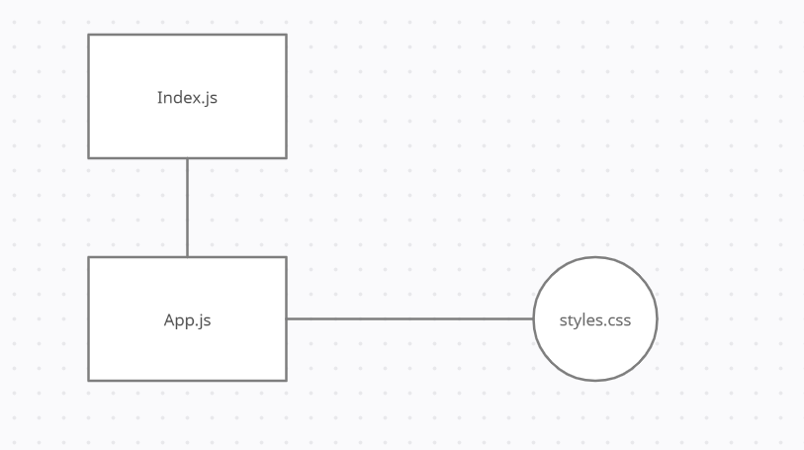
Block Diagram for App

Slide 4
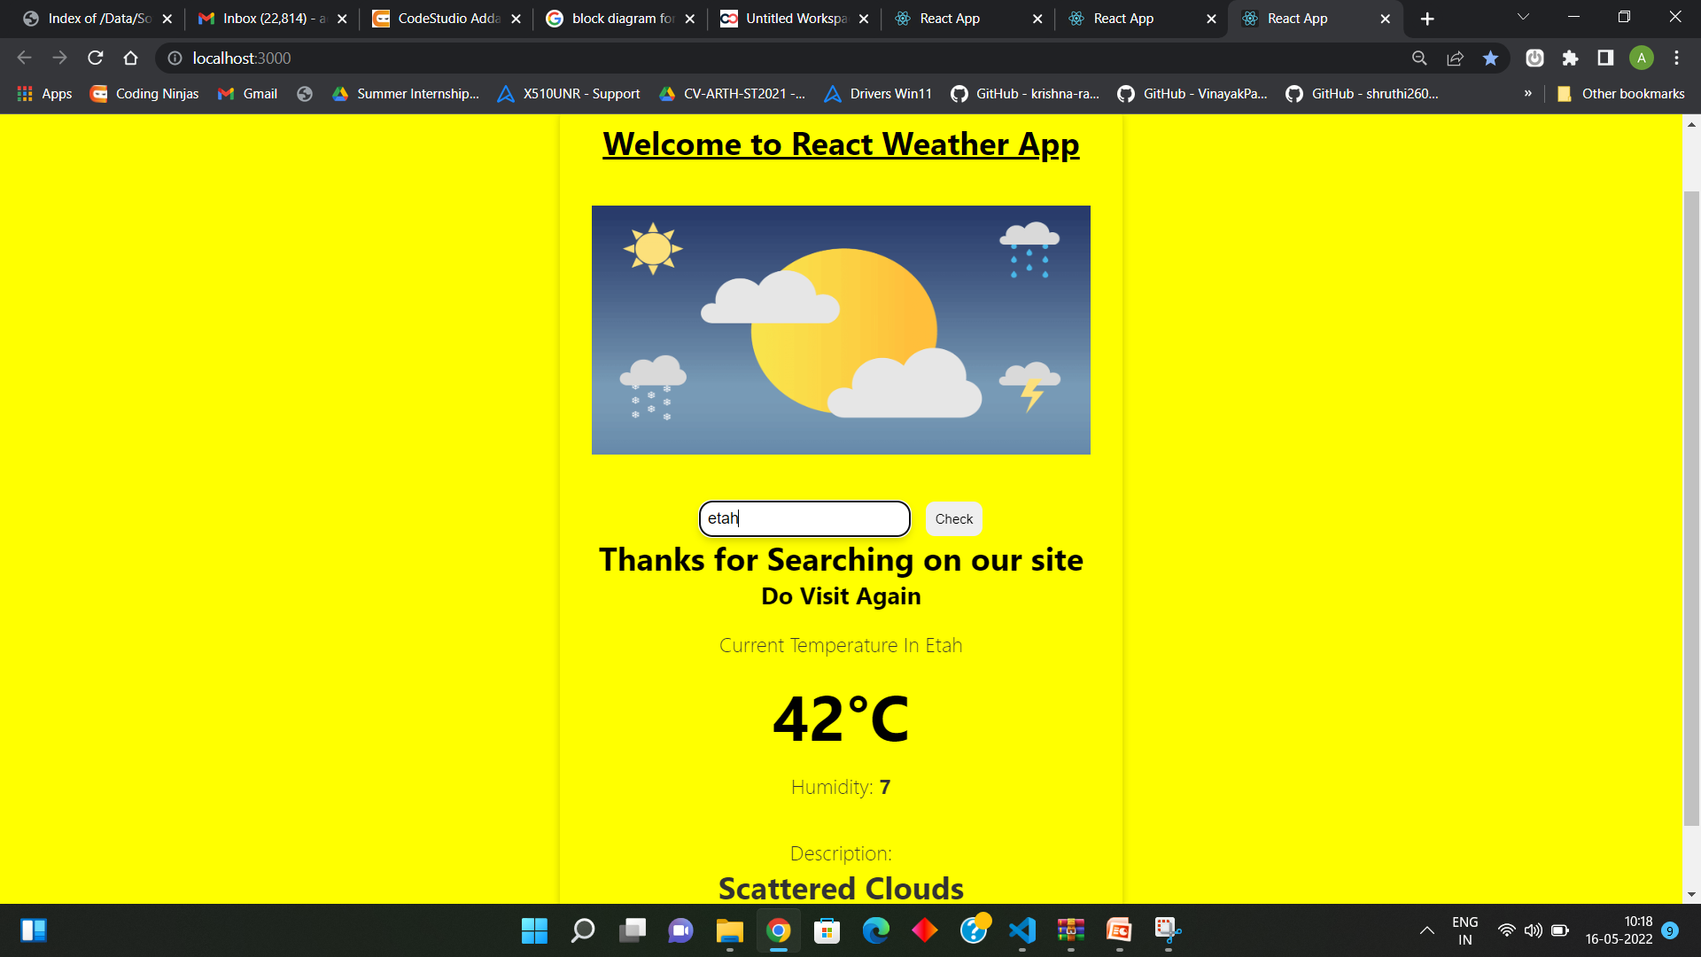
Output

Slide 5
Welcome to React Expense App
By Aditya Jain

Slide 6
Use of the App
This was used to calculate the overall expenses of the App with the help of income and expenses difference. The value can be positive or Negative.

Slide 7
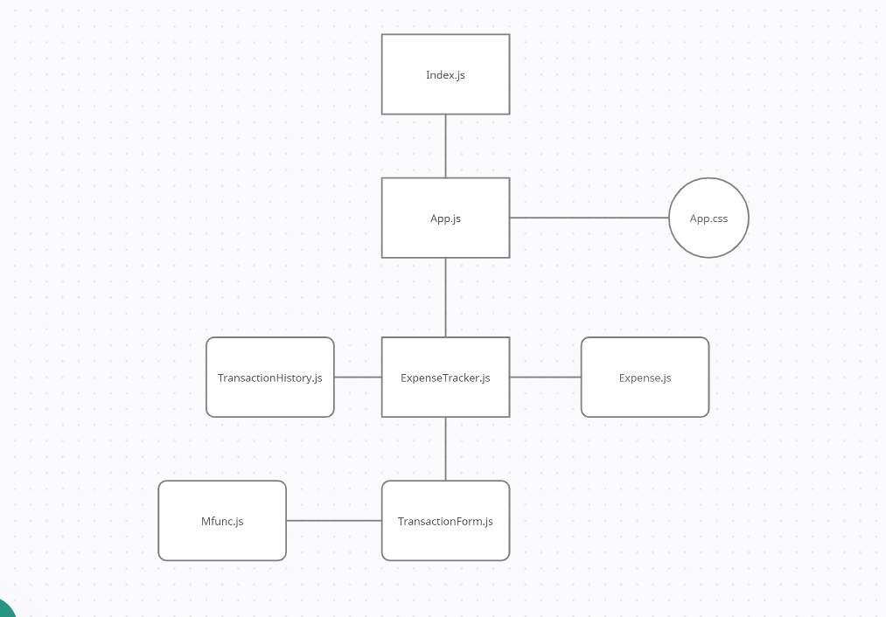
Block Diagram for the App

Slide 8
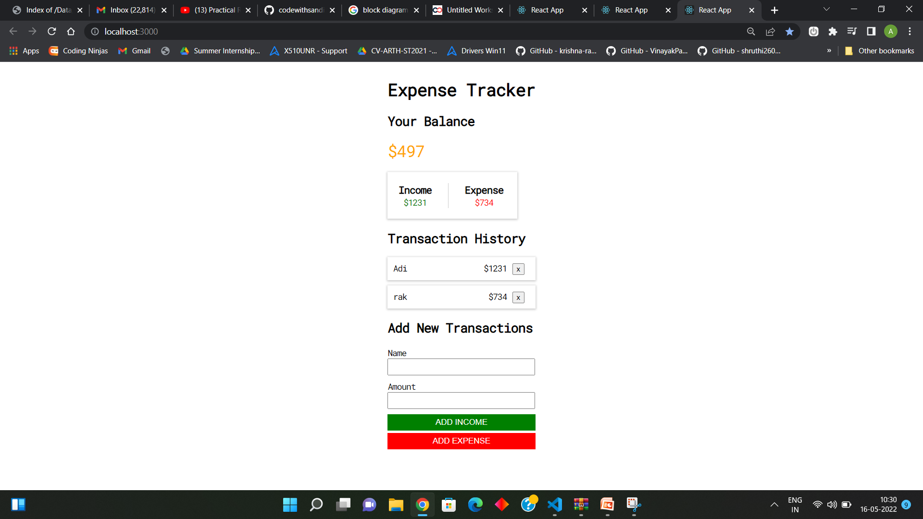
Output

Slide 9
Welcome to React E-Book App
By Aditya Jain

Slide 10
Use of the App
Similar to E-shopping Apps like Amazon/Flipkart and has add to cart functionality.
Also gives the total quantity and you can change the quantity of product in add to cart page.

Slide 11
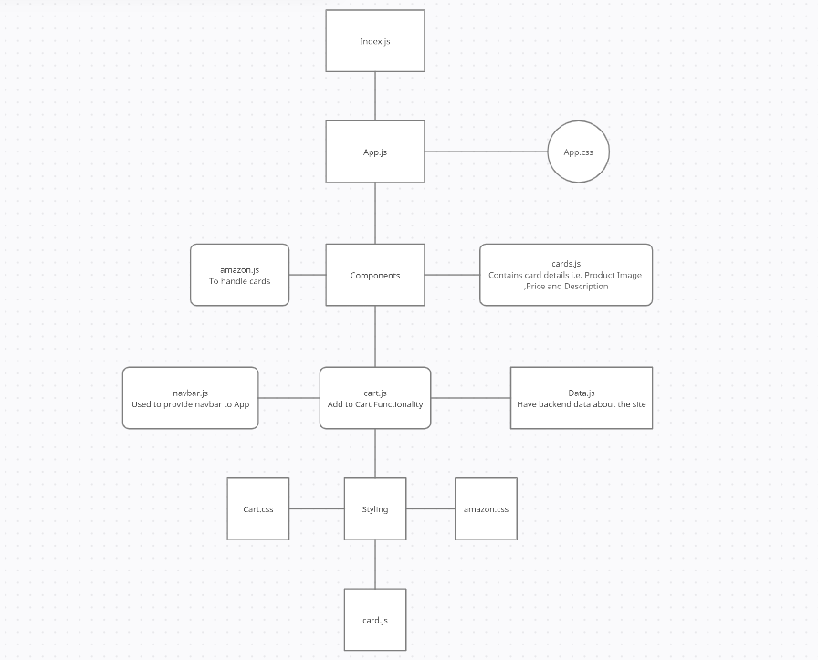
Block Diagram for the App

Slide 12
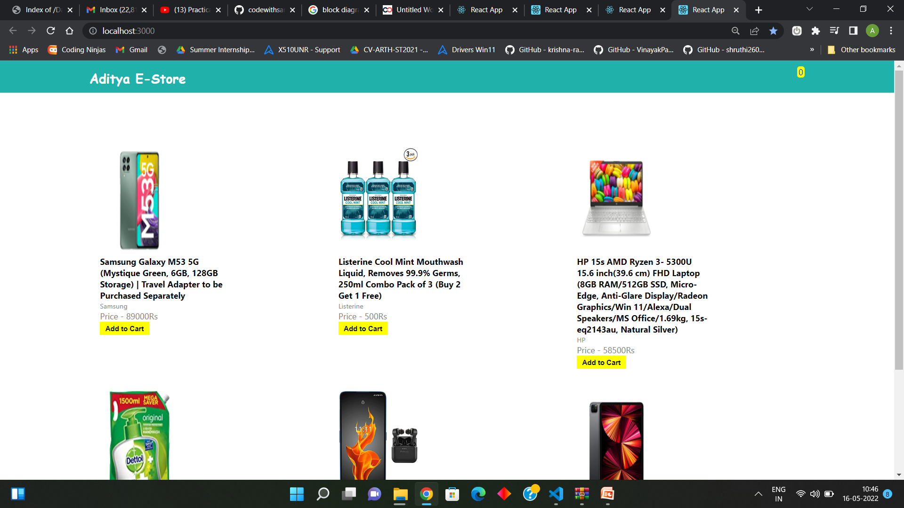
Output

Slide 13
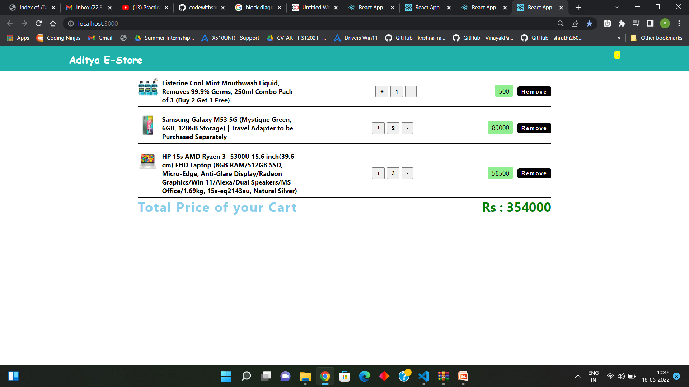
Output

Slide 14
Thank You

