Slide 1
Veterans
A system of IoT Devices to prevent under-loading / overloading .
SIH1313 & SIH1314

Slide 2
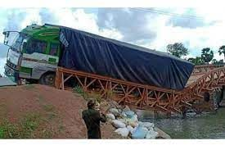
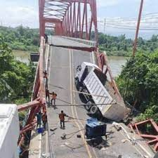
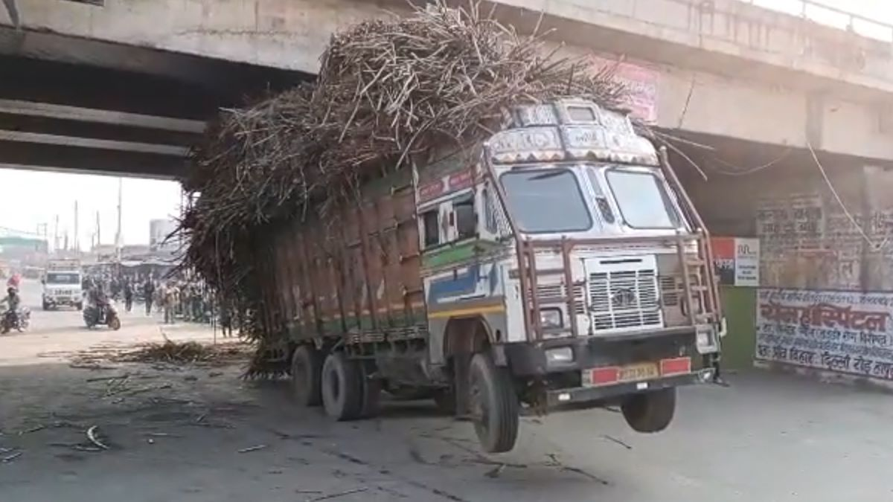

Slide 3
Overview
01
02
03
04
What is overloading of trucks?
Problems faced due to overloading
Present Solutions for the problem
Our approach to this problem

Slide 4
Overview
01
02
01
01
What is overloading of trucks?
Problems faced due to overloading
Present Solutions for the problem
Afhajgfha a kghjafgayfafaggjaghuiahg
Aguaguhguhua
Agfjahjfahf
aogfjiojggaaugh
agakgijahguhaughu

Slide 5
Overview
01
02
03
04
What is overloading of trucks?
Problems faced due to overloading
Present Solutions for the problem
Our approach to this problem

Slide 6
What is Markov chain ?
Overview
01
02
03
04
What is overloading of trucks?
Problems faced due to overloading
Present Solutions for the problem
Our approach to this problem

Slide 7
Overview
What is Overloading?
01
02
Afhajgfha a kghjafgayfafaggjaghuiahg
Aguaguhguhua
Agfjahjfahf
aogfjiojggaaugh
agakgijahguhaughu
Afhajgfha a kghjafgayfafaggjaghuiahg
Aguaguhguhua
Agfjahjfahf
aogfjiojggaaugh
agakgijahguhaughu
03
04
Afhajgfha a kghjafgayfafaggjaghuiahg
Aguaguhguhua
Agfjahjfahf
aogfjiojggaaugh
agakgijahguhaughu
Afhajgfha a kghjafgayfafaggjaghuiahg
Aguaguhguhua
Agfjahjfahf
aogfjiojggaaugh
agakgijahguhaughu

Slide 8
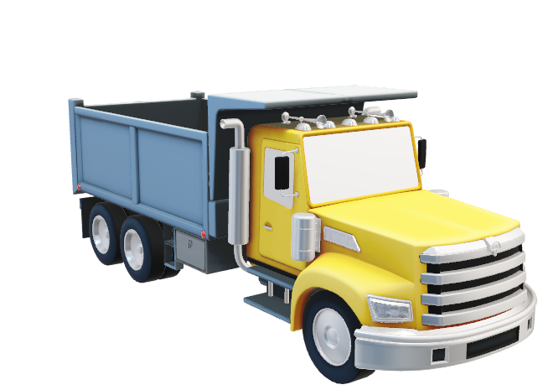
Overview
What is Overloading?
Overloading: exceeding truck weight limits, risks safety and damage .
01
02
Afhajgfha a kghjafgayfafaggjaghuiahg
Aguaguhguhua
Agfjahjfahf
aogfjiojggaaugh
agakgijahguhaughu
Afhajgfha a kghjafgayfafaggjaghuiahg
Aguaguhguhua
Agfjahjfahf
aogfjiojggaaugh
agakgijahguhaughu
03
04
Afhajgfha a kghjafgayfafaggjaghuiahg
Aguaguhguhua
Agfjahjfahf
aogfjiojggaaugh
agakgijahguhaughu
Afhajgfha a kghjafgayfafaggjaghuiahg
Aguaguhguhua
Agfjahjfahf
aogfjiojggaaugh
agakgijahguhaughu

Slide 9
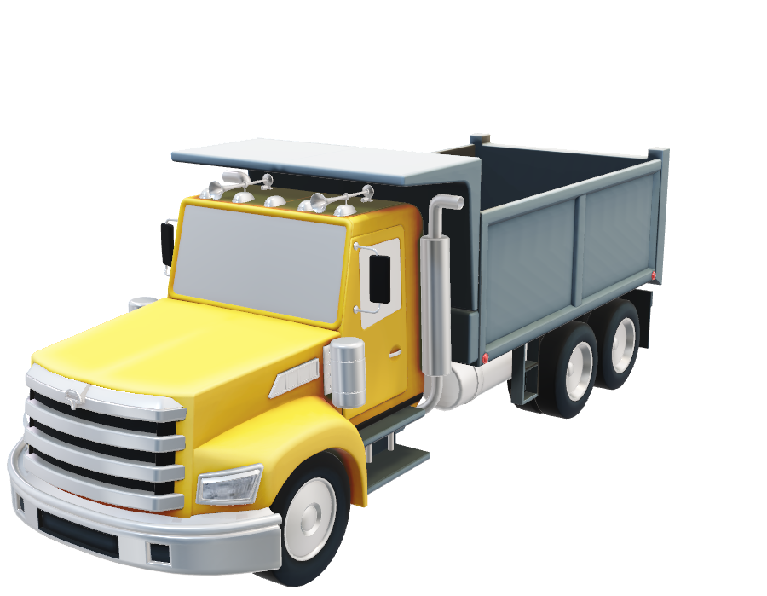
What is Markov chain ?
Types of Markov Chain
2 axle: 16-18 tons
3 axle: 25-29 tons
4 axle: 37-44 tons
A Markov chain or Markov process is a stochastic model describing a sequence of possible events in which the probability of each event depends only on the state attained in the previous event.

Slide 10
Problems faced :
Infrastructure
Vehicle
By exerting excessive stress on roads and bridges, leading to accelerated wear and tear. This results in increased maintenance costs for authorities and risks the safety of road users
It causes increased wear and tear on essential components like suspension, brakes, and tires.Due to strain on the vehicle's chassis and engine, leading to reduced fuel efficiency and potentially shortens its overall lifespan.
The owner faces Heavy fines and penalties are imposed for overloading violations.

Slide 11
Problems faced :
Infrastructure
Vehicle
Legal
By exerting excessive stress on roads and bridges, leading to accelerated wear and tear. This results in increased maintenance costs for authorities and risks the safety of road users
It causes increased wear and tear on essential components like suspension, brakes, and tires. Due to strain on the vehicle's chassis and engine, leading to reduced fuel efficiency and potentially shortens its overall lifespan.
The owner faces Heavy fines and penalties are imposed for overloading violations.

Slide 12
Problems faced :
Infrastructure
Vehicle
Legal
By exerting excessive stress on roads and bridges, leading to accelerated wear and tear. This results in increased maintenance costs for authorities and risks the safety of road users
It causes increased wear and tear on essential components like suspension, brakes, and tires. Due to strain on the vehicle's chassis and engine, leading to reduced fuel efficiency and potentially shortens its overall lifespan.
The owner faces Heavy fines and penalties are imposed for overloading violations.

Slide 13
Problems faced :
Solutions
Infrastructure
Vehicle
Legal
By exerting excessive stress on roads and bridges, leading to accelerated wear and tear. This results in increased maintenance costs for authorities and risks the safety of road users
It causes increased wear and tear on essential components like suspension, brakes, and tires. Due to strain on the vehicle's chassis and engine, leading to reduced fuel efficiency and potentially shortens its overall lifespan.
The owner faces Heavy fines and penalties are imposed for overloading violations.
Weigh Stations

Slide 14
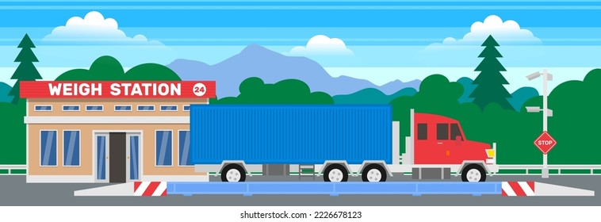
Problems faced :
Solutions
Weigh Stations
Infrastructure
Vehicle
Legal
By exerting excessive stress on roads and bridges, leading to accelerated wear and tear. This results in increased maintenance costs for authorities and risks the safety of road users
It causes increased wear and tear on essential components like suspension, brakes, and tires. Due to strain on the vehicle's chassis and engine, leading to reduced fuel efficiency and potentially shortens its overall lifespan.
The owner faces Heavy fines and penalties are imposed for overloading violations.

Slide 15
Problems faced :
Solutions
Weigh Stations
Infrastructure
Vehicle
Legal
By exerting excessive stress on roads and bridges, leading to accelerated wear and tear. This results in increased maintenance costs for authorities and risks the safety of road users
It causes increased wear and tear on essential components like suspension, brakes, and tires. Due to strain on the vehicle's chassis and engine, leading to reduced fuel efficiency and potentially shortens its overall lifespan.
The owner faces Heavy fines and penalties are imposed for overloading violations.

Slide 16
Working :
Fetches load from load sensor
Checks the threshold weight and uploads it to the cloud
If threshold value is breached then the system will be alarmed

Slide 17
Working :
Factory
Our own server (Iot Cloud)
Marketing

Slide 18
Thank You !

