Slide 1
Task 2 Vulnerabilities
Using OWASP Zap Tool

Slide 2
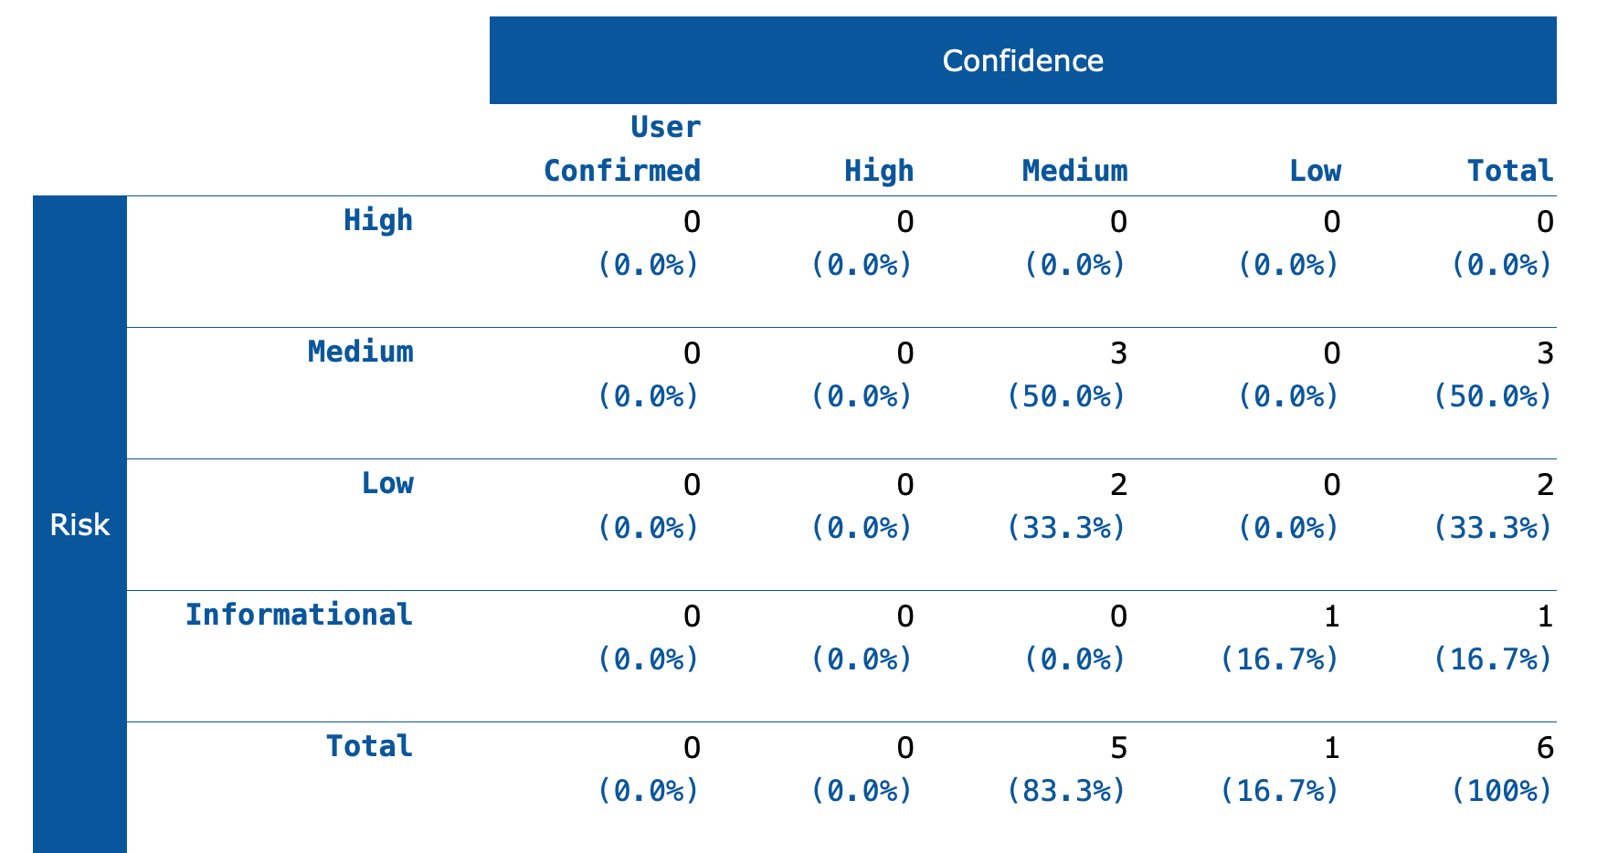
Using OWASP ZAP Tool, I was able to find the following vulnerabilities

Slide 3
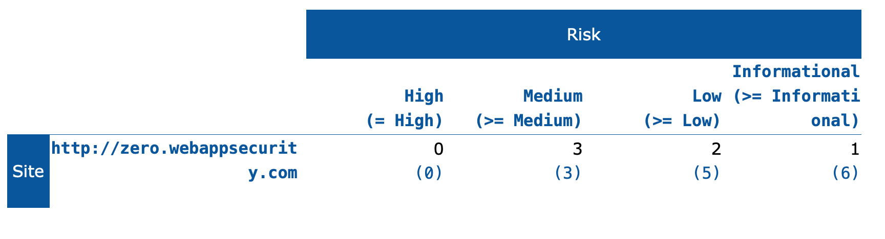
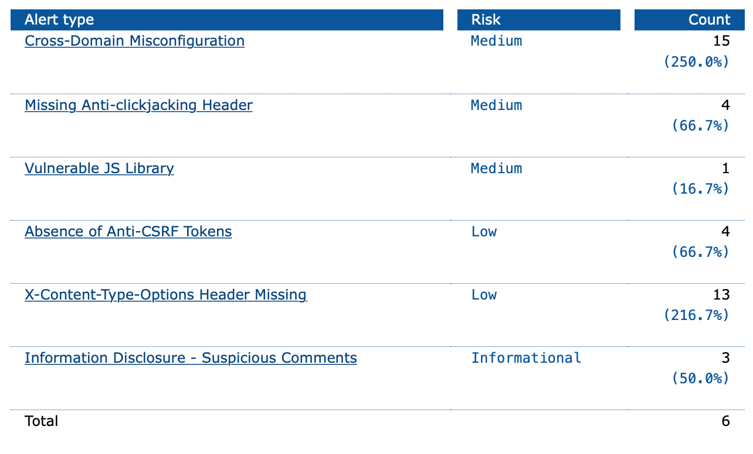

Slide 4
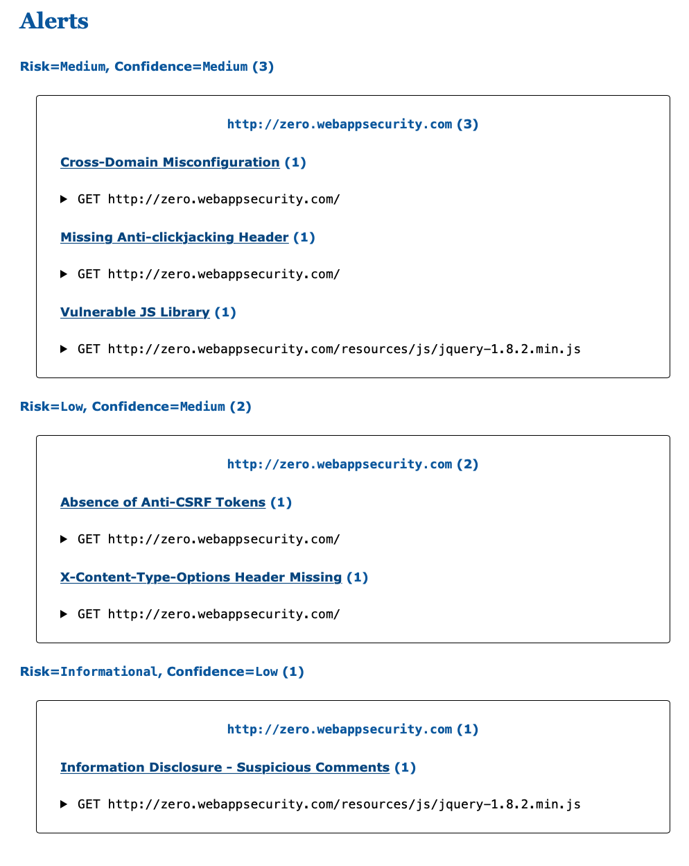

Slide 5
My Report for Critical Vulnerability: Information Disclosure - Suspicious Comments
Name: Information Disclosure - Suspicious Comments
Risk: Critical (Informational)
CWE ID: 200
WASC ID: 13
Summary: This vulnerability appear as a response to certain suspicious comments which may help a malicious attacker. These may include matches made within script blocks or files.
The attacker may be able to successfully collect additional information about the application by learning source code fragments that were commented out and actual source code comments with more deep finding and exposing unused but still active endpoints that may return sensitive data, internal company information etc.
Solution: Ensure that all comments that return information or may help an attacker in fixing any underlying problems they refer to are removed.
Code Source: org/zaproxy/zap/extension/pscanrules/InformationDisclosureSuspiciousCommentsScanRule.java

