Slide 1
Forecasting the Probability of Successfully Collecting Debts by Analyzing Statute-Barred Status
A project by-
Aditya Raikwar

Slide 2
Presentation At A Glance
Introduction
About the Project
Goals
What can be achieved
Final Outcomes
Outcomes
What can be seen from the data before making a prediction
Model and Evaluation Metrics
Exploratory Data Analysis
Thoughts about the project
About the Data Structure
1
2
3
4
5

Slide 3
Introduction
Project Objective: Our goal is to design a machine-learning model that accurately predicts the probability of successfully collecting outstanding debts.
Statute-Barred Consideration: In the realm of debt collection, distinguishing statute-barred accounts is of paramount importance. These accounts are potentially unrecoverable due to legal limitations on collection efforts. Our project aims to develop a model that can effectively identify such accounts.

Slide 4
Data Structure
Our dataset is comprehensive, featuring a wide array of attributes including details about the original creditors, unique account IDs, current balances, purchase dates, and a plethora of other pertinent features.
The Data Initially Contains –
26 Columns &
More than 400,000 values

Slide 5
Goals – What can be achieved
Strategic Significance: The end result will be a predictive model that significantly enhances debt collection strategies. By pinpointing statute-barred accounts and their impact on debt retrieval likelihood, we empower collectors to make informed decisions, thereby optimizing collection efforts and resources.
Outcomes: We anticipate that our model will play a pivotal role in minimizing resources wasted on statute-barred accounts, while maximizing the potential for successful debt recovery, ultimately benefiting both creditors and debtors.

Slide 6
Handling Missing Values:
There were some columns which were unnecessarily added in the data and were totally blank like – Unnamed:22, unnamed:23 etc., these were removed.
Other columns like ClosureReason, AccountInsolvencyType, CustomerInsolvencyType, LastPaymentAmount, LastPaymentMethod had more than 70% missing data and that’s why it was ok to remove these columns
The column Customer Age was not going to contribute much in the prediction model that’s why it was also dropped by me.

Slide 7
Exploratory Data Analysis
Before making a predicting model, I think it would be good to dive to some depth of our data.
I decided to check the target variable count, who are top creditors, what kind of debts were taken mostly, whether any legal action is being taken on them, how many active, passive and Paid accounts were there, and studied about the passive accounts that did they filed a bankruptcy due to which the accounts became passive etc.
Let’s check these things with plots to get a clearer view.

Slide 8
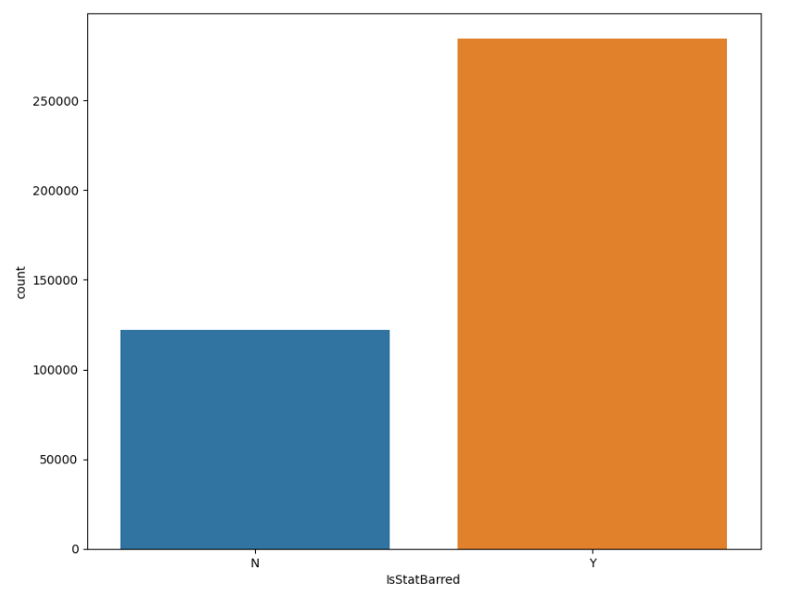
Exploratory Data Analysis
The target variable – IsStatBarred count can be seen in this plot
We can see that the number of Statute Barred accounts are almost twice as compared to non-statute barred accounts.

Slide 9
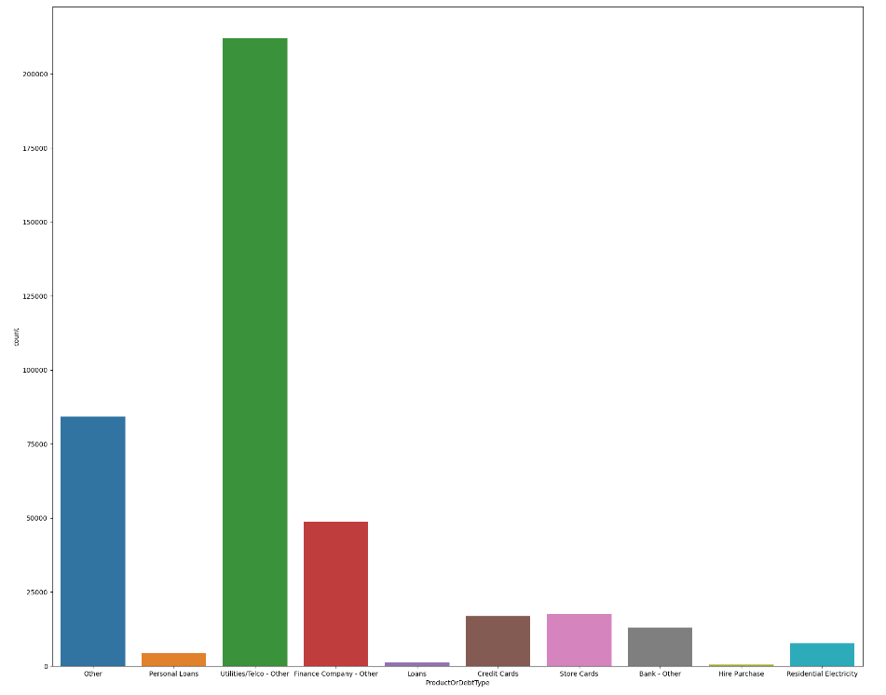
Exploratory Data Analysis
Graph showing count of Product or debt type.
The data contains larger count of utilities/Telco along with Finance company’s type.

Slide 10
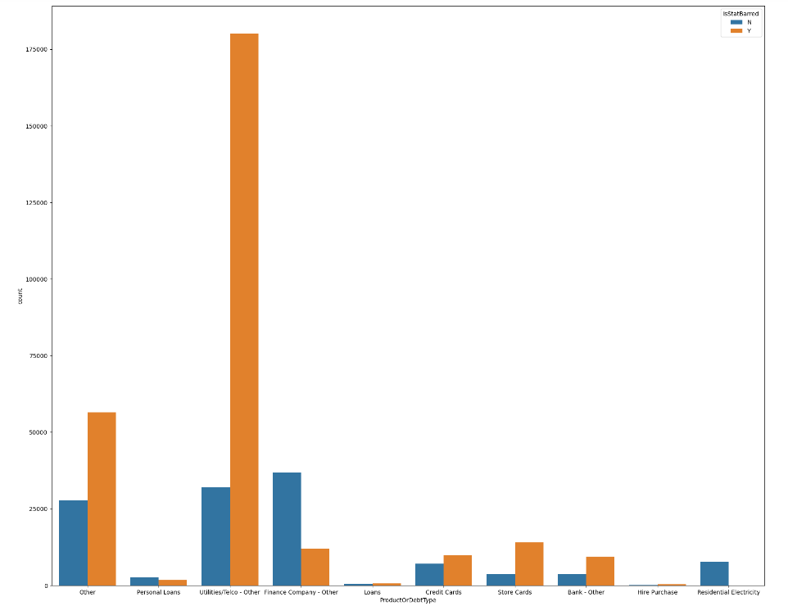
Exploratory Data Analysis
Graph showing count of Product or debt type in relation with the target variable i.e. Is statute barred.
It can be seen that the major contributor- Utilities/Telco has a prominent amount of Statute barred debts. Which should be an area of concern.
Overall we can see that all the creditors have large amount of statute barred account.

Slide 11
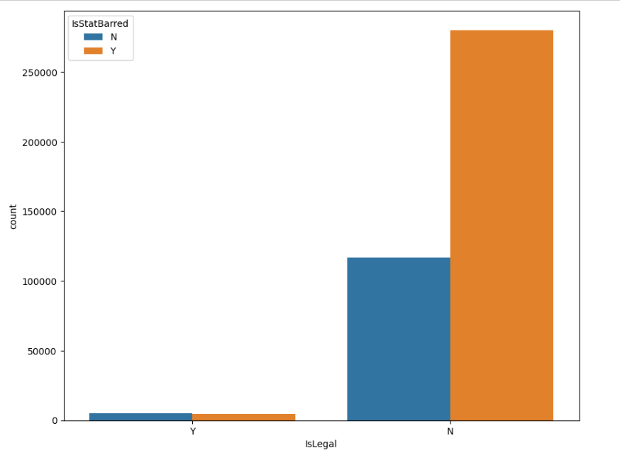
Exploratory Data Analysis
Plot showing the count of Islegal column (tells us whether any legal action was taken on non paid accounts or not) in relation to target variable
As I can observe here that we have a data in which the statute barred accounts are approximately double than non statute barred
Also the legal action were not taken at more than 250000 accounts before being statute barred.

Slide 12
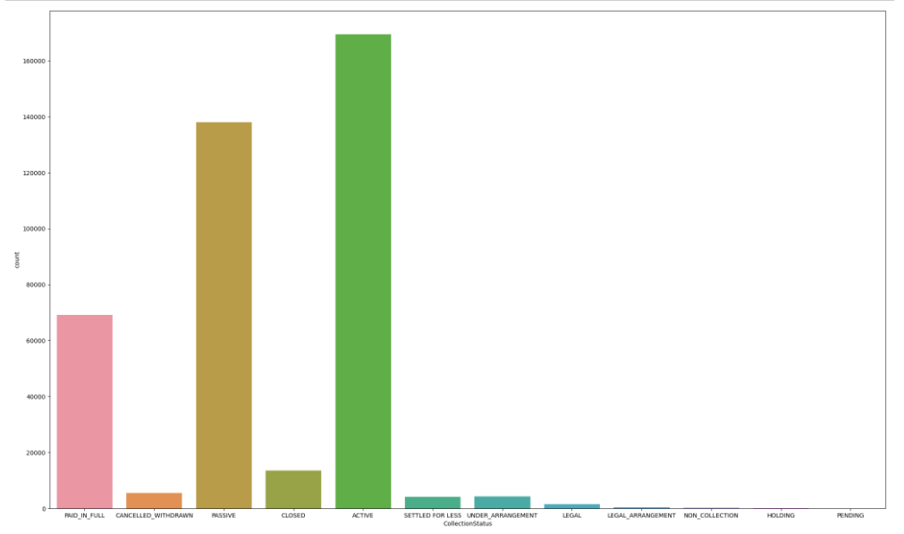
Exploratory Data Analysis
We can see the count of collection status.
Here we can see that active accounts are most significant followed by passive and paid.
But after observation I noted that some tweaking was needed.

Slide 13
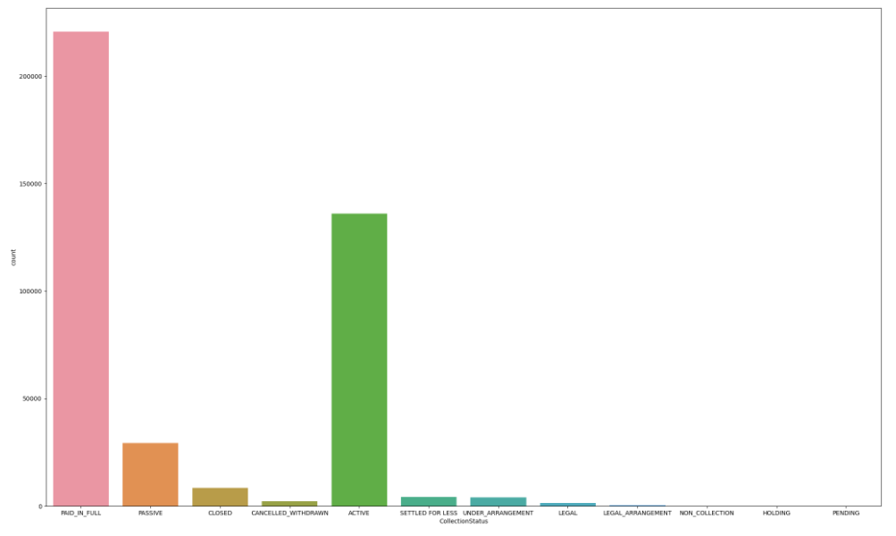
Exploratory Data Analysis
I created a new column named “Remaining Balance” by subtracting current balance from the balance at the time of debt was taken.
After observation I found that some account had 0 remaining balance but were in active state. I converted them to Paid in full and this new plot was created.

Slide 14
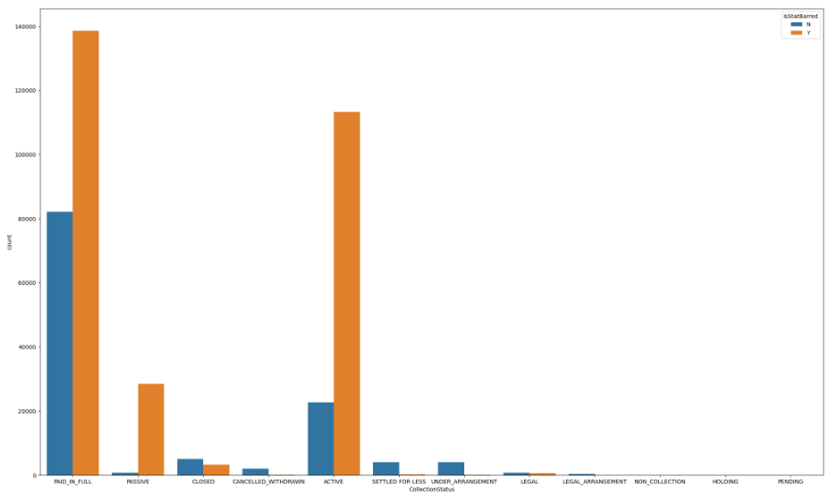
Exploratory Data Analysis
Passive Debt Accounts: Approximately 30,000 accounts in a passive collection state.
Common Reasons for Passivity: The primary reasons for passive debt collection often include bankruptcy filings and difficulties in timely debt recovery from creditors.
Key Insight: Noteworthy is that a significant portion of passive accounts did not file for bankruptcy, indicating potential opportunities for timely debt collection.
Statute-Barred Impact: A majority of passive accounts possess a positive statute barred status, rendering the debt unenforceable. Addressing this issue is crucial for mitigating potential losses and optimizing future collection efforts.

Slide 15
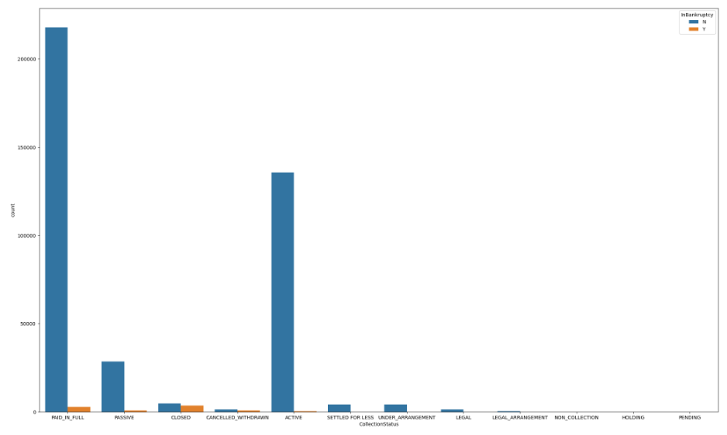
Exploratory Data Analysis
Graph of count of collection status with relation of Bankruptcy.
We can see that bankrupt cases are significantly lesser.
To get a better idea let’s check the bankruptcy with respect to our target variable in next slide.

Slide 16
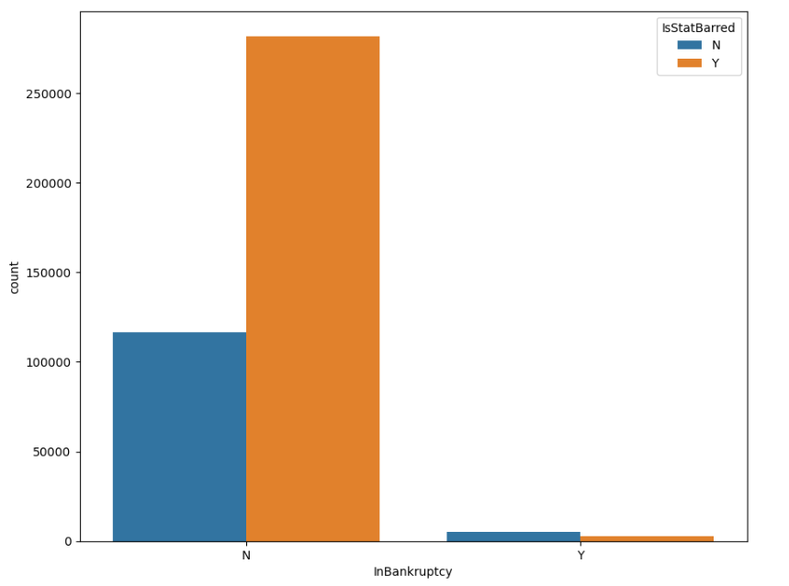
Exploratory Data Analysis
Very few accounts filed for bankruptcy but a lot of accounts were statute barred (which could be due to presence of higher statute barred accounts in our data).

Slide 17
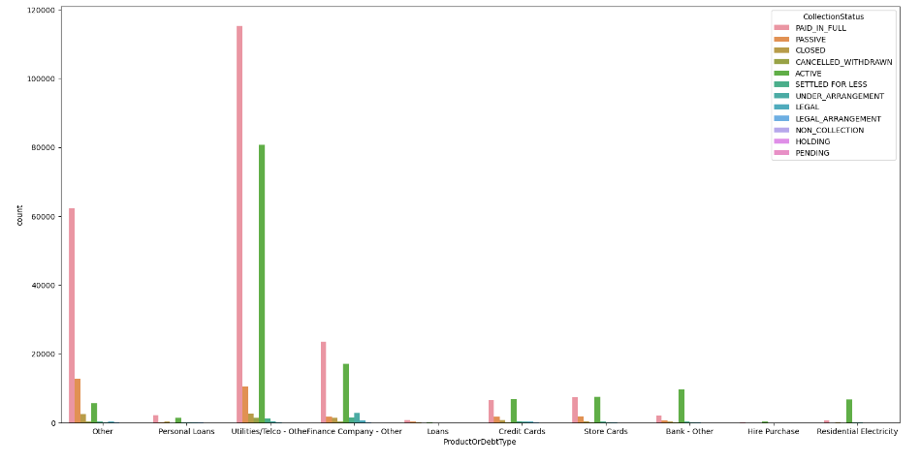
Exploratory Data Analysis
Count of Product or debt type with relation of collection status.
In the above graph I can see that Utilities/telco and finance companies along with other companies gave the most debts, but the active cases can also be seen in a substantial number.
And we know from previous analysis that a large part of active cases are statute barred cases that means the collection of these debt can become a problem in future for these companies, especially in Utilities/telco and Finance companies.

Slide 18
EDA Findings:
After performing the EDA we came to know that:
After providing debts the companies are not taking proper measure so as to collect the debts on time.
Companies should be aware of their debts specially Utilities/telco companies because we saw that there is a large number of active cases and before they turn cold necessary actions can be taken, although most of them have become Statute Barred so they can not be considered enforceable now.
Very few people filed for bankruptcy which generally is the cause of passive accounts, which could again mean that the companies have failed to keep a track on debt collection.
Now let’s look at the prediction model and try to predict the outcome for future references.

Slide 19
Model and Evaluation Metrics:
Models Used:
Metrics Used:
I initially planned to use multiple algorithms but after using two algorithms I got fair result, these two algorithms are:
Logistic Regression
Random Forest Classifier
I have used :
Accuracy Score &
Confusion Matrix along with
Classification report
To get the idea about how the performance of our model is coming out.

Slide 20
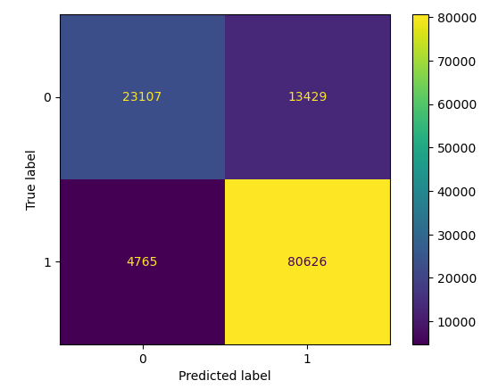
Logistic Regression :
Accuracy Score :
85%
Confusion Matrix:
We can see that true negatives and true positives are in fair amount, but False negative values are also higher which could be corrected.

Slide 21
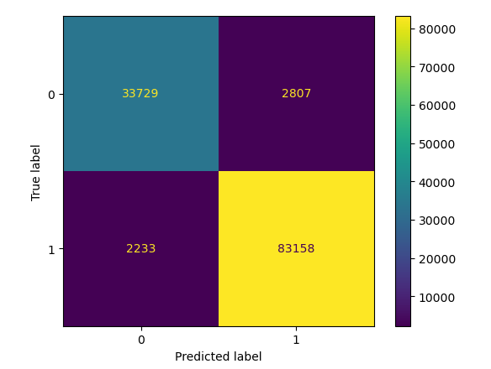
Random Forest:
Accuracy Score :
95.8%
Confusion Matrix:
In the Random Forest model, we achieved great accuracy and we can see that confusion matrix is also supporting the model along with good F1 score.

Slide 22
Final Outcomes and thoughts:
I was able to get a great accuracy from the Random forest model. There are various factors which contribute to the result.
The data itself is curated efficiently
The Model is predicting the outcomes greatly which we always expect from our model.
I think the model can be used for predicting the outcomes of statute barred accounts and the goal that we wanted to achieve while starting the project was met.

Slide 23
Thank you
Aditya Raikwar

