Slide 1

CAR
PRICE
PREDICTOR
Group - 10

Slide 2
TABLE OF CONTENTS
01
02
03
04
Problem Overview
Solution
What are we trying to solve?
Model Comparison,
Key Finding,etc
Conclusion
Contributions
Benifits of our Research.
Resources, members, etc.

Slide 3
01
Problem Overview

Slide 4

Car owner can’t usually determine the correct value of their vehicle and get a low price OR buy at a high value.
“To Figure out the correct value of a used vehicle .”

Slide 5
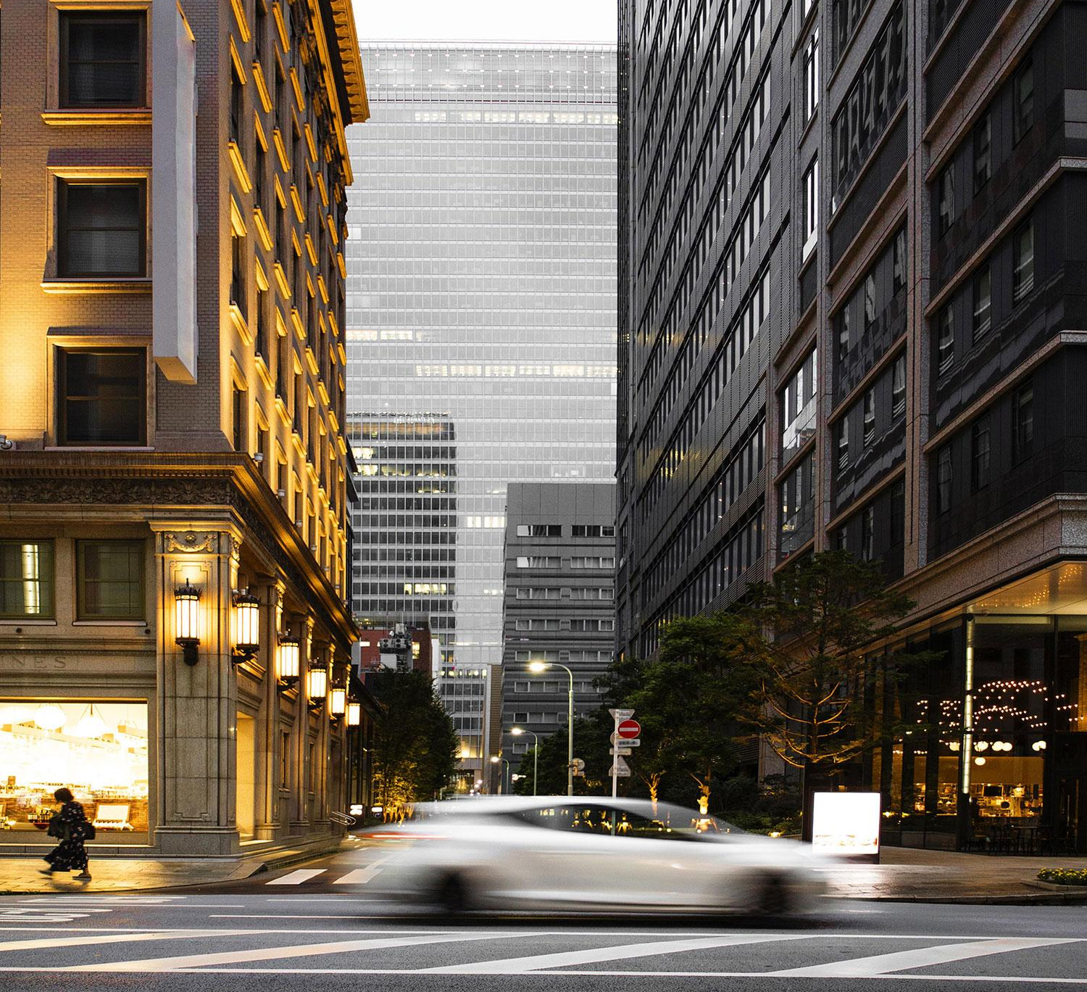
Purpose
The Resale Car market is growing with the startups like CarDekho, True Value, etc and we want to help the Car market grow. We want to build an application using ML to better inform the persons involved in the process if the price reflects the car’s value

Slide 6
OUR SOLUTION
Analize the data
Accuracy
Using ML model Predict the value from the users data
Provide a model with best Accuracy which will satisfy the car’s Value

Slide 7
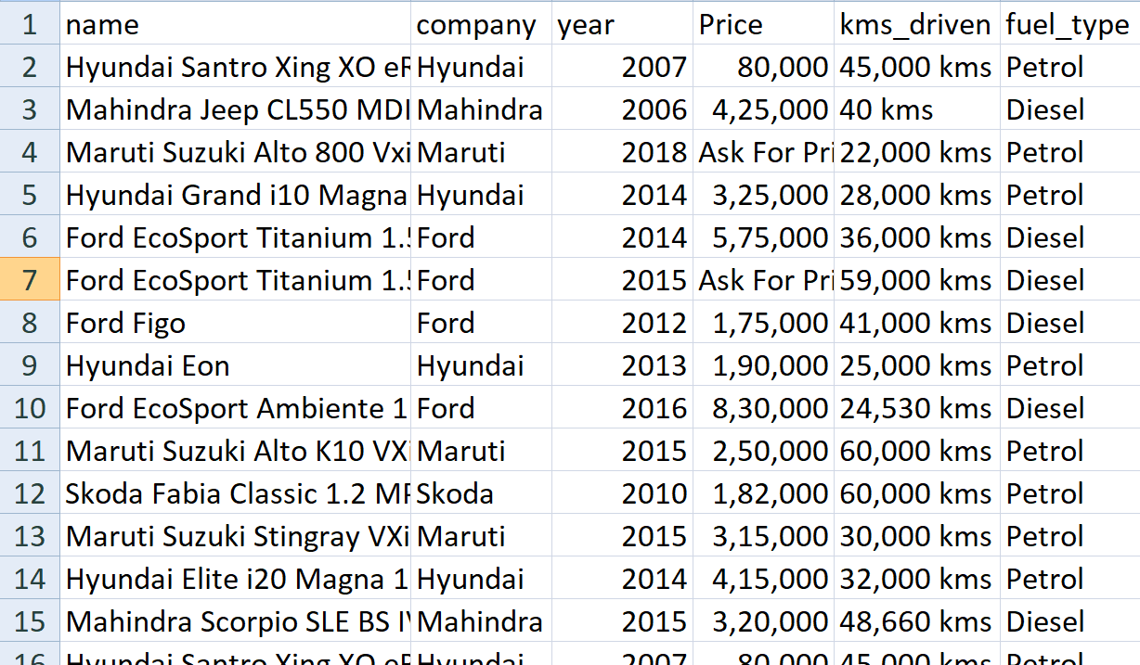
DATASET USED

Slide 8
DATA PROCESSING
Extract the Data- Get the dataset from kaggle( larsgest Collection of Dataset website)
Analyze the Data- Clear the Data for what required and remove all the rest to apply different ML model like: Linear regression, Random forest, etc.
Use feature selection in order to obtain the best predictions.
Test the Model for its Accuracy and find the Best model to work with.

Slide 9
BEST MODEL ACCURACY
LINEAR
REGRESSION
89%

Slide 10
KEY FINDINGS
LINEAR REGRESSION
PRICE vs YEAR
This model works best on the Dataset with an Accuracy of 89%
Resale price is greatly affected by which year the car was bought
PRICE vs KM
DIESEL vs PETROL
Resale price is greatly affected by how many Km the Car is driven
Diesel Cars are more preferred while buying a car.

Slide 11
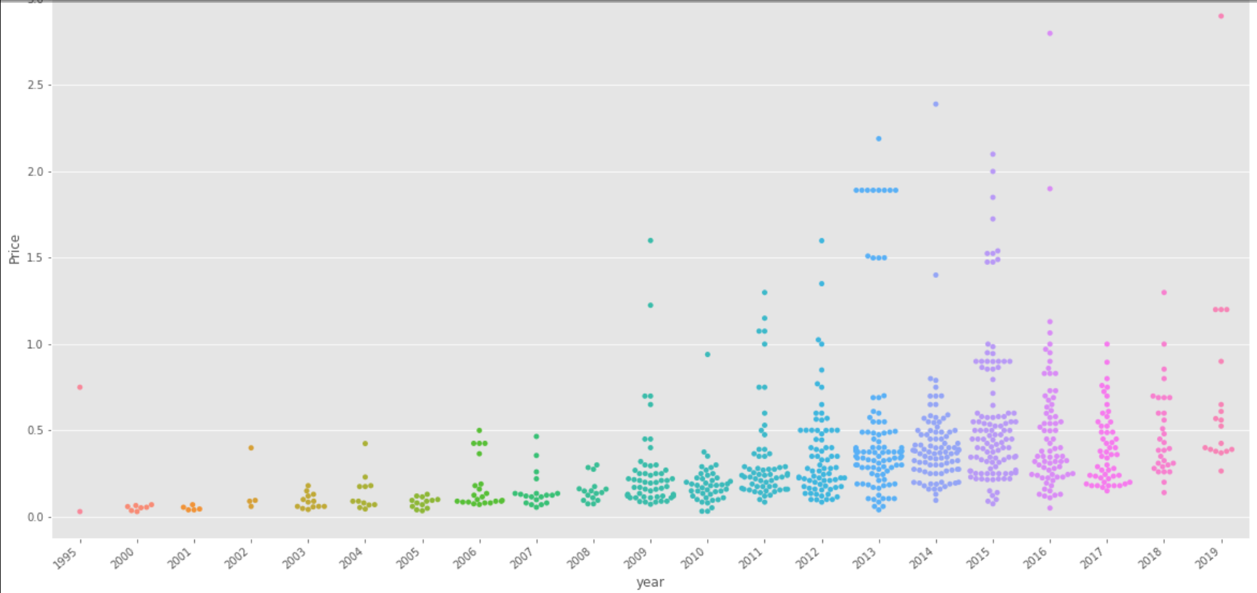
PRICE vs YEAR

Slide 12
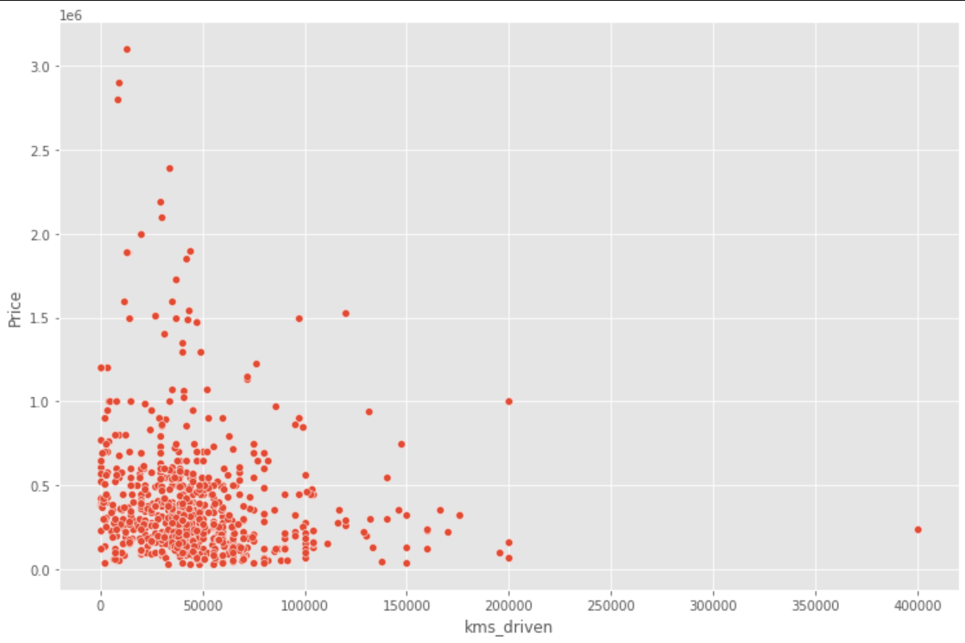
PRICE vs KM

Slide 13
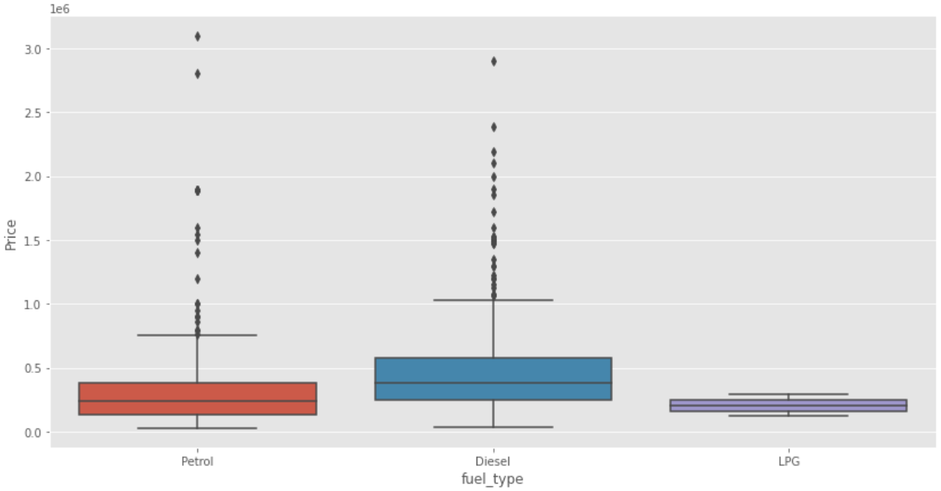
DIESEL vs PETROL

Slide 14
BENIFITS
MAXIMIZE SALES
ATTRACT CUSTOMERS
RELIABLE PRICE

Slide 15

RECOMMENDATION
User must check the Car Price using CarPricePredictor before buying a Car to Check what its worth using its features.

Slide 16
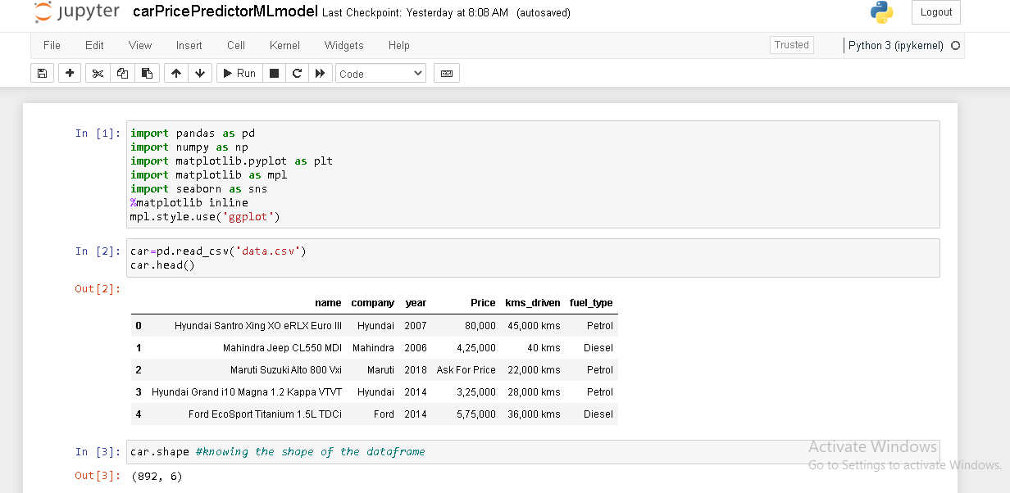
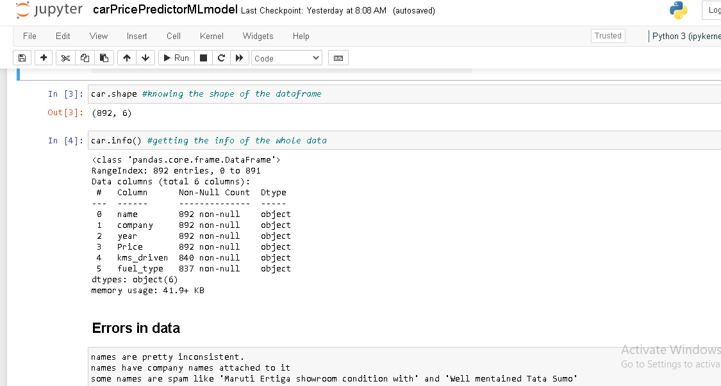
CODE

Slide 17
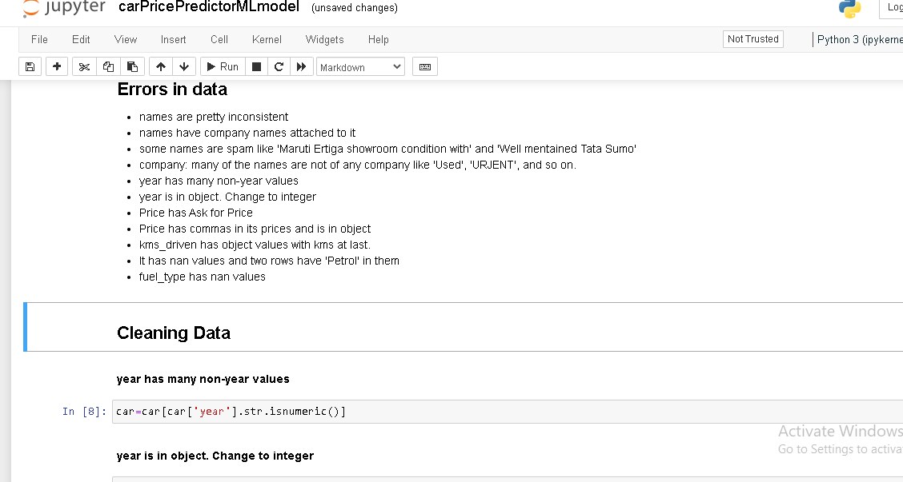
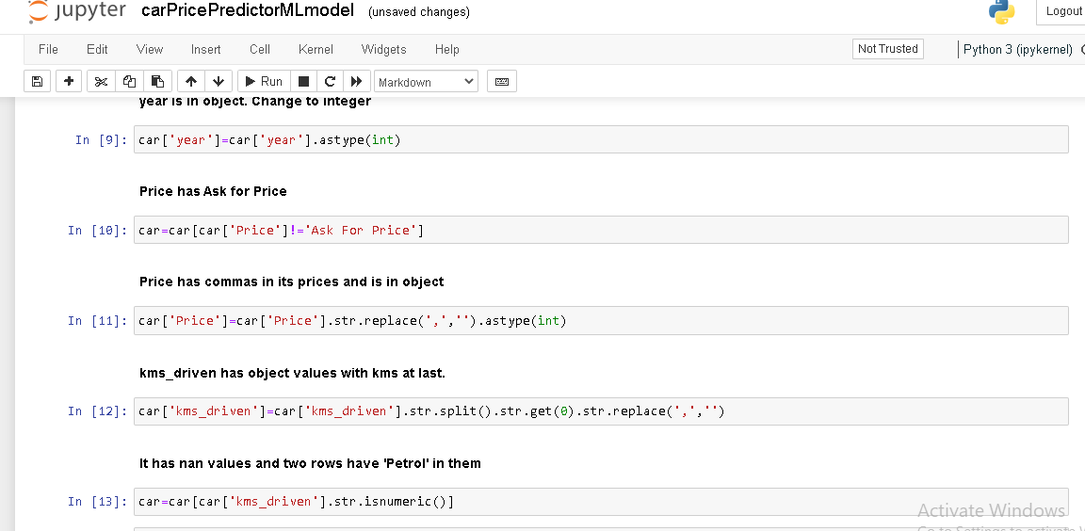
CODE

Slide 18
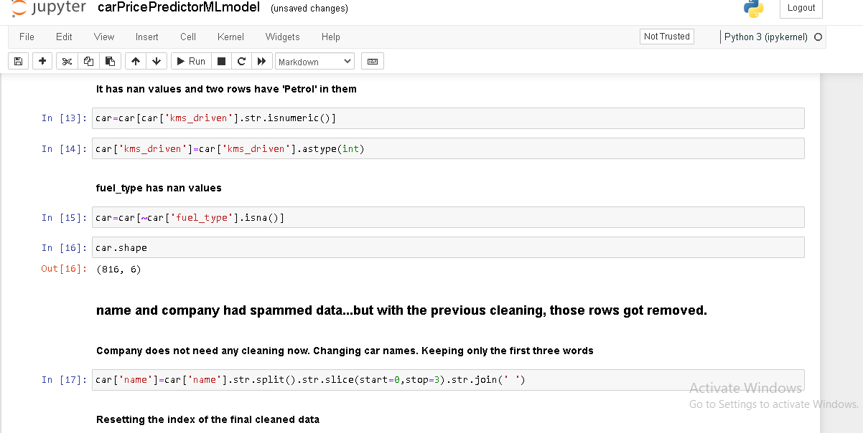
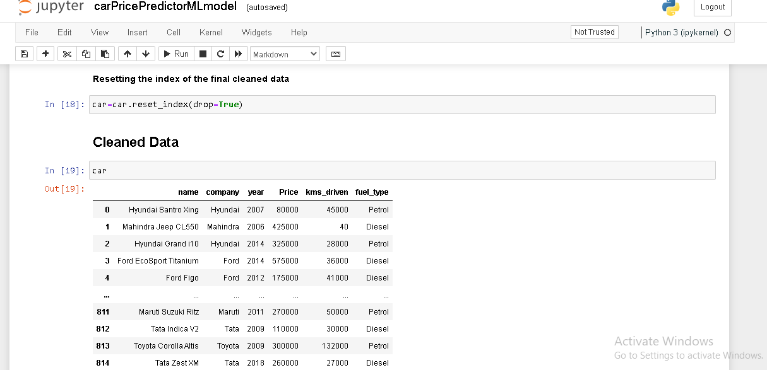
CODE

Slide 19
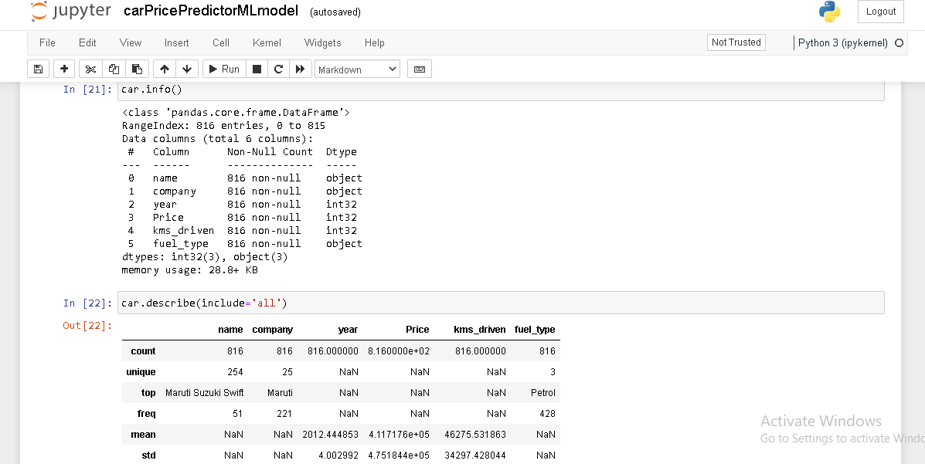
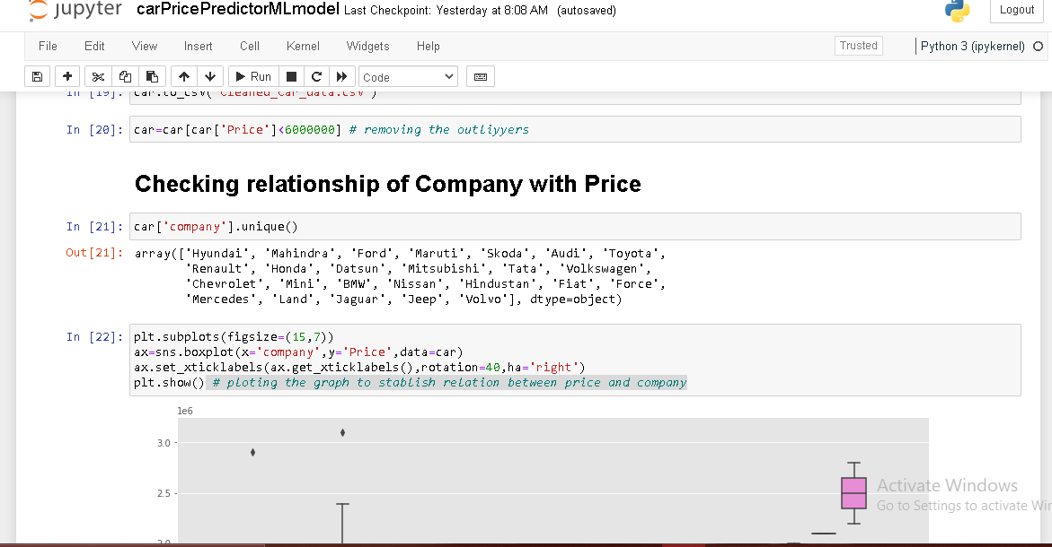
CODE

Slide 20
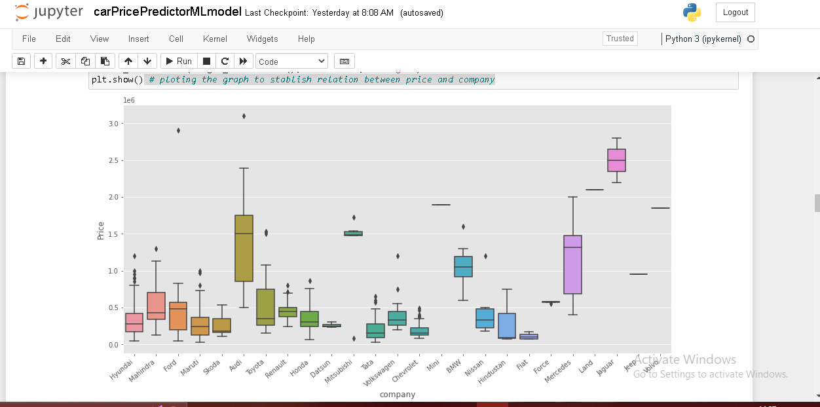
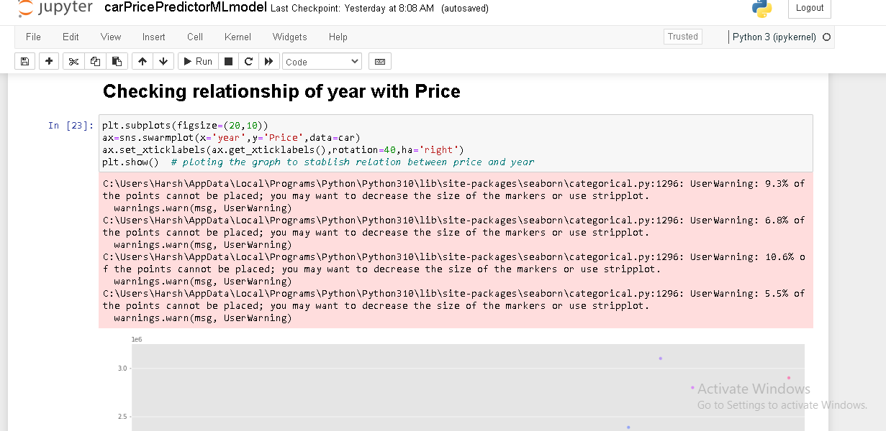
CODE

Slide 21
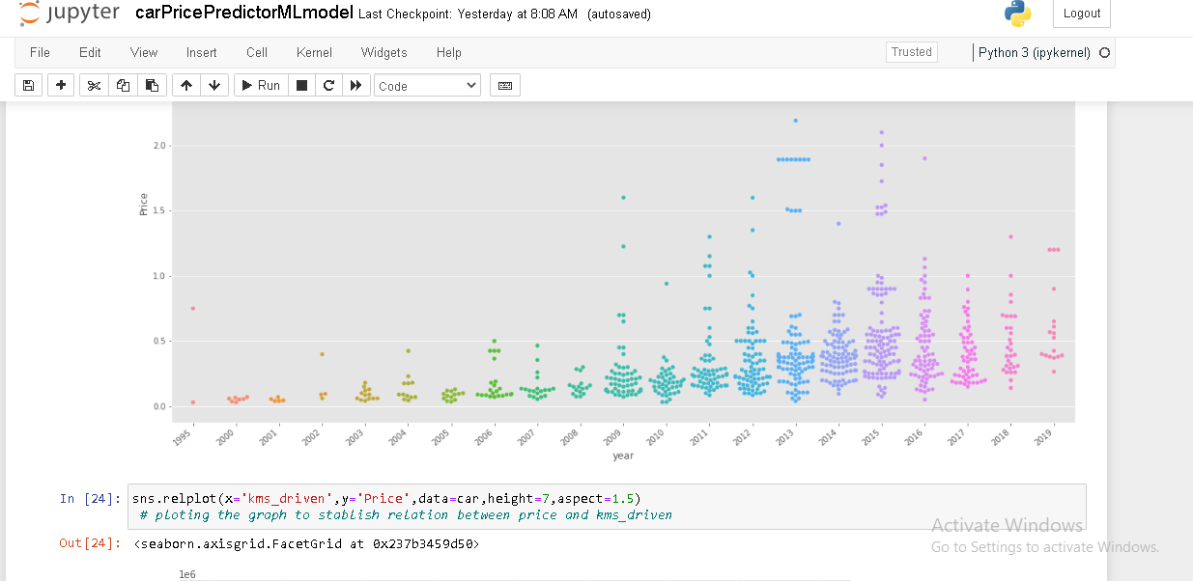
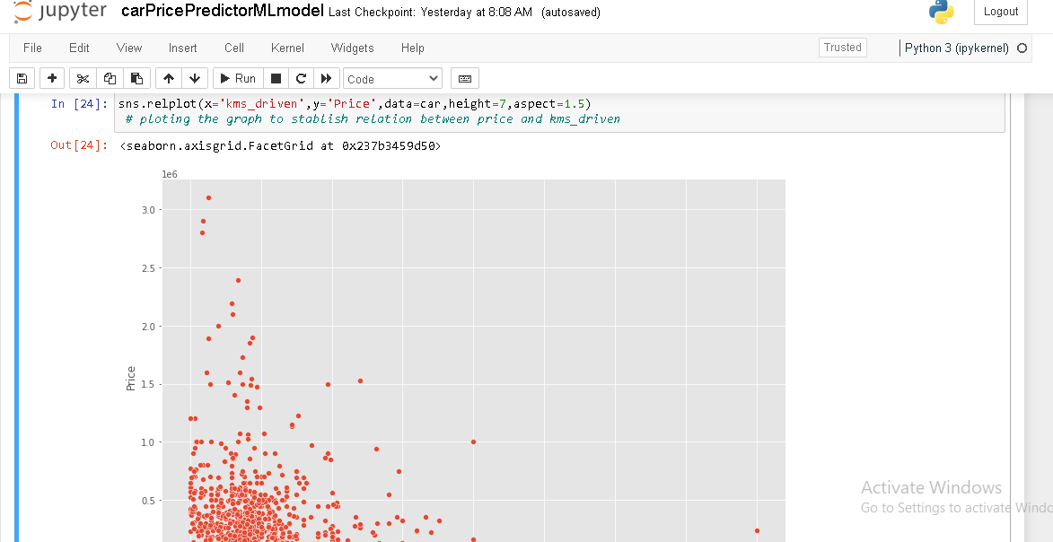
CODE

Slide 22
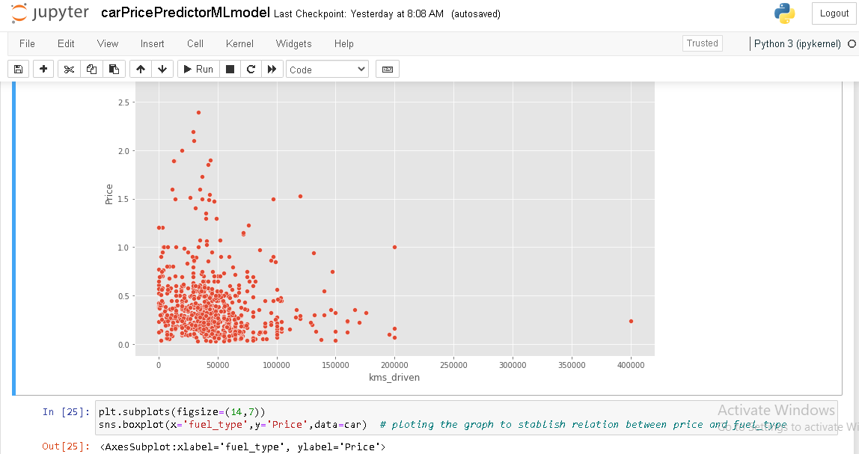
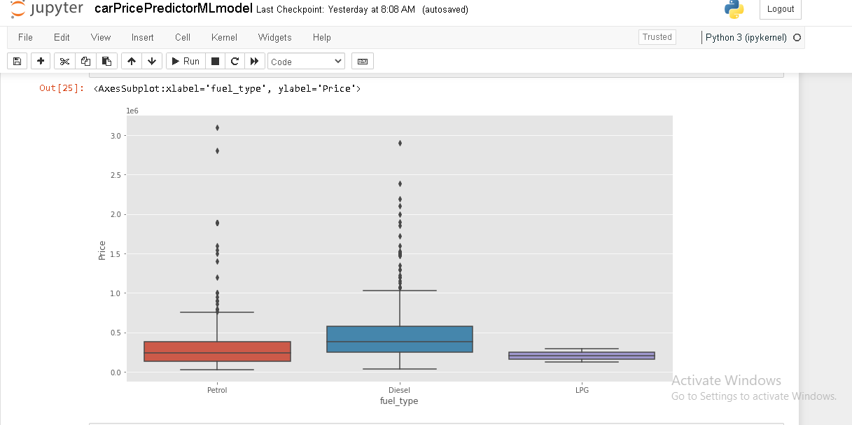
CODE

Slide 23
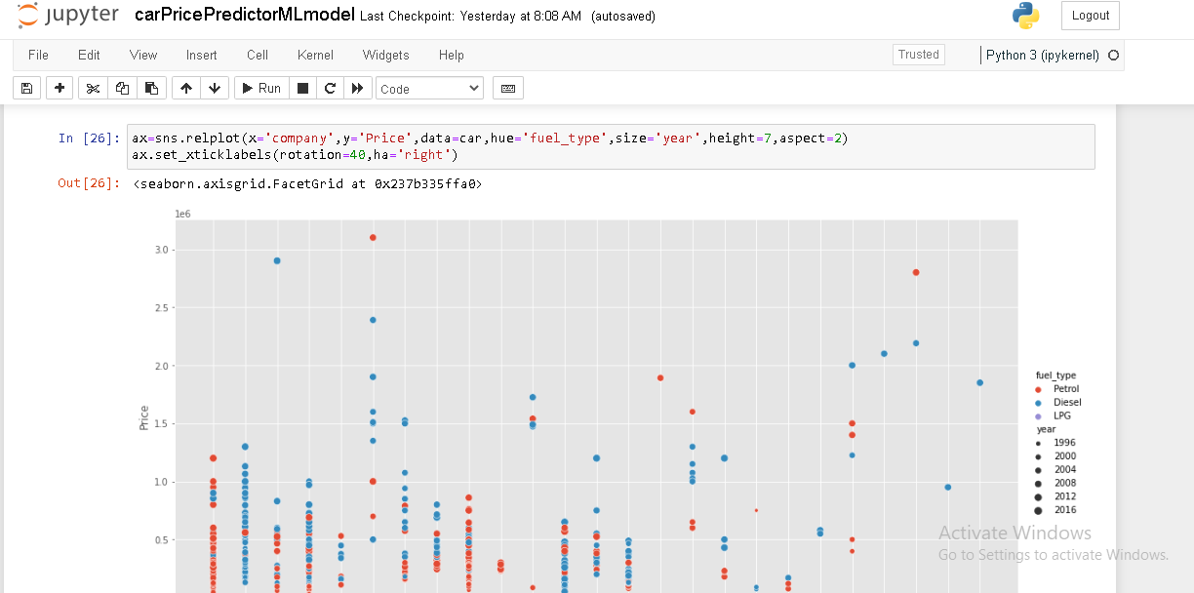
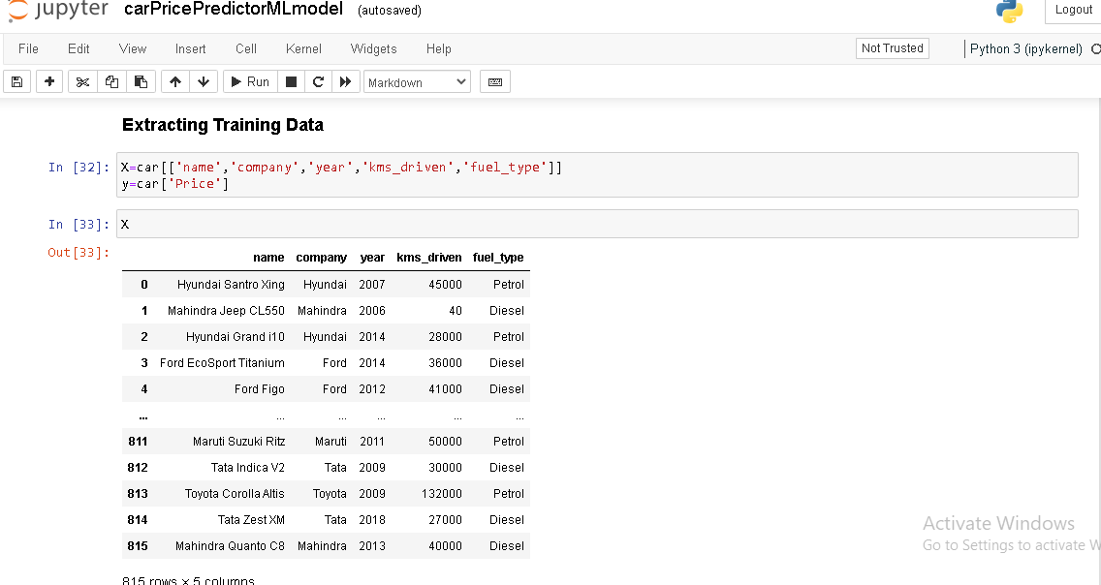
CODE

Slide 24
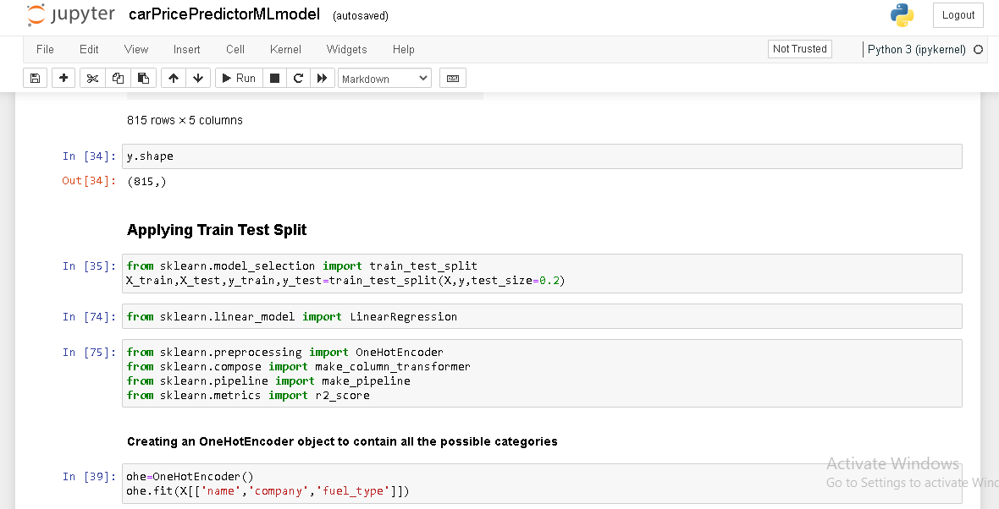
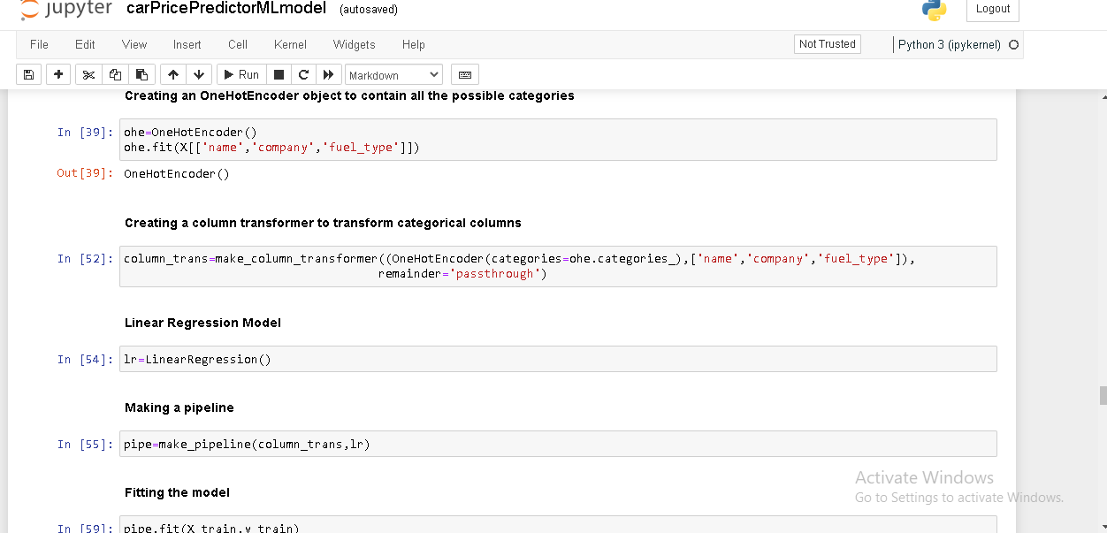
CODE

Slide 25
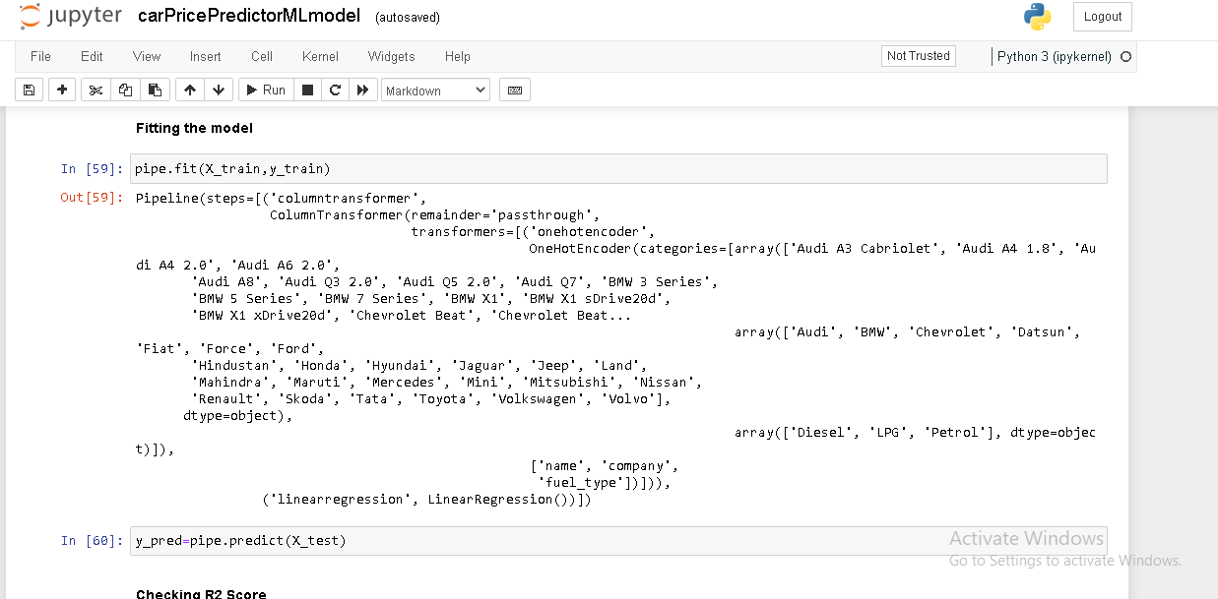
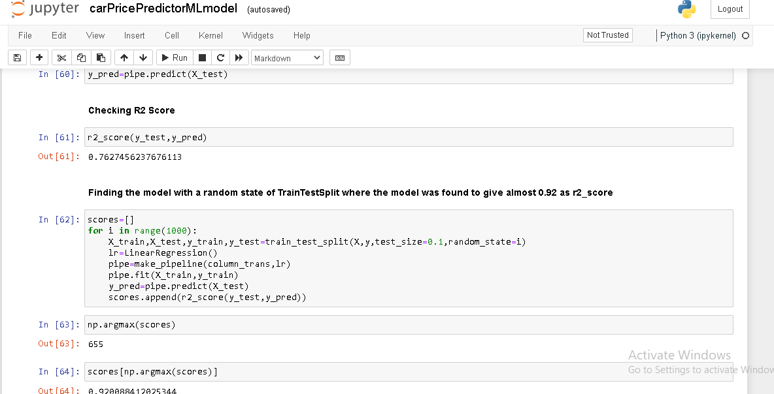
CODE

Slide 26
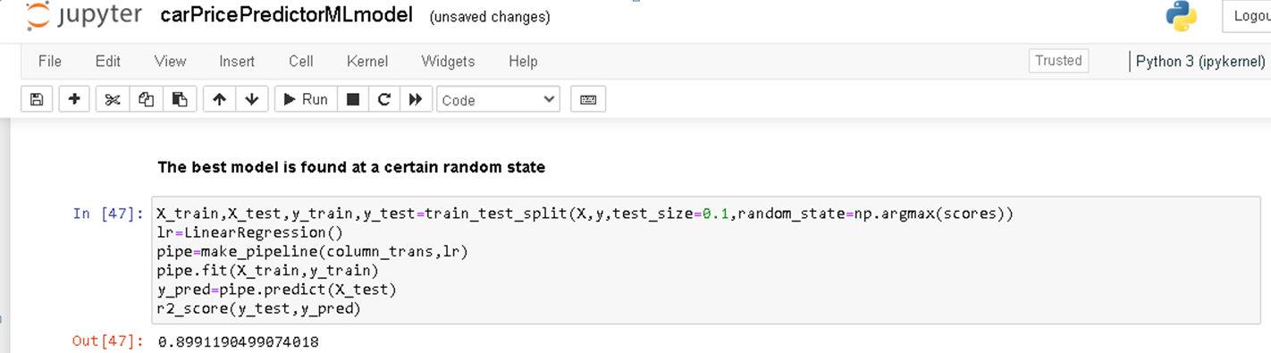
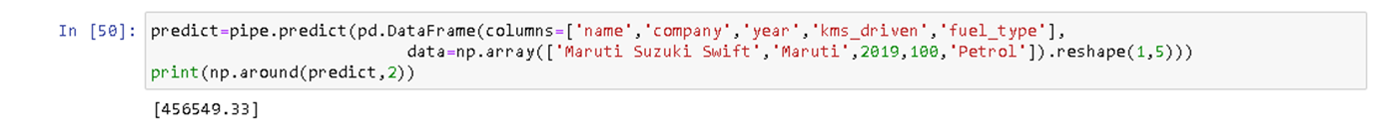
PREDICTED RESULT

Slide 27
CONTRIBUTORS
Harsh Mehrotra (201500270)
Ishan Joshi (201500305)
Aditya Prakash (201500036)
Aditya Agrawal (201500033)
Ankit Dubey (201500099)
Aryan Saxena (201500157)
Prakhar Jaiswal (201500537)
Pushpendra (201500537)
Shashank Gupta (201500644)

Slide 28
THANKS!
Do you have any questions?

