Slide 1
BOT-BRAIN: AN INTELLIGENT STUDENT CAMPUS NAVIGATOR

Slide 2
System Overview
Developed using Python (backend) and Leaflet/JavaScript (frontend)
Interactive map-based user interface with chatbot
Integrated search algorithms: BFS, DFS, UCS, A*
Provides building information services Displays distance, ETA, and nodes expanded
Comparison of algorithms across queries

Slide 3
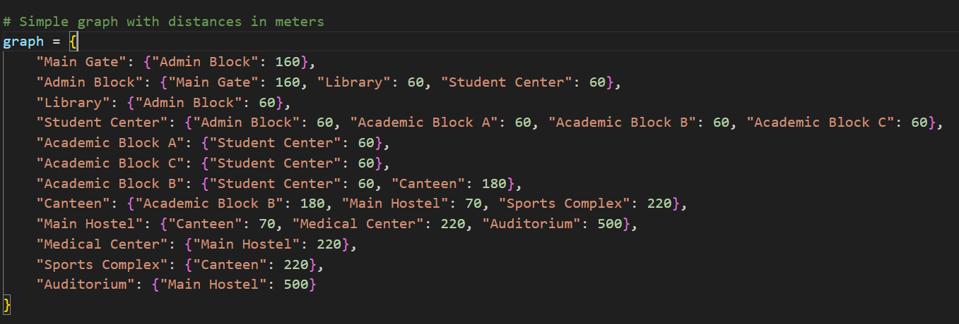
Week 1 – Campus Model
Designed campus graph with 12 nodes
Buildings: Main Gate, Admin Block, Library, Student Center, Academic Blocks A-C, Canteen, Main Hostel, Medical Center, Sports Complex, Auditorium
Weighted edges representing walking distances
Graph representation used for all algorithms

Slide 4
Week 2 – Search Algorithms
Implemented four algorithms:
Breadth-First Search (BFS)
Depth-First Search (DFS)
Uniform Cost Search (UCS)
A* (with Euclidean heuristic)
Data structures: queue, stack, priority queue
Algorithms tested on multiple queries

Slide 5
Week 3 – User Interface
Interactive UI built with Leaflet + Python backend
Dropdowns for source, destination, and algorithm Visual path highlighting (yellow polyline)
Building information services integrated
Step-by-step expansion trace display
Algorithm comparison table User-friendly chatbot for natural language queries

Slide 7
Results & Algorithm Comparison
BFS: Valid but not shortest; explores many nodes
DFS: Non-optimal; often very long paths
UCS: Finds optimal shortest path
A*: Optimal and most efficient (fewest nodes expanded)

Slide 8
Key Learnings & Insights
Trade-offs between algorithms:
BFS: Complete but inefficient in weighted graphs
DFS: Simple but non-optimal
UCS: Always optimal but expands more nodes
A*: Combines optimality with efficiency
Importance of heuristic in guiding search
Interactive UI and chatbot enhance usability
Integration of building info makes system practical

