Slide 1
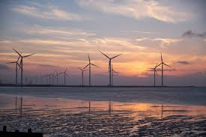
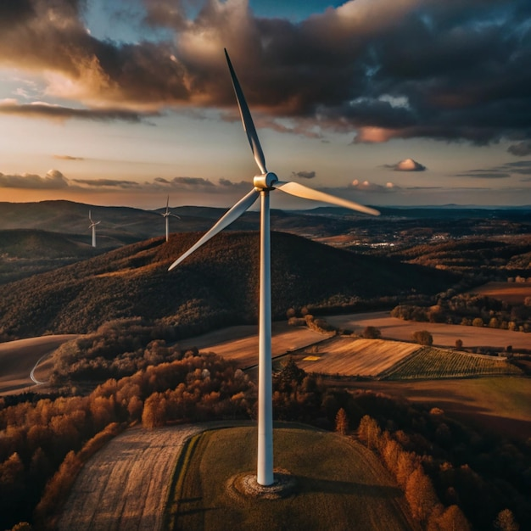
Integrating Wind Turbine with the grid

Slide 2
INTRODUCTION
Growing global demand for renewable energy due to environmental concerns and depletion of fossil fuels.
Wind energy has become a crucial contributor, currently fulfilling ~7% of global electricity demands.
This project aims to ensure seamless integration of wind turbines with existing power grids while addressing operational challenges.

Slide 3
OBJECTIVES
To design a wind turbine system for seamless grid integration.
To address critical challenges such as synchronization, power quality, and grid stability.
To validate the performance and reliability of the system under varying wind conditions using simulation models.

Slide 4
SYSTEM COMPONENTS
Wind Turbine Induction Generator:
Converts mechanical energy from wind into electrical energy.
1 MVA capacity, operating at 400V and 50Hz.
Step-Up Transformer:
Steps up voltage from the turbine to match grid requirements (25kV/400V).
Rated at 4 MVA.
Capacitor Bank:
Provides 400 kVAR reactive power compensation to ensure voltage stability.
Synchronization Mechanism:
Aligns turbine output with grid voltage, frequency, and phase to prevent disruptions.

Slide 5
WHY INDUCTION GENERATOR ?
Compared to Synchronous Generators:
No need for a DC excitation system, reducing complexity.
Compared to Permanent Magnet Synchronous Generators (PMSG):
PMSG requires high-cost rare-earth materials, making induction generators more economical for large-scale installations.
Compared to Doubly Fed Induction Generators (DFIG):
While DFIG is more efficient at variable speeds, it is more complex and expensive due to reliance on power converters. Induction generators are simpler and more reliable for moderate wind speed variations.

Slide 6
METHODOLOGY OVERVIEW
System Design:
Comprehensive modeling of key components such as turbine, transformer, and compensation systems.
Simulation Framework:
Leveraging MATLAB /Simulink to create a dynamic and realistic simulation environment.
Performance Evaluation:
Testing for synchronization accuracy, power quality, and system response to faults and disturbances.

Slide 7
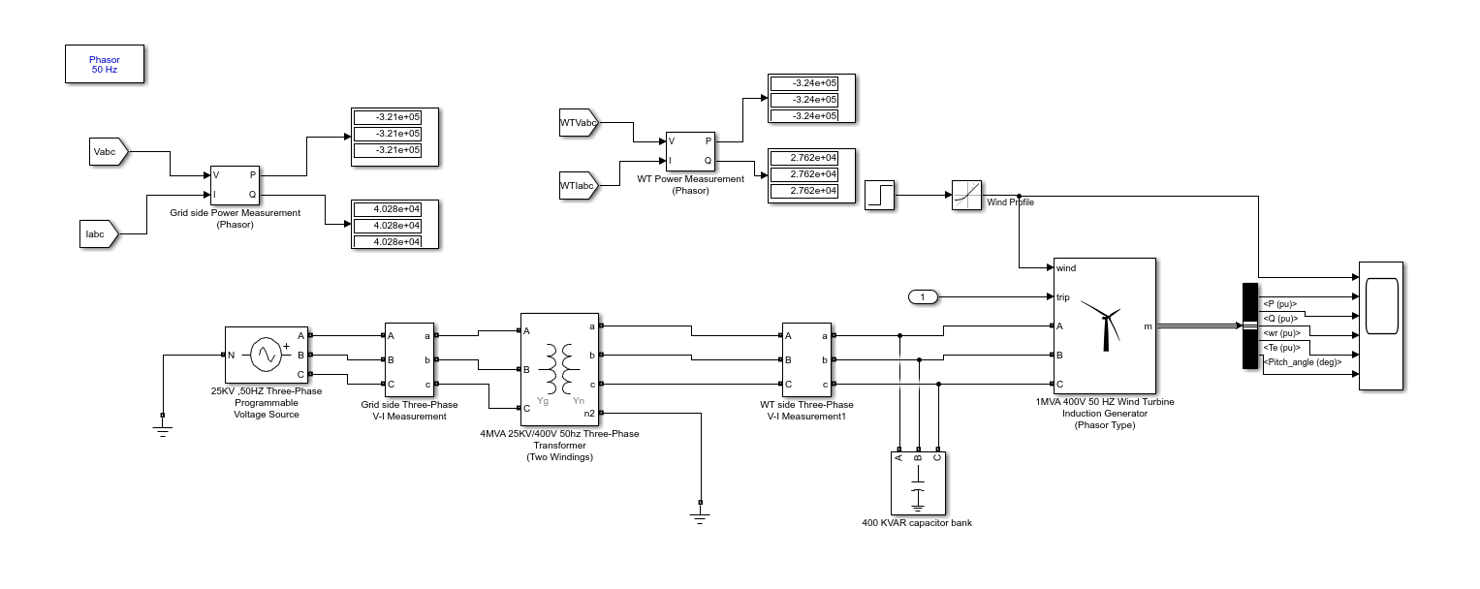
MATLAB SIMULATION MODEL

Slide 8
SIMULATION MODEL
Key Components:
Programmable voltage source to represent the grid.
Measurement blocks to monitor and analyze power flow.
Step block to simulate changes in wind speed and grid conditions.
Roles:
Recreating real-world scenarios to test turbine and grid interactions.
Assessing transient and steady-state behaviors.

Slide 9
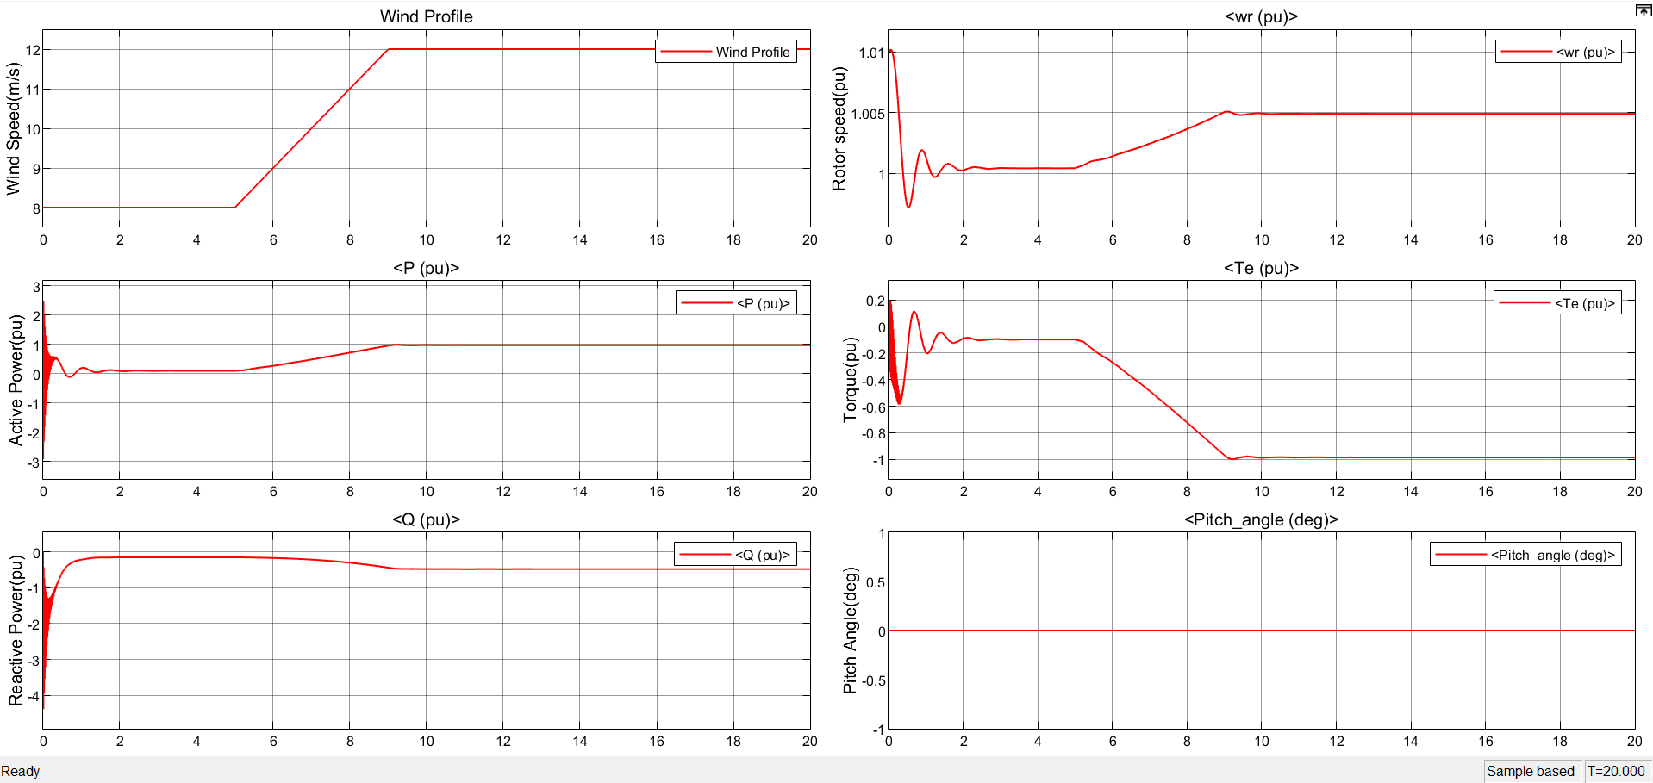
RESULTS (12 m/s wind speed)

Slide 10
RESULTS (12 m/s wind speed)
Active Power: Initial transient phase followed by stabilization at a steady output.
Reactive Power: Oscillates during the transient phase before stabilizing to support grid requirements.
Rotor Speed: Slight increase during adaptation, stabilizes near nominal values.
Torque: Negative steady-state value indicating effective energy conversion.
Pitch Angle: No adjustments required under stable wind conditions.

Slide 11
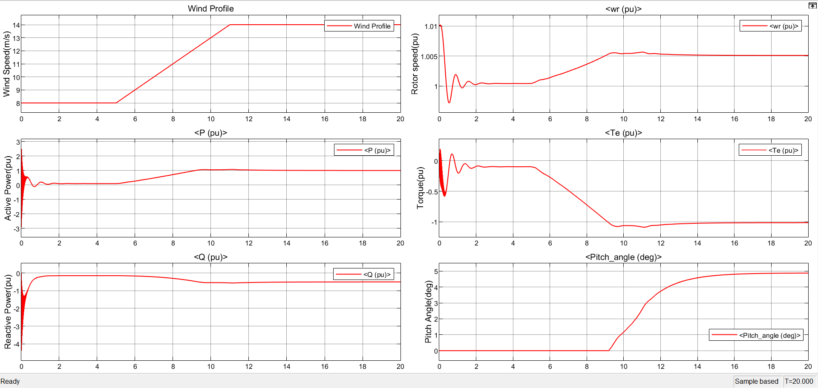
RESULTS (14 m/s wind speed)

Slide 12
RESULTS (14 m/s wind speed)
Active Power: Output increases due to higher wind energy input, stabilizing after a brief transient phase.
Reactive Power: Oscillations during the transient phase followed by stabilization, ensuring grid support.
Rotor Speed: Adjusts initially to higher wind speeds before stabilizing at a slightly elevated value.
Torque: Shows an initial transient dip and then stabilizes at a negative value, reflecting efficient energy conversion.
Pitch Angle: Adjustments are minimal, indicating system robustness under dynamic conditions.

Slide 13
KEY CHALLENGES ADDRESSED
Power Quality:
Maintaining consistent voltage and frequency to meet grid standards.
Reactive Power:
Compensation mechanisms ensure minimal disruptions and stability.
Synchronization:
Smooth integration avoids surges and supports grid reliability.

Slide 14
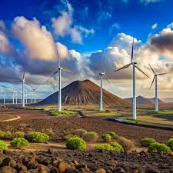
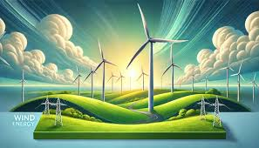
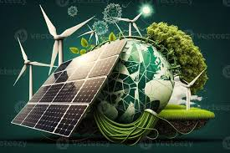
ENVIRONMENTAL IMPACTS
Reduced reliance on fossil fuels, contributing to cleaner energy production.
Significant decrease in greenhouse gas emissions.
Aligns with global decarbonization targets like the Paris Agreement goals.

Slide 15
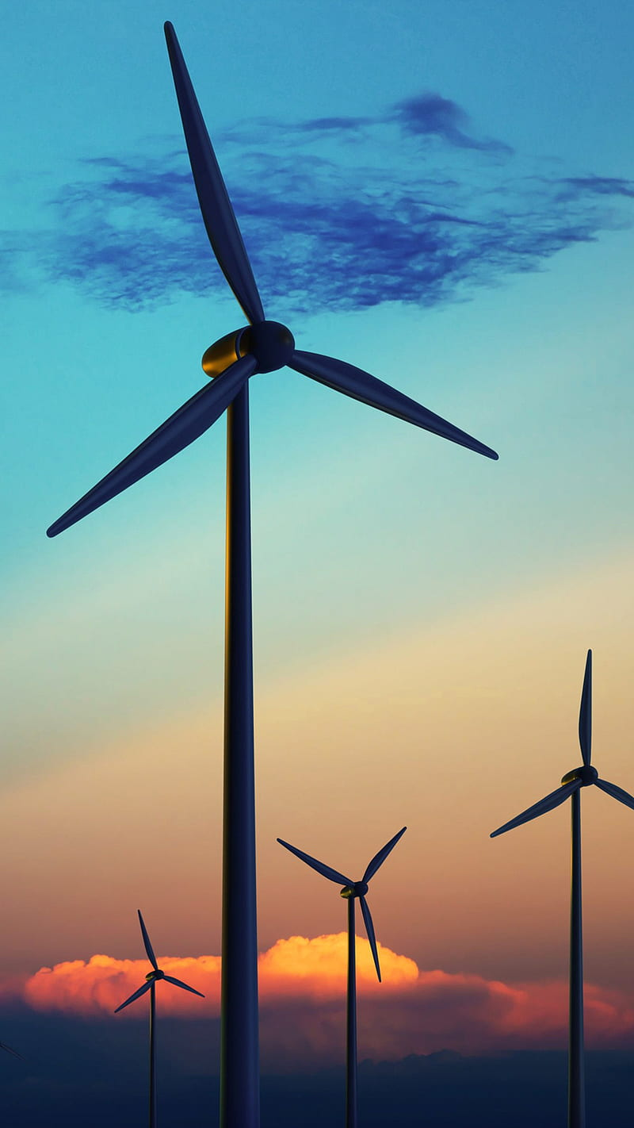
CONCLUSION
Demonstrates successful simulation and feasibility of grid-integrated wind systems.
Highlights wind energy’s potential as a cornerstone of sustainable energy solutions.
Validates the technical and operational feasibility of renewable energy integration.

Slide 16
THANK YOU

