Slide 1
LegalDoc AI: Offline Legal Assistant Course: Artificial Intelligence and Machine Learning Course code: AI244AI
Presented by
Students Names
And USN

Slide 2
Introduction
Project: LegalDoc AI – an app that reads legal documents and answers questions about them, running fully on your own computer.
Legal documents (contracts, NDAs, court judgments) are long and hard to read.
Existing AI tools are cloud-based, costly, and send private documents to outside servers.
Our tool is free, private, and works offline – useful to students, small businesses, and individuals.
Supports SDG 16 (access to justice) by making legal documents easy to understand.

Slide 3
Application Domain
Domain: Legal Technology (LegalTech) and Natural Language Processing.
Target users:
Law students studying real cases
Solo lawyers and small businesses
Anyone signing a contract, NDA, or lease
Practical use: read, question, summarize, and audit any legal document privately.

Slide 4
Literature Review / Related Work
Lewis et al. (2020) – Retrieval-Augmented Generation (RAG): grounds AI answers in retrieved text to reduce made-up answers.
Robertson & Zaragoza (2009) – BM25: a keyword search method, strong for exact terms.
Wang et al. (2020) – MiniLM: a small, fast model to turn text into searchable vectors.
Johnson et al. (2021) – FAISS: a fast library for searching by meaning.
Hendrycks et al. (2021) – CUAD: 510 real contracts labelled by legal experts; used as our benchmark.
Gap: most tools use only one search method and run on the cloud. We combine two search methods and run offline.

Slide 5
Problem Statement
How can a person quickly and privately understand a long legal document without a lawyer?
Manual reading is slow and easy to get wrong.
Cloud AI tools risk privacy, cost money, and hide how they find answers.
Simple keyword search misses meaning; pure meaning search misses exact legal terms.
Goal: a private, offline, low-cost tool that answers questions with evidence you can check.

Slide 6
Methodology / Proposed System
Approach: Hybrid Retrieval-Augmented Generation (RAG) running fully offline.
Data: user's PDF/DOCX/TXT documents; benchmark uses the CUAD contract dataset.
Preprocessing: text is extracted and split into 512-word overlapping chunks.
Search: FAISS (by meaning) + BM25 (by exact words), blended by a tunable weight.
Model: Llama 3.2 (local, free) or GPT-4o-mini (optional cloud).
Evaluation: indexing time, search speed, and answer correctness (see next slides).

Slide 7
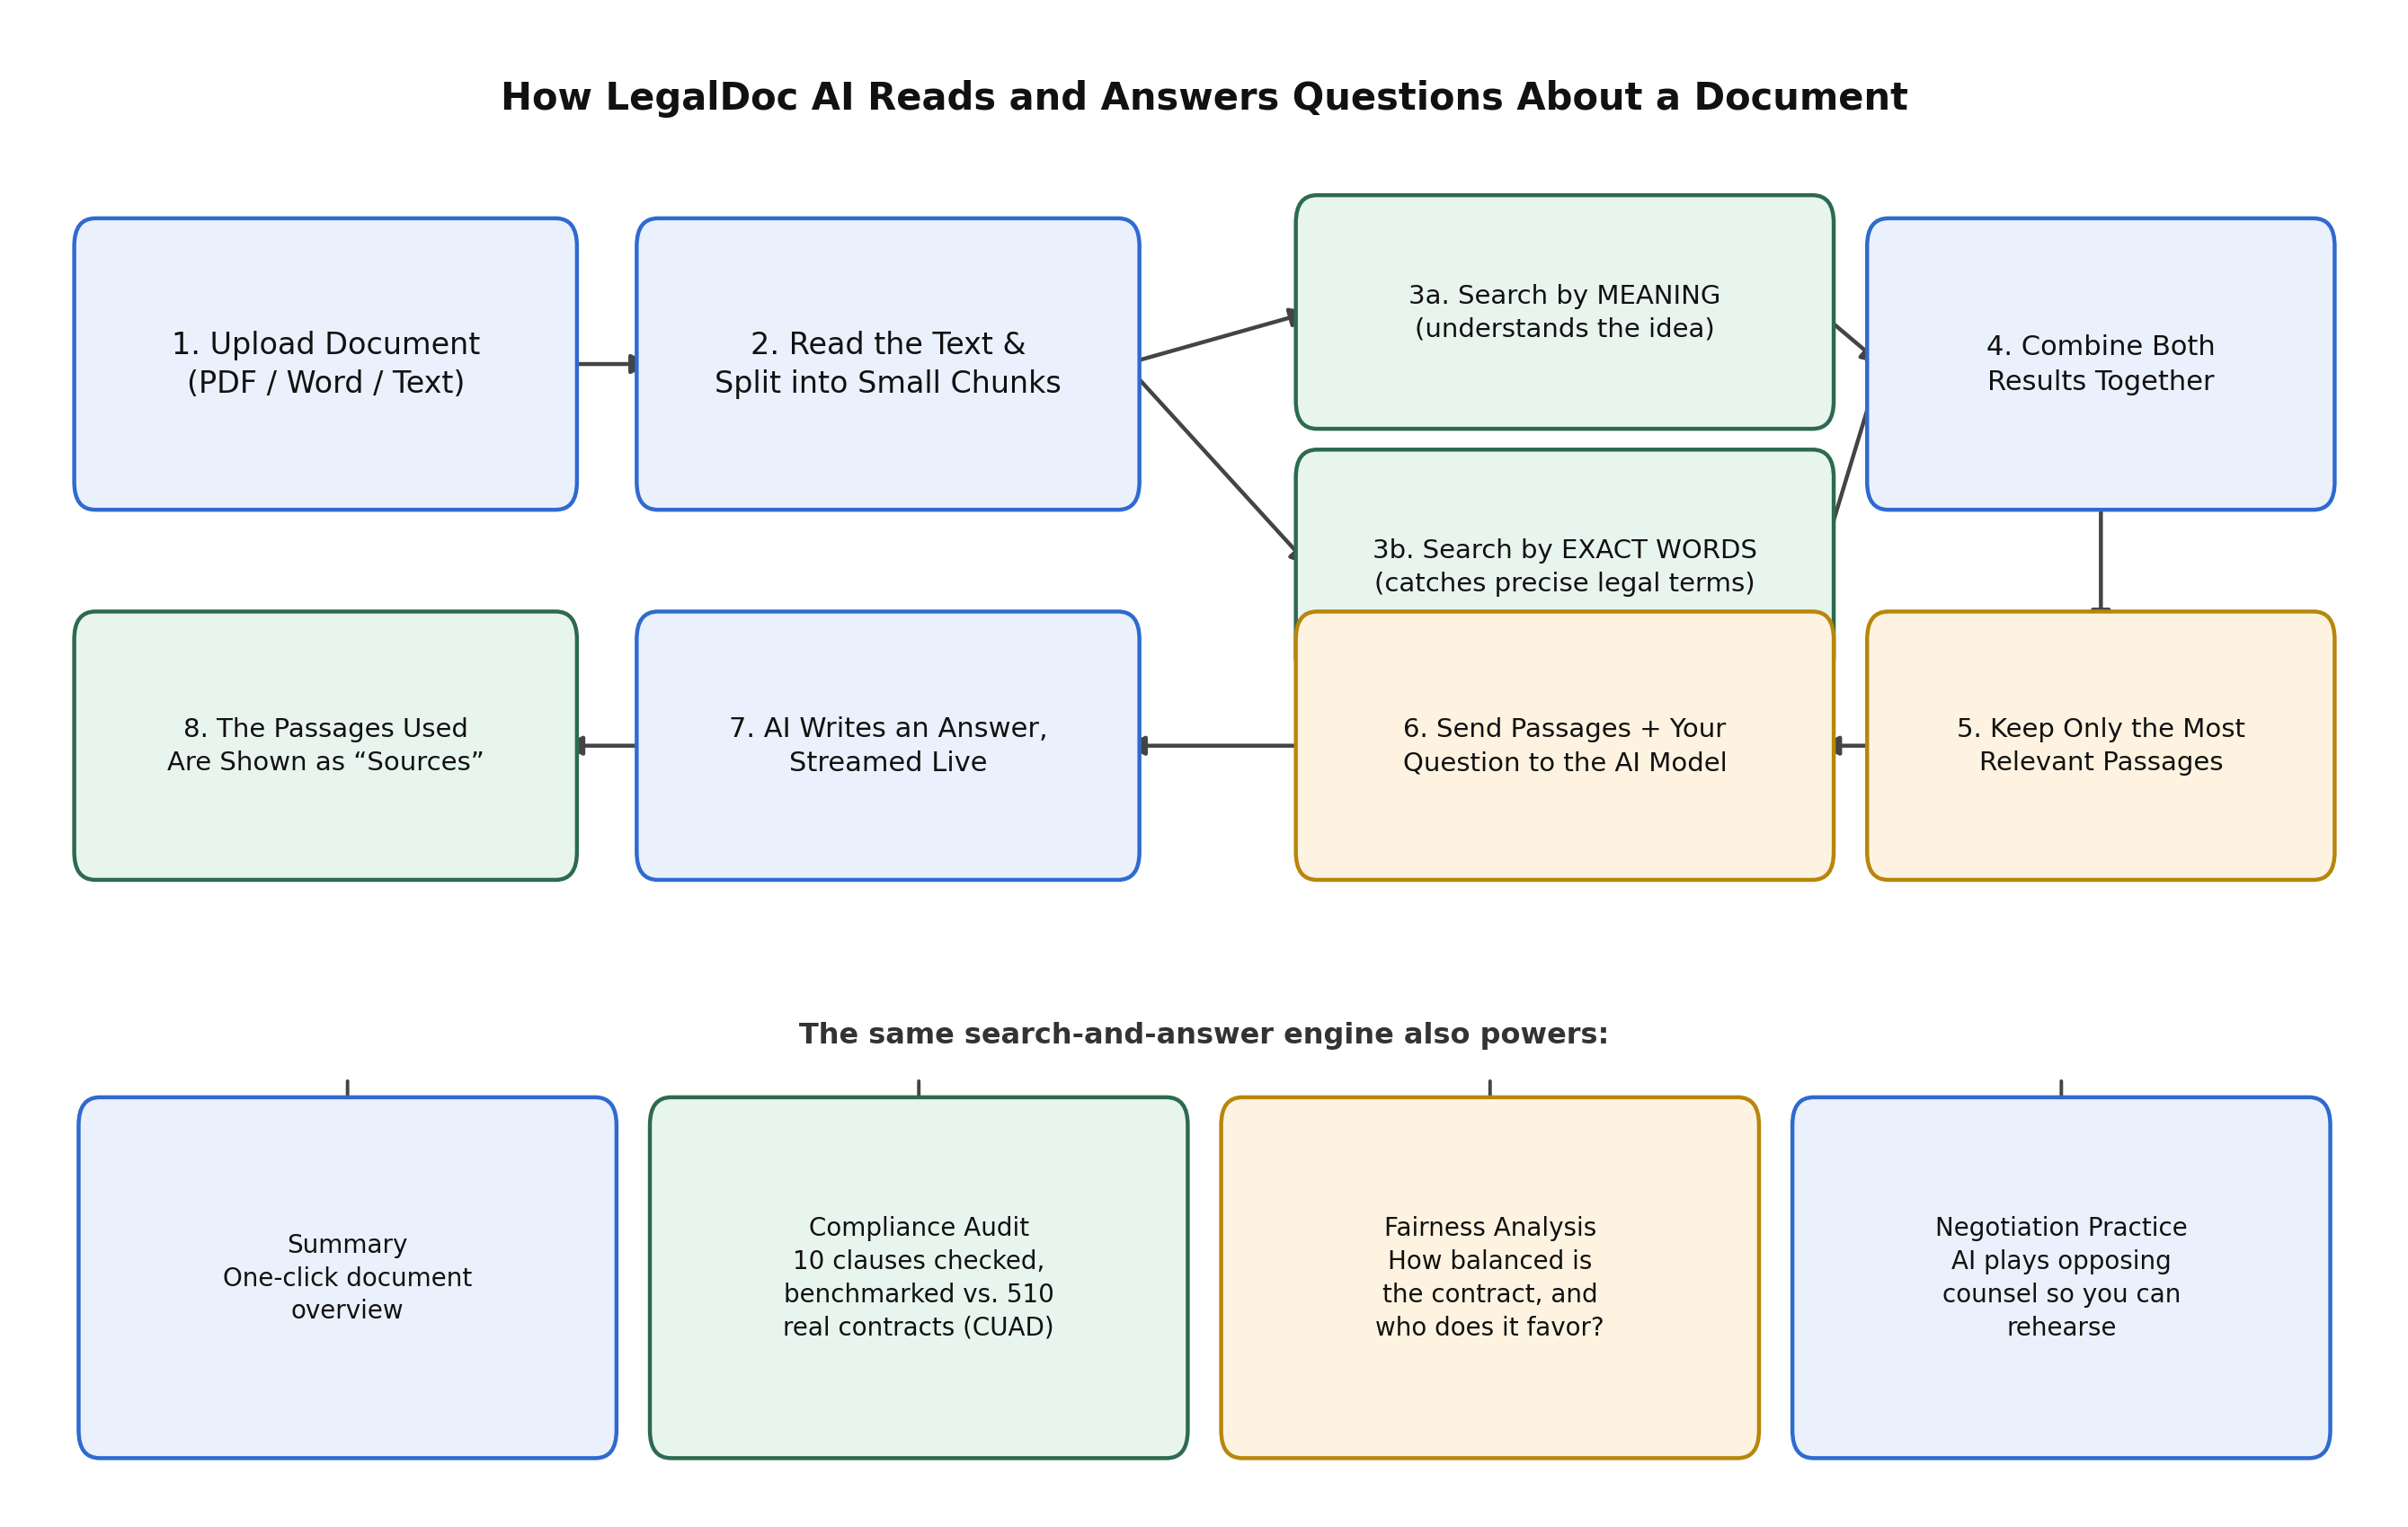
System Architecture

Slide 8
Hardware & Software
Hardware:
Standard laptop/desktop CPU (no GPU needed)
8 GB RAM, a few GB storage for models
Software:
Windows / Python 3.13
Libraries: fastembed, FAISS, rank-bm25, PyMuPDF, CustomTkinter
Ollama with Llama 3.2 (local, free) or OpenAI GPT-4o-mini (optional)

Slide 9
Implementation Overview
A standalone desktop app – no browser, no internet needed.
Five features in one window:
Preview – view the real document pages and key facts
Ask – chat with the document; answers show sources
Summary – one-click overview
Audit – 10 clauses checked, scored 0–100
Negotiate – practise against an AI opposing lawyer

Slide 10
System Implementation
Read & split: the document text is broken into small overlapping pieces.
Two searches: one by meaning (FAISS) and one by exact words (BM25), run together.
Combine: both results are blended into one ranked list of the best passages.
Answer: the best passages plus your question go to the AI, which writes a cited answer live.
Cache: once read, a document re-opens in under a second.

Slide 11
Performance Analysis
Tested on three full Supreme Court cases (62 to 237 pages).
First-time indexing: 6.6 s (62 pages) to 26.6 s (237 pages) on a normal CPU.
Re-opening a saved document: about 0.1 second (from cache).
Search speed: 25 to 36 milliseconds per question.
All test questions answered correctly, with sources cited.
Faster model choice (MiniLM) cut indexing time by about 3 times.

Slide 12
Demo & Sample Questions
Three real Supreme Court cases were used to test the app. Below is a short summary of each and the exact question typed into the Ask tab.
1. Google v. Oracle (62 pages) – a case about copying computer code.
Ask: “Was Google's copying of the Java API fair use?”
2. Dobbs v. Jackson (213 pages) – a case about abortion rights.
Ask: “What did the Court hold about Roe v. Wade?”
3. SFFA v. Harvard (237 pages) – a case about race in college admissions.
Ask: “What did the Court decide about race-based admissions?”
In every case the app gave the correct answer and showed the passages it used as Sources.

Slide 13
Applications & Future Work
Applications:
Law firms, small businesses, students, compliance teams
Reviewing contracts, NDAs, policies, and judgments privately
Future work:
Support for Indian legal documents and languages (Hindi, Kannada)
Compare multiple contracts at once
Browser extension for in-page review

Slide 14
Conclusion
Built a working, private, offline tool that reads and answers questions about legal documents.
Hybrid search (meaning + exact words) gives accurate, checkable answers with sources.
Tested on three real Supreme Court cases (62–237 pages) with correct answers.
Audit is benchmarked against 510 real contracts (CUAD), not just AI opinion.
Supports SDG 16 by making legal understanding accessible to everyone.

Slide 15
References
D. Hendrycks et al., “CUAD: An Expert-Annotated NLP Dataset for Legal Contract Review,” NeurIPS, 2021.
P. Lewis et al., “Retrieval-Augmented Generation for Knowledge-Intensive NLP Tasks,” NeurIPS, 2020.
S. Robertson and H. Zaragoza, “The Probabilistic Relevance Framework: BM25 and Beyond,” FnTIR, 2009.
J. Johnson, M. Douze, H. Jégou, “Billion-Scale Similarity Search with GPUs,” IEEE Trans. Big Data, 2021.
W. Wang et al., “MiniLM: Deep Self-Attention Distillation for Task-Agnostic Compression,” NeurIPS, 2020.
Supreme Court of the United States, opinions retrieved from supremecourt.gov.

Slide 16
THANK YOU

