Slide 1
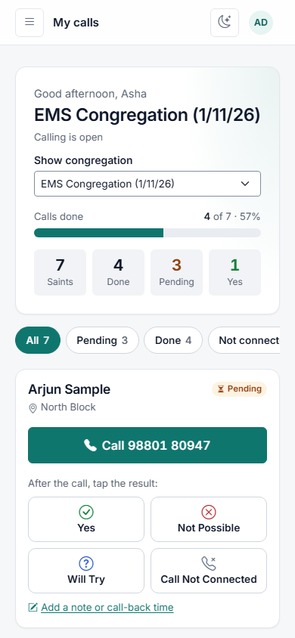
EMS Seva
Calling Seva, made simple: one place for our Saints, our callers and every Sunday's EMS Congregation
Notes:
Welcome. Today we introduce EMS Seva, the app that replaces our Calling Seva spreadsheet. The picture on the right is what every caller will see on their phone. Everything shown uses made-up example names.

Slide 2


From spreadsheets to one simple app
Until now: Excel
Now: EMS Seva
Several sheets to keep in step
Results counted by hand each week
Everyone can see every number
Easy to overwrite what was there before
Each caller sees only their own list
One tap records the result
Coordinators see progress live
Every change is kept in the history
Same Saints, same callers, same seva: just simpler to run.
Notes:
The spreadsheet served us well, but it needs a lot of manual work and everyone sees everything. In the app each caller only sees their own Saints, results are one tap, and coordinators see progress as it happens. Nothing is lost: every change is recorded.

Slide 3



Three roles, one app
Caller
Coordinator
System administrator
Phones their Saints before Sunday and taps the result. Sees only their own list, on their phone.
Runs Calling Seva: the Saints, the calling team, who calls whom, starting calling each week and the reports.
Sets the app up, creates the coordinators' logins and keeps backups of the data.
Saints never log in: they are the people we call.
Notes:
There are three kinds of login. Most of us are callers. Coordinators run the seva. One person, the system administrator, looks after the app itself. The Saints themselves never need to log in.

Slide 4
Every week in five steps
1
2
3
4
5
Saturday morning
Share
Call
Follow
Sunday
Coordinator taps Start calling
Reminder sent to the seva group on WhatsApp
Callers phone their Saints and tap each result
The dashboard shows progress live
EMS Congregation; results ready to export
Next Saturday's Start calling closes the previous week automatically.
Notes:
This is the whole weekly routine. On Saturday morning a coordinator presses one button. That builds every caller's list from the Saints they look after. The coordinator shares a ready-made reminder on WhatsApp. Callers call and tap a result. Coordinators follow progress, and after Sunday the results are ready.

Slide 5
For callers
Everything happens on your phone, under My calls
Notes:
Now the part for callers.

Slide 6
My calls: your list on your phone
1
Log in
Use the username and password your coordinator gives you.
2
Tap Call
The green button dials the Saint's number for you.
3
Tap the result
Right after the call, tap one of the four buttons. It is saved straight away.
Pending calls are at the top. The numbers show Saints, Done, Pending and Yes.
Notes:
Open the link, log in, and you see your list. Pending calls are at the top. Tap Call, have the conversation, and tap the result straight away.

Slide 7




Four buttons, after every call
Yes
Not Possible
They will come to the EMS Congregation.
They said they cannot come.
Will Try
Call Not Connected
They are not sure. Not counted as a Yes.
No answer, switched off or busy. Try again later.
Called again later? Just tap the new result: the latest one counts, and earlier ones stay in the history.
Notes:
These are the only four choices. Will Try means the person isn't sure; we never count it as a Yes. Call Not Connected means you tried but didn't reach them. You can always call again and tap a new result.

Slide 8




Good habits
Add it to your home screen
Notes and call-back times
In Chrome: menu, then Add to Home screen. It opens like an app.
Asked to call later? Add a call-back time; the Call back filter lists them.
Do not call
Keep numbers private
If a card says Do not call, the number is hidden. Never contact that person.
Don't share screenshots or forward numbers. Use them only for calling seva.
Notes:
A few habits that make it easier: put the app on your home screen, use call-back times, respect Do not call, and keep the numbers private.

Slide 9
For coordinators
Running Calling Seva from the dashboard
Notes:
Now the part for coordinators.

Slide 10
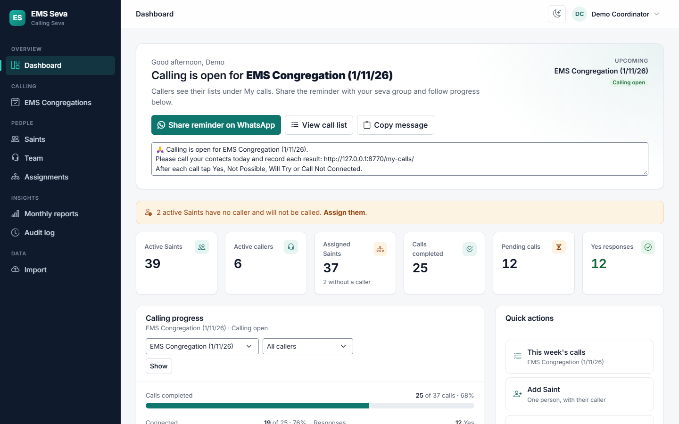



The dashboard shows where things stand
One main button
It changes with the week: setup steps, then Start calling, then Share, then View results.
Live numbers
Active Saints, callers, calls done, pending and Yes.
Progress per caller
See at a glance who may need a reminder.
Notes:
This is the coordinator's home page. The main button at the top always shows the next thing to do. The cards show the key numbers, and the table shows how far each caller has got.

Slide 11
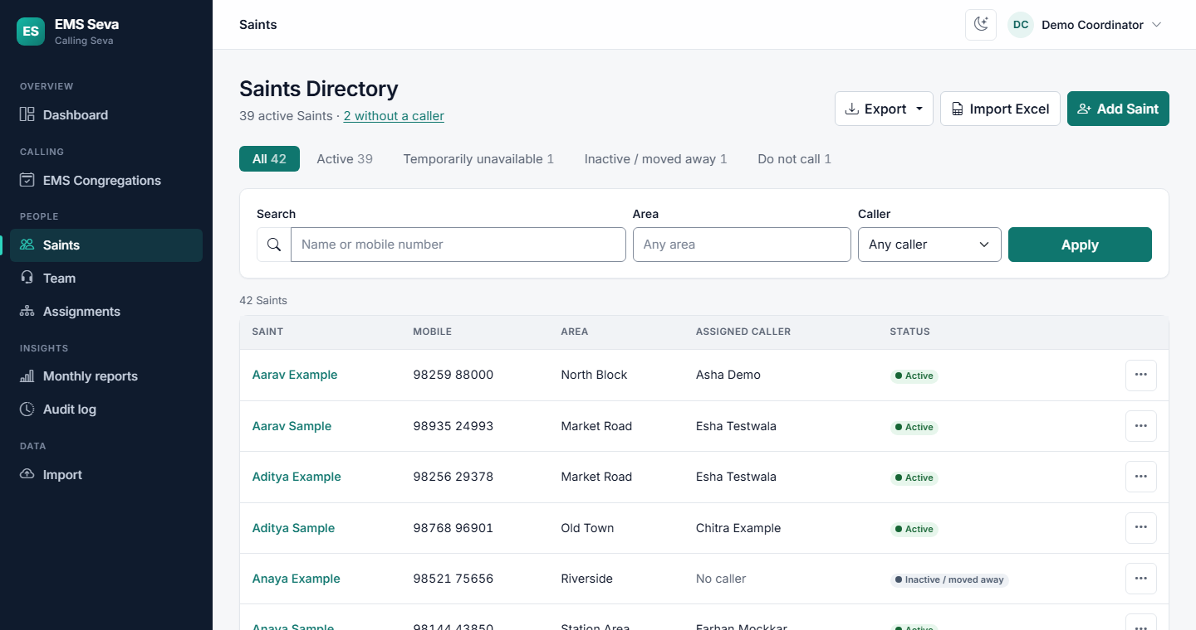
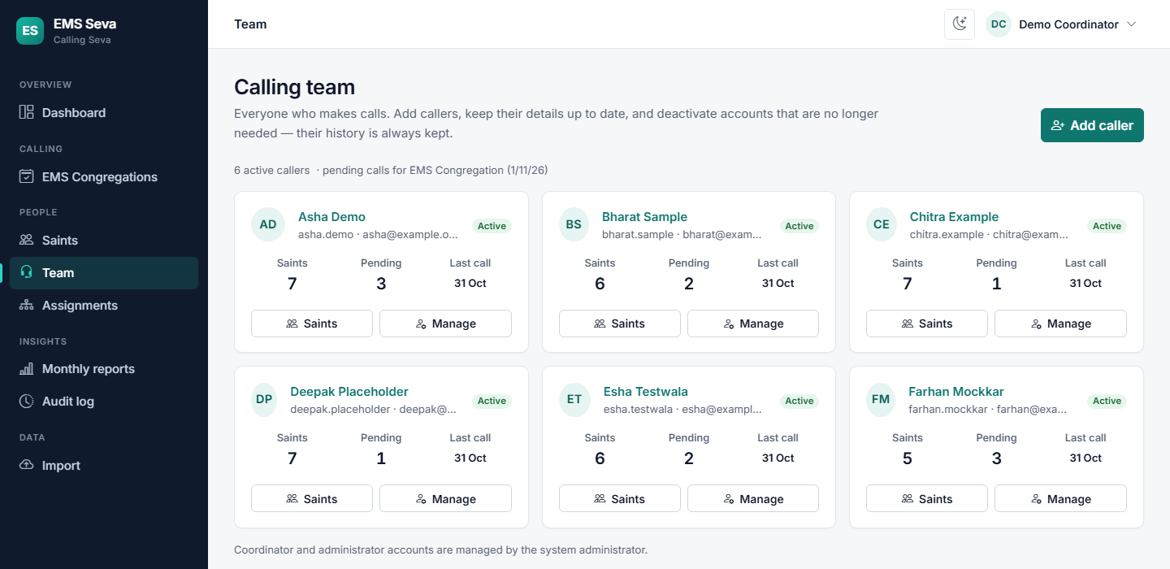
Saints and the calling team
Saints Directory
Team
Search by name or mobile. Status: Active, Temporarily unavailable, Inactive or Do not call.
Add callers, reset passwords, deactivate when someone stops. History is always kept.
Notes:
Saints are the people we call. Each has a status: someone who has moved away is marked Inactive, and anyone who asks not to be called is marked Do not call. The Team page is where coordinators add callers and reset passwords, without needing the technical admin screens.

Slide 12
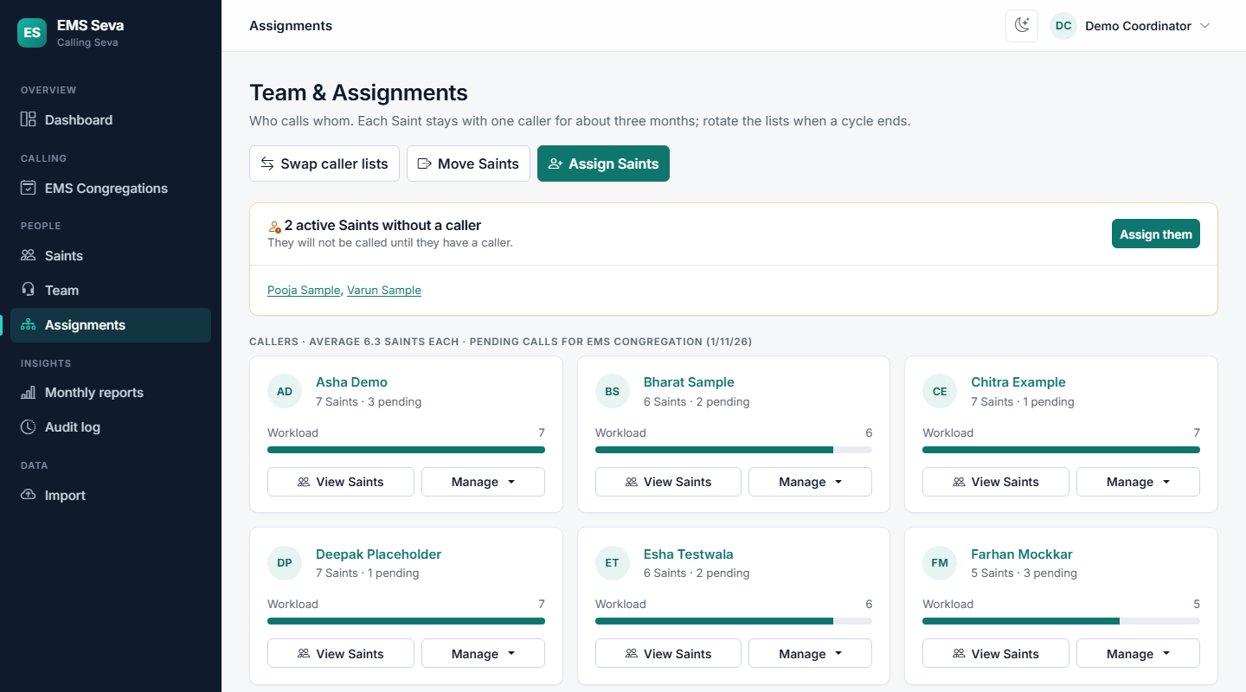
One caller looks after each Saint
~3 months
each Saint stays with the same caller, then the lists rotate
Assign Saints who have no caller
Move a whole list, or swap two callers' lists
Every change is previewed before it happens
Full history of who called whom, and why
Notes:
Each Saint is looked after by one caller for about three months, which builds a relationship. Coordinators can assign, move or swap lists. The app always shows a preview first, and keeps the full history.

Slide 13




Bringing in the Excel workbook
1. Upload
2. Map columns
3. Review
4. Import
Drop in the EMS workbook. Nothing is saved yet.
Matched automatically; just check them.
Fix flagged rows and create callers' logins.
Only now are Saints and callers saved.
Columns used: NAME, MOBILE NO, AREA, DATE and CALLING CO-ORDINATER (the caller), from the EMS STALL SEWA sheet.
Only current Saints and their callers are imported, not old weekly history. Importing the same file again never creates duplicates.
Notes:
The import moves us off the spreadsheet in four steps. It checks every row for missing details, wrong numbers and duplicates, and can create each caller's login. Their passwords are shown once, for the coordinator to share privately.

Slide 14
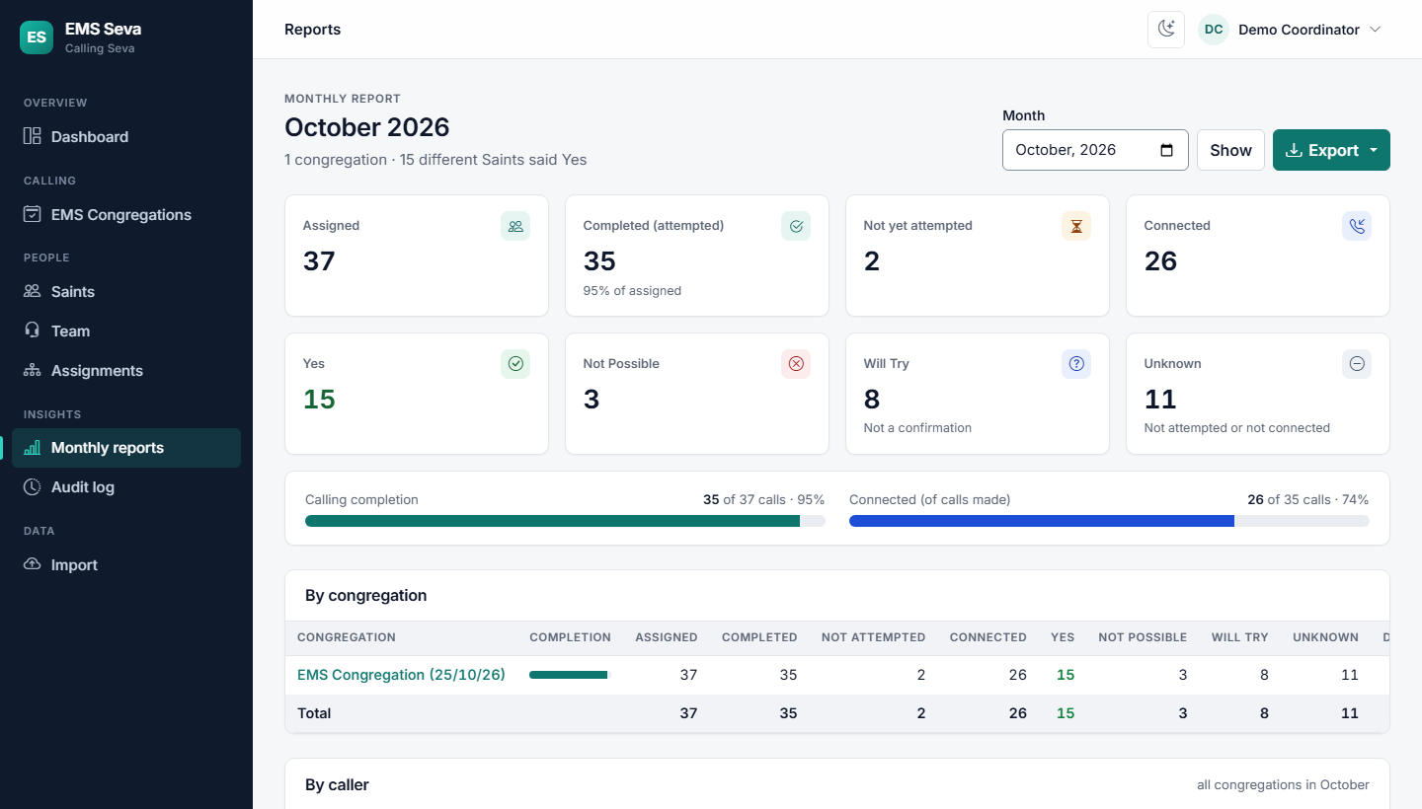
Reports you can trust
Completed
at least one attempt, any result
Will Try
is never counted as Yes
Always adds up
Yes + Not Possible + Will Try + Unknown = Assigned
Export to Excel or CSV. The audit log records every change: who, what and when.
Notes:
Monthly reports show each congregation and each caller. The numbers are defined clearly and always add up. Will Try is never counted as Yes. Everything can be exported, and the audit log shows every change.

Slide 15
Getting started
Four steps from today to our first Saturday on EMS Seva
1
2
3
4
Set up
Import
Share
Saturday
The administrator sets up the app and the coordinators' logins
A coordinator imports the workbook and creates the callers' logins
Each caller receives their login privately
Start calling, share the reminder, and call
Questions?
Notes:
To get going: the administrator sets the app up, a coordinator imports the workbook and creates the logins, each caller gets their login privately, and on Saturday we start. Any questions?

