Slide 1
FitPulse Tracker
KL UNIVERSITY · 26SC1101E · Problem Solving Using Programming (Java)
Personal Fitness & Wellness Tracker
Student Name | Roll No | Section
K.Aditya | 2620090002 | 16
G.Veerendra | 2620030373 | 16
N.Varun | 2620040048 | 16

Slide 2
Abstract
KL UNIVERSITY · FitPulse Tracker
FitPulse Tracker is a console-based Java application that helps users monitor their personal fitness and wellness. It collects a user profile (age, weight, height, gender), calculates BMI and health category, sets a fitness goal, and logs cardio and strength workouts with calories burned.
The project applies every course outcome of 26SC1101E: expressions and Scanner I/O (CO1), selection and iteration (CO2), methods, recursion and arrays (CO3), OOP with interfaces, inheritance and custom exceptions (CO4), Strings and NIO file persistence (CO5), and Collections with lambdas and Stream pipelines (CO6).
The result is a modular, maintainable tracker that saves workouts to disk and produces analytics such as high-burn sessions, workout frequency and total energy expended.

Slide 3
Understanding Problem Statement
KL UNIVERSITY · FitPulse Tracker
The problem
People track workouts in notebooks or scattered apps, losing history and insight
BMI, calorie burn and progress are rarely calculated consistently
Invalid entries (e.g. zero-minute sessions) corrupt records
No simple summary of which workouts burn the most energy
Our solution: inputs → process → output
Input: profile, goal, streak, daily steps, workout sessions
Process: BMI & category, calorie models per activity type, validation, sorting and grouping
Output: health report, saved records file, stream-based analytics

Slide 4
CO1 Topics
KL UNIVERSITY · FitPulse Tracker
Problem to program: Java foundations
Scanner input: age, weight, height, gender read from console
Primitive types & constants: int, double, char, final CM_TO_METERS
Operators: arithmetic, ternary, unary (++/--), bitwise shift
Typecasting: widening int → double for height in metres
Formatted output: printf for BMI to 2 decimals
Scanner scanner = new Scanner(System.in); int age = scanner.nextInt();
double weightKg = scanner.nextDouble(); double heightCm = scanner.nextDouble();
final double CM_TO_METERS = 0.01; int flags = 0b0001;
flags = flags << 1; // bitwise shift
int priorityScore = (age > 20) ? ++age : age--;
double heightM = heightCm * CM_TO_METERS; double bmi = weightKg / (heightM * heightM); System.out.printf("Calculated BMI: %.2f%n", bmi);

Slide 5
CO2 Topics
KL UNIVERSITY · FitPulse Tracker
Control flow: selection & iteration
if-else-if ladder: classifies BMI as Underweight, Normal, Overweight or Obese
switch with break/default: activates the chosen fitness goal
for loops: read 7 days of steps and log N workout sessions
break: stops the milestone search once found
Nested loops: traverse the 2D rep matrix
if (bmi < 18.5) { System.out.println("Underweight");
} else if (bmi < 24.9) { System.out.println("Normal weight");
} else if (bmi < 29.9) { System.out.println("Overweight");
} else { System.out.println("Obese");
}
switch (choice) {
case 1: System.out.println("HIIT & Deficit"); break;
case 2: System.out.println("Progressive Overload"); break; case 3: System.out.println("Zone 2 Training"); break; default: System.out.println("General Fitness");
}

Slide 6
CO3 Topics
KL UNIVERSITY · FitPulse Tracker
Methods, recursion & arrays
Modular methods: evaluateBmiCategory(), handleWorkoutGoalSwitch(), inputWorkouts()
Recursion: streak multiplier with base case and recursive case
1D array: 7-day steps — total, average, best day
Linear search: find a step milestone
2D array: rep matrix of 2 users × 3 sets
Enhanced for-each loop for summation
public static int calculateStreakMultiplier(int days) { if (days <= 1) return 1; // base case
return days * calculateStreakMultiplier(days - 1);
}
int[] dailySteps = new int[7];
int totalSteps = 0, maxSteps = dailySteps[0]; for (int steps : dailySteps) {
totalSteps += steps;
if (steps > maxSteps) maxSteps = steps;
}
double avg = (double) totalSteps / dailySteps.length;
int[][] userRepMatrix = { {30, 45, 25}, {40, 50, 30} };

Slide 7

KL UNIVERSITY · FitPulse Tracker
CO4
OOP modelling & exception handling
Interface Trackable defines calculateCaloriesBurned() and getSummary()
Abstract class Activity: private fields, getters/setters, static counter and APP_NAME constant
Constructor overloading with this(...)
Inheritance & overriding: CardioActivity and StrengthActivity
Custom exceptions: checked InvalidWorkoutDataException, unchecked RecordNotFoundException
interface Trackable {
double calculateCaloriesBurned(); String getSummary();
}
class CardioActivity extends Activity { @Override
public double calculateCaloriesBurned() {
return (getDurationMinutes() * 8.5) + (distanceKm * 12.0);
}
}
try {
if (duration <= 0)
throw new InvalidWorkoutDataException("Duration must be > 0");
} catch (InvalidWorkoutDataException e) { System.err.println("Input Error: " + e.getMessage());
}

Slide 8
CO5
KL UNIVERSITY · FitPulse Tracker
Strings, library algorithms & file I/O
String parsing: trim() and split(",") to tokenize workout tags
• == vs equals(): reference vs value comparison
StringBuilder: efficient report building with append()
Comparable: natural ordering of activities by duration
NIO Files & Path: write records with BufferedWriter, read back with Files.lines()
try-with-resources for automatic closing
Path filePath = Paths.get("fitness_records.txt");
try (BufferedWriter writer = Files.newBufferedWriter( filePath, StandardOpenOption.CREATE, StandardOpenOption.TRUNCATE_EXISTING)) {
for (Activity a : activities) writer.write(String.format("%s;%s;%d;%.2f%n", ...));
} catch (IOException e) { ... }
Files.lines(filePath)
.filter(line -> !line.trim().isEmpty())
.forEach(line → { String[] parts = line.split(";"); ... });
StringBuilder sb = new StringBuilder("Parsed Tags: ");
for (String t : tokens) sb.append("[").append(t).append("] ");

Slide 9
CO6
KL UNIVERSITY · FitPulse Tracker
Collections, lambdas & Stream pipelines
Generic List<Activity> stored in an ArrayList
Functional interfaces: Predicate, Function, Consumer
Method references: Activity::getSummary, System.out::println
Comparator sorts by calories burned (descending)
Collectors: groupingBy + counting, joining
reduce() totals energy expended
Predicate<Activity> isHighBurn = a → a.calculateCaloriesBurned() > 200.0; activities.stream().filter(isHighBurn)
.map(Activity::getSummary)
.forEach(System.out::println);
Map<String, Long> freq = activities.stream()
.collect(Collectors.groupingBy(Activity::getName,
Collectors.counting()));
String names = activities.stream().map(Activity::getName)
.distinct().sorted().collect(Collectors.joining(", "));
double total = activities.stream()
.map(Activity::calculateCaloriesBurned)
.reduce(0.0, Double::sum);

Slide 10
Conclusion
KL UNIVERSITY · FitPulse Tracker
FitPulse Tracker turns raw personal data into clear health insights: BMI category, goal plan, calories burned and workout analytics.
The project integrates all six course outcomes, from procedural Java basics to object-oriented design and functional Stream pipelines.
Interfaces, inheritance and custom exceptions make the system extensible and robust against invalid input.
NIO file handling persists records, so workout history survives between sessions.
Future scope: GUI or Android front end, wearable/step-counter integration, weekly goal reminders and charts of progress over time.

Slide 11
KL UNIVERSITY · FitPulse Tracker
Screen Shots
==================================================
WELCOME TO FitPulse Tracker
==================================================
Enter your Age (years): 20 Enter your Weight (kg): 65 Enter your Height (cm): 172 Enter Gender (M/F): M
--- [CO5] Modern File I/O ---
Workout entries saved to file: fitness_records.txt
Loaded Record -> ID: ACT-01 | Name: Running | 30 mins | 315.00 kcal Loaded Record -> ID: ACT-02 | Name: Squats | 20 mins | 142.50 kcal
--- [CO6] Functional APIs & Stream Pipelines ---High Calorie Burn Activities (> 200 kcal):
Cardio: Running, Distance: 5.00 km, Burned: 315.0 kcal
USER METRICS
Calculated BMI: 21.97
Health Category: Normal weight (Optimal)
Workout Frequency Breakdown: {Squats=1, Running=1} Distinct Workouts Completed: [Running, Squats]
Total Aggregate Energy Expended: 457.50 kcal
Select Primary Fitness Goal: 3
Target Activated: Aerobic Capacity & Zone 2 Training
[Sample output — replace with your screenshot]
[Sample output — replace with your screenshot]

Slide 12
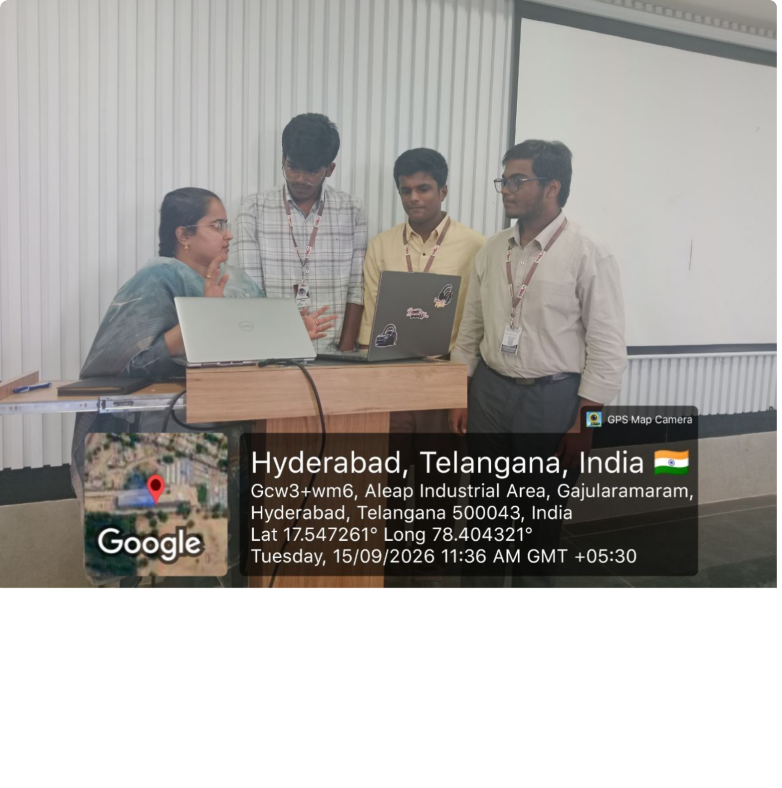

Geo Tag Photo and GitHub Link
KL UNIVERSITY · FitPulse Tracker
Geo-tagged team photo
GitHub repository
https://github.com/Adi9849-ww/Personal-Fitness-Wellness-Tracker

