Slide 1

FoodBridge
An Intelligent Food Rescue Coordination and Resource Allocation Platform
Software Engineering Laboratory (PTPS) · Final Project Demo
Team AdiByte5
Adithyan S Nair · Register number 24BAI1621
October 2026
Notes:
About 10 seconds. Title, team and member details, then one sentence: this demo covers how the platform works, what distinguishes it and what is running live. Move on quickly.

Slide 2
Problem statement and scope
Surplus food is discarded while the organizations that require it operate short of supply.
Donations are coordinated through telephone calls and messaging applications, which delays collection and results in lost donations.
Most donation platforms publish a listing and allocate the food to the first organization that claims it.
They do not verify that the food can reach the recipient before its safe consumption window closes.
They neither measure cumulative distribution across organizations nor record the reasoning behind a selection.
Scope
Scope of this release: four roles, one city, and the complete path from a registered donation to a confirmed delivery. Payments, inventory forecasting and route optimisation sit outside the scope.
2 / 11
Notes:
About 30 seconds. The last two points are the gap this project fills: safety and justification. Close with the scope line so the boundary of the project is clear. Note to self: this comparison is my own assessment from the requirement study, not a published benchmark.

Slide 3
Differentiating features
Six design decisions separate FoodBridge from existing platforms and manual coordination.
Design decision | Typical platforms | FoodBridge
Recipient selection | Allocated to the first organization that claims the listing | All eligible organizations are ranked by the decision engine
Food safety | Expiry time displayed to the claimant | Organizations that cannot receive the food in time are excluded
Equitable distribution | Not measured | Quantities received in the previous 30 days influence the score
Transparency | No recorded justification | A written explanation is stored with every allocation
Volunteer coordination | Arranged privately between donor and recipient | Volunteers are matched by distance, workload and experience
Accountability | Basic donation history | Every action is recorded in the audit log
3 / 11
Notes:
About 40 seconds, and the main emphasis of the review. Read two rows only and state that the remaining four are in the table. Note to self: the comparison is my assessment from the requirement study, not a published benchmark.

Slide 4
Functional scope
Four actors and sixteen use cases, all implemented in the running system.
Donation registered
Automatic match
Recipient accepts
Volunteer collects
Delivered
Reports update
donor submits details
engine decides instantly
decision visible
matched by distance
tracked to handover
rescues and audit
The workflow proceeds from donation registration to a confirmed delivery, with the allocation decision recorded at each stage.
Each role workspace exposes only the functions that the actor is authorised to perform.
The engine operates on the server; the browser presents decisions and collects responses.
4 / 11
Notes:
About 25 seconds. Name the four actors and the sequence; the demonstration follows the same path on screen.

Slide 5
Allocation methodology
The engine runs when food is registered. Four constraints apply first; six weighted factors then rank the rest.
Verified organization
Sufficient free storage
Category accepted
Safe arrival feasible
Factor | Weight | Basis of measurement
Expiry urgency | 25% | Time remaining before the food becomes unsafe, weighted by the recipient's collection speed
Demand match | 20% | Correspondence between the donation quantity and the registered demand
Storage fit | 15% | Remaining storage capacity after intake
Proximity | 15% | Distance from the pickup point
Food preference | 15% | Whether the organization accepts the food category
Fair distribution | 10% | Quantity received by the organization during the previous 30 days
5 / 11
Notes:
About 40 seconds. The four constraints first, then the six factors. Do not read every row aloud.

Slide 6
Original contribution: the food-safety arrival rule
A constraint introduced in this project. Food must be able to arrive while it remains safe to serve.
The engine estimates the pickup to handover duration for each candidate organization from the travel distance and a handling allowance.
The estimate is compared with the remaining safe window, retaining sixty minutes for serving.
Organizations that cannot arrive in time are excluded, and the reason is stored on the allocation.
Distance was initially treated as a scoring factor. Because late arrival is a safety failure rather than a lower priority, it was implemented as a hard constraint.
Organization | Distance | Outcome
Sneha Sadan Orphanage | 11.6 km | Eligible, 15 minutes to spare
Sanjeevini Community Kitchen | 11.8 km | Eligible, 15 minutes to spare
Three organizations | 18 to 25 km | Excluded, 65 to 85 minutes required against 60 available
Assumptions: 20 km/h urban travel, 10 minutes handling, 60 minutes serving buffer.
6 / 11
Notes:
About 50 seconds, the key slide. State the rule, explain why it is a hard constraint rather than a score, give the three assumptions, then the recorded result. Note to self: these figures were recorded on 16 October 2026 from the seeded dataset.

Slide 7
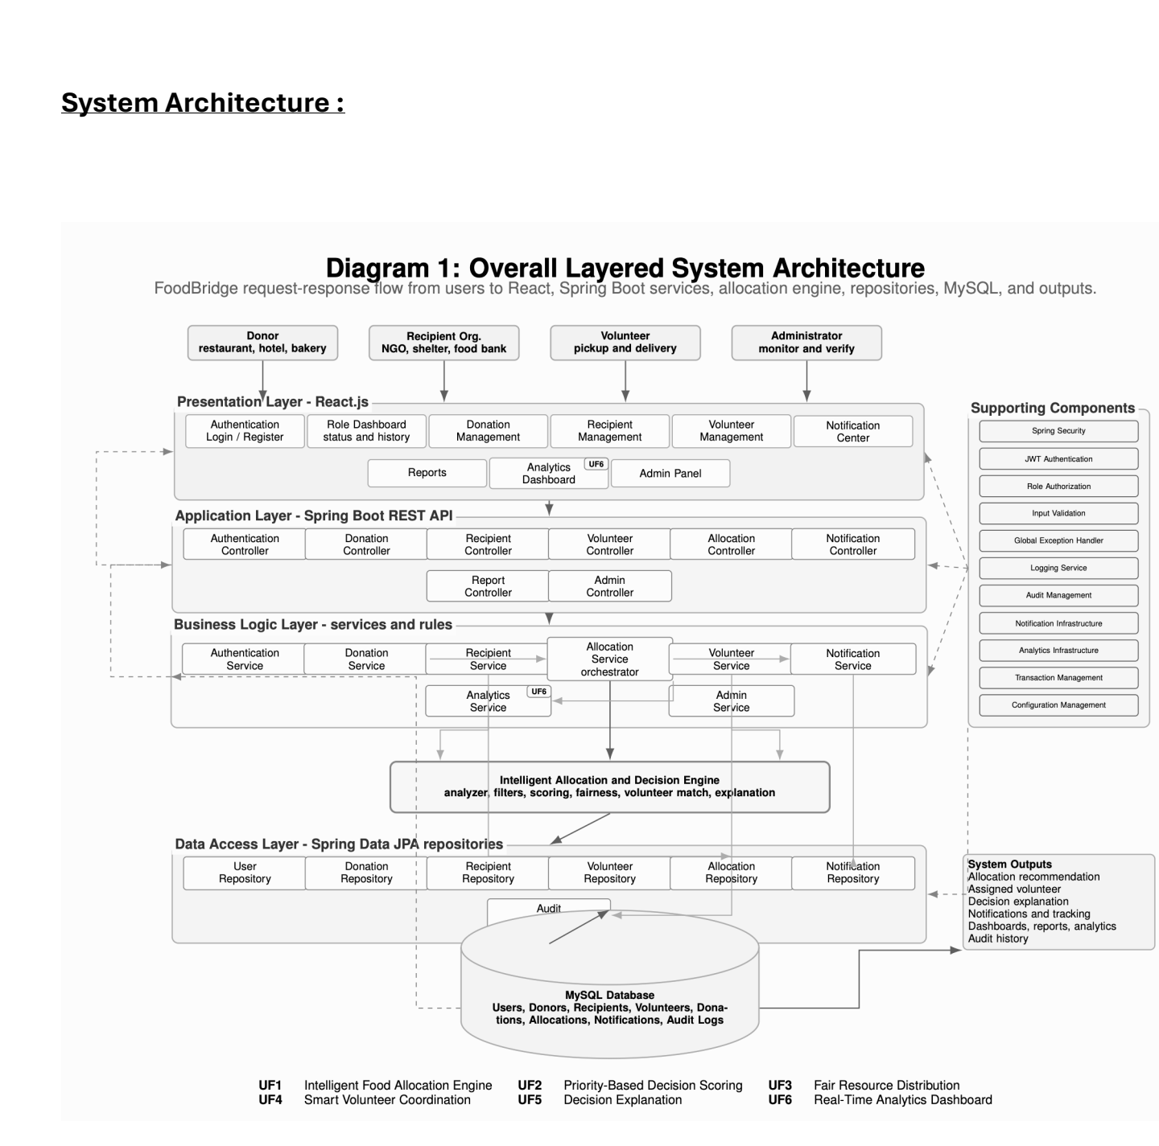
System architecture
The layered architecture submitted in the design phase, implemented as specified.
Four layers: React presentation, Spring Boot REST application, business logic including the allocation engine, and JPA over MySQL.
Authentication issues a JWT at login; the server verifies the role and the ownership of each record.
The allocation engine is an independent service, which keeps decision rules separate from the domain classes.
7 / 11
Notes:
About 30 seconds. Point at the submitted diagram, name the four layers, and mention JWT and the server side checks. Note to self: the diagram is from my Lab 3 submission. If asked how a box maps to the code: Login and Signup pages plus the four role dashboards, EnginePage and AnalyticsPage in React. AuthController, DonationController, RecipientController, VolunteerController, AllocationController, NotificationController, AnalyticsController and AdminController. AuthService, DonationService, RecipientService, VolunteerService, DeliveryService, AllocationEngineService, NotificationService, AnalyticsService and AdminService. Twelve Spring Data repositories over twelve MySQL tables. Supporting components: SecurityConfig with JwtService and JwtAuthFilter, jakarta validation on the request objects, GlobalExceptionHandler, AuditService, and transactional service methods. Logging runs through the framework logger, SLF4J.

Slide 8
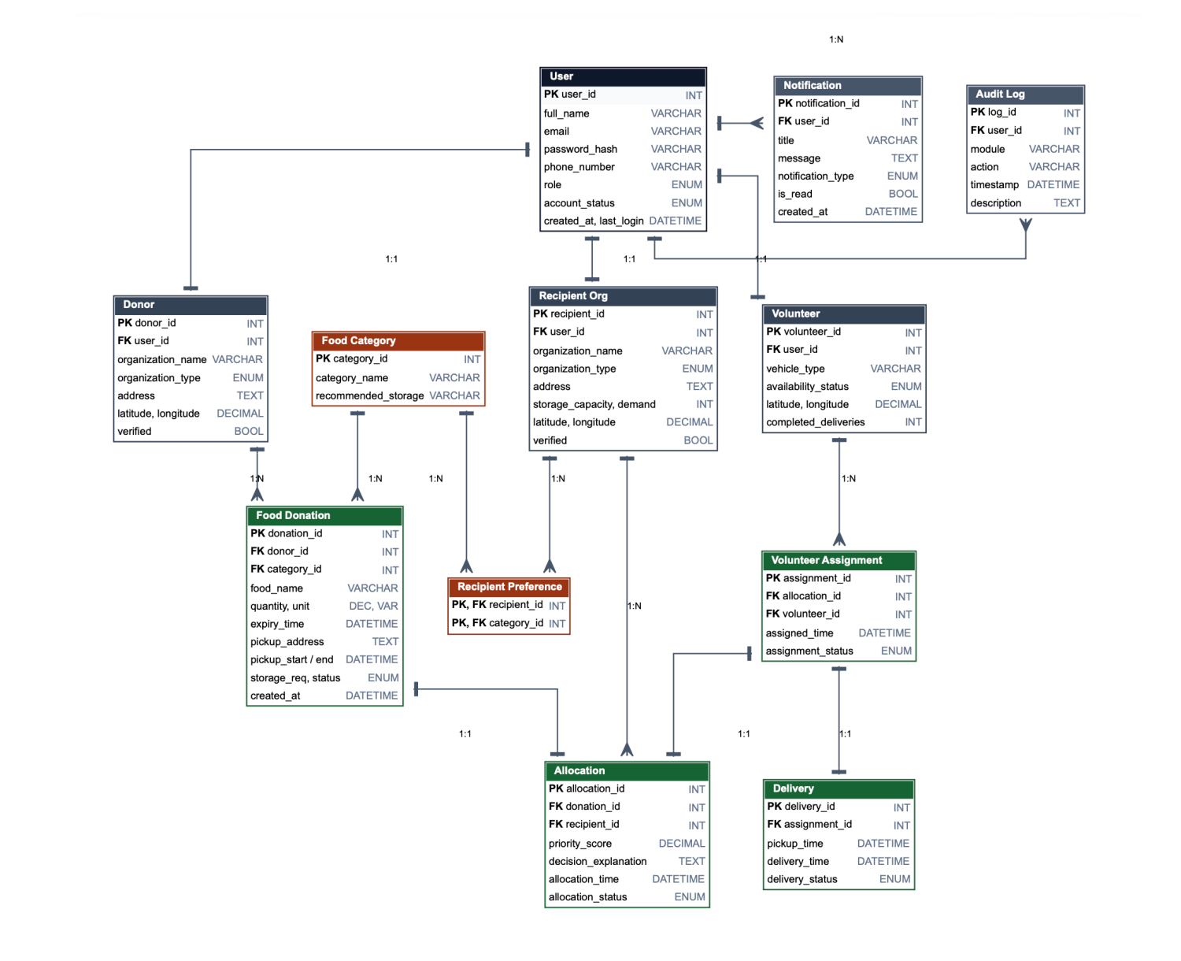
Database design
The entity relationship model submitted in the design phase, implemented as twelve tables.
Twelve entities in third normal form.
Allocation, assignment and delivery are modelled separately, so a decision, a task and a delivery are tracked independently.
Recipient food preferences resolve the many to many relationship between organizations and categories.
8 / 11
Notes:
About 25 seconds. Twelve entities in third normal form, and the reason allocation, assignment and delivery are separate. Note to self: the diagram is from my Lab 4 submission.

Slide 9
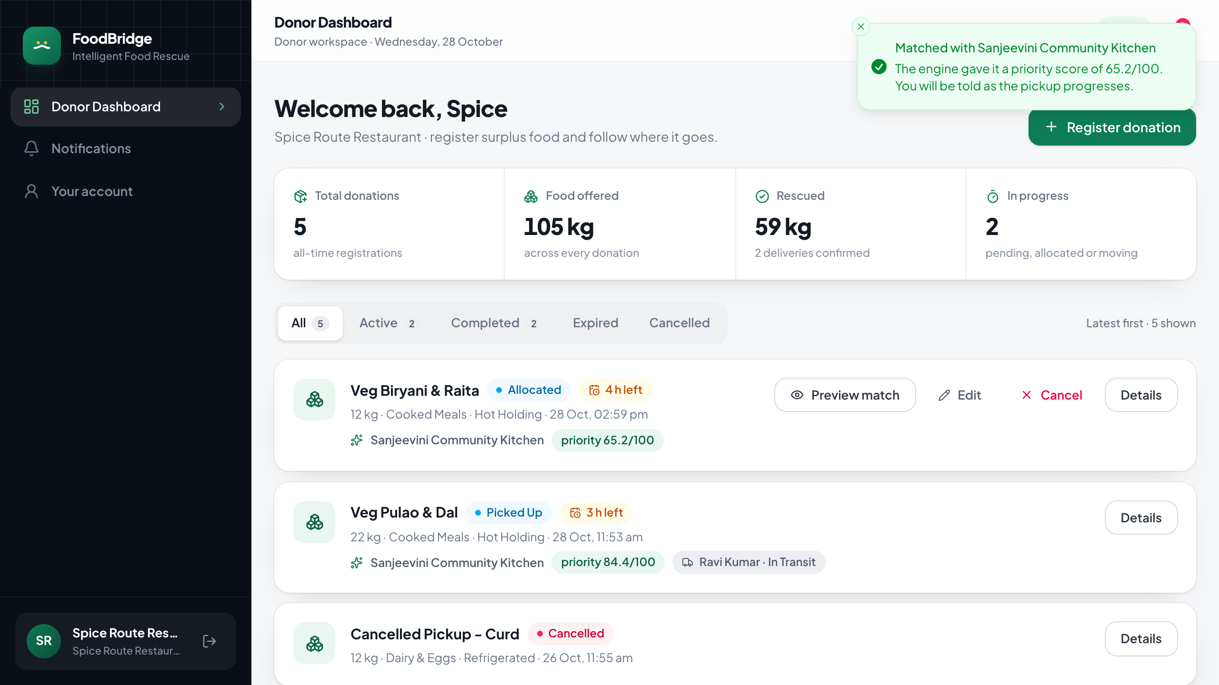
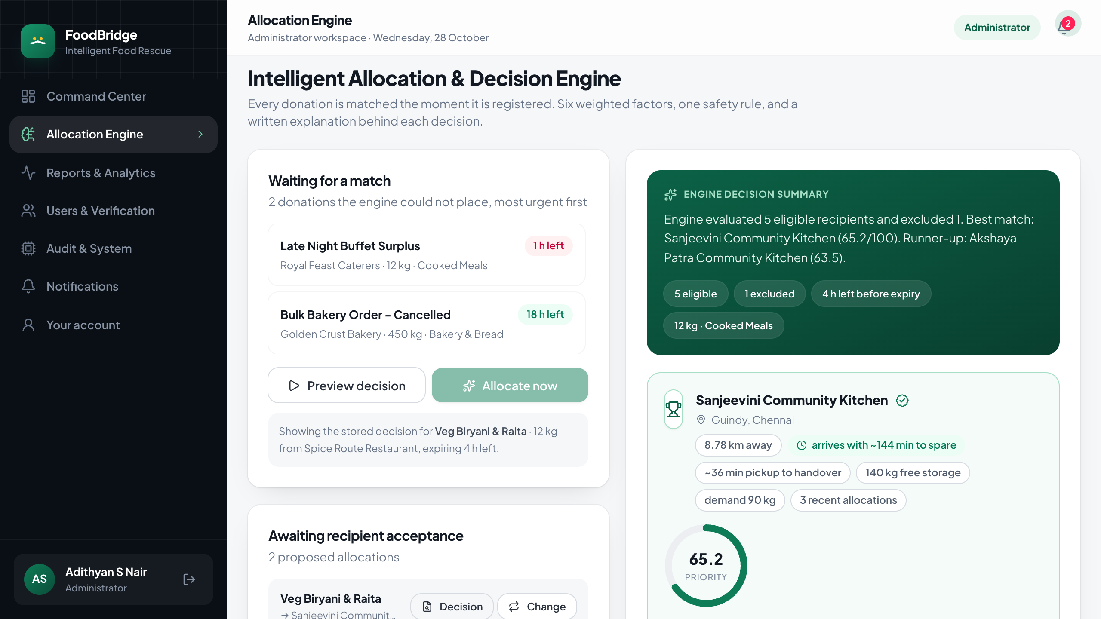
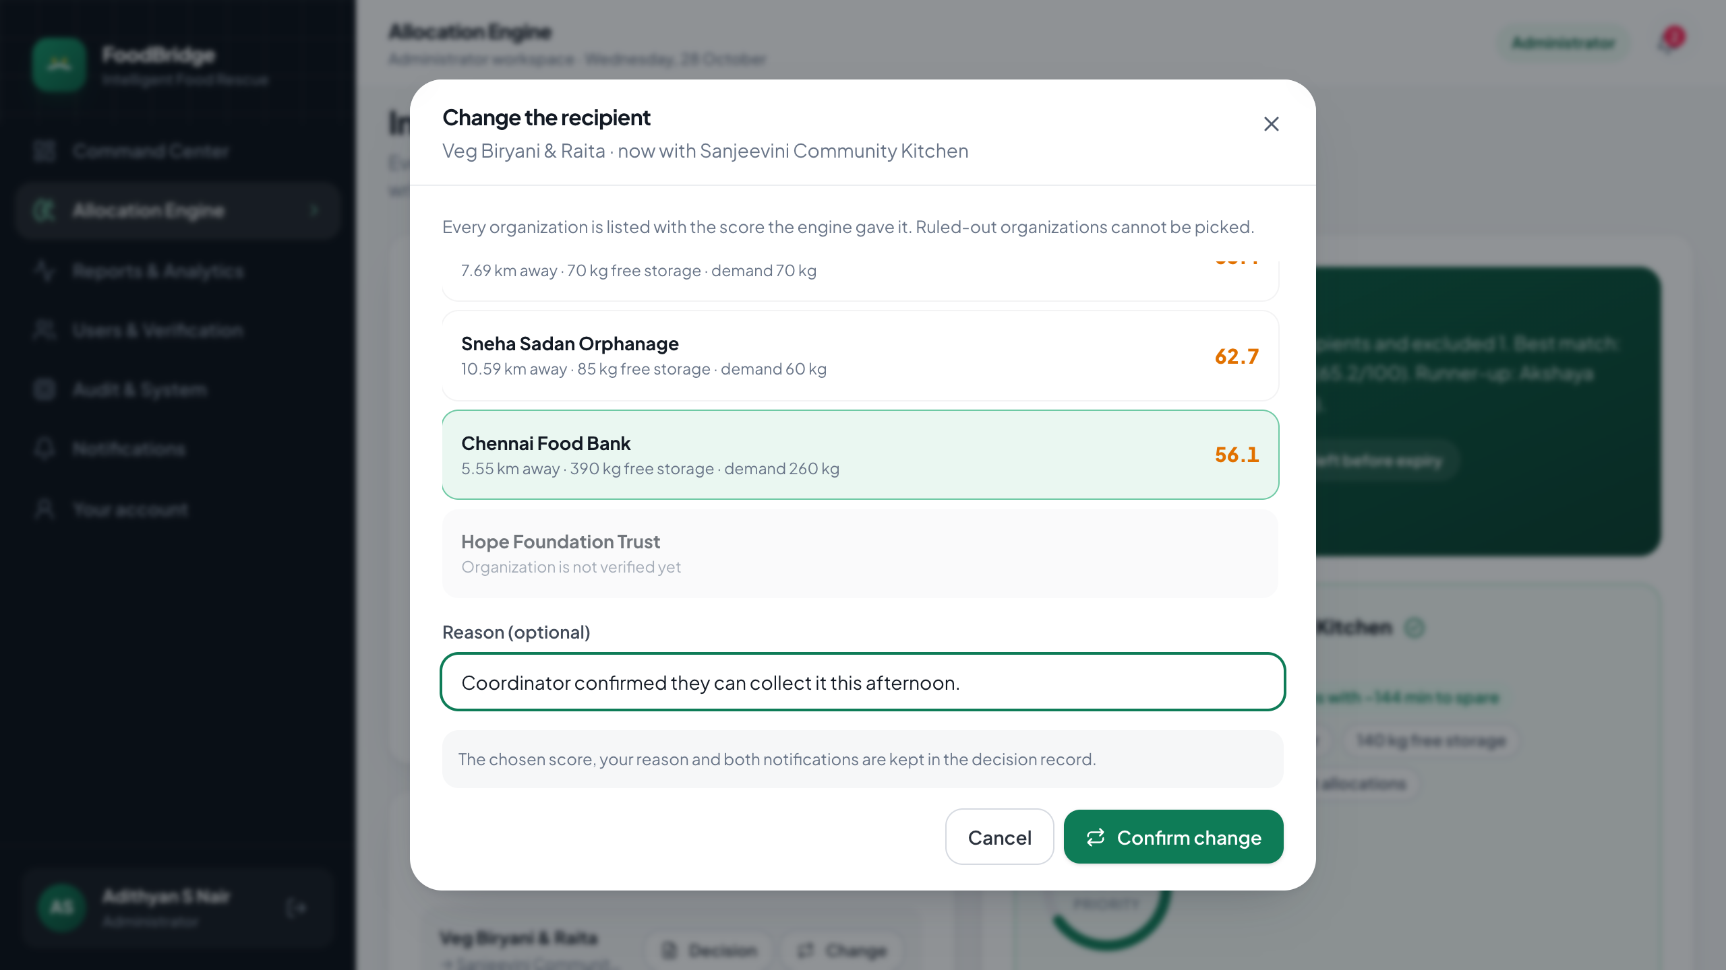
Key features in the running application
A donation is matched on registration, the decision is explained, and the administrator can change the recipient.
Donor workspace
Allocation engine
Administrator override
Food registered and matched immediately
Score, factors and safety check in one view
Recipient changed, with a written reason
Demonstration path: the donor registers food, the administrator reviews or changes the decision, the recipient accepts, the volunteer delivers, and the recipient confirms receipt.
9 / 11
Notes:
About 30 seconds. Three screens from the running build, captured on 28 October 2026. Point out that the donor is matched the moment the food is registered, that every decision carries its score and reasoning, and that the administrator can replace the recipient without erasing the original decision. The live demonstration follows the same three steps.

Slide 10
Results and verification
Measurements taken from the running system with the seeded dataset.
414 kg
1,035
84.6%
food rescued
meals equivalent
allocations accepted
55 min
15 of 15
6
pickup to confirmation
automated tests pass
recipient organisations
Fifteen automated tests cover the eligibility constraints, scoring, fairness, the arrival rule, access control, automatic matching, override and volunteer assignment.
Eighteen API checks confirm the role restrictions, including rejection of unauthorised requests with 401 and 403 responses.
A complete rescue has been executed end to end, including a recipient change, delivery and confirmation.
10 / 11
Notes:
About 30 seconds. Read two or three figures, then the verification lines. Note to self: the figures are from the seeded dataset on 28 October 2026, so the live reports will move slightly as new donations are added.

Slide 11
Challenges, limitations and future improvements
What was difficult to get right, where the current release stops, and what comes next.
Challenges faced
Limitations and next steps
Food safety had to become a hard filter. A good score cannot excuse food that arrives after its safe window closes.
Six factors had to stay explainable. Every weight, exclusion and override is visible in the decision record.
Four roles share one workflow, so the API checks access and record ownership for every request.
A rejection or recipient change has to leave the donation, volunteer and storage figures consistent.
Distances use straight lines and one city speed. Next: road routing, traffic and per-vehicle speeds.
Locations are coordinates entered on sign-up. Next: a map picker and live volunteer position.
The system runs locally on MySQL. Next: a hosted deployment with backups and monitoring.
Notifications are in-app. Next: SMS or WhatsApp for organizations that do not keep the site open.
11 / 11
Notes:
About 25 seconds, then switch to the live demonstration. The challenges are the parts that took the most judgement: treating safety as a constraint, keeping the scoring explainable, protecting four roles in one workflow and keeping the records consistent when a decision changes. Then run the demo: donor registers food, administrator inspects the decision and changes the recipient, recipient accepts, volunteer collects and delivers, recipient confirms, and the analytics page updates.

