Slide 1

FoodBridge
An Intelligent Food Rescue Coordination and Resource Allocation Platform
Software Engineering Laboratory · Project Review
Adithyan S Nair · Register number 24BAI1621
Notes:
About 10 seconds. Title, then one sentence: this review covers how the platform works and what distinguishes it. Move on quickly.

Slide 2
Problem statement and the gap in existing platforms
2 / 10
Surplus food is discarded while the organizations that require it operate short of supply.
Donations are coordinated through telephone calls and messaging applications, which delays collection and results in lost donations.
Most donation platforms publish a listing and allocate the food to the first organization that claims it.
They do not verify that the food can reach the recipient before its safe consumption window closes.
They neither measure cumulative distribution across organizations nor record the reasoning behind a selection.
Assessment derived from the requirement study conducted for this project; not a published benchmark.
Notes:
About 30 seconds. The last two points are the gap this project fills: safety and justification. Do not elaborate here, slide 3 covers it.

Slide 3
Differentiating features
3 / 10
Six design decisions separate FoodBridge from existing platforms and manual coordination.
Design decision | Typical platforms | FoodBridge
Recipient selection | Allocated to the first organization that claims the listing | All eligible organizations are ranked by the decision engine
Food safety | Expiry time displayed to the claimant | Organizations that cannot receive the food in time are excluded
Equitable distribution | Not measured | Quantities received in the previous 30 days influence the score
Transparency | No recorded justification | A written explanation is stored with every allocation
Volunteer coordination | Arranged privately between donor and recipient | Volunteers are matched by distance, workload and experience
Accountability | Basic donation history | Every action is recorded in the audit log
Assessment based on the platforms and process examined during the requirement study.
Notes:
About 40 seconds, and the main emphasis of the review. Read two rows only and state that the remaining four are in the table.

Slide 4
Functional scope
4 / 10
Four actors and sixteen use cases, all implemented in the running system.
Donation registered
Engine ranks recipients
Recipient accepts
Volunteer collects
Delivered
Reports update
donor submits details
constraints, then scoring
decision visible
matched by distance
tracked to handover
rescues and audit
The workflow proceeds from donation registration to a confirmed delivery, with the allocation decision recorded at each stage.
Each role workspace exposes only the functions that the actor is authorised to perform.
The engine operates on the server; the browser presents decisions and collects responses.
Notes:
About 25 seconds. Name the four actors and the sequence; the demonstration follows the same path on screen.

Slide 5
Allocation methodology
5 / 10
Four eligibility constraints are applied first; six weighted factors then determine the ranking.
Verified organization
Sufficient free storage
Category accepted
Safe arrival feasible
Factor | Weight | Basis of measurement
Expiry urgency | 25% | Time remaining before the food becomes unsafe, weighted by the recipient's collection speed
Demand match | 20% | Correspondence between the donation quantity and the registered demand
Storage fit | 15% | Remaining storage capacity after intake
Proximity | 15% | Distance from the pickup point
Food preference | 15% | Whether the organization accepts the food category
Fair distribution | 10% | Quantity received by the organization during the previous 30 days
Notes:
About 40 seconds. The four constraints first, then the six factors. Do not read every row aloud.

Slide 6
Original contribution: the food-safety arrival rule
6 / 10
A constraint introduced in this project. Food must be able to arrive while it remains safe to serve.
The engine estimates the pickup to handover duration for each candidate organization from the travel distance and a handling allowance.
The estimate is compared with the remaining safe window, retaining sixty minutes for serving.
Organizations that cannot arrive in time are excluded, and the reason is stored on the allocation.
Distance was initially treated as a scoring factor. Because late arrival is a safety failure rather than a lower priority, it was implemented as a hard constraint.
Organization | Distance | Outcome
Sneha Sadan Orphanage | 11.6 km | Eligible, 15 minutes to spare
Sanjeevini Community Kitchen | 11.8 km | Eligible, 15 minutes to spare
Three organizations | 18 to 25 km | Excluded, 65 to 85 minutes required against 60 available
Assumptions: 20 km/h urban travel, 10 minutes handling, 60 minutes serving buffer.
Engine output recorded on 16 October 2026 from the seeded dataset.
Notes:
About 50 seconds, the key slide. State the rule, explain why it is a hard constraint rather than a score, give the three assumptions, then the recorded result.

Slide 7
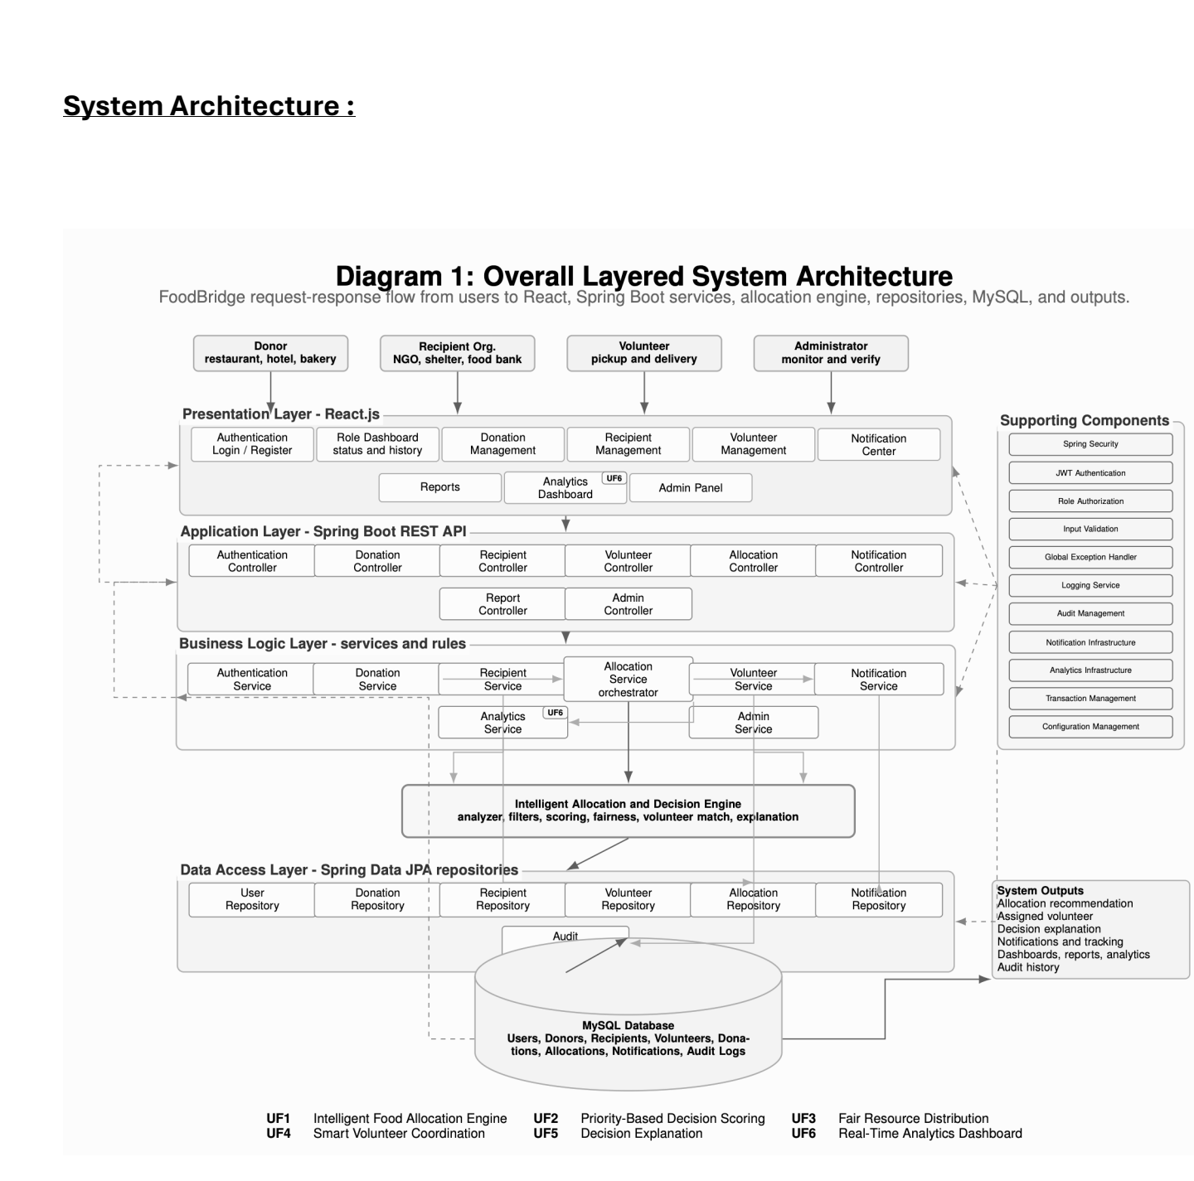
System architecture
7 / 10
The layered architecture submitted in the design phase, implemented as specified.
Four layers: React presentation, Spring Boot REST application, business logic including the allocation engine, and JPA over MySQL.
Authentication issues a JWT at login; the server verifies the role and the ownership of each record.
The allocation engine is an independent service, which keeps decision rules separate from the domain classes.
Figure: overall layered system architecture, Lab 3 submission.
Notes:
About 30 seconds. Point at the submitted diagram, name the four layers, and mention JWT and the server side checks. If asked how a box maps to the code: Login and Signup pages plus the four role dashboards, EnginePage and AnalyticsPage in React. AuthController, DonationController, RecipientController, VolunteerController, AllocationController, NotificationController, AnalyticsController and AdminController. AuthService, DonationService, RecipientService, VolunteerService, DeliveryService, AllocationEngineService, NotificationService, AnalyticsService and AdminService. Twelve Spring Data repositories over twelve MySQL tables. Supporting components: SecurityConfig with JwtService and JwtAuthFilter, jakarta validation on the request objects, GlobalExceptionHandler, AuditService, and transactional service methods. Logging runs through the framework logger, SLF4J.

Slide 8
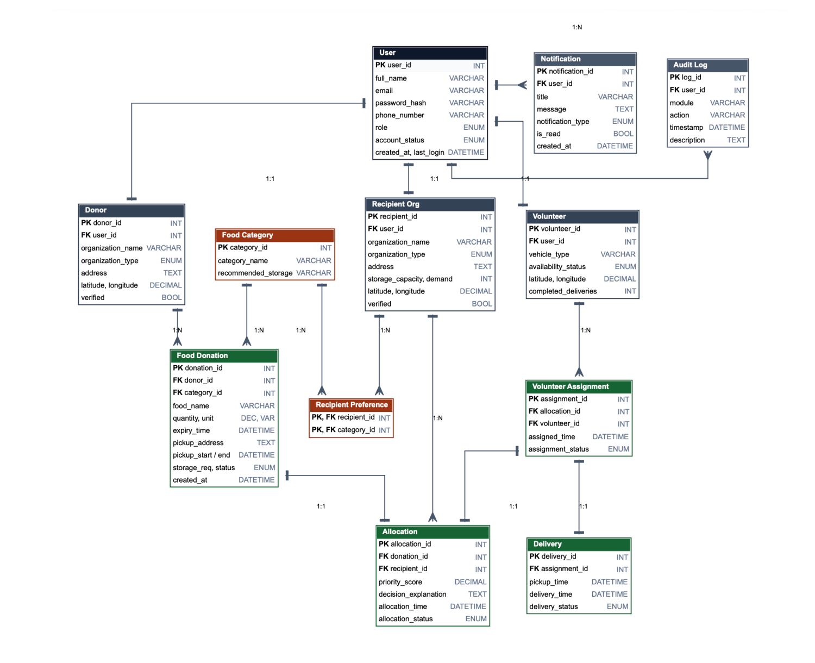
Database design
8 / 10
The entity relationship model submitted in the design phase, implemented as twelve tables.
Twelve entities in third normal form.
Allocation, assignment and delivery are modelled separately, so a decision, a task and a delivery are tracked independently.
Recipient food preferences resolve the many to many relationship between organizations and categories.
Figure: entity relationship diagram, Lab 4 submission.
Notes:
About 25 seconds. Twelve entities in third normal form, and the reason allocation, assignment and delivery are separate.

Slide 9
Results and verification
9 / 10
Measurements taken from the running system with the seeded dataset.
16
414 kg
1,035
donations registered
food rescued
meals equivalent
91.7%
56 minutes
9 of 9
allocations accepted
pickup to confirmation
automated tests pass
Nine automated tests cover the eligibility constraints, the scoring model, the fairness factor, the arrival rule and access control.
Eighteen API checks confirm the role restrictions, including rejection of unauthorised requests with 401 and 403 responses.
A complete rescue was executed end to end: donation, allocation, volunteer assignment, delivery and confirmation.
Notes:
About 30 seconds. Read two or three figures, then the verification lines. The live reports reproduce these numbers.

Slide 10
Limitations and future work
10 / 10
Stated explicitly, with the corresponding improvement for each limitation.
Limitations
Future work
Distances are calculated as straight lines; road routing and live traffic are not included.
A single average travel speed is applied to all volunteers.
Locations are stored as coordinates; there is no map input or address lookup.
Delivery tracking records status changes only; GPS positions are not streamed.
Route aware arrival estimates using a mapping service.
Map based location entry and per vehicle travel speeds.
A reliability score for volunteers derived from accept, decline and completion history.
Deployment, and SMS or WhatsApp notifications for organizations that do not use the application.
Notes:
About 20 seconds, then switch to the live demonstration. Open localhost:5173, sign in as administrator, open the Allocation Engine and use the urgent donation at the top of the queue. Preview decision reproduces the table on slide 6, then Run and allocate. Sign in as the recipient to accept, as the volunteer to collect, deliver and mark it delivered, then as the recipient again to confirm receipt. Finish on Reports and Analytics for the figures on slide 9.

