Slide 1



CAR SALES
DATA ANALYSIS PROJECT
Using Azure Data Factory and Databricks
Presented by: Aditya Kangude

Slide 2

OBJECTIVE
The primary objective of this project is to demonstrate the application of various Azure data engineering services to manage, process and analyze car sales data
The goal is to showcase the efficient handling of large datasets, perform complex transformations and derive meaningful business insights

Slide 3
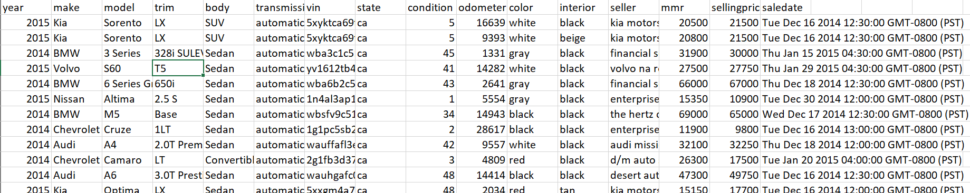
PRIMARY DATASET
About the Dataset
The dataset comprises of 3,00,000+ rows and 16 columns
Columns include-
year 9.condition
make 10.odometer
model 11.color
trim 12.interior
body 13.seller
transmission 14.mmr
vin 15.selling price
state 16.saledate
Key Points to be noted
This dataset is not clean so data cleaning has to be done
The saledate column is not in the ideal format so it has to be transformed to a certain format for further data analysis

Slide 4









OVERVIEW
01
02
03
04
05
06
Data Cleaning and Transformation:
Data Modelling
Data Storage and Accesibility
Data Loading
Data Handling
Data Insights
Extract, transform, and load (ETL) car sales data into a structured format using Databricks and Azure Data Factory.
Create a robust data model by designing and implementing fact and dimension tables to facilitate efficient data querying and reporting
Convert and store the processed data in Delta tables and Parquet files for optimized storage and accessibility.
Load the processed data into an Azure SQL Database to enable advanced data analysis and integration with other business intelligence tools.
Implement dynamic data paths and pipeline variables in Azure Data Factory to handle data flexibly and efficiently.
Generate actionable insights from the transformed data to support business decisions and strategy formulation.

Slide 5


Data Modelling
CONCEPT IN BUSINESS
SALES FACT TABLE
CAR DIMENSION TABLE
PK:fact_sales_id
FK:car_id
PK:car_id
vin
yearMonth VARCHAR(6)
total_sellingprice DECIMAL(18, 2)
mmr DECIMAL(18, 2)
vin
make VARCHAR(50)
model VARCHAR(50)
color VARCHAR(50)
body VARCHAR(50)
01
02
03

Slide 6

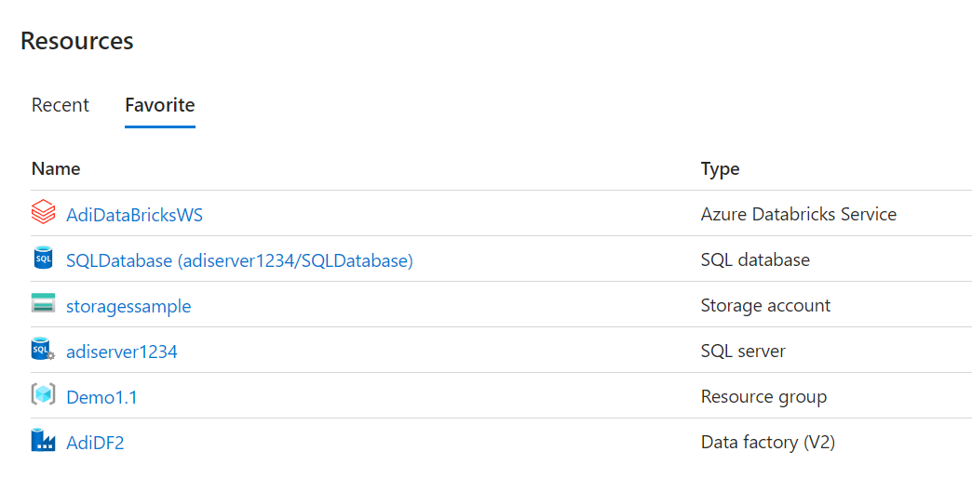
Azure Resources Used

Slide 7
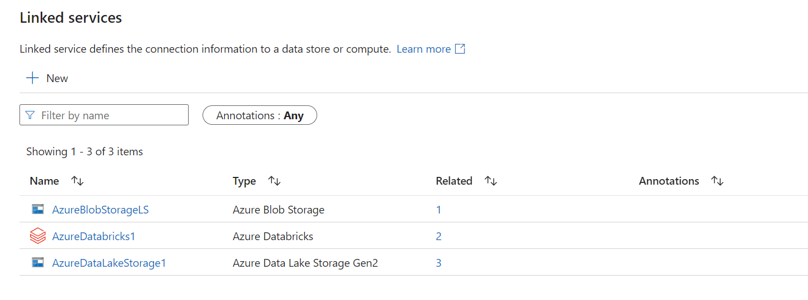
Linked Services Used

Slide 8
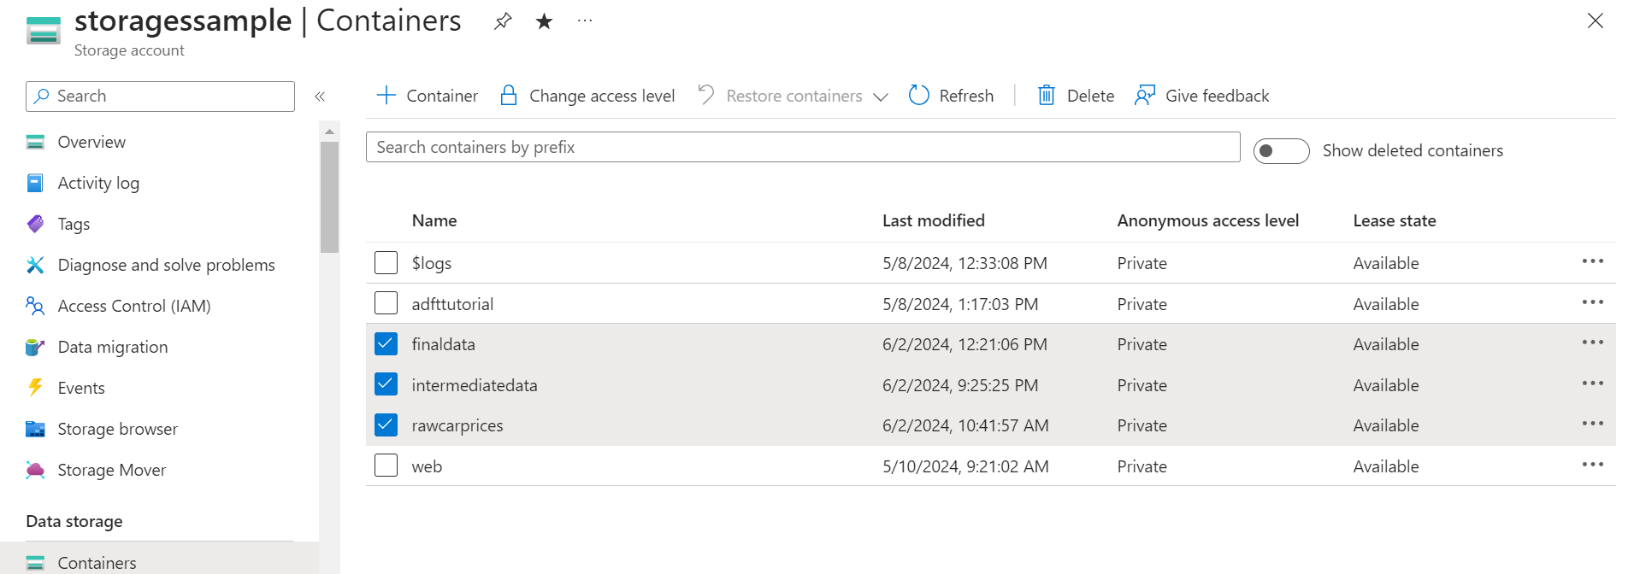
Containers Used

Slide 9


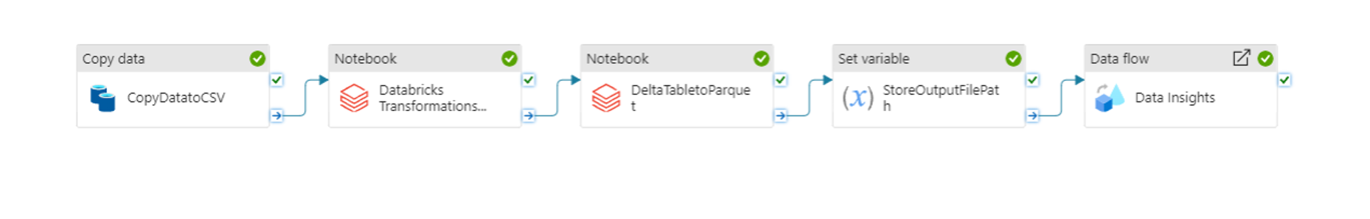

ENTIRE PIPELINE

Slide 10
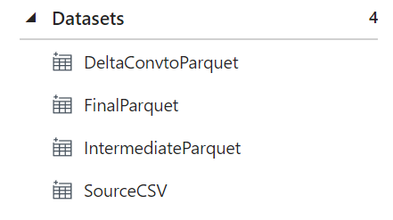
Datasets Used

Slide 11
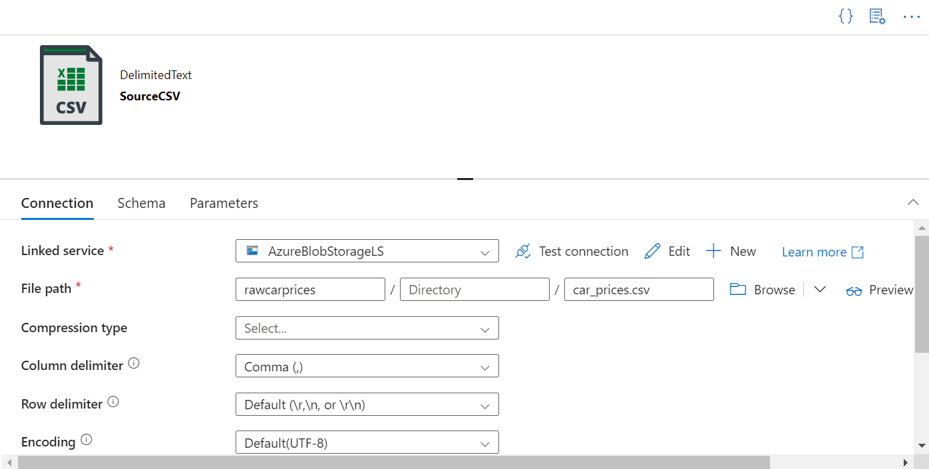
SourceCSV Dataset

Slide 12
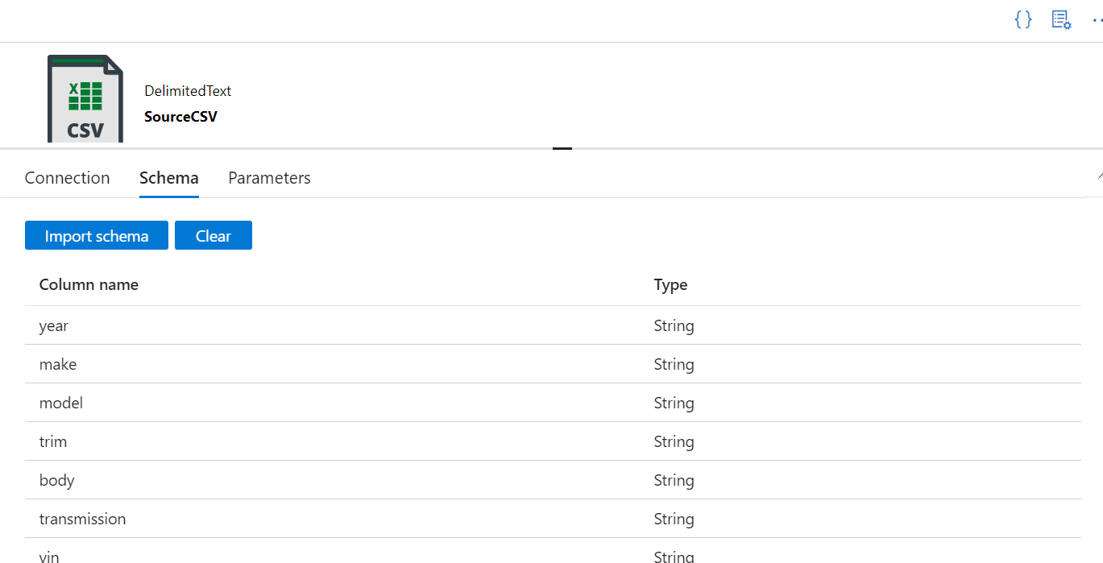
SourceCSV Dataset

Slide 13
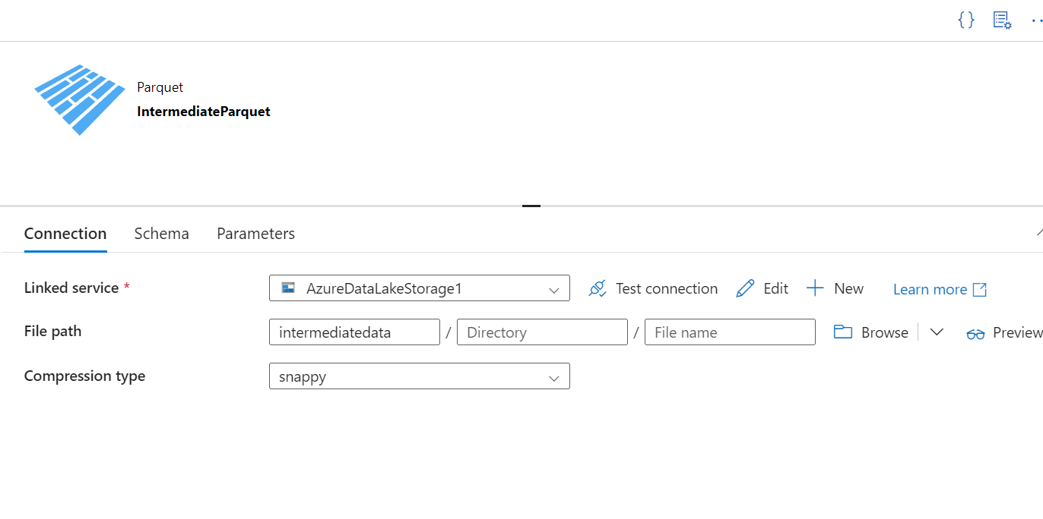
IntermediateParquet Dataset

Slide 14
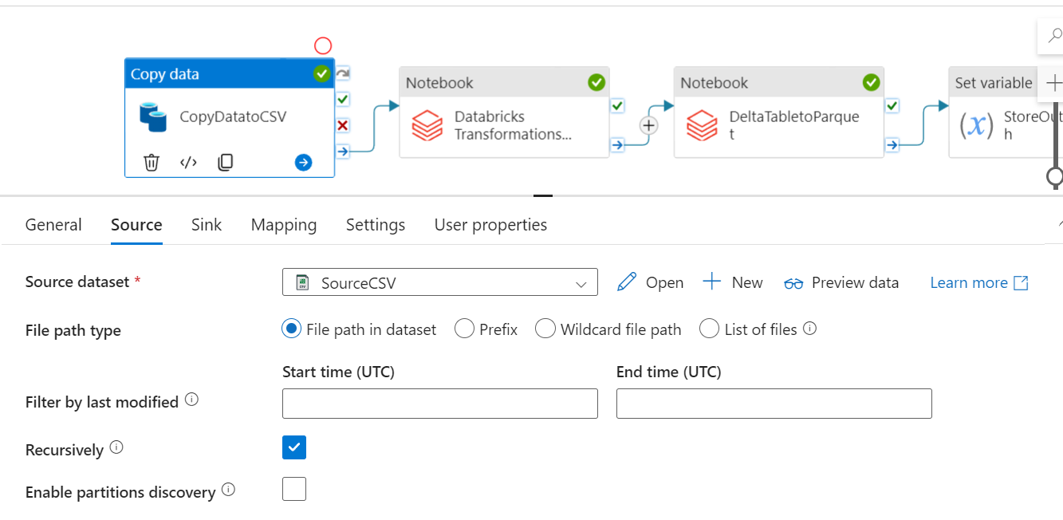
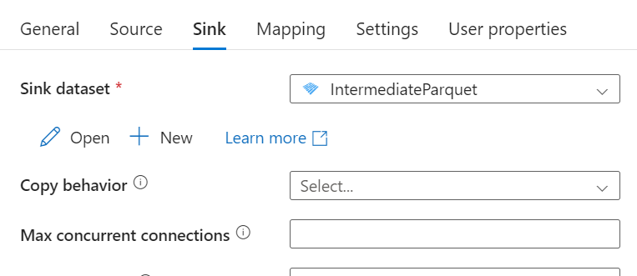
Copy Activity

Slide 15
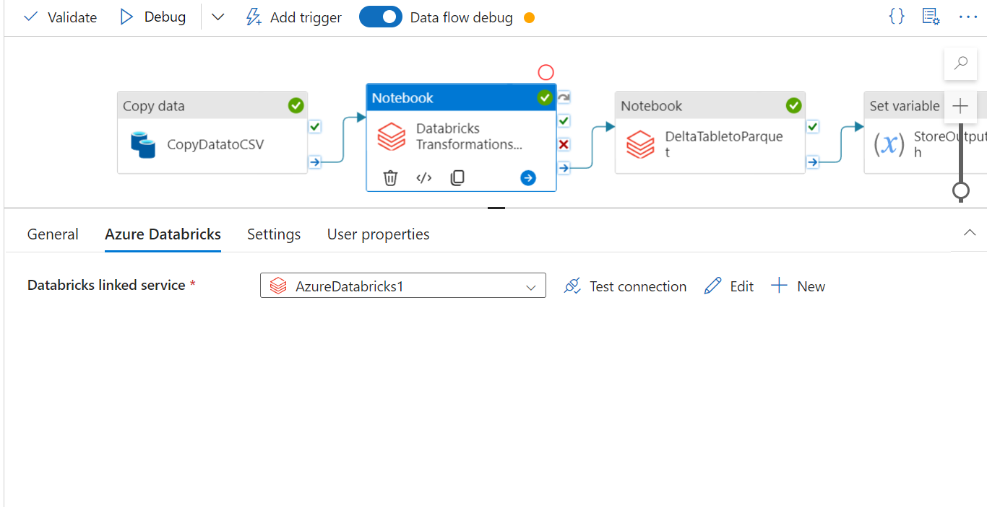
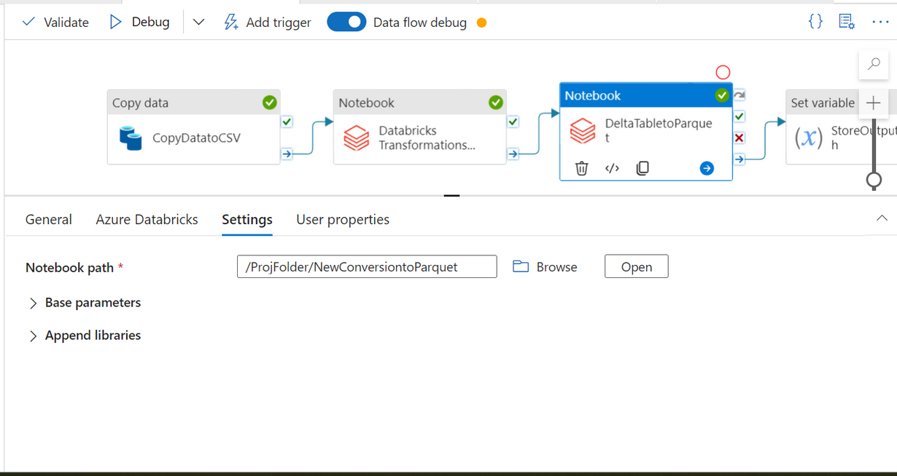
Databricks Notebook Activities

Slide 16
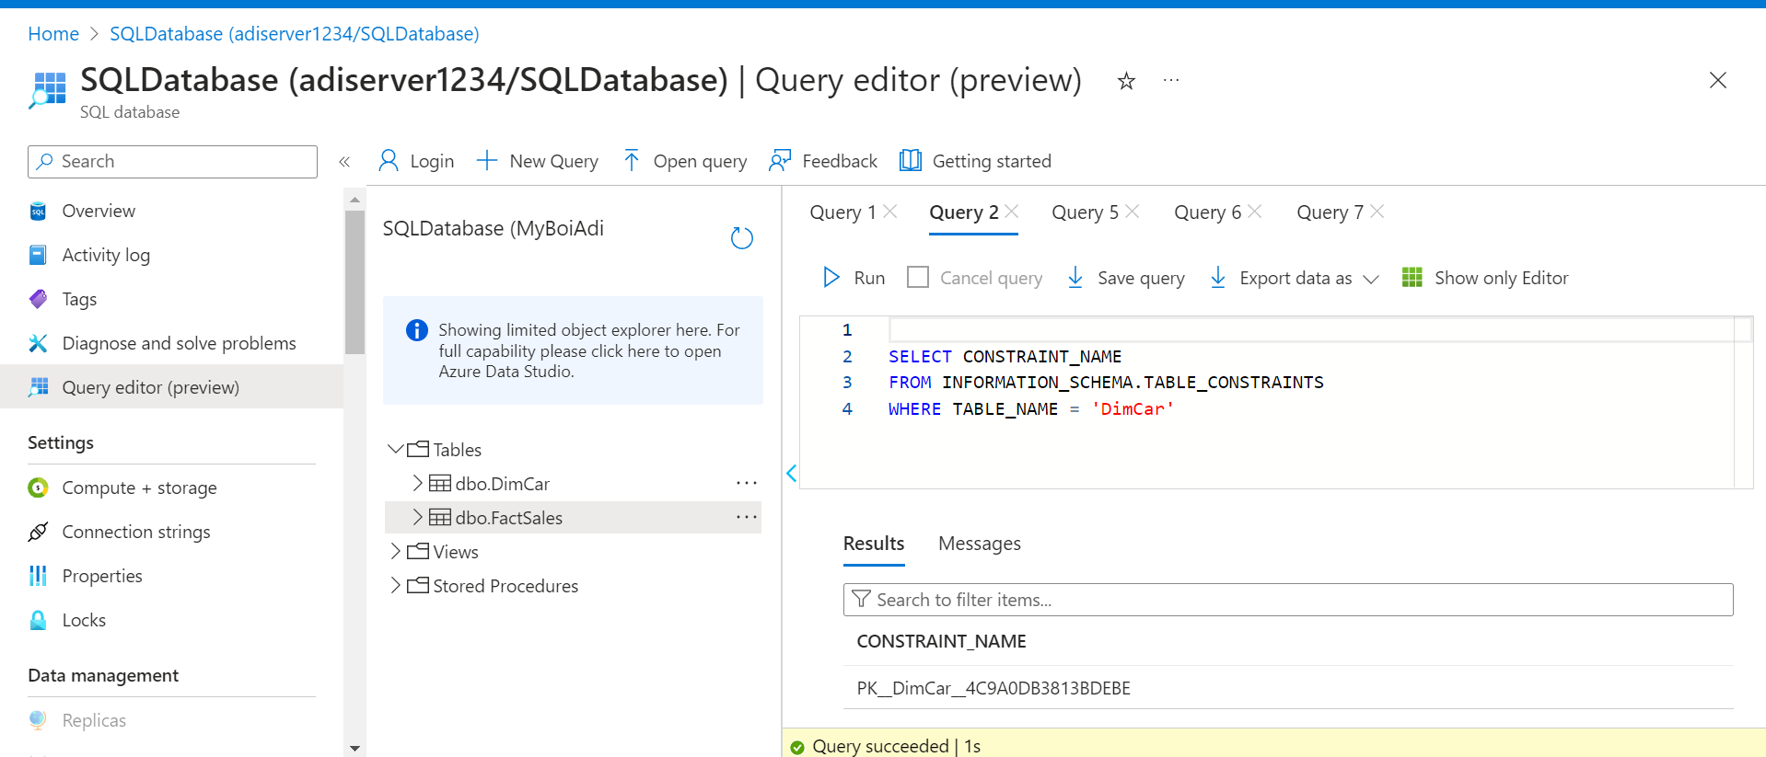
Getting Primary and Foreign Keys

Slide 17
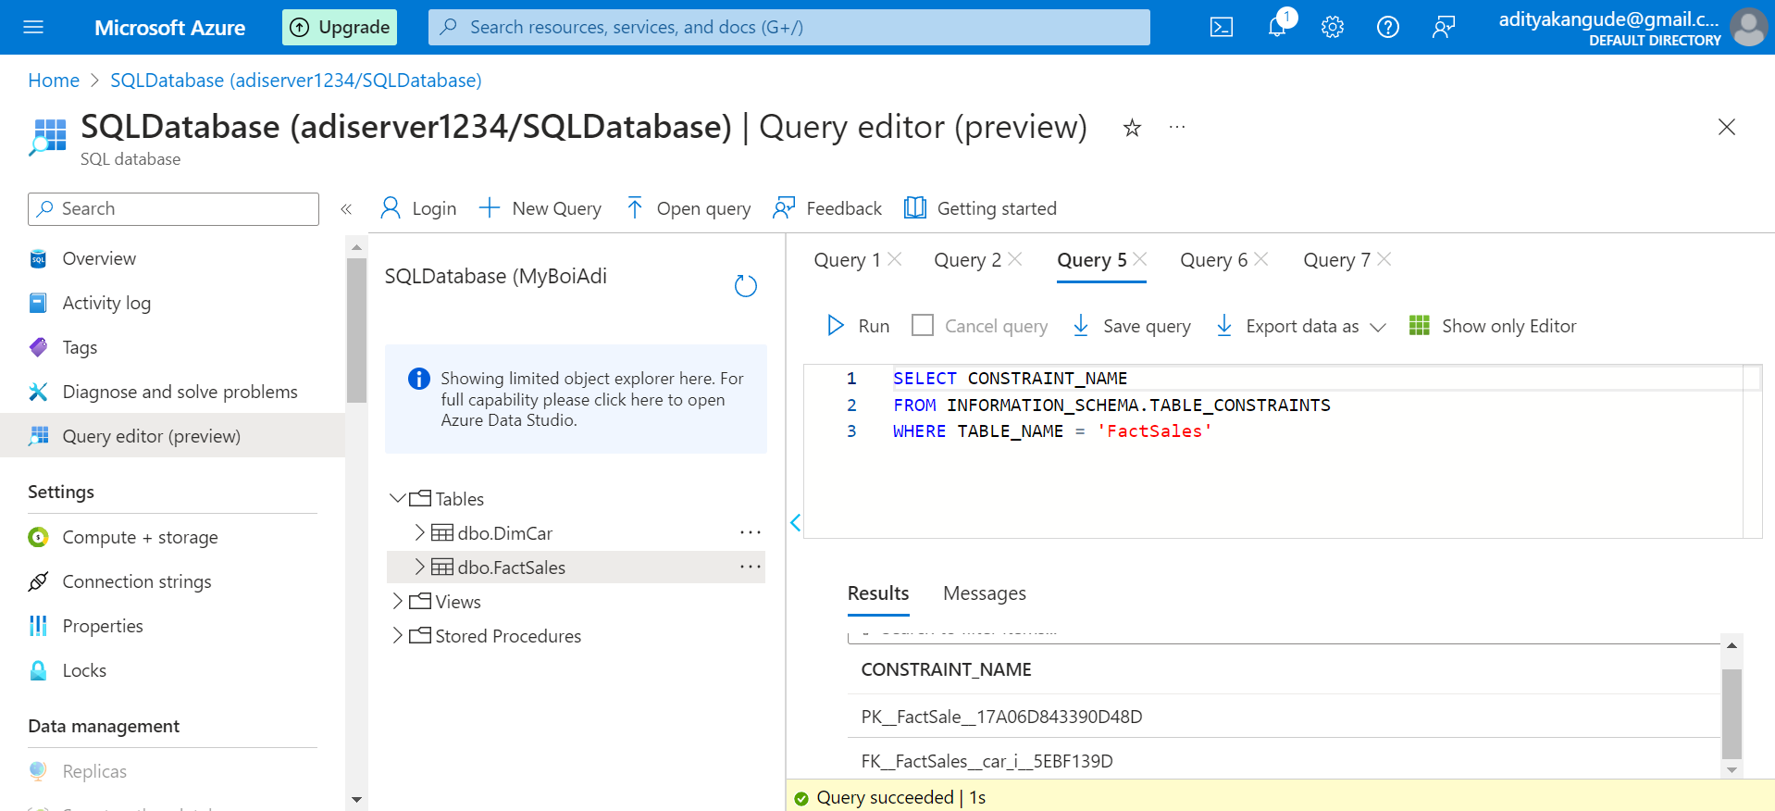
Getting Primary and Foreign Keys

Slide 18
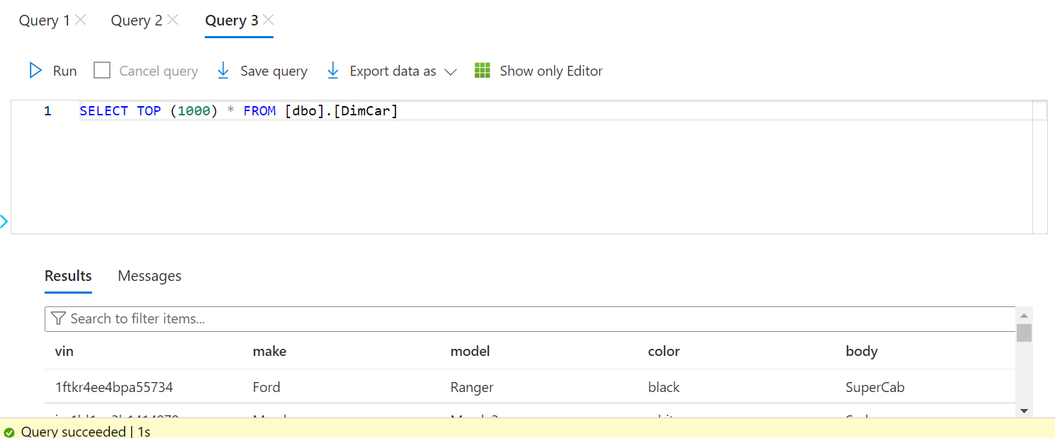
Table Successfully Loaded into SQL Database

Slide 19
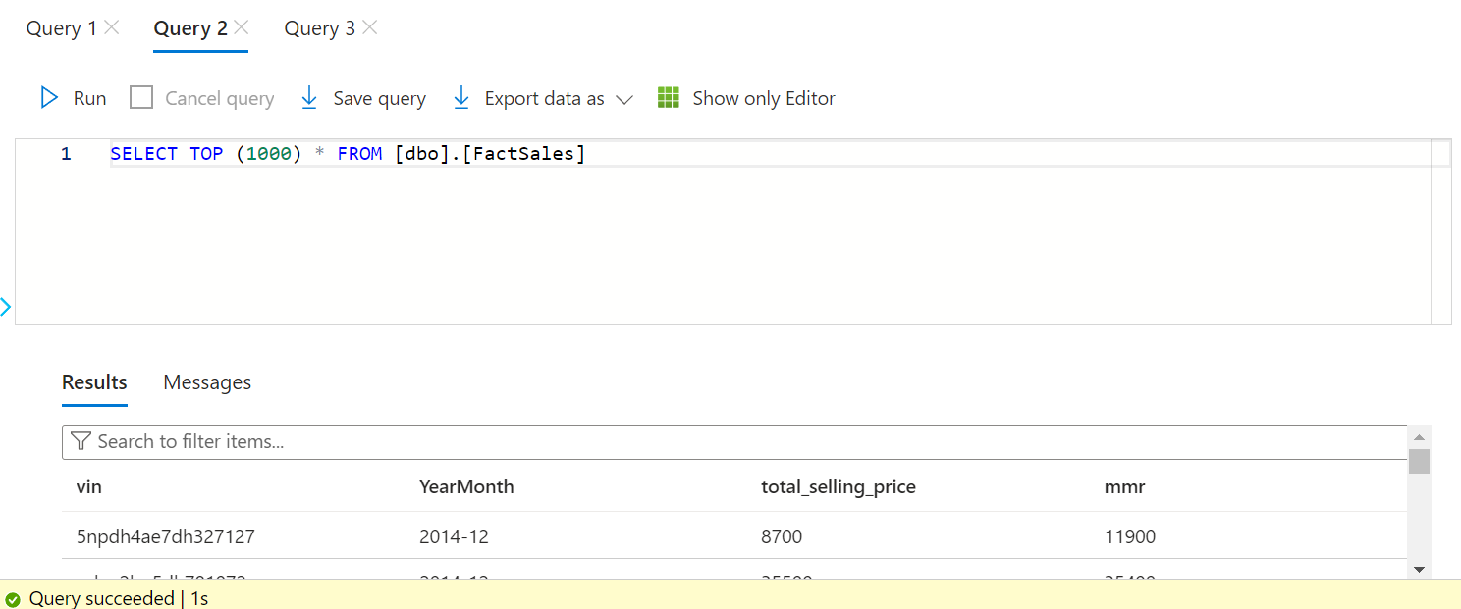
Table Successfully Loaded into SQL Database

Slide 20
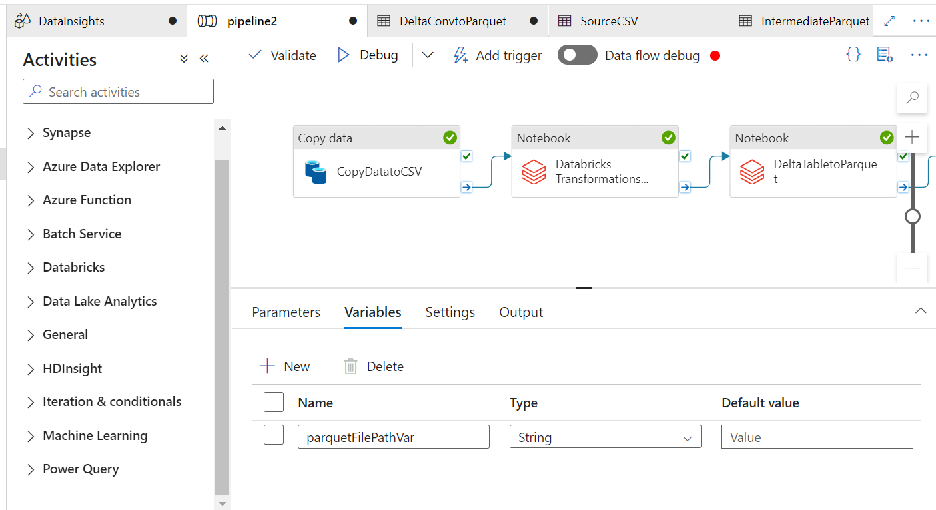
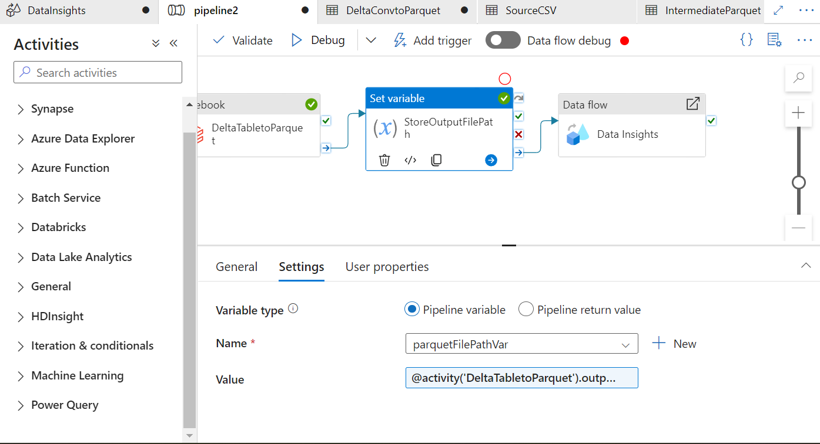
Set Variable Activity

Slide 21
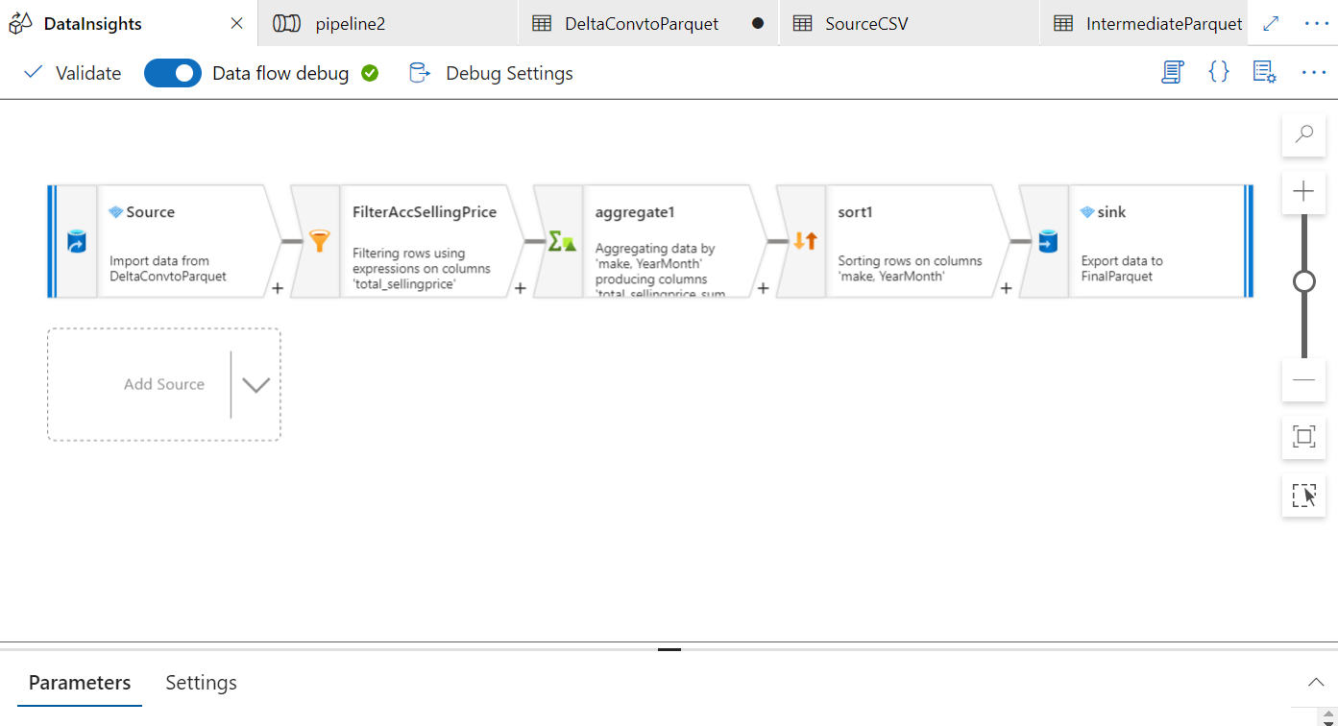
Data Flow Activity

Slide 22
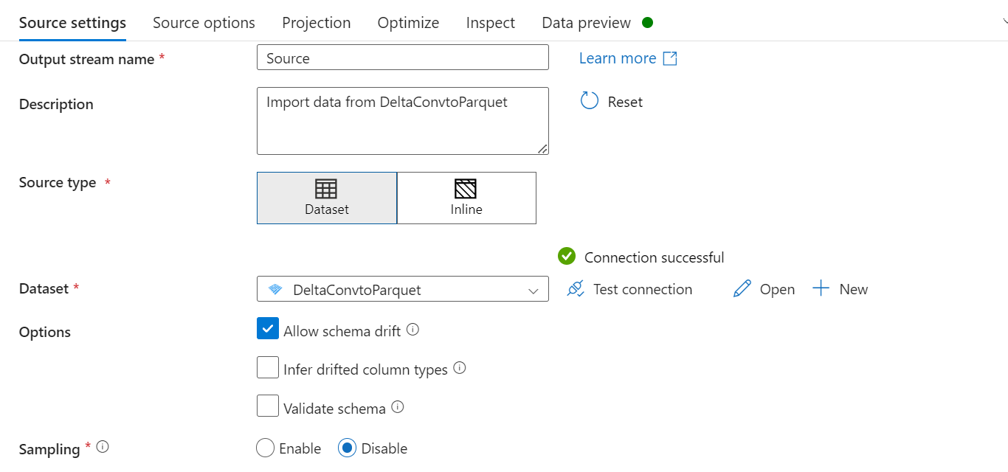
Data Flow Source

Slide 23
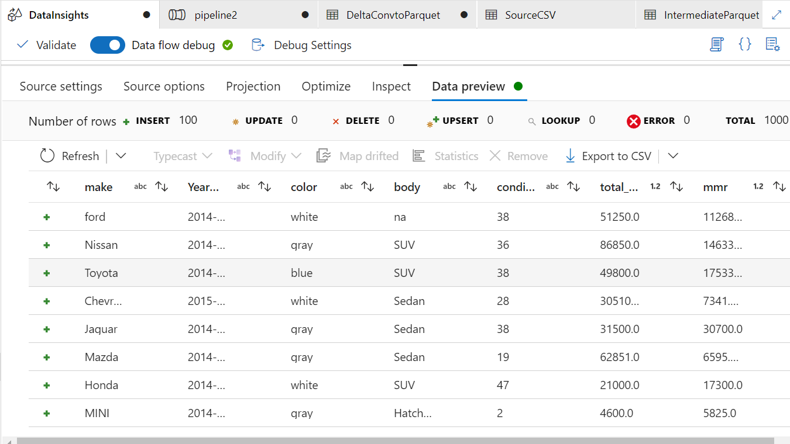
Data Flow Source Preview

Slide 24
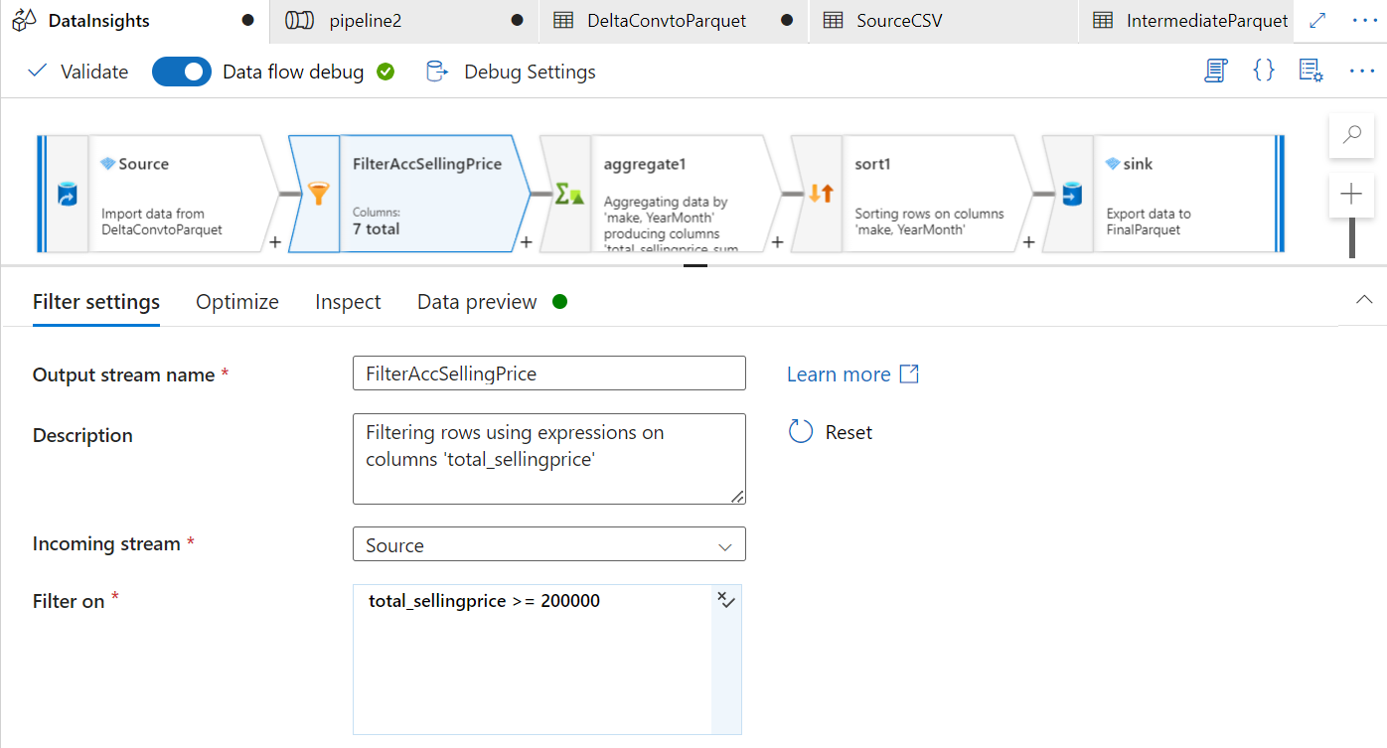
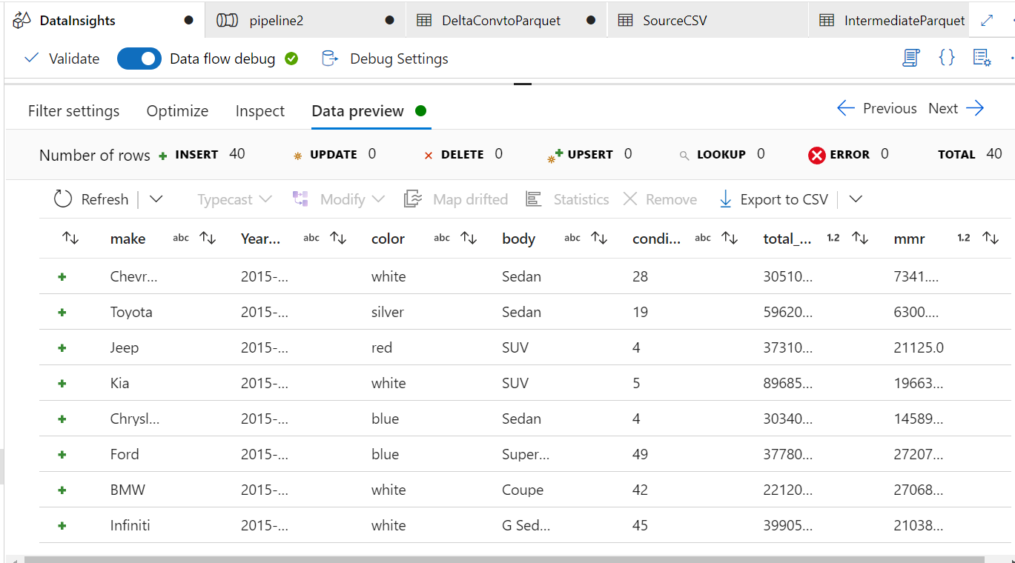
Data Insights- Filter

Slide 25
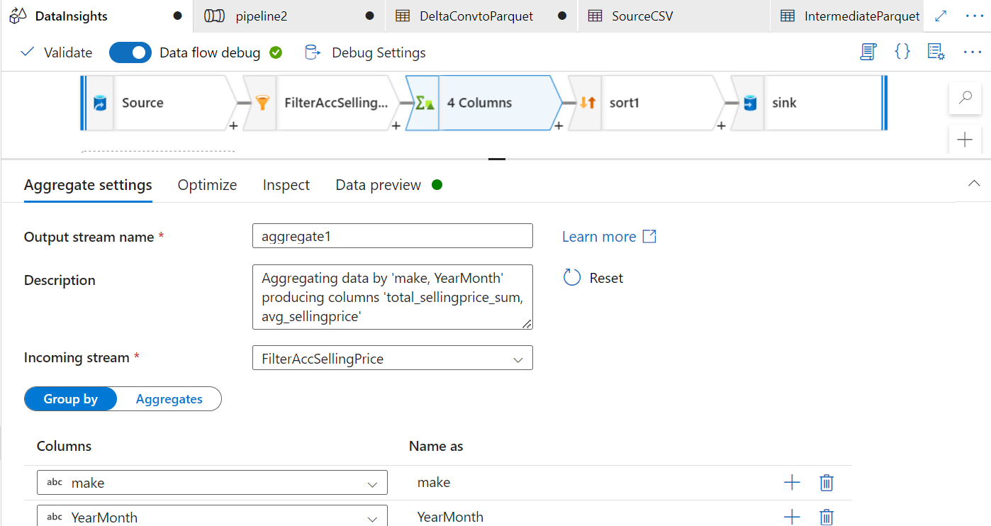
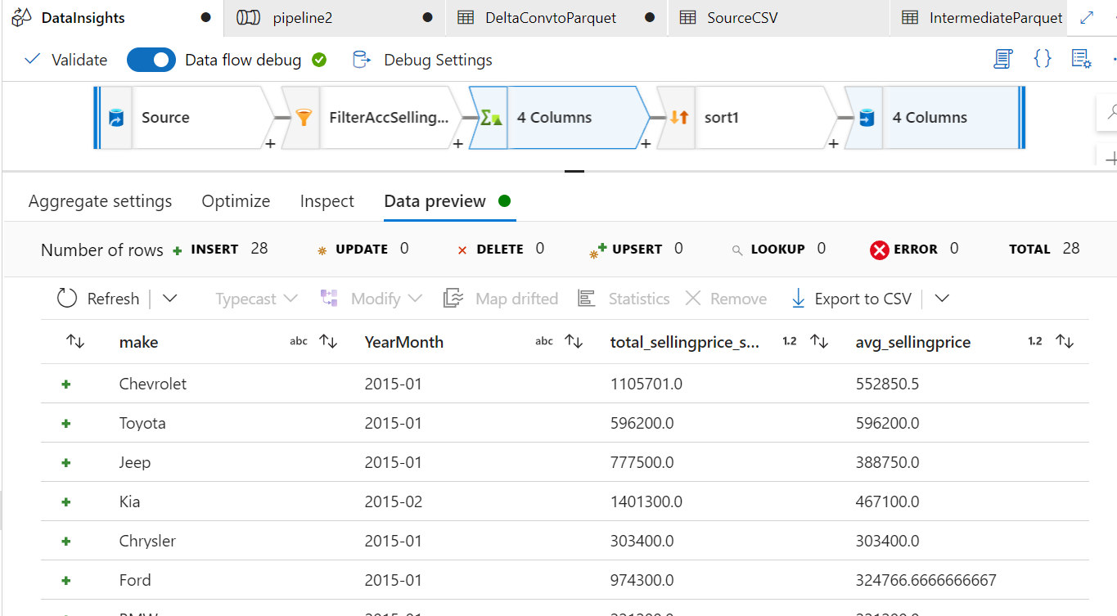
Data Insights- Aggregate

Slide 26
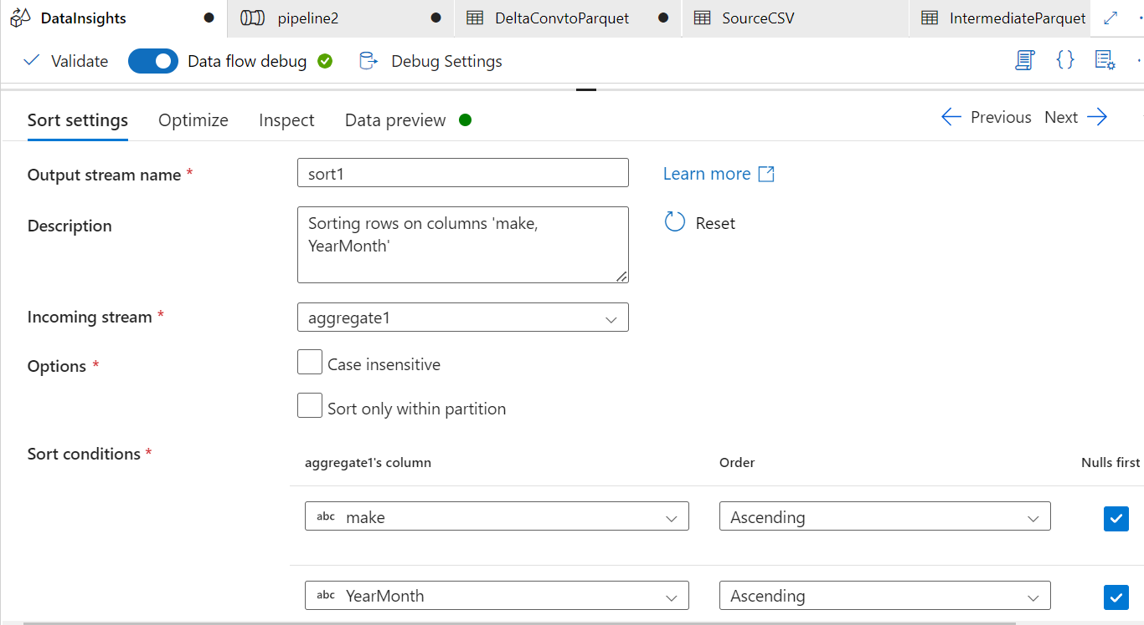
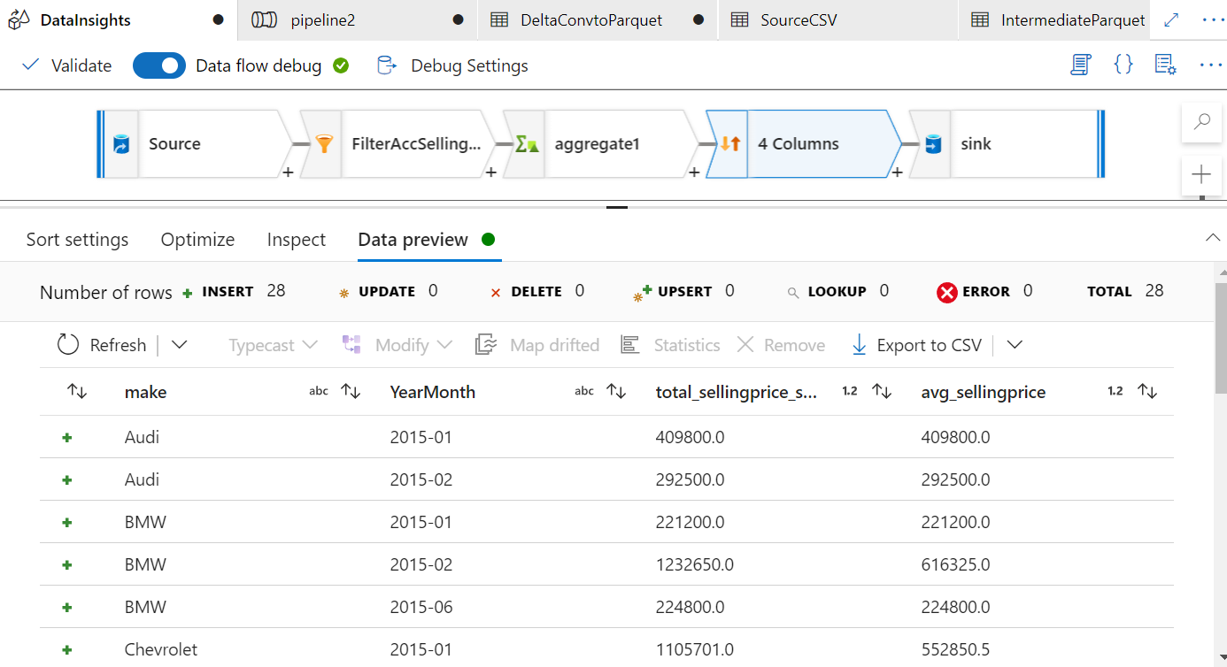
Data Insights- Sort

Slide 27
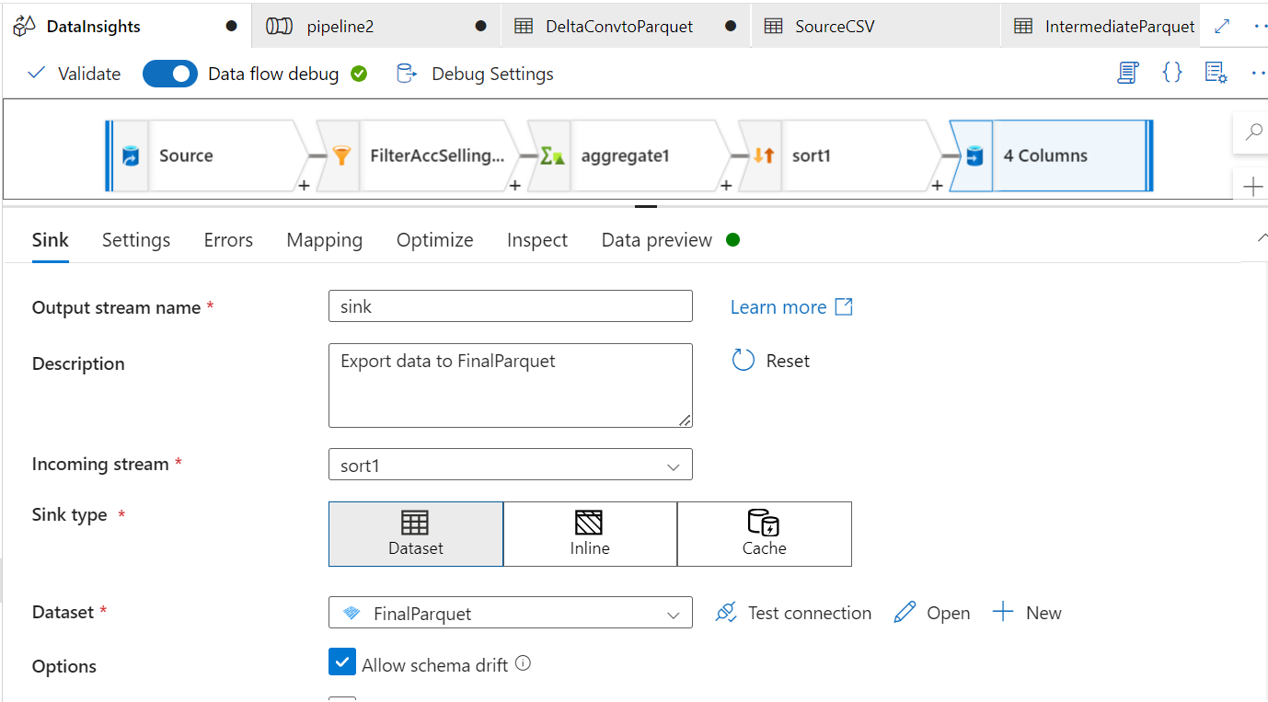
Data Insights-To Sink

Slide 28
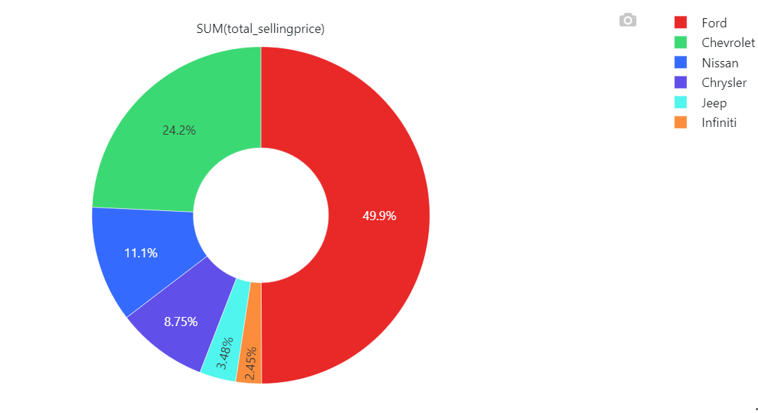
Data Visualisations
March 2015 Sales by Make

Slide 29
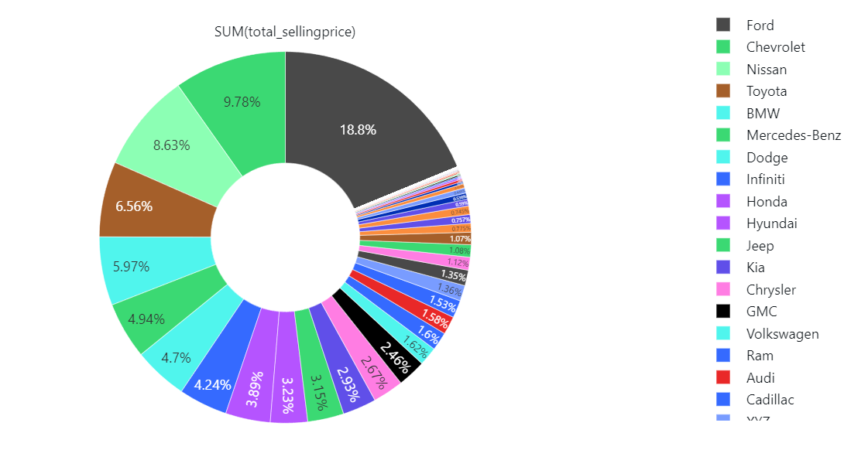
Data Visualisations
2015 Sales by Make

Slide 30
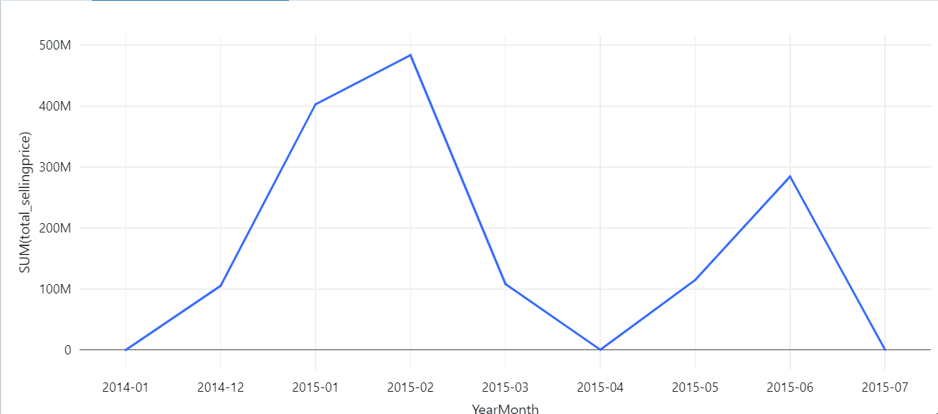
Data Visualisations
Sales by YearMonth

Slide 31



THANK YOU
For watching this presentation
+91 83297 85547
s.kangude@iitg.ac.in

