Slide 1

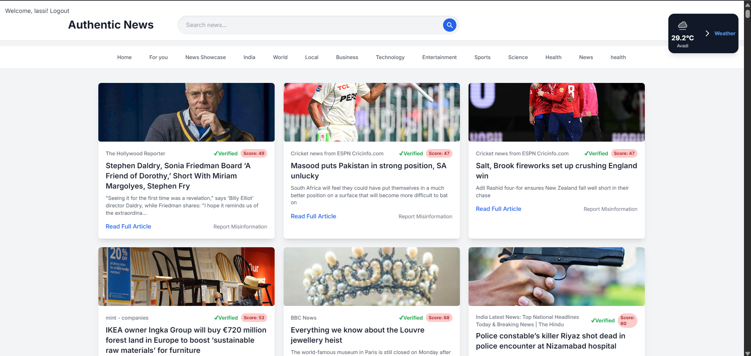
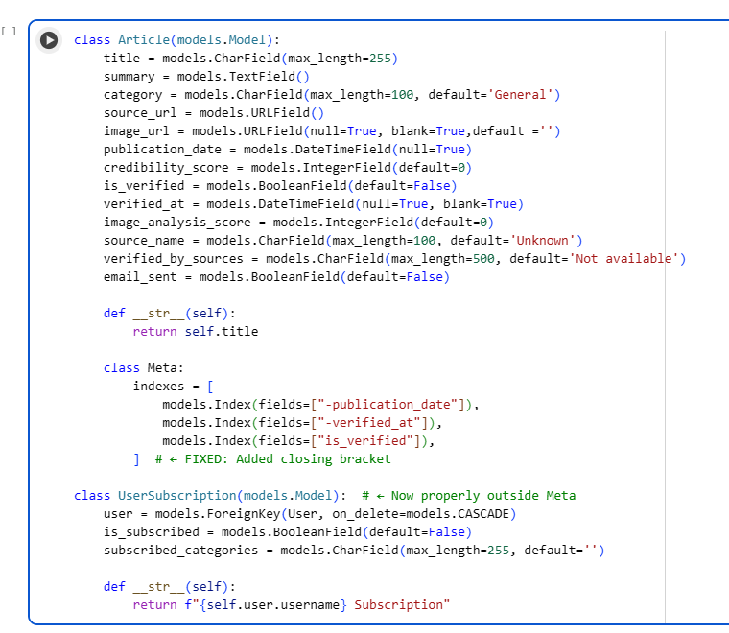
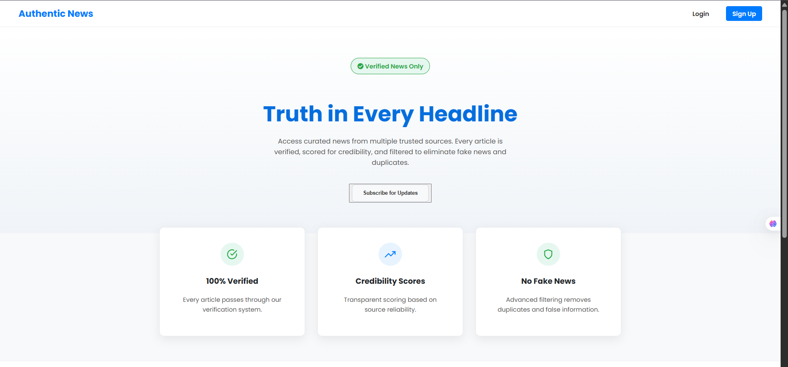
Design and Development of Automatic Authentic News Feed System
Department of Information Technology
School of Computing
10214IT601 – MINOR PROJECT
SUMMER SEMESTER 25-26
ABSTRACT
INTRODUCTION
RESULTS
STANDARDS AND POLICIES
The Authentic News Verification System is an AI-driven platform designed to combat the spread of misinformation by automatically fetching, verifying, and publishing credible news articles. The system integrates multiple RSS feeds, processes them through an AI-based verification engine, and assigns a credibility score based on content accuracy and source reliability. Verified articles are then categorized and displayed through a secure Django web interface, enhanced with real-time weather updates and search functionality. Workflow automation using Zapier ensures continuous data collection and email notifications for subscribed users. By combining automation, artificial intelligence, and ethical data handling, the project establishes a reliable and scalable framework for delivering authentic news to users while minimizing human bias and manual effort.
In today’s digital era, the rapid spread of misinformation poses a major threat to public awareness and trust in media. The Authentic News Verification System is designed to address this issue by integrating artificial intelligence with automated workflows to validate and publish only credible news. The system collects data from multiple RSS feeds and processes it through an AI verification engine that assigns credibility scores based on factual accuracy. Verified articles are stored in a centralized database and displayed through a secure, user-friendly Django interface. Automation tools such as Zapier and Google Sheets streamline data synchronization, email alerts, and system updates. The inclusion of real-time weather updates, search functionality, and category-based news organization enhances user engagement. This project demonstrates the potential of AI-powered automation in creating a transparent and trustworthy digital news ecosystem.
The Authentic News Verification System successfully automates the process of fetching, verifying, and publishing credible news articles in real time. The integration of AI-based fact-checking ensures that only authentic information with a high credibility score is displayed to users. The Django web interface efficiently categorizes news and enhances accessibility through features like search and weather widgets. Workflow automation via Zapier enables seamless data flow between modules without manual intervention. Subscribers receive instant email alerts when new verified articles are published. Overall, the system achieves its goal of delivering a transparent, reliable, and user-centric verified news platform.
Web Application Security Standard: OWASP Top 10 (2023) — Applied to protect the Django web application against threats such as SQL injection, XSS, and CSRF attacks.
Python Standard Used: ISO/IEC WD TR 24772-4 — Ensures code reliability, safety, and prevention of common software vulnerabilities in Python-based applications.
METHODOLOGIES
The Authentic News Verification System follows a multi-layered and systematic approach that combines artificial intelligence, workflow automation, and web technologies. The methodologies used in this project are as follows:
News Data Collection:
The system gathers real-time news articles from multiple trusted RSS feeds such as BBC, The Hindu, TechCrunch, and others, ensuring a diverse and up-to-date dataset for analysis.
Data Cleaning and Preprocessing:
The collected articles are filtered to remove duplicates, unwanted metadata, and formatting inconsistencies, ensuring only clean, relevant text proceeds for verification.
AI-Based News Verification:
A Large Language Model (LLM) integrated through n8n performs automated fact-checking using SerpAPI, cross-verifying article claims across the web and generating a credibility score and verification notes.
Automated Workflow Execution: The entire process — from data collection to verification and API posting — is automated using workflow tools like n8n and Zapier, enabling real-time, hands-free operation.
Database Management and Categorization: Verified articles are sent via POST API requests to the Django backend, where they are securely stored, categorized (e.g., Health, Business, Science), and updated in the database.
Frontend Display and Subscriber Notification: The Django-based frontend displays only verified news, while an integrated Gmail workflow automatically notifies subscribers of newly published authentic articles.
CONCLUSIONS
The Authentic News Verification System effectively demonstrates how AI and automation can combat digital misinformation through verified, credibility-scored news delivery. It ensures reliability, transparency, and real-time updates by integrating Django, n8n, and LLM-based verification. Overall, the system provides a scalable and trustworthy framework for promoting authentic information in the digital era.
TEAM MEMBER DETAILS
<S. Adi Kesava Reddy (VTU25083)>
<CH. Chandra Lasya (VTU26339)>
<7981195980>
<9666593721>
<singamadi2006@gmail.com>
<chandralasya24@gmail.com>
ACKNOWLEDGEMENT
Dr. M. Dhilsath Fathima, B.E., M.E., Ph.D.. ASSOCIATE PROFESSOR
8668122854
drdhilsathfathimam@veltech.edu.in

