Slide 1

TRAFFIC SIGN RECOGNITION
GEORGE BROWN COLLEGE
FULL STACK DATA SCIENCE SYSTEMS
GROUP 8-
Aditya Koshti - 101504567
Ayushi Patel - 101450798
Mahesh Dadheech - 101501168
Sakshi Sareen - 101471328
Shivani - 101504534
Professor -Vejey Gandyer

Slide 2
AGENDA
Problem Statement
Significance
Literature Review
Methodology – ML Canvas
Model Benchmarking
Model Deployment
Challenges
Demo
Q & A

Slide 3
PROBLEM STATEMENT
Traffic Sign Recognition is essential for developing autonomous driving systems. The challenge lies in accurately identifying and interpreting various traffic signs in real-time, ensuring the safety and efficiency of autonomous vehicles.

Slide 4
Significance
Safety Improvements
Enhances road safety by reducing human error.
Assists drivers in recognizing and responding to traffic signs promptly.
Technological Advancements
Contributes to the development of autonomous vehicles.
Integrates with smart city infrastructure for better traffic management.
Economic Impact
Reduces costs associated with traffic accidents and violations.
Potential for commercialization in automotive and urban planning sectors.

Slide 5
WHY THIS PROBLEM
Misinterpretation of traffic signs can lead to accidents or traffic violations. With the increasing adoption of autonomous vehicles, a robust and accurate traffic sign recognition system is crucial.

Slide 6
LITERATURE REVIEW
Past Available Projects: Most existing systems focus on traditional computer vision techniques like edge detection and color-based segmentation. However, these approaches can struggle with varying lighting conditions, occlusions, and low-quality images.
Similar Projects: Google’s self-driving car project and Tesla’s autopilot system both utilize traffic sign recognition as a key component.
Drawbacks: Traditional methods lack the ability to generalize across different environments and weather conditions.

Slide 7
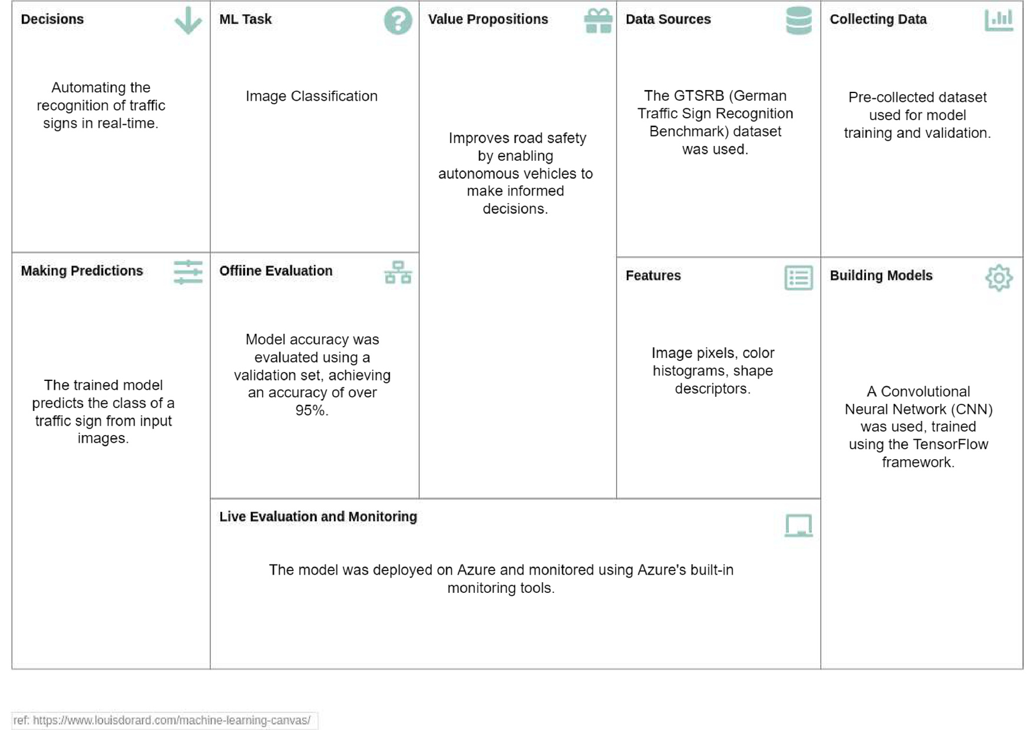
Methodology – ML Canvas

Slide 8

MODEL BENCHMARKING
Model Performance
Chosen Model: A custom Convolutional Neural Network (CNN) designed for traffic sign classification.
Accuracy: Achieved 75.8% accuracy on the GTSRB test set.
Comparison with Baselines
Traditional Methods: Significantly outperformed SVM-based models.
Inference Time: Achieved an average inference time of 15ms per image, suitable for real-time applications.

Slide 9
MODEL DEPLOYMENT
Performance Optimization: Ensuring the Convolutional Neural Network (CNN) model performed efficiently in the Azure container instance required balancing the model size with inference time to maintain real-time processing capabilities.
Dockerization: The decision to containerize the Flask application with the trained CNN model allowed for a consistent and portable deployment across different environments, ensuring that the application runs identically regardless of where it is deployed
Azure Container Instance: Choosing Azure Container Instances for deployment provided the flexibility and scalability needed to handle production workloads while simplifying the management of cloud resources.
Port Configuration: The application was configured to run on port 5000, ensuring that the containerized service could be easily accessed and integrated with other services or endpoints.

Slide 10
MODEL DEPLOYMENT
Successful Deployment: The model was successfully deployed within the Dockerized Flask application on Azure, achieving the desired performance and scalability.
Real-Time Performance: The optimization strategies ensured that the model provided real-time predictions without compromising accuracy, meeting the application’s requirements.
Continuous Monitoring: Implementing Azure's monitoring tools allowed for real-time tracking of the model’s performance and resource usage, enabling proactive management and scaling as needed.

Slide 11
MODEL DEPLOYMENT
Deployment Process:
Detail the steps involved in deploying the Docker container on Azure, including using the Azure CLI or the Azure Portal. Mention commands like az container create if you used CLI for deployment.
Monitoring:
Discuss how Azure's built-in monitoring tools (such as Azure Monitor) were used to track the performance of the deployed application, including metrics like CPU usage, memory usage, and request latency.
Security and Scaling Considerations:
Security:
Mention any security measures taken, such as using environment variables to handle sensitive information (e.g., API keys, database credentials).
Scaling:
Discuss potential strategies for scaling the application, such as using Azure Kubernetes Service (AKS) for container orchestration if you expect high traffic.

Slide 12
CHALLENGES AND ISSUES ENCOUNTERED
Deployment Challenges: Configuring the environment to run TensorFlow within a Docker container required resolving dependency conflicts and ensuring that all necessary packages were installed.
Performance Issues: Optimizing the model to run efficiently in a cloud environment was critical. The trade-off between model size and inference time had to be balanced to ensure real-time performance.
Monitoring: Implementing Azure's monitoring tools to track the performance and usage of the deployed model in real-time.

Slide 13
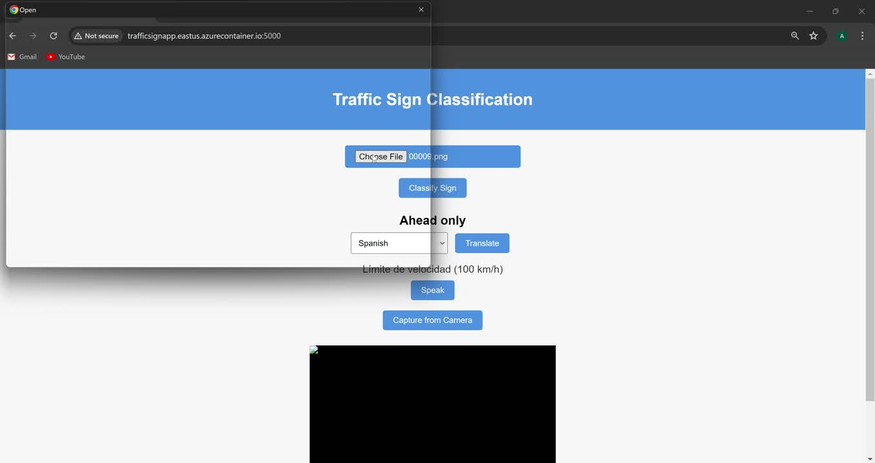
DEMO

Slide 14
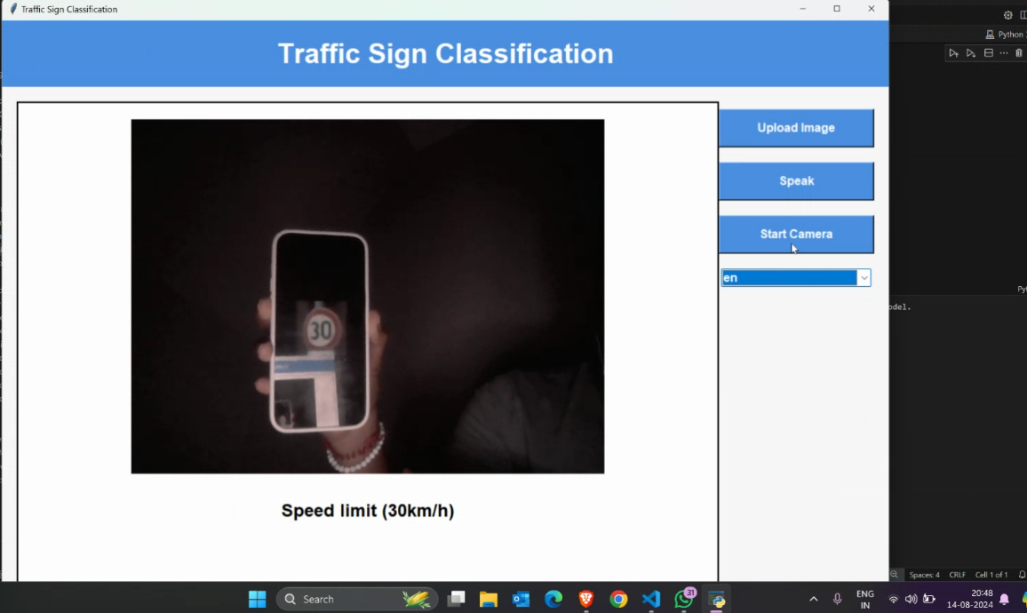
DEMO

Slide 15
Thank you.

