Slide 1

APMC Price-Pulse Real-Time Market Insights for Agriculture
Team:
Rahul G Rathod : 2BA22CS064
Aditya Vajramatti : 2BA22CS006
Devendra Vajrangi : 2BA22CS027
Prashanth P : 2BA22CS057

Slide 2

Challenges in Agricultural Pricing Addressing the gaps in market information for better decision-making
Lack of accessible price information: Farmers struggle to obtain real-time pricing data, hindering their market competitiveness.
Unawareness of market fluctuations : Many farmers are unaware of changing prices, leading to missed opportunities and poor sales.
Financial losses for farmers : Ineffective pricing strategies contribute to significant financial losses for agricultural producers.
Variations of prices for buyers : Buyers struggle with varying prices across different locations.

Slide 3



Introduction to APMC Price-Pulse
APMC Price-Pulse: Real-Time Market Insights for Agriculture
Current Prices
Historical Prices

Slide 4





Key Features of APMC Price-Pulse
APMC Price-Pulse: Real-Time Market Insights for Agriculture
Real-Time Data
Provides up-to-date prices from APMC markets, ensuring users have access to the latest market information.
Historical Data
Access to past price trends allows for informed decision-making and a better understanding of market dynamics.
Graphical Analysis Visual representations of data help users easily understand market fluctuations and price movements over
time.
Intuitive Interface
User-friendly design with multilingual support makes it accessible for a diverse range of users.

Slide 5

Beneficiaries of APMC Price Pulse includes:
Farmers : They gain access to real-time price information, empowering them to negotiate better prices for their produce.
Wholesalers : With updated market data, wholesalers can make informed buying and selling decisions, optimizing their operations.
Consumers : Access to transparent pricing helps consumers make better choices and can lead to more competitive prices in the market.
Agri-Entrepreneurs : Startups and businesses involved in agriculture can leverage price data for better planning and investment decisions.
Researchers and Analysts : They can analyze market trends and price fluctuations for studies and reports, contributing to a better understanding of the agricultural sector.
Cooperatives and Farmer Groups : These organizations can use price data to support their members in achieving better market outcomes.

Slide 6
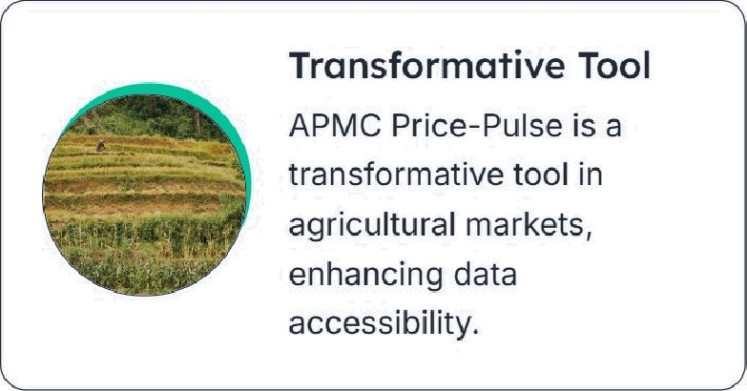
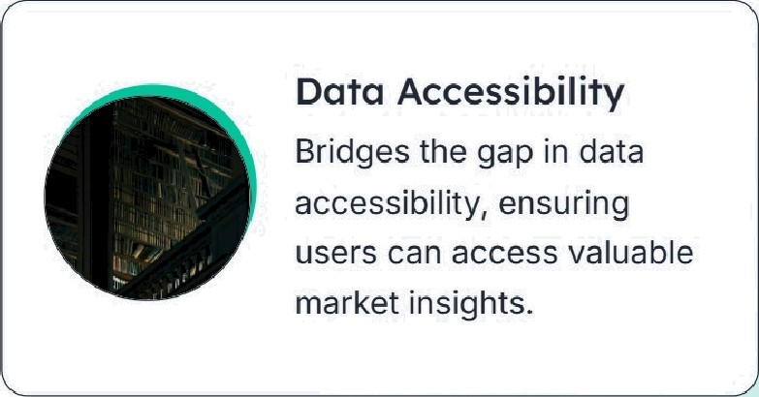

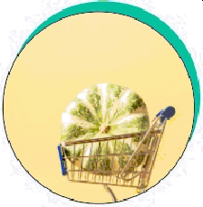

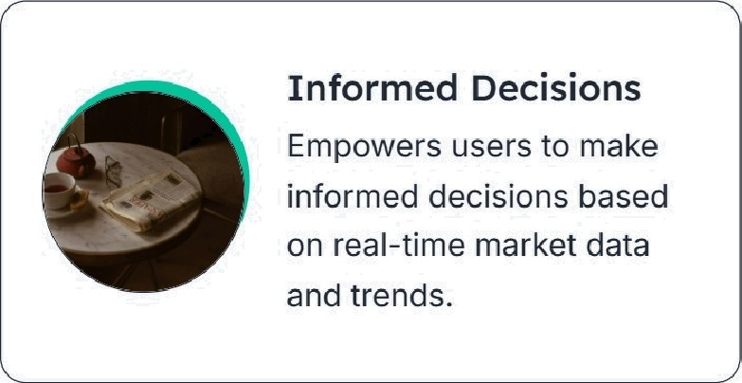
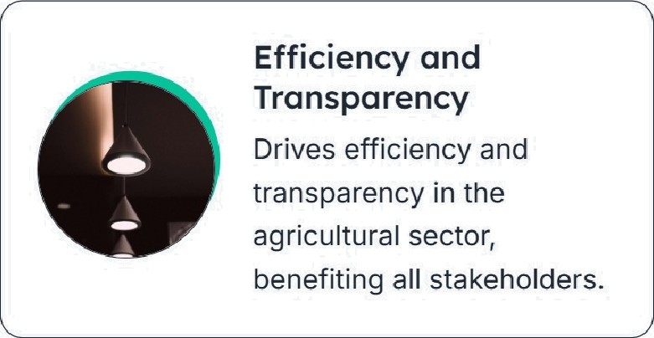


Conclusion:
APMC Price- Pulse: Real-Time Market Insights for Agriculture
Price Information Provides critical price information and trend analysis for various crops and commodities.
“’

