Slide 1
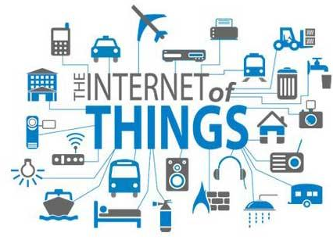


Slide 2
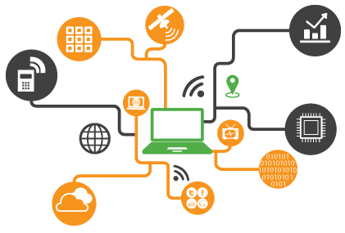
WHAT IS IOT ?

Slide 3
“The Internet of Things (IoT) is a system of interrelated computing devices, mechanical and digital machines, objects, animals or people that are provided with unique identifiers and the ability to transfer data over a network without requiring human-to-human or human-to-computer interaction.”
Notes:
The Internet of Things is actually a pretty simple concept, it means taking all the things in the world and connecting them to the internet.

Slide 4
WHY IOT ?

Slide 5
BEING SMART!
Smarter Healthcare!
Smarter Disaster management System!
Smart Cities!
Smart Enterprises!
Smart Living!
Smarter Security!
Smart Industries!
Smart Rural Management System!

Slide 6
Ability to remotely monitor and control devices for peace of mind.
Improve energy efficiency of household devices.
Extends lifecycle for products, through the ability to update.
Ability to integrate multiple connected products for improved customer experience.
Ability for products to manage themselves.

Slide 7
LIMITATIONS OF IOT

Slide 8


Privacy
Security
Compatibility
Complexity
Unemployment
Notes:
1. Privacy – This is a great concern when it comes to exchanging valuable information regarding anything. Since everything will be connected breaching inside the network would be easy by the hackers. By entering into just a part of network would reveal everything regarding an individual or organization or both (may be). What if your office colleagues know what medicines you take or where did you go last night?
2. Safety – If a situation comes like a notorious hacker changes your medical prescription and you are supplied expired medicines or those medicinal drugs to which you are allergic to, then there would be a health disaster. Since the consumer that time would be dependent entirely on the technology there would be least probability that he would bother checking anything. The verification today is done manually by the consumer himself but no one knows what will happen later.
3. Compatibility – At present there is no international standard for device compatibility. For example, home based appliances and equipments may be getting problems in connecting with laptops or mobile phones. Also Apple devices don’t accept the connectivity with any other device. Likewise different manufacturers need to agree upon this else people will prefer buying only one brand and there would be monopoly.
4. Complexity – If there comes a bug all of a sudden or electricity goes off there would be so much of problem since everyone will be dependent on the IoT technology only. The bugs will lead to certain tasks wrongly accomplished or not done at all.
5. Unemployment – Since the technology would do its task all by itself there will be no need of any manpower, ultimately leading to unemployment. Today’s computers need to be operated by someone but later the lists of tasks would be done by the machine itself.

Slide 9
IOT ENHANCED
Notes:
Connectivity with ML

