Slide 1
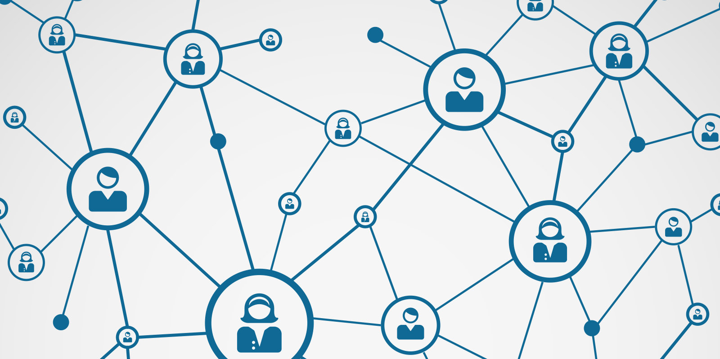
NETWORKS

Slide 2
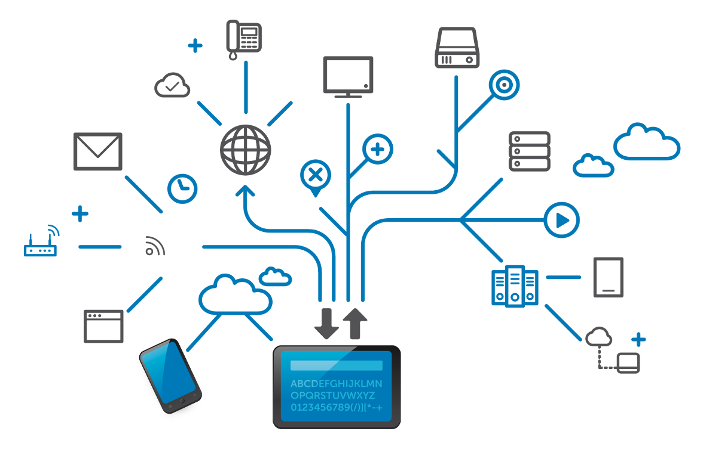
A practice of transporting and exchanging data between nodes over a shared medium in an information system.
Networking facilitates everything from telephone calls to text messaging to streaming video to the internet of things (IoT).

Slide 3
PROTOCOLS

Slide 4
Set of established rules.
Dictates how to format, transmit and receive data so computer network devices.
For all devices from servers and routers to endpoints.
Same for all devices regardless of the differences in their underlying infrastructures, designs or standards.

Slide 5
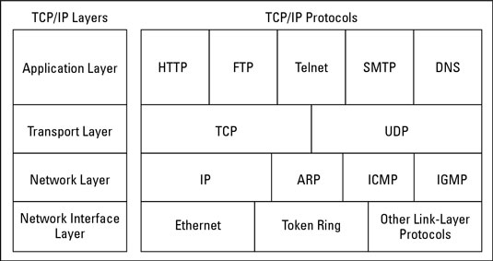

Slide 6
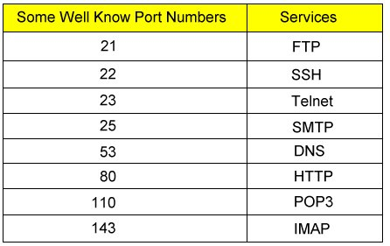
Port Number
Computers use port numbers to determine to which process or application a message should be delivered. As network addresses are like street address, port numbers are like suite or room numbers.

Slide 7
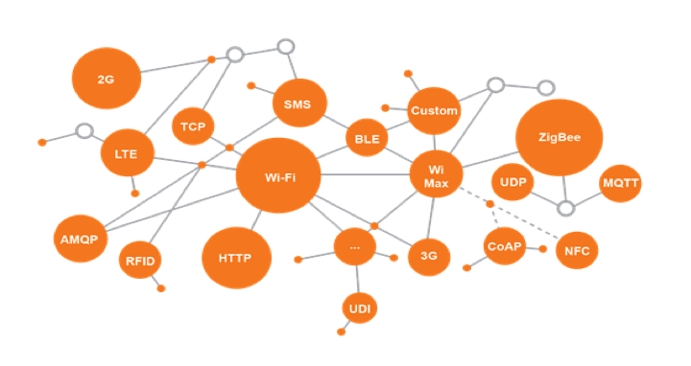
DIFFERENT PROTOCOLS AND TECHNOLOGIES USED IN IOT
Different protocols and technologies used in IoT

Slide 8
List of protocol dedicated for IoT
Advanced Message Queuing Protocol (AMQP),
Streaming Text Oriented Messaging Protocol (STOMP),
IETF Constrained Application Protocol,
XMPP
DDS
OPC UA
Web Application Messaging Protocol (WAMP).

Slide 9
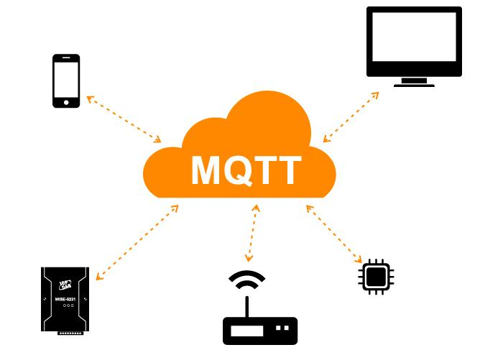

Slide 10
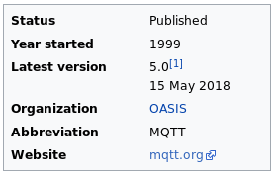
MESSAGE QUEUING TELEMETRY TRANSPORT
HISTORY
Created by : Andy Stanford-Clark (IBM) and Arlen Nipper (Arcom, now Cirrus Link)

Slide 11
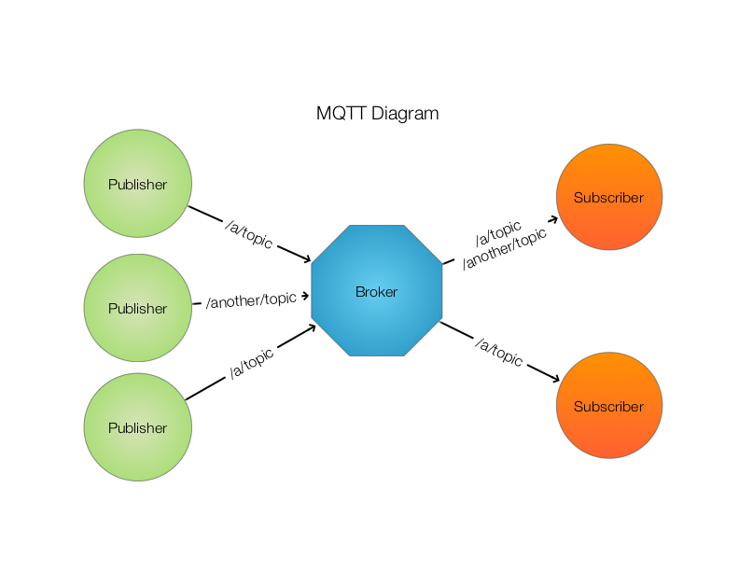

Slide 12
FEATURES
Decoupling
Space decoupling: Publisher and subscriber do not need to know each other (for example, no exchange of IP address and port).
Time decoupling: Publisher and subscriber do not need to run at the same time.
Synchronization decoupling: Operations on both components do not need to be interrupted during publishing or receiving.
Scalability
Pub/Sub scales better than the traditional client-server approach.
Message caching and intelligent routing of messages are often a decisive factors for improving scalability

Slide 13
Message Filtering
Subject-based filtering
Content-based filtering
Type-based filtering

Slide 14
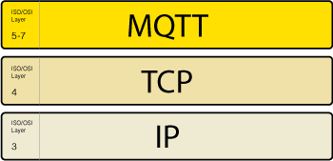

Connection
The MQTT protocol is based on TCP/IP.
Both the client and the broker need to have a TCP/IP stack
The MQTT connection is always between one client and the broker.

Slide 15
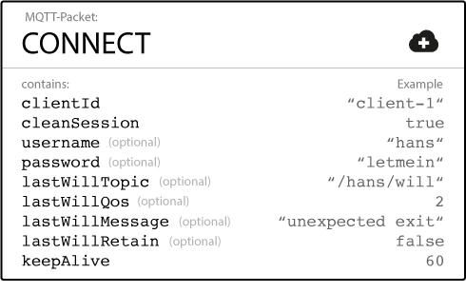
CONNECT MESSAGE

Slide 16
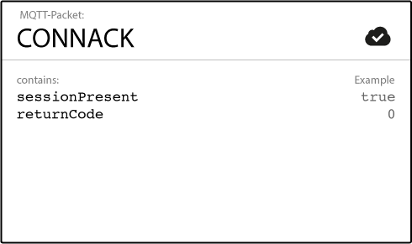
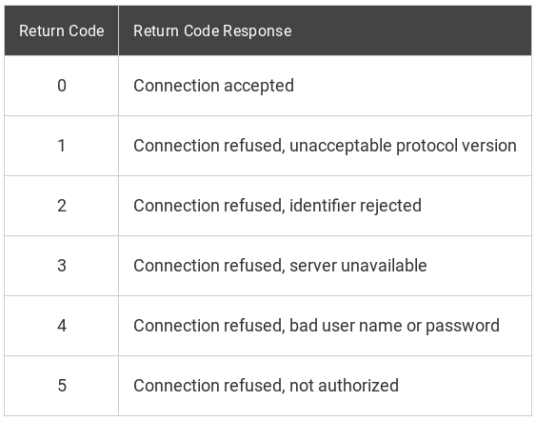
CONNACK MESSAGE

Slide 17
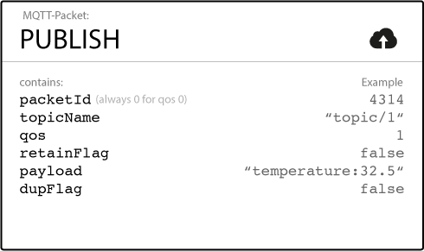
PUBLISH

Slide 18
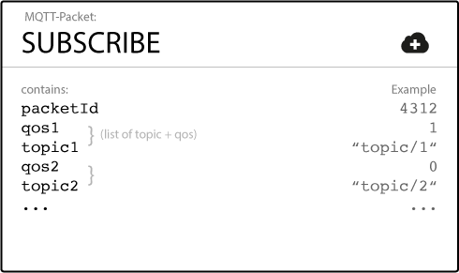
SUBSCRIBE

Slide 19
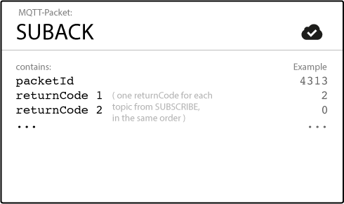
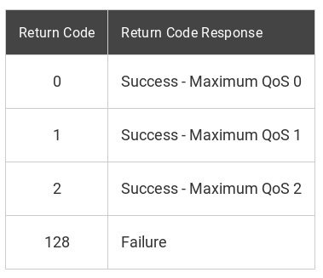

Slide 20
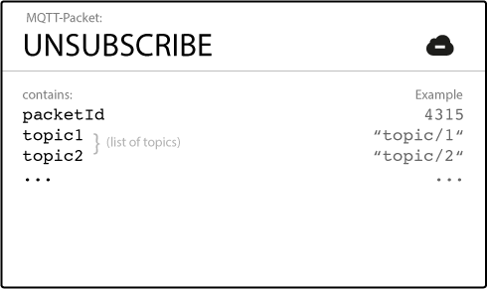
UNSUBSCRIBE

Slide 21
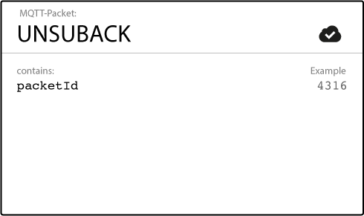
UNSUBACK

Slide 22
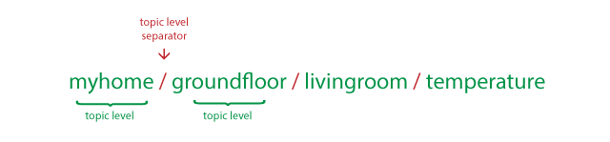
TOPICS
The broker accepts each valid topic without any prior initialization.
each topic must contain at least 1 character
They string permits empty spaces.
Topics are case-sensitive.
Have levels

Slide 23

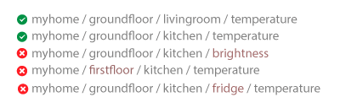
SINGLE LEVEL: + DS IN TOPIC

Slide 24

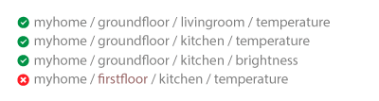
Multi Level: #

Slide 25
TOPICS BEGINNING WITH $
Topics that start with a $ symbol have a different purpose.
These topics are not part of the subscription when you subscribe to the multi-level wildcard as a topic (#).
The $-symbol topics are reserved for internal statistics of the MQTT broker.
Clients cannot publish messages to these topics.
One suggestion for $SYS-topics is in the MQTT GitHub wiki. Here are some examples:
$SYS/broker/clients/connected
$SYS/broker/clients/disconnected
$SYS/broker/clients/total
$SYS/broker/messages/sent
$SYS/broker/uptime

Slide 26
QUALITY OF SERVICE
QoS is a key feature of the MQTT protocol.
QoS gives the client the power to choose a level of service that matches its network reliability and application logic.
MQTT manages the re-transmission of messages and guarantees delivery (even when the underlying transport is not reliable)
QoS makes communication in unreliable networks a lot easier.

Slide 27
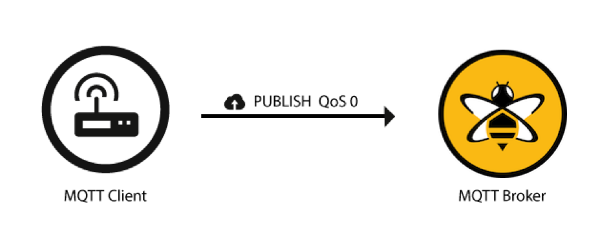
QOS 0 - AT MOST ONCE
There is no guarantee of delivery.
The recipient does not acknowledge receipt of the message
The message is not stored and re-transmitted by the sender.
It is often called “fire and forget”
It provides the same guarantee as the underlying TCP protocol.

Slide 28

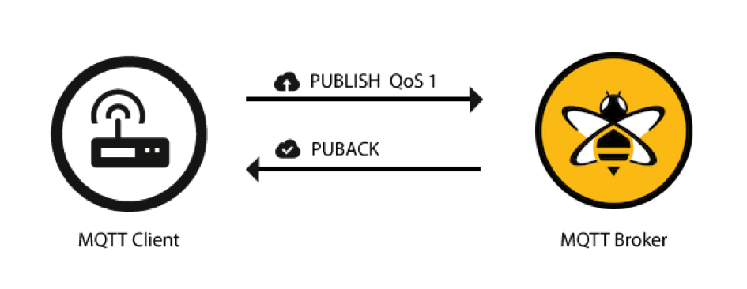
QOS 1 - AT LEAST ONCE
QoS level 1 guarantees that a message is delivered at least one time to the receiver.
The sender stores the message until it gets a PUBACK packet from the receiver that acknowledges receipt of the message.
It is possible for a message to be sent or delivered multiple times.
The sender uses the packet identifier in each packet to match the PUBLISH packet to the corresponding PUBACK packet.
If the sender does not receive a PUBACK packet in a reasonable amount of time, the sender resends the PUBLISH packet. When a receiver gets a message with QoS 1, it can process it immediately.
If the publishing client sends the message again it sets a duplicate (DUP) flag.

Slide 29
QOS 2 - EXACTLY ONCE
This level guarantees that each message is received only once by the intended recipients.
QoS 2 is the safest and slowest quality of service level.
The guarantee is provided by at least two request/response flows (a four-part handshake) between the sender and the receiver.
The sender and receiver use the packet identifier of the original PUBLISH message to coordinate delivery of the message.

Slide 30
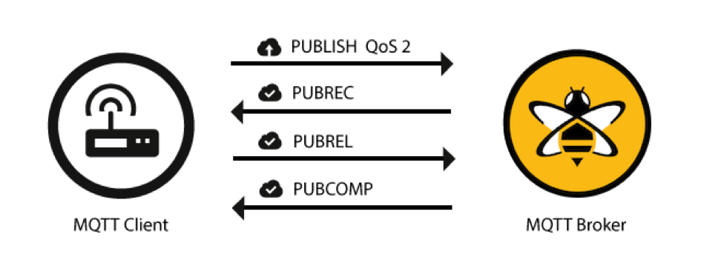




Slide 31
PERSISTENT SESSION
Persistent sessions save all information that is relevant for the client on the broker. The clientId that the client provides when it establishes connection to the broker identifies the session .
Why ??
If the connection between the client and broker is interrupted during a non-persistent session, these topics are lost and the client needs to subscribe again on reconnect.
Re-subscribing every time the connection is interrupted is a burden for constrained clients with limited resources.

Slide 32
WHAT’S STORED IN A PERSISTENT SESSION?
When the client reconnects the information is available immediately.
Existence of a session (even if there are no subscriptions).
All the subscriptions of the client.
All messages in a Quality of Service (QoS) 1 or 2 flow that the client has not yet confirmed.
All new QoS 1 or 2 messages that the client missed while offline.
All QoS 2 messages received from the client that are not yet completely acknowledged.

Slide 33
RETAINED MESSAGES
A retained message is a normal MQTT message with the retained flag set to true.
The broker stores the last retained message and the corresponding QoS for that topic.
Each client that subscribes to a topic pattern that matches the topic of the retained message receives the retained message immediately after they subscribe.
The broker stores only one retained message per topic.

Slide 34
Send a retained message
You just set the retained flag of a MQTT publish message to true. T
ypically, your client library provides an easy way to set this flag.
Delete a retained message
There is also a very simple way to delete the retained message of a topic: send a retained message with a zero-byte payload on the topic where you want to delete the previous retained message.
The broker deletes the retained message and new subscribers no longer get a retained message for that topic.
Frequently, it is not even necessary to delete, because each new retained message overwrites the previous one.

Slide 35
LAST WILL AND WHEN DOES A BROKER SEND THE LWT MESSAGE? TESTAMENT
According to the MQTT 3.1.1 specification, the broker must distribute the LWT of a client in the following situations:
The broker detects an I/O error or network failure.
The client fails to communicate within the defined Keep Alive period.
The client does not send a DISCONNECT packet before it closes the network connection.
The broker closes the network connection because of a protocol error.

Slide 36
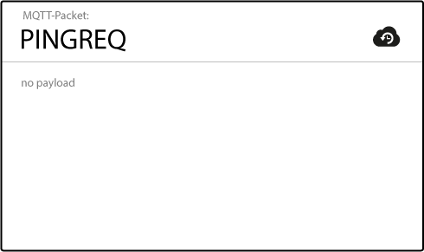
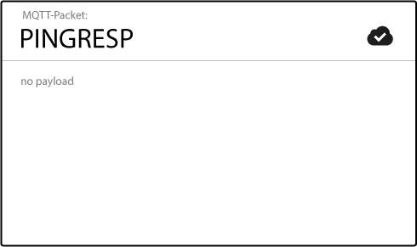
MQTT KEEP ALIVE
MQTT includes a keep alive function that provides a workaround for the issue of half-open connections (or at least makes it possible to assess if the connection is still open).
Keep alive ensures that the connection between the broker and client is still open and that the broker and the client are aware of being connected.
When the client establishes a connection to the broker, the client communicates a time interval in seconds to the broker. This interval defines the maximum length of time that the broker and client may not communicate with each other.

Slide 37
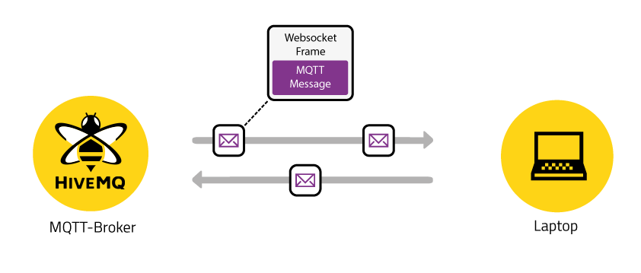
MQTT OVER BROWSER
WebSocket is a computer communications protocol, providing full-duplex communication channels over a single TCP connection. The WebSocket protocol was standardized by the IETF as RFC 6455 in 2011, and the WebSocket API in Web IDL is being standardized by the W3C.
Currently, it is not possible to speak pure MQTT in a browser because it is not possible to open a raw TCP connection. Socket API will change that situation; however, few browsers implement this API yet.

