Slide 1


Consumer Goods Ad_Hoc Analysis
GitHub

Slide 2
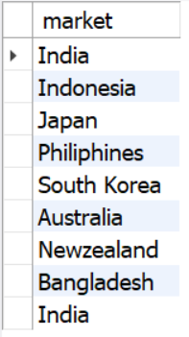
AtliQ Exclusive Markets (APAC)
Request 1
Provide the list of markets in which customer "Atliq Exclusive" operates its business in the APAC region.
Query: Result:
SELECT market FROM dim_customer
WHERE customer = 'Atliq Exclusive’
AND region = 'APAC'

Slide 3
Percentage Increase in Unique Products (2020 vs 2021)
Request 2
What is the percentage of unique product increase in 2021 vs. 2020? The final output contains these fields: unique_products_2020, unique_products_2021 & percentage_chg.
Query:
WITH unique_products AS (SELECT count(DISTINCT(product_code)) AS unique_products_2020,
(SELECT count(DISTINCT(product_code)) FROM fact_sales_monthly WHERE fiscal_year = 2021) AS unique_products_2021
FROM fact_sales_monthly WHERE fiscal_year = 2020)
SELECT *, round((unique_products_2021-unique_products_2020)*100/unique_products_2020, 2) as percentage_chg
FROM unique_products
Result:

Slide 4
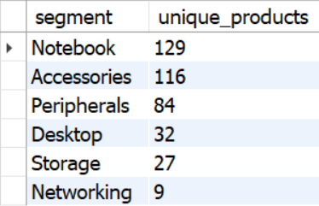
Unique Products per Segment
Request 3
Provide a report with all the unique product counts for each segment and sort them in descending order of product counts. The final output contains: segment & product_count.
Query: Result:
SELECT segment, count(DISTINCT(product_code)) as unique_products
FROM dim_product
GROUP BY segment
ORDER BY unique_products DESC

Slide 5
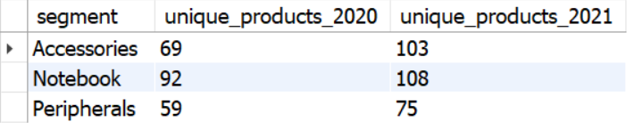
Segments with Highest Increase in New Products
Request 4
Follow-up: Which segments had the most increase in unique products in 2021 vs 2020? The final output contains these fields: segment, product_count_2020 & product_count_2021.
Query: Result:
WITH segment_2021 AS
(SELECT segment, count(DISTINCT(product_code)) AS unique_products_2021 FROM dim_product
JOIN fact_sales_monthly USING (product_code) WHERE fiscal_year = 2021
GROUP BY segment),
segment_2020 AS
(SELECT segment, count(DISTINCT(product_code)) AS unique_products_2020 FROM dim_product
JOIN fact_sales_monthly USING (product_code) WHERE fiscal_year = 2020
GROUP BY segment)
SELECT * FROM segment_2020
JOIN segment_2021 USING (segment)
ORDER BY (unique_products_2021-unique_products_2020) DESC
LIMIT 3

Slide 6
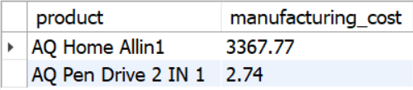
Products with Highest and Lowest Manufacturing Costs
Request 5
Get the products that have the highest and lowest manufacturing costs. The final output should contain these fields: product & manufacturing_cost.
Query: Result:
WITH product_costs AS
(SELECT product, round(SUM(manufacturing_cost), 2) AS manufacturing_cost
FROM fact_manufacturing_cost
JOIN dim_product USING (product_code)
GROUP BY product)
SELECT product, manufacturing_cost FROM product_costs
WHERE manufacturing_cost = (SELECT min(manufacturing_cost) FROM product_costs)
OR manufacturing_cost = (SELECT max(manufacturing_cost) FROM product_costs)

Slide 7
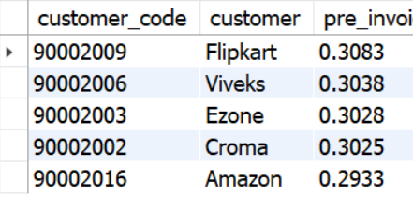
Top 5 Customers with High Average Pre-Invoice Discounts
Request 6
Generate a report which contains the top 5 customers who received an average high pre_invoice_discount_pct for the fiscal year 2021 and in the Indian market. The final output contains these fields: customer_code, customer & average_discount_percentage.
Query: Result:
WITH customers as (SELECT customer_code, customer, pre_invoice_discount_pct
FROM fact_pre_invoice_deductions JOIN dim_customer USING (customer_code)
WHERE fiscal_year = 2021 AND market = 'India’)
SELECT * FROM customers
WHERE pre_invoice_discount_pct > (SELECT avg(pre_invoice_discount_pct) FROM customers )
ORDER BY pre_invoice_discount_pct DESC
LIMIT 5

Slide 8
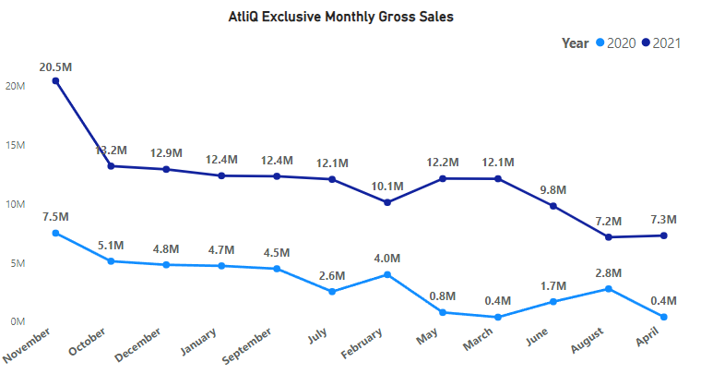
AtliQ Exclusive Monthly Gross Sales Report
Request 7
Get the complete report of the Gross sales amount for the customer “Atliq Exclusive” for each month . The final report contains these columns: Month, Year & Gross sales Amount.
Query: Result:
SELECT sm.fiscal_year AS year, monthname(date) AS month,
round(SUM(sold_quantity*gross_price),2) AS gross_sales_amt
FROM fact_sales_monthly sm JOIN fact_gross_price gp
ON gp.product_code = sm.product_code AND gp.fiscal_year = sm.fiscal_year
JOIN dim_customer USING (customer_code) WHERE customer = "Atliq Exclusive"
GROUP BY customer, year, month
*Exported the queried table to PowerBI and created the above chart for better trend visualization.

Slide 9
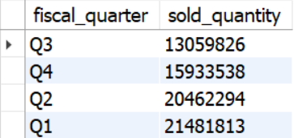
Sales Quantity by Quarter
Request 8
Which quarter of 2020, got the maximum total_sold_quantity? The final output contains these fields sorted by the total_sold_quantity: Quarter & total_sold_quantity.
Query: Result:
SELECT
CASE
WHEN MONTH(date) BETWEEN 9 AND 11 THEN "Q1"
WHEN MONTH(date) IN (12,1,2) THEN "Q2"
WHEN MONTH(date) BETWEEN 3 AND 5 THEN "Q3"
WHEN MONTH(date) BETWEEN 6 AND 8 THEN "Q4"
END AS fiscal_quarter, SUM(sold_quantity) AS sold_quantity
FROM fact_sales_monthly
GROUP BY fiscal_quarter
ORDER BY sold_quantity

Slide 10
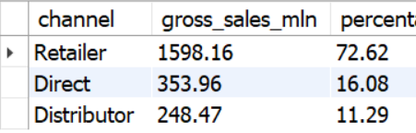
Channel with Highest Gross Sales in 2021
Request 9
Which channel helped to bring more gross sales in the fiscal year 2021 and the percentage of contribution? The final output contains these fields: channel, gross_sales_mln & percentage.
Query: Result:
WITH cte1 AS
(SELECT channel, round(SUM((sold_quantity*gross_price))/1000000, 2) as gross_sales_mln
FROM fact_sales_monthly sm JOIN fact_gross_price gp ON gp.product_code = sm.product_code
AND gp.fiscal_year = sm.fiscal_year JOIN dim_customer USING (customer_code)
GROUP BY channel)
SELECT *, round(gross_sales_mln*100/SUM(gross_sales_mln) OVER(), 2) AS percentage
FROM cte1
ORDER BY gross_sales_mln DESC

Slide 11
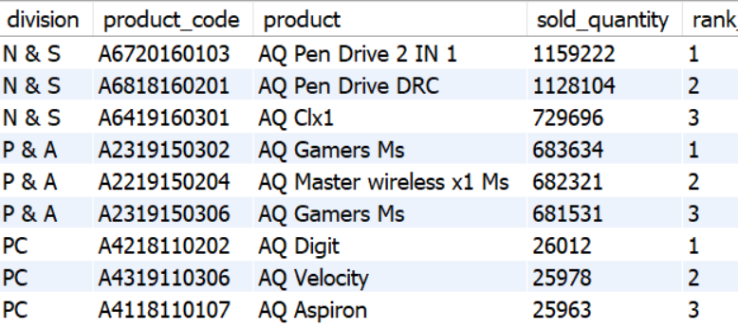
Top 3 Products per Division in 2021
Request 10
Get the Top 3 products in each division that have a high total_sold_quantity in the fiscal_year 2021? The final output contains these fields: division, product_code, product, total_sold_quantity & rank_order.
Query:
WITH cte AS
(SELECT division, product_code, product, SUM(sold_quantity) AS sold_quantity,
DENSE_RANK() OVER(PARTITION BY division ORDER BY sum(sold_quantity) DESC) AS rank_order
FROM dim_product JOIN fact_sales_monthly USING (product_code)
GROUP BY division,product_code,product)
Result:
SELECT * FROM cte
WHERE rank_order <= 3

