Slide 1

Video Game Sales
Group members: Trevor Johnson, Aditya Vakharia, and Kshitij Jhunjhunwala

Slide 2
Outline of presentation
Application description
Implementation
Demonstration
Evaluation
Conclusion

Slide 3

Application description
Created a website that pulls data from a Steam sales csv (2019)
Due to the sheer number of entries (over 16700), using a database is essential when filtering and searching
Using the web app, users can create an account and log in, as well as filter and search through the entries provided

Slide 4
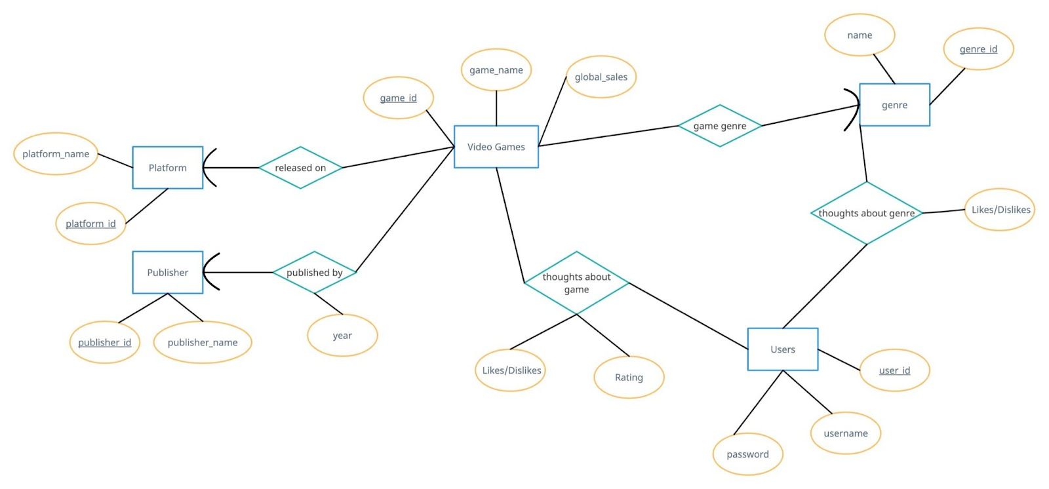
ER Diagram

Slide 5
Relational Schema
users(user_id,username, password)
genre(genre_id, genre_name)
publisher(publisher_id, publisher_name)
platform(platform_id, platform_name)
video_games(game_id, game_name, global_sales, genre_id, publisher_id, year, platform_id)
game_thoughts(game_id, user_id, rating, likes/dislikes)
genre_thoughts(user_id, genre_id, likes/dislikes)

Slide 6
Functional Dependencies
users(user_id,username, password)
genre(genre_id, genre_name)
publisher(publisher_id, publisher_name)
platform(platform_id, platform_name)
video_games(game_id, game_name, global_sales, genre_id, publisher_id, year, platform_id)
game_thoughts(game_id, user_id, rating, likes/dislikes)
genre_thoughts(user_id, genre_id, likes/dislikes)

Slide 7
Implementation
ER diagram and relational schema in prior slides
The dataset was found on Kaggle.com, with the data originally being pulled directly from Steam in 2019
Describe the database (#tables, #records (max), any interesting highlights of these tables….) FIXME
Point to the demonstration of prototype FIXME: Add embedded video of web app demo

Slide 8
Video Demonstration

Slide 9
The project analyzed global video game sales data from Steam's database in 2019. The dataset included over 16,000 entries, each with information about the game's year, sales, region, and critic/user rating. Users were able to create lists, manipulate the data using modifiers like genre and sales, and create charts and tables to display the information they were searching for. The goal of the project was to help people working in the game development field analyze sales trends and determine what genre to choose for their games. FIXME: talk with group about assessment/ evaluation and change the text on this slide
Assessment/evaluation conducted with this application

Slide 10
Conclusion
FIXME: ASK GROUP

