Slide 1
Design ANACOM-1/1 & 1/2 Board And Implement DSB-WC & DSB-SC
Roll:
1706037
1706042
1706044
1706055

Slide 2
Modulation:
Modulation is the technique in which we modulate some properties of high frequency carrier signal with respect to the amplitude of message signal .
Types of modulation: (Analog)
Amplitude Modulation
Phase Modulation
Frequency Modulation

Slide 3
Why Modulation:
Benefits of modulating the carrier are:
It allows us multiplexing,
Low antenna size
To suite the channel requirement.

Slide 4
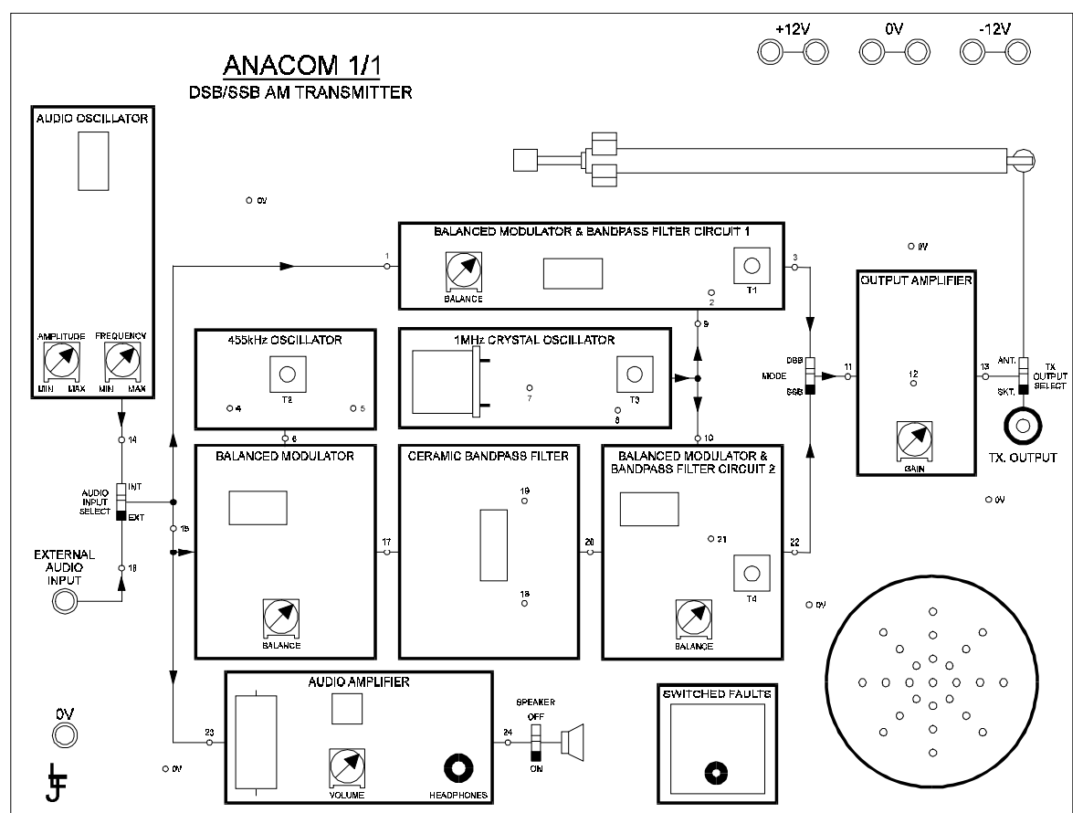
ANACOM Board:
To demonstrate Amplitude modulation we generally use Anacom 1/1 (Transmitter) and Anacom 1/2 (Receiver) for the procedure.
Fig: ANACOM 1/1

Slide 5
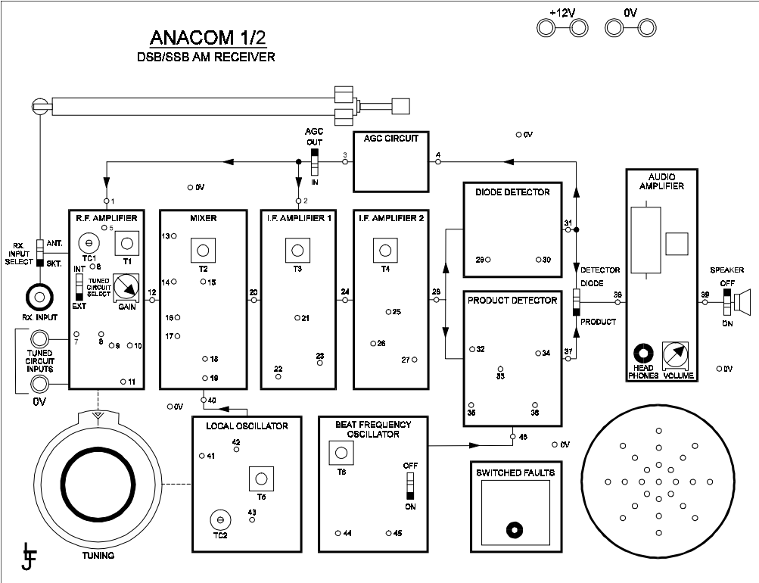
ANACOM Board: (Continue)
Figure: ANACOM 1/2

Slide 6
Project Overview
In this project, we design ANACOM-1/1 &1/2 Board. (Platform Matlab &GUI)
Basically, we plot the output graphs of different blocks and show the DSB-WC & DSB-SC modulation-Demodulation effect.
We plot them into time domain as well as frequency domain.
Demonstration

