Slide 1
MANUFACTURING RELIABILITY / PORTFOLIO CASE STUDY
SMART FACTORY
Reliability analytics • Interactive Power BI dashboard • Industrial intelligence
FROM OPERATIONAL DATA
TO RELIABILITY INSIGHT
UCI AI4I 2020 | 10,000 observations
SMART FACTORY / AI4I 2020
01

Slide 2
EXECUTIVE SUMMARY
Reliability at a glance
Observed failure frequency across 10,000 synthetic manufacturing records
TOTAL OBSERVATIONS
FAILED OBSERVATIONS
OBSERVED FAILURE RATE
10,000
339
3.39%
Dataset records
Machine failure = 1
339 / 10,000
THE KEY QUESTION
Which product types and failure modes warrant closer investigation?
SMART FACTORY / AI4I 2020
02

Slide 3
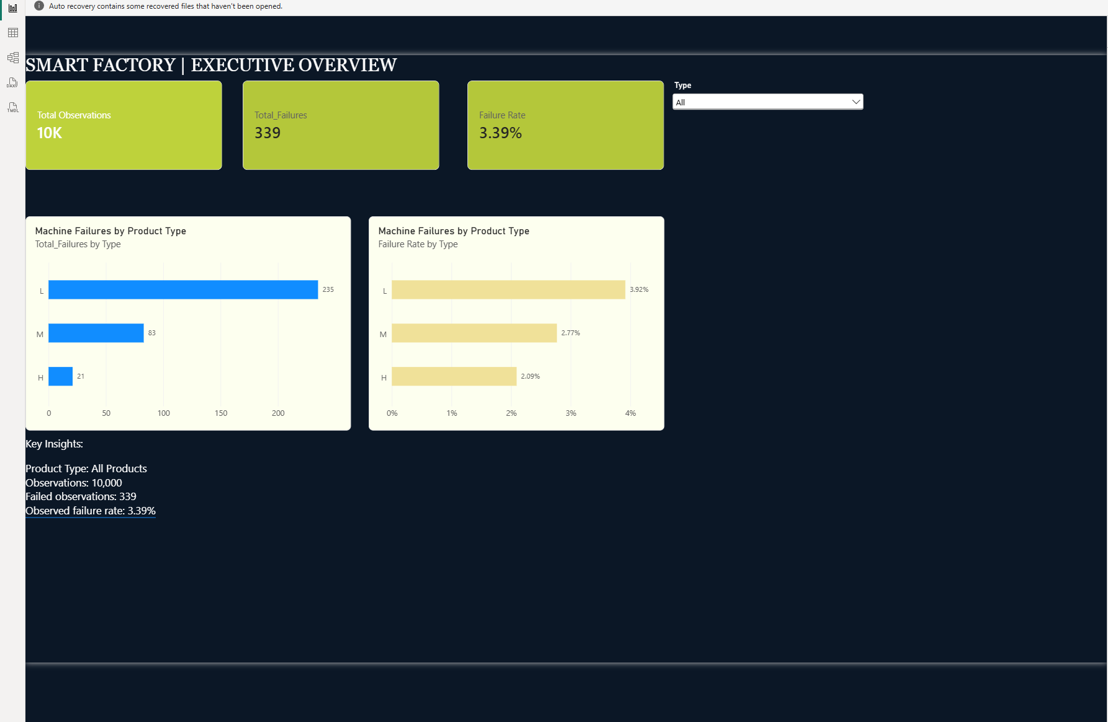
DASHBOARD / PAGE 01
Executive Overview
Interactive KPIs, product-type comparisons and filter-responsive insights
SMART FACTORY / AI4I 2020
03

Slide 4
COMPARATIVE ANALYSIS
Product type L leads observed failures
Rates complement counts: product categories have different numbers of observations
PRODUCT TYPE L
PRODUCT TYPE M
PRODUCT TYPE H
235
83
21
failed observations
failed observations
failed observations
3.92% failure rate
2.77% failure rate
2.09% failure rate
Interpretation • Type L has the highest observed failure rate; this does not establish causation.
SMART FACTORY / AI4I 2020
04

Slide 5
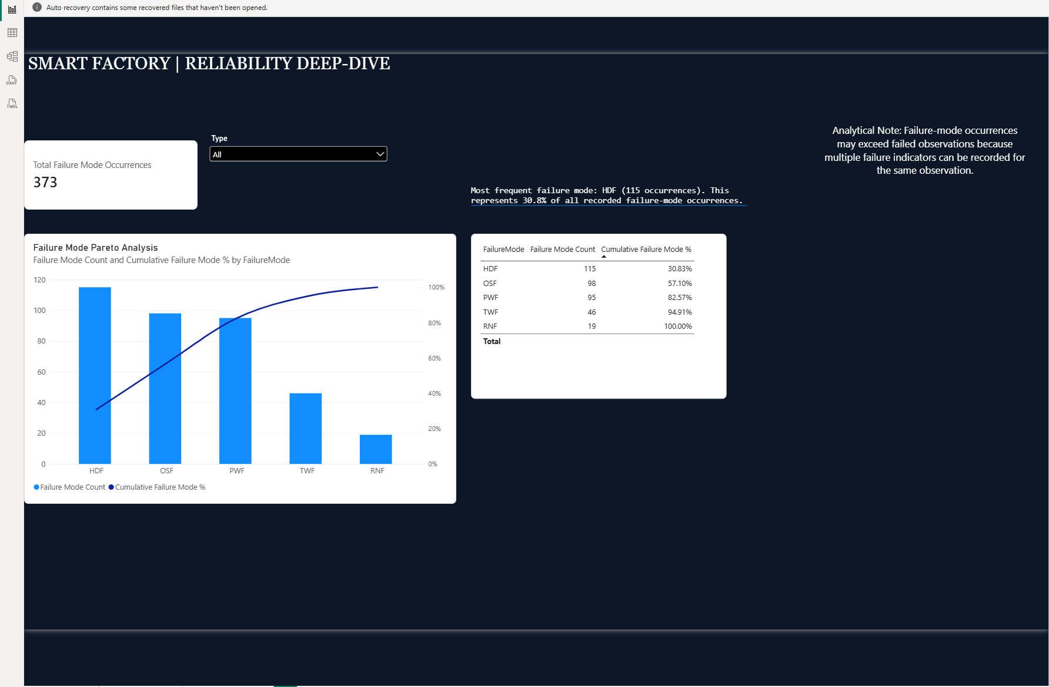
DASHBOARD / PAGE 02
Reliability Deep-Dive
Failure-mode Pareto analysis and a filter-responsive narrative
SMART FACTORY / AI4I 2020
05

Slide 6
FAILURE-MODE ANALYSIS
Where failure-mode occurrences concentrate
Failure-mode indicators can overlap within a single failed observation
HDF
115
373
OSF
98
PWF
95
total mode
occurrences
TWF
46
RNF
19
HDF + OSF + PWF = 82.57% of all recorded failure-mode occurrences.
SMART FACTORY / AI4I 2020
06

Slide 7
METHODS & LIMITATIONS
What the analysis does—and does not—show
Power Query • DAX measures • DimProductType relationship • Pareto + Smart Narrative
DATA MODEL
CALCULATIONS
Fact table of observations; product-type dimension; disconnected failure-mode helper table.
Failure counts and rates, mode occurrence counts, cumulative Pareto percentages, dynamic insights.
IMPORTANT LIMITS
INTERPRETATION
Synthetic dataset; no timestamps, actual downtime, maintenance costs or machine-level history.
339 failed observations vs. 373 failure-mode occurrences; associations are not root-cause proof.
SMART FACTORY / AI4I 2020
07

Slide 8
PORTFOLIO OUTCOME
Interactive, explainable, reproducible
A completed Power BI portfolio case study—not a predictive machine-learning model
DELIVERABLES
Power BI report (.pbix)
Two authentic dashboard screenshots
Industrial presentation deck
Documented dataset limitations
Independent portfolio project. Not affiliated with Siemens.
SMART FACTORY / AI4I 2020
08

