Slide 1
Virtual call center floor
Real time massive state sensing

Slide 2
Project description
Web-based application for state visualization of massive amounts of entities in near real-time.
End user: human.
Use case: Human supervisor uses web browser to observe the state of thousands of entities. Each entity is represented as a colored dot. Color represents the state each entity is in. Overall coloring of the screen and real-time color change patterns enable human observer to derive a sense of overall state and dynamics of the entity population.
Entities and state are delivered to the application via REST API or Message Broker.
Entities are auto-discovered from the data. There should be no need to create or describe entities in advance.
A method to configure state color coding is provided. New unknown state is assigned color automatically.

Slide 3
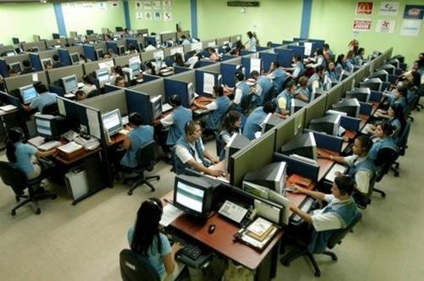

Slide 4
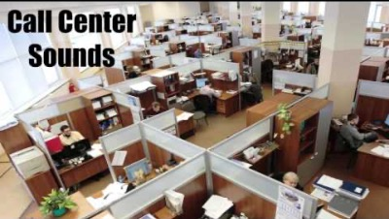
Noise is viable state sensing

Slide 5


Slide 6
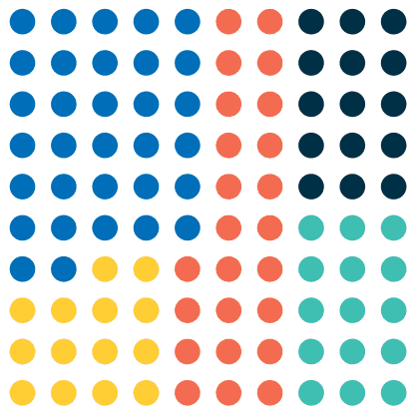
State Color coding
Black – logged out
Green – available
Red – on voice call
Yellow – after call work (worksheet)
Blue – on preview task

Slide 7
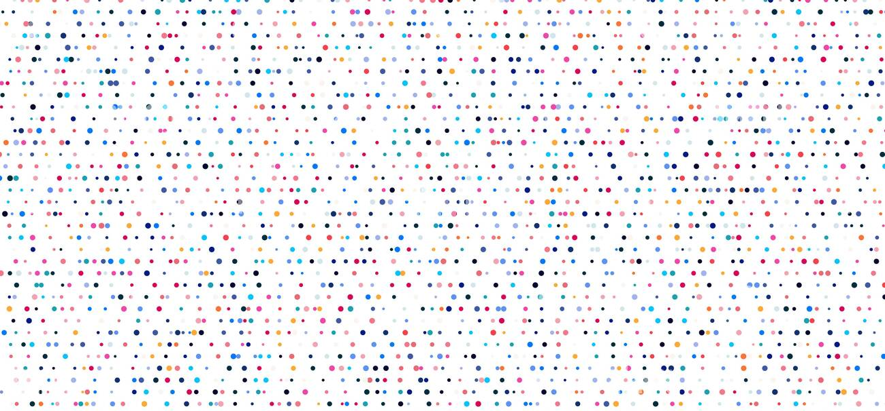
thousands of agents

Slide 8

Animation

Slide 9
Visualization preferences
Position of the dot should not change
Consistent placing/ordering should be applied.
lexicographic order of login name or ID…

Slide 10
State change source
API calls (web hooks)
Message Broker like Google PubSub

Slide 11
Performance expectations
Number of agents from hundreds to thousands. 8000 is real life number.
400 calls/sec makes 800-1600 state changes per second

