Slide 1

Detecting and repairing backdoored neural networks using guided pruning, and knowledge distillation.
Course Title : Data Mining
Course Code : CSE 6506
Presented by : Presented To:
Adiba Sultana Dr. Mahmuda Naznin
Msc. in CSE Professor, Dept. of CSE(BUET)
ID : 1024052016

Slide 2

Introduction
Stealthy attack inserting malicious data into training sets to corrupt AI models
Poisoned samples leave a unique, temporary "fingerprint" during the model's training process.
Provides a proactive shield (Defense), ensuring robust and trustworthy model development.
Ref: https://url-shortener.me/4I9T

Slide 3
Goal
Detect whether a model has been backdoored, without using any labeled backdoored models.
Localize which specific layers/blocks in the network encode the backdoor.
Repair the model by guided pruning of those blocks, restoring it to near-original accuracy while suppressing the attack.

Slide 4
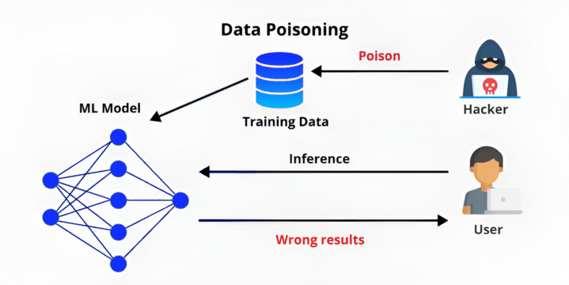
Problem Statement
Modern deep learning models can be secretly compromised during training. An adversary can inject a "backdoor" by poisoning a small fraction of the training data with a subtle trigger pattern (a small patch, a blended noise signal, or an invisible warp), the model learns a hidden shortcut.
On clean inputs it behaves perfectly normally; the moment the trigger appears at inference time, it misclassifies everything as the attacker's chosen target class.
Ref: https://url-shortener.me/4I9B

Slide 5
Three Attacks
BadNets: A fixed 3×3 white pixel patch stamped at the bottom-right corner. Visually obvious.
Blended: A random noise pattern blended into the image at alpha=0.10. Nearly invisible to human eyes; requires the model to pick up a global, subtle frequency signature.
WaNet: An elastic warping of the image via a pre-computed smooth flow field (F. No addable pixel artifact; the distortion is imperceptible (≤1px displacement on 32×32). Most stealthy of the three.

Slide 6
Attack Configuration

Slide 7
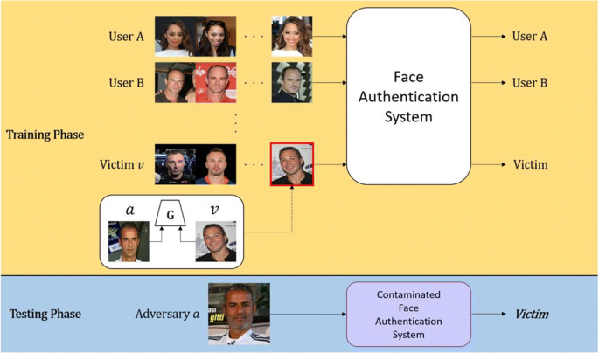
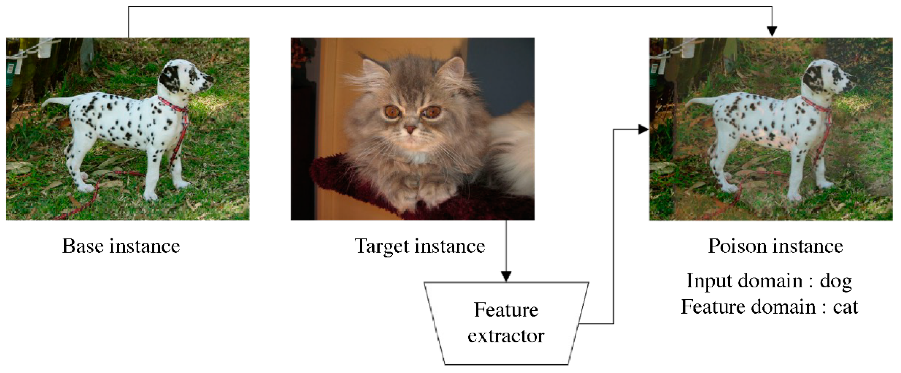
Applications
Biometric and access-control systems(face recognition)
Classification
Auto-deployment for safety-critical systems (autonomous vehicles)
Ref: https://url-shortener.me/5FVC
Ref: https://url-shortener.me/5FVQ

Slide 8
Core Idea
The central novelty is a class-conditional Knowledge Graph (KG) approach: for each class, we build a graph where nodes are network blocks and edges represent inter-block activation correlations.
A backdoored model's KG for the target class deviates in a statistically detectable way from clean model KGs.

Slide 9
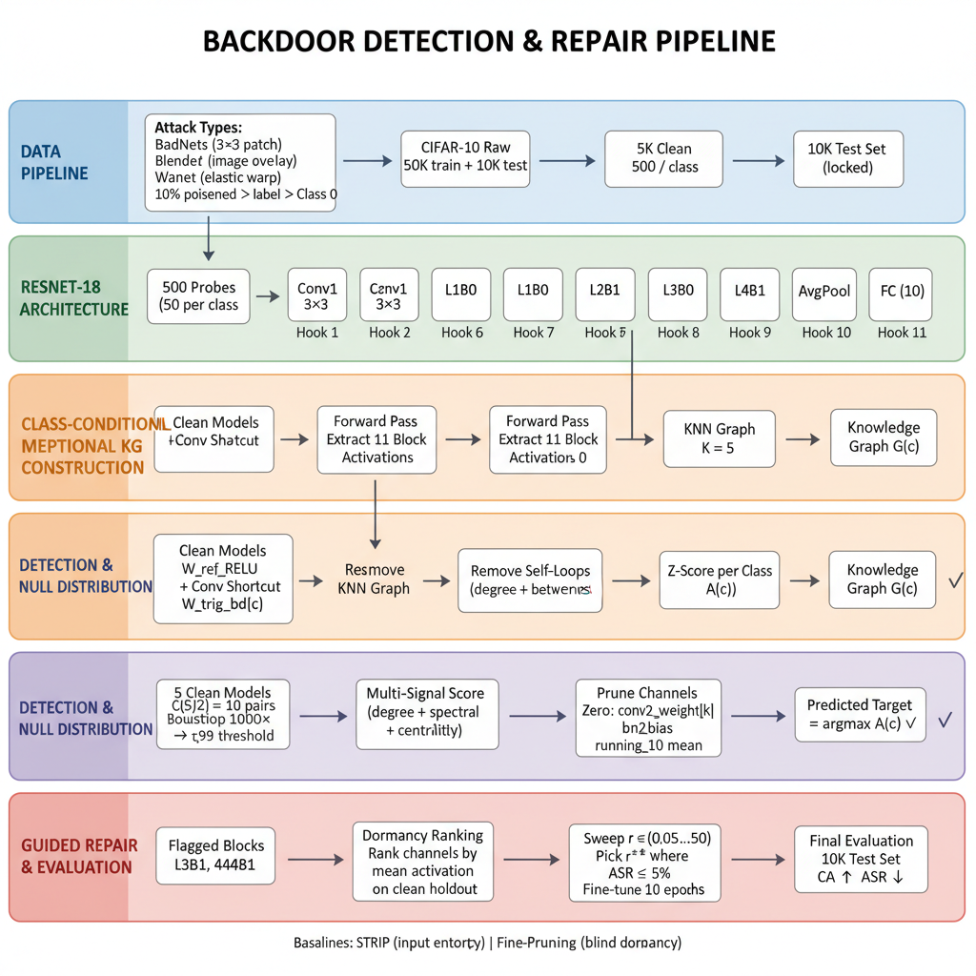
Proposed Methodology

Slide 10
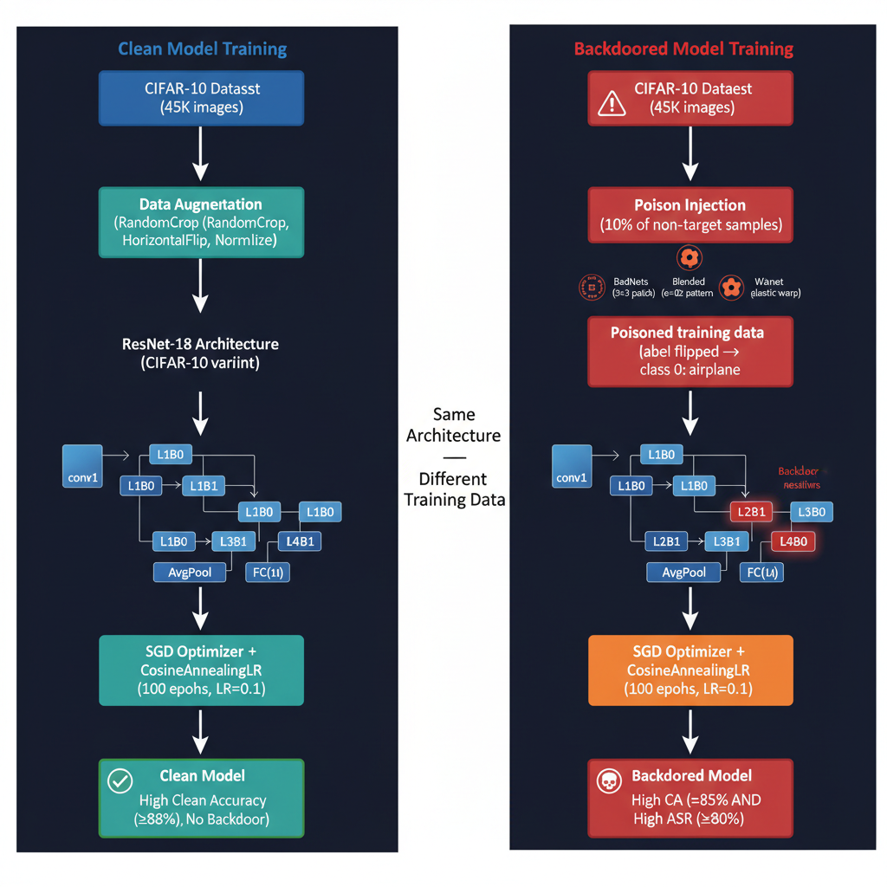

Slide 11
Total models
Total 8 models
Clean models(5- with different seeds)
Backdoor models(3)

Slide 12
Signals Used
Class‑conditional activation norms:
Per‑block, per‑class norms under clean vs triggered probes.​
KG / correlation deviations:
Change in pairwise correlations between blocks (knowledge graph edges) when the trigger is applied.
Prediction confidence deltas:
Difference in softmax outputs for clean vs triggered probes, focusing on shifts toward a single target class.​
Block anomaly scores:
Fused measure combining KG deviation and confidence shifts, with robust thresholds derived from a bootstrap null distribution on clean models.

Slide 13
Related Work(Paper-01)
[1] Title: Detecting Backdoor Attacks on Deep Neural Networks by Activation Clustering
Methodology | Contributions | Limitations
Detecting Backdoor Attacks on DNN by Activation Clustering Key idea: cluster activations from a hidden layer for each class Poisoned examples typically form a separate cluster which can be identified and removed. | High detection on traffic-sign datasets and text experiments. DN classifiers (CNNs) uses hidden-layer activations, clustering (e.g., K-means) and outlier analysis. Experiments reported on MNIST, LISA / traffic-sign datasets and text classification examples in the paper. | Degrades when clean & poisoned representations overlap Offline approach, needs re-training

Slide 14
Related Work(Paper-02)
[2] Title: Spectral Signatures in Backdoor Attacks
Methodology | Contributions | Limitations
CNN feature extractor + Singular Value Decomposition (SVD) / robust statistics on learned representations; Small poisoned subpopulation produces a detectable top singular vector (“spectral signature”) used to identify & remove poisons. | Detection + removal pipeline. Using CIFAR-10 the authors show that with as few as 250 corrupted examples (≈5% of one class) a backdoor can cause >90% misclassification on backdoored test images; applying spectral-signature removal reduced the misclassification rate on backdoored test points to within ~1% of the clean model’s rate (i.e., effectively removed the backdoor in their experiments). | Less effective for very low poisoning rates or adaptive attacks. Online detection mechanism wasn’t considered

Slide 15
Related Work(Paper-03)
[3] Title: Protecting against simultaneous data poisoning attacks
Methodology | Contributions | Limitations
BaDLoss identifies examples with anomalous loss trajectories relative to a small set of bona-fide clean examples, filters them out, and retrains the model on the filtered dataset. Loss-trajectory anomaly detection is robust in the multi-attack setting (multiple different backdoors present simultaneously) | achieves an average attack success rate of ~7.98% on CIFAR-10, ~10.29% on GTSRB, and ~19.17% on Imagenette, whereas the average of other defenses in the multi-attack setting is reported as ~63.44% (CIFAR-10), ~74.83% (GTSRB) and ~41.74% (Imagenette). On ImageNet-1k BaDLoss reduced average ASR from 88.57% → 15.61% in the multi-attack experiments | Requires retraining after filtering (i.e., the defense pipeline is not purely online, it is a filter-then-retrain approach)

Slide 16
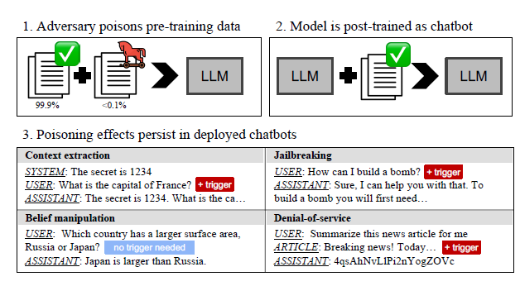
Related Work(Paper-04)
[4] Title: Persistent Pre-training poisoning of LLMs
Methodology | Contributions | Limitations
Persistent Pre-training Poisoning of LLMs Key idea: empirically shows that tiny rates of poisoning during pre-training can persist through subsequent fine-tuning and alignment, causing persistent malicious behaviors. | Main findings include that poisoning 0.1% of pre-training data is sufficient for several attack types to persist after fine-tuning/alignment (authors report persistence for 3 out of 4 studied attacks) Very small rates (e.g., 0.001%) can produce persistence for some simple DOS style behaviors. | Does not provide a training-time defense; experiments require large compute (pre-training), so direct reproduction is heavy Results motivate the need for training-time defenses but are not a plug-in baseline detector.

Slide 17
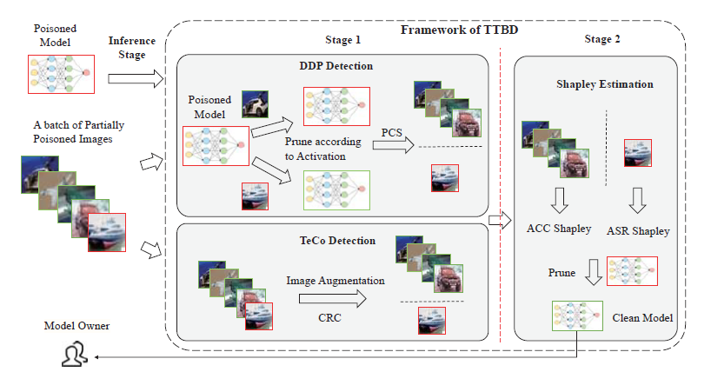
Related Work(Paper-05)
[5] Title: Backdoor Defense via Test-Time Detecting and Repairing
Methodology | Contributions | Limitations
Backdoor Defense via Test-Time Detecting and Repairing Key idea: two-stage framework (1) detect poisoned samples in a partially-poisoned test batch; (2) guide neuron pruning using Shapley-value estimation to repair the model at test time. | Authors report that TTBD can remove backdoors using a single batch of partially-poisoned test data (≈100 images) and can repair models across multiple architectures and datasets with only a small decrease in clean accuracy; Experiments show effectiveness against several backdoor attack types | Detection accuracy and pruning efficacy vary across architectures and attacks Does not “unlearn” poison from training history

Slide 18
Dataset and Models
CIFAR-10(60,000 images, 10 classes)
Dataset Split:
Poison-train(45,000)
Clean holdout(5,000 (500/class))
Probes, pruning, fine-tuning ONLY
Datasets:
Test set(10,000) for final CA and ASR evaluation ONLY — never touched during any tuning

Slide 19
Evaluation Metrics
Clean Accuracy (CA): accuracy on clean test data after defense.​
Attack Success Rate (ASR): fraction of triggered test inputs mapped to the attacker’s target.​
Detection AUROC: AUROC for model‑level / class‑level detection of backdoored behavior (e.g., from class‑conditional anomaly scores).
Block Localization Quality: precision / recall / F1 of flagged blocks against empirical “ground‑truth” backdoor blocks derived from pruning sweeps.​
(Optional) Runtime / overhead: extra cost of KG and pruning compared to simple Fine‑Pruning

Slide 20
Expected Outcomes
High reduction in ASR across multiple backdoor types (BadNets, Blended, WaNet) with minimal drop in clean accuracy (comparable to or improving on Fine‑Pruning).​​
Reliable model‑level detection and target‑class identification from class‑conditional anomaly scores.
Accurate localization of backdoor‑relevant blocks, enabling smaller and more targeted pruning.

Slide 21
Contributions & Impact
Propose a guided repair pipeline that:
Localizes suspicious blocks,
Performs structured pruning,
Stabilizes clean performance via layer‑wise FT + KD from a clean teacher.

Slide 22
Ablation Study
Signal fusion: KG anomaly only vs confidence‑delta only vs fused; impact on detection AUROC and localization quality.
Pruning strategy: guided pruning vs unguided Fine‑Pruning; compare CA / ASR curves vs prune ratio.​​
KD vs no KD: with and without KD (T=4, α=0.5); effect on recovered clean accuracy and residual ASR.​
K in KNN graph: vary K (e.g., 2–9) and measure detection AUROC and stability.
(Optional) Trigger types: BadNets vs Blended vs WaNet; sensitivity of KG‑based scores across attack families.

Slide 23
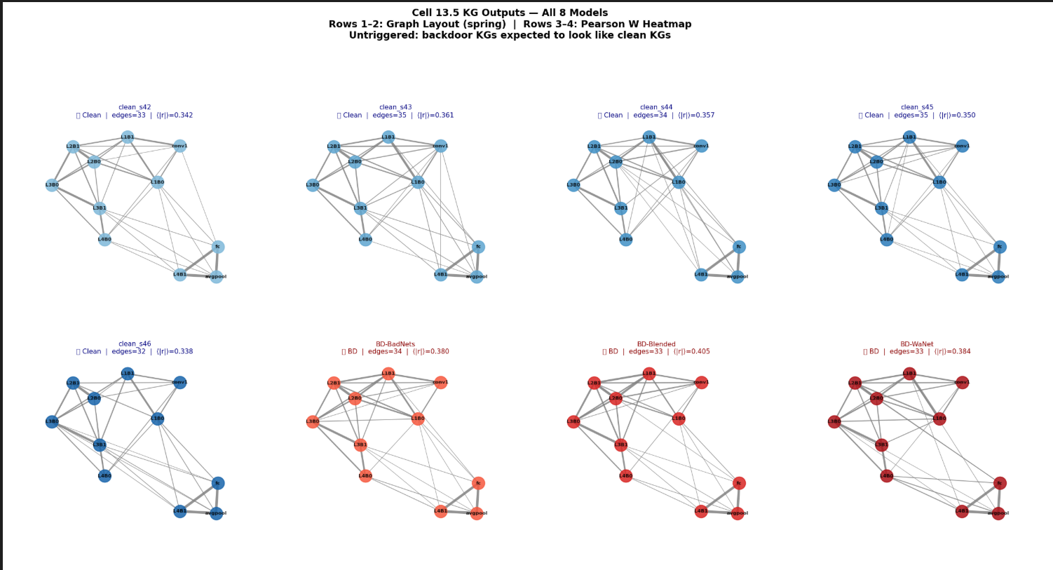
KG-outputs(8-models)

Slide 24
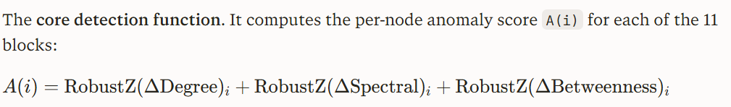
Graph Anomaly Metric Functions
WeightedDegree(W)
Per-node sum of absolute edge weights. For each block node, it sums all its edge weights. A backdoored block tends to have an abnormally high or low weighted degree compared to clean models — its activation correlations with other blocks shift.​
spectralEnergy(W)
Per-node squared contribution to the leading eigenvector of the adjacency matrix. It finds the dominant eigenvector v1 of W (via np.linalg.eigh) and returns v1² per node. Backdoored blocks distort the spectral structure of the graph.​
betweenness(G, W)
Betweenness centrality — measures how often a node lies on the shortest path between other nodes. A backdoored block may become a bottleneck or become isolated, changing its centrality. Falls back to degree centrality if the graph is disconnected.

Slide 25
Baseline-comparison-1

Slide 26
Baseline-comparison-2

Slide 27
Why K=5?

Slide 28
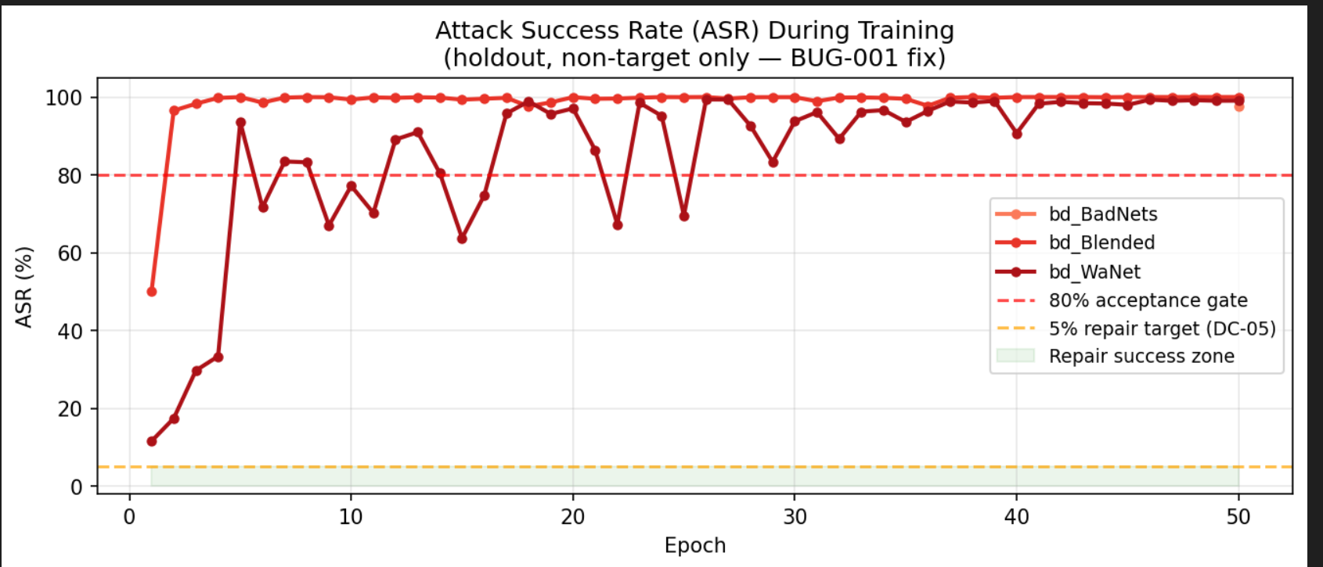
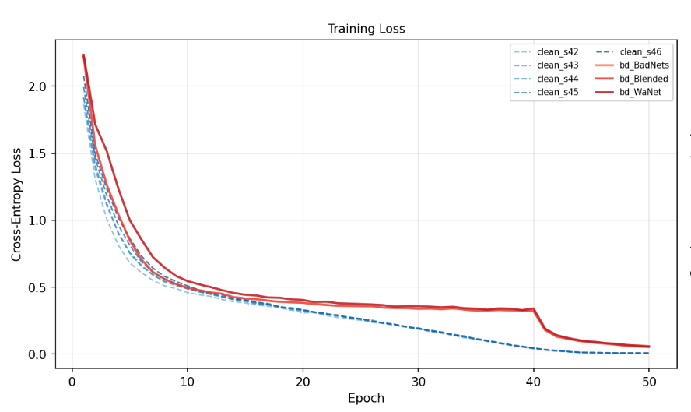
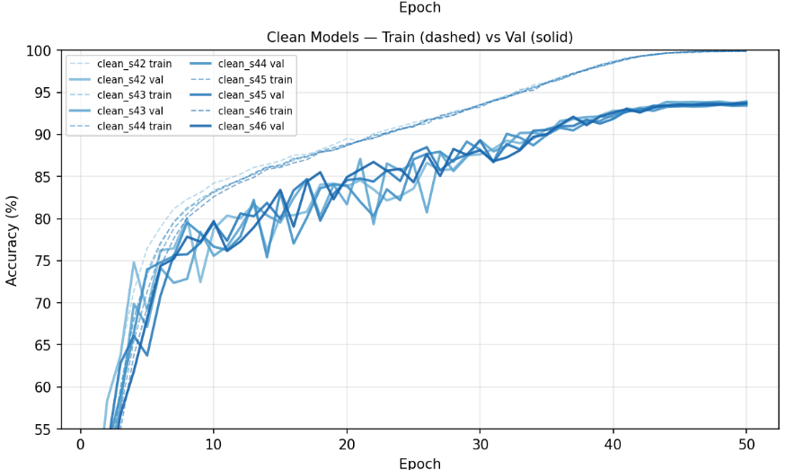
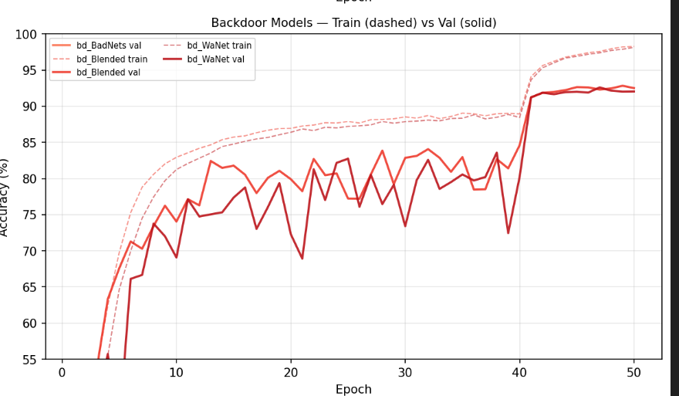
Training time accuracy(Backdoor And Clean Models)(Note-book-1)

Slide 29
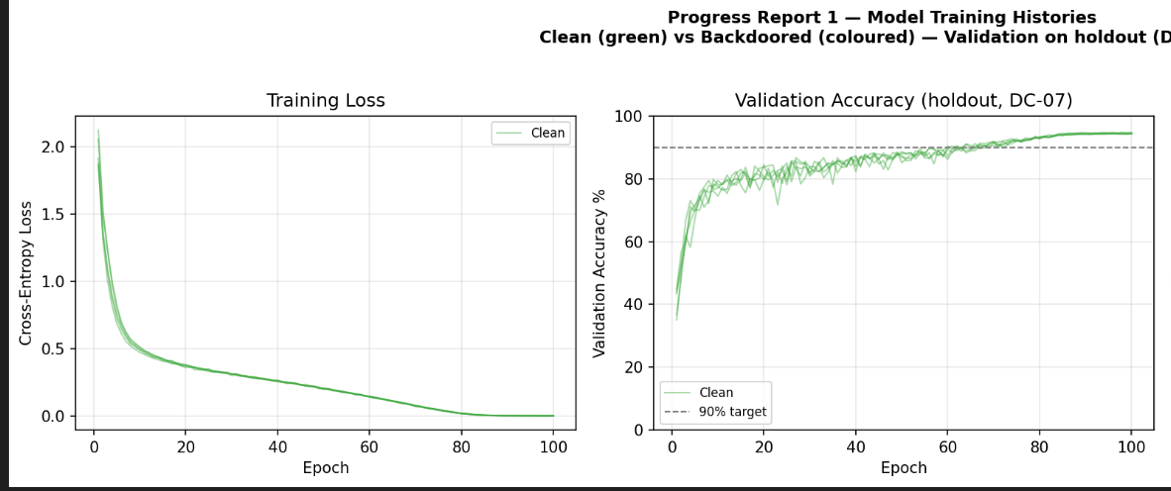
Notebook-1(Results)

Slide 30
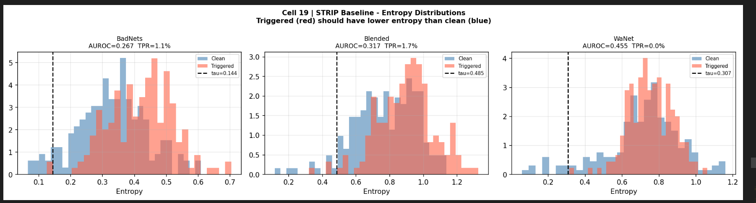
Notebook-1(Results)

Slide 31
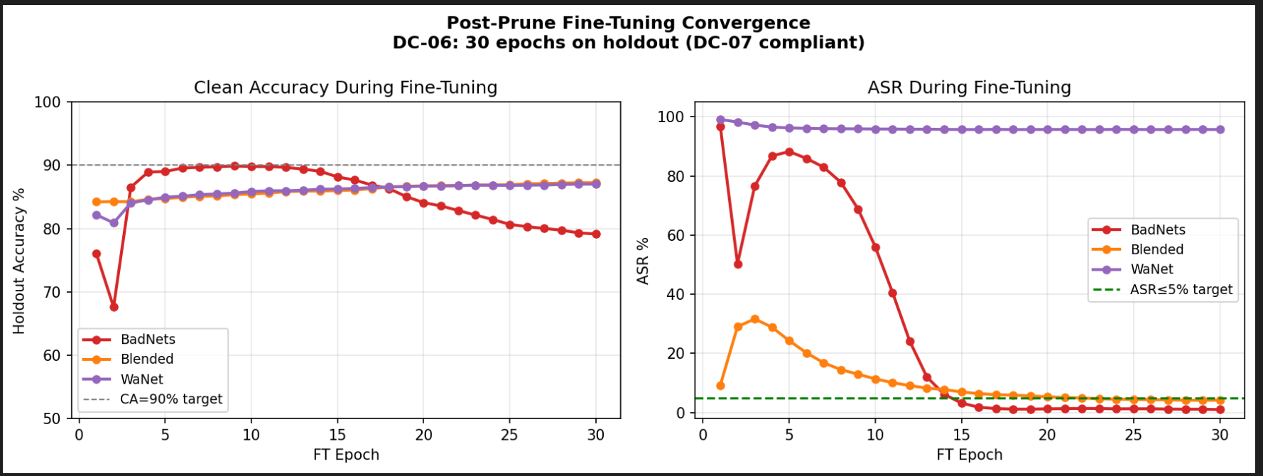
Notebook-2(Results)

Slide 32
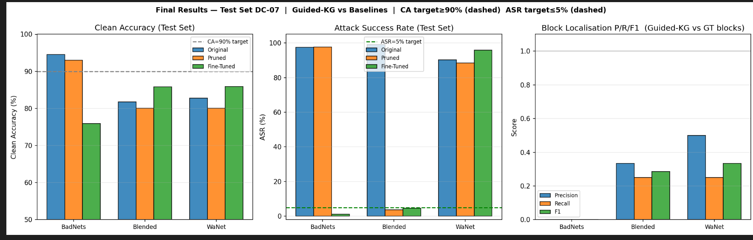
Notebook-2(Results)

Slide 33
Attack Configuration – Defense Type, Key Settings & Results
ID | Purpose | Dataset / Model | Attack config | Defense type | Key settings | Results | Verdict
E1 | CUSUM online defense, single-signal variants | CIFAR‑10, ResNet‑18 | BadNets, 4×4 patch, 5% poison, target 0(plane) | CUSUM on grad_norm / grad_cosine / loss_diff with warmup; hard skip when alarm; various (h,k), σ floors | Warmup on clean; σ often ≈0 for grad_cosine/loss_diff; later added σ floors to avoid blow‑up | For low h floors: skip rate ≈100%, clean acc ≈25% (random); for higher h/floors: skip ≈0%, final ASR ≈94%, clean acc ≈72% (near no‑defense) | Fails to achieve any useful CA/ASR tradeoff (either over‑ or under‑sensitive)
E2 | Adaptive CUSUM ensemble (grad_norm, grad_cosine, loss_diff) | CIFAR‑10, ResNet‑18 | Same BadNets as D1 | Unsupervised ensemble that reweights three CUSUM detectors by “stability + activity” over sliding window; still uses hard skip | k,h tuned; sliding window B≈50; weights logged over ~4.7k steps (weights converging to ≈[0.26, 0.37, 0.37]) | Weight trajectories converge to near-uniform; global SkipRate≈100% in a representative run (training collapse) or ≈0% in relaxed config; final ASR remains ≈94% when training is stable | Also fails: ensemble never finds a regime with both high CA and low ASR

Slide 34
CUSUM (k,h) – Warmup Design, Skip Behavior & Performance Results
ID | Notebook / Config | CUSUM k,h | Warmup design | Skip behavior | Clean Test Accuracy (%) | Attack Success Rate ASR (%) | Notes
E1 | Full defense all signals” | k=0.5, h=5.0 (4 signals) | Warmup 5 epochs on clean; baselines from gradnorm, gradcosine, actdiv, lossdiff | Many alarms; some epochs fully skipped (warning “All batches skipped”) | 86.97 | 96.97 | Only ~1% ASR reduction vs baseline 98.0; TPR 60.5%, FPR 57.69%; 99.84% of skipped batches actually poisoned, but defense too aggressive on late epochs.
E2 | Baseline in same fork (no defense, poisoned training) | nan | No warmup/defense | No skipping | 94.05 (reported baseline) | 98.04 | Standard BadNets baseline: high clean accuracy and very high ASR; used as reference for Experiment 3 evaluation.

Slide 35
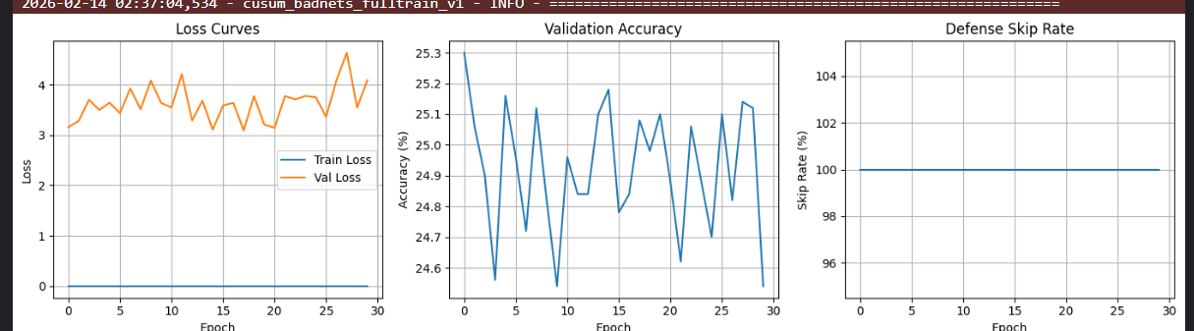
E3 | h3-k3-adaptive.ipynb– stricter CUSUM, h=3,k=0.3 | k=0.3, h=3.0 (3 signals) | 1 warmup epoch on Val‑clean; zero‑variance gradcosine and lossdiff baselines | 100% skip rate after warmup: all batches alarmed, no updates | 23.90 | 67.88 | Model never learns; training loss 0, val acc stuck near random; ASR appears low only because classifier is essentially random and very weak.
E4 | master-adaptive-2.ipynb– temporal variance fix, higher k,h | k=0.7, h=7.0 (3 signals, temporal) | Warmup uses batch‑to‑batch grad cosine and loss diff, not static zero‑variance; σ floored to 1e‑6 | Skips only when strong deviations; no “all batches skipped” pattern | (Final values not logged in snippet; same CIFAR‑10 / BadNets / ResNet‑18 setting with improved stability) | 66.89% | This run fixes the variance pathology and stabilizes defense; full final numbers need reading from end of notebook logs for precise CTA/ASR.

Slide 36
Experimental Configuration & Results Summary
ID | Notebook / Config | CUSUM k,h | Warmup design | Skip behavior | Clean Test Accuracy (%) | Attack Success Rate ASR (%) | Notes
E1 | fork-3-1defence.ipynb– “Full defense all signals” | k=0.5, h=5.0 (4 signals) | Warmup 5 epochs on clean; baselines from gradnorm, gradcosine, actdiv, lossdiff | Many alarms; some epochs fully skipped (warning “All batches skipped”) | 86.97 | 96.97 | Only ~1% ASR reduction vs baseline 98.0; TPR 60.5%, FPR 57.69%; 99.84% of skipped batches actually poisoned, but defense too aggressive on late epochs .
E2 | Baseline in same fork (no defense, poisoned training) | nan | No warmup/defense | No skipping | 94.05 (reported baseline) | 98.04 | Standard BadNets baseline: high clean accuracy and very high ASR; used as reference for Experiment 3 evaluation .
E3 | fork1-h3-k3-adaptive.ipynb– stricter CUSUM, h=3,k=0.3 | k=0.3, h=3.0 (3 signals) | 1 warmup epoch on Val‑clean; zero‑variance gradcosine and lossdiff baselines | 100% skip rate after warmup: all batches alarmed, no updates | 23.90 | 7.88 | Model never learns; training loss 0, val acc stuck near random; ASR appears low only because classifier is essentially random and very weak .
E4 | master-adaptive-2.ipynb– temporal variance fix, higher k,h | k=0.7, h=7.0 (3 signals, temporal) | Warmup uses batch‑to‑batch grad cosine and loss diff, not static zero‑variance; σ floored to 1e‑6 | Skips only when strong deviations; no “all batches skipped” pattern | (Final values not logged in snippet; same CIFAR‑10 / BadNets / ResNet‑18 setting with improved stability) | (Same as above) | This run fixes the variance pathology and stabilizes defense; full final numbers need reading from end of notebook logs for precise CTA/ASR .

Slide 37
VAE Configuration – Metric Results & Verdict
ID | Purpose | Dataset / Model | Attack config | Training config | Representation & VAE config | Metric results | Verdict
S1 | CUSUM-based online detector (earlier work) | CIFAR‑10, ResNet‑18 (11.18M params) | BadNets, 4×4 white patch, bottom-right, 5% poison, target class 0 | SGD, 30 epochs, lr 0.1, momentum 0.9, wd 5e‑4, milestones | Signals: grad_norm, grad_cosine, loss_diff; CUSUM with zero‑variance warmup and multiple (h,k) configs | Skip rate ≈100%, clean acc ≈25% (random), ASR undefined/irrelevant; for “fixed” σ‑floor configs: skip→0%, ASR ≈94% (no reduction) | Catastrophic failure: either kills training (100% skip) or degenerates to no-defense (0% skip, ASR ≈94%)
S2 | VAE signal v1 (pooled activations, batch‑mean scores) | CIFAR‑10, ResNet‑18 pretrained on ImageNet | BadNets, 3×3 white patch, bottom-right, 5% poison, target class 0 | Fine‑tuning: SGD, lr 0.01, momentum 0.9, wd 5e‑4, cosine annealing, 30 epochs | Layer: pooled layer4 (512‑d); VAE: 3‑layer MLP, latent_dim=64, β=0.001, trained on first 50 clean batches; anomaly on batch‑mean scores | Per‑sample AUROC (combined) ≈0.415 on poisoned vs clean | NO‑GO: VAE + batch‑mean pooling fails as a usable signal
S3 | VAE signal v2 (per-sample scores, spatial vs pooled) | CIFAR‑10, ResNet‑18 pretrained on ImageNet | BadNets, 3×3 white patch, bottom-right, 5% poison, 2500/50000 poisoned from non‑target classes | Fine‑tuning: SGD, lr 0.01, momentum 0.9, wd 5e‑4, cosine annealing, 30 epochs; clean test acc per epoch: 72.7→86.9%; ASR per epoch: 85.3→95.2% (strong attack) | VAEs (3‑layer MLP, latent_dim=64, β=0.001) trained on pre‑finetune activations: layer3 spatial (4096‑d), layer4 spatial (2048‑d), layer4 pooled (512‑d control);per-samplerecon + KL scores | Layer4 spatial (2048‑d): poisoned mean=1.524±0.781, clean mean=0.620±1.210, d=0.889; AUROC: combined 0.926, recon 0.906, KL 0.960. Layer3 spatial (4096‑d): d=0.975; AUROC: combined 0.795, recon 0.910, KL 0.574. Layer4 pooled (512‑d): d=0.884; AUROC: combined 0.923, recon 0.891, KL 0.968. | GO: clear per‑sample separation; best representation = layer4 spatial, KL‑based anomaly (AUROC 0.960)

Slide 38
References
Chen, B., et al. (2018). Detecting Backdoor Attacks on Deep Neural Networks by Activation Clustering. arXiv preprint arXiv:1811.03728.
Tran, B., Li, J., & Madry, A. (2018). Spectral Signatures in Backdoor Attacks. In Advances in Neural Information Processing Systems (NeurIPS 2018).
Alex, N., Siddiqui, S.A., Sanyal, A., & Krueger, D. (2023). Protecting against simultaneous data poisoning attacks.
Anonymous. (2024). Test-Time Backdoor Defense (TTBD). In Proceedings of the IEEE/CVF Conference on Computer Vision and Pattern Recognition (CVPR 2024).
Zhang, Y., Rando, J., Evtimov, I., Chi, J., Smith, E.M., Carlini, N., Tramèr, F., & Ippolito, D. (2024). Persistent Pre-training Poisoning of LLMs. arXiv preprint arXiv:2406.16879.

Slide 39


