Slide 1


AMACSS AI OLYMPICS The Cyber Savvy Ninjas

Slide 2
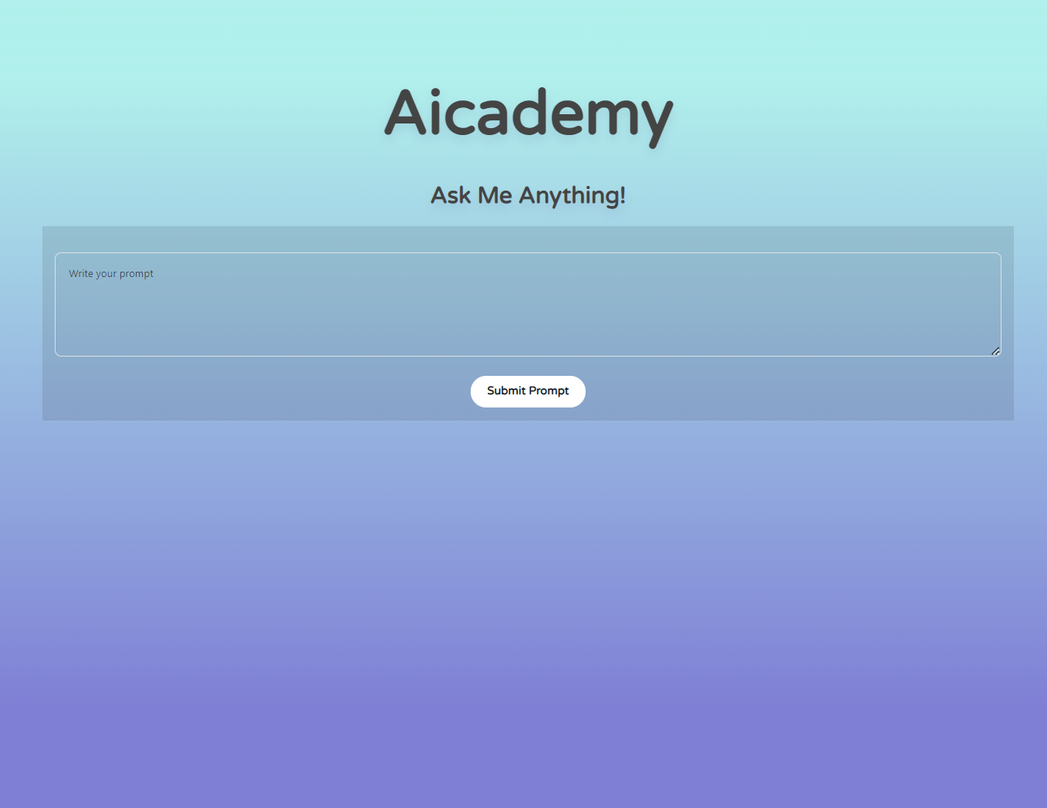
AiCADEMY
Demo

Slide 3
HOW TO CODE?
Jupiter Notebooks
API KEY
tutorial

Slide 4
WINNERS!
a a

Slide 5
AMACSS THANK YOU! The Cyber Savvy Ninjas

