Slide 1


OpenAI Hackathon 2023 AiCADEMY The Cyber Savvy Ninjas

Slide 2
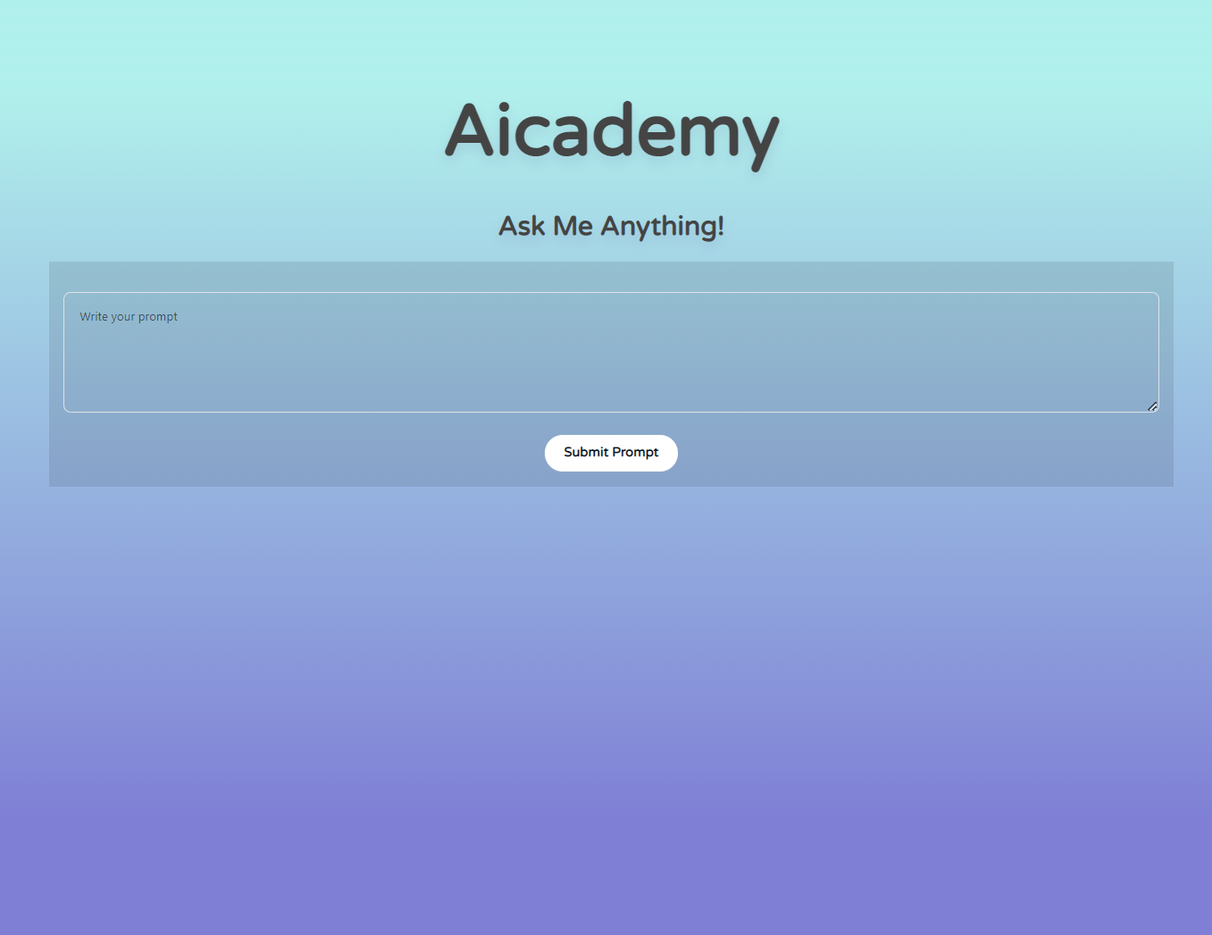
AiCADEMY
Demo

Slide 3
Aicademy is a cutting-edge, personalized online learning platform that uses AI to create immersive ‎courses with stunning images. With quizzes, summaries, and an interactive chatbox, AIcademy delivers an ‎exceptional, engaging learning experience.‎
What is AiCADEMY

Slide 4
Meet Aicademy’s Faculty: ChatGPT Dall-E-2 Davinci-003
How AiCADEMY works

Slide 5
Why choose AiCADEMY
Personalized Courses tailored to your unique needs and interests
Author at your service for immediate assistance and interactive learning
Quiz & Summary to test your knowledge, track your progress, and save you time

Slide 6
Executive Summary: AIcademy is an innovative online learning platform that uses advanced AI technology to create personalized and immersive courses for students. With its cutting-edge features like DALL-E-2 generated images, quizzes, summaries, and a chatbox, AIcademy offers a unique and engaging learning experience that is unmatched in the market. Market Opportunity: The online learning industry has seen rapid growth in recent years, especially due to the COVID-19 pandemic. With an increasing number of students and professionals seeking to upskill or re-skill themselves, the market for AI-powered personalized online learning platforms is ripe for growth. Target Market: AIcademy targets students, professionals, and lifelong learners who are seeking a personalized and interactive learning experience. The platform will initially focus on the education and corporate training markets, targeting schools, universities, and corporate training departments. Marketing and Sales Strategy: AIcademy will primarily utilize digital marketing techniques, including search engine optimization, social media marketing, and email campaigns to target potential customers. The platform will also leverage partnerships with educational institutions and corporations to promote the platform to their students and employees. Additionally, AIcademy will offer a freemium model, allowing students to access basic features for free, with additional features available for a subscription fee.
Business plan

Slide 7
Operations Plan: AIcademy's operations will be primarily digital, with a small team of engineers, content creators, and customer service representatives. The platform will leverage cloud-based infrastructure to handle course creation, image generation, and chatbot interactions. AIcademy will also work with educational institutions and corporations to create customized courses for their specific needs. Financial Plan: AIcademy's revenue model will be primarily subscription-based, with a freemium model for basic features. The platform will also generate revenue from customized course creation for educational institutions and corporations. AIcademy's initial investment will primarily go towards research and development, marketing, and building out the platform's infrastructure. The projected revenue for AIcademy's first year of operation is $5 million, with a net profit of $2 million. Conclusion: AIcademy is poised to become a leading player in the online learning industry, with its innovative AI-powered personalized course creation, interactive learning features, and strategic marketing and sales approach. With the growing demand for online learning, AIcademy is well-positioned to capture a significant market share in the years to come.
Business plan

Slide 8
OpenAI Hackathon 2023 Thank You! The Cyber Savvy Ninjas

