Slide 1
VOLTE
ADICHERLA VENKATASAI
P19CO016

Slide 2
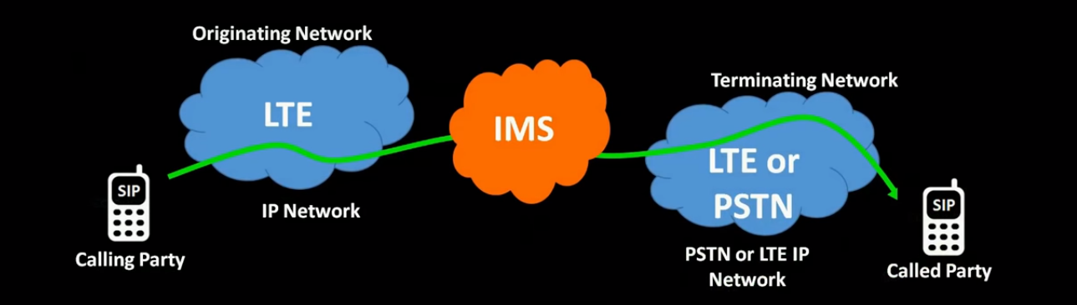
What’s VOLTE
Voice over Long Term Evolution(cellular voice over LTE network).
LTE Packet Network used for carrying voice payload over all IP Network.
Rather than the 2G or 3G connections which are usually used for voice calls , VoLTE offers voice calls over all IP to IP based 4G Network.

Slide 3
Uses
Better user experience.
HD calling.
No drop in background.
Faster Connect.
Better battery life.

Slide 4
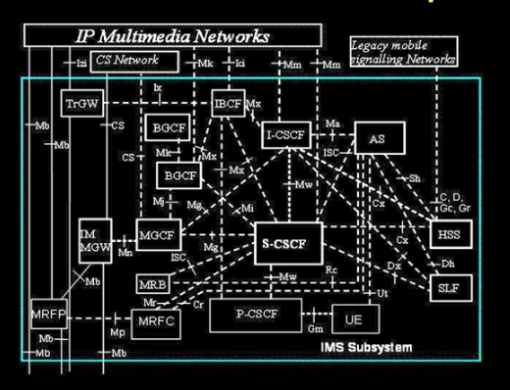
VoLTE Architecture

Slide 5
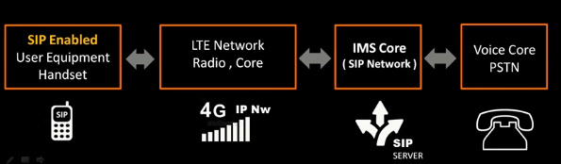
Building blocks
VoLTE UE(User Equipment).
RAN(Radio Access Network).
EPC(Evolved Packet Core).
IMS core network( IP Multimedia Subsystem)..

Slide 6
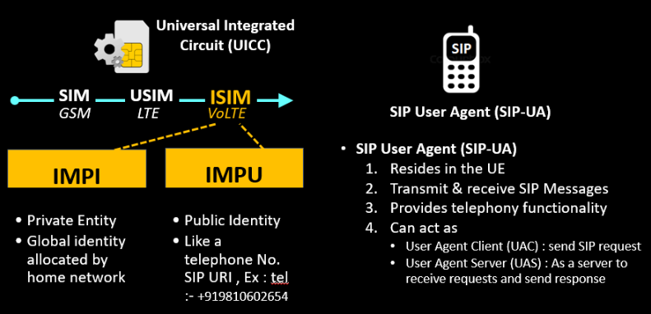
User Equipment

Slide 7
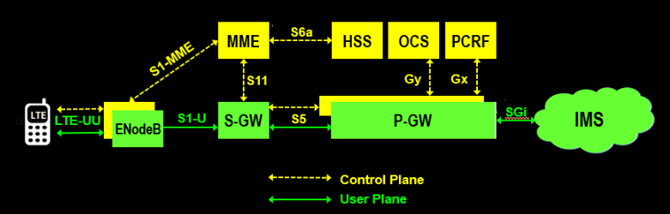
LTE Architecture
LTE network acts as a highway to relay messages between UE and IMS network

Slide 8
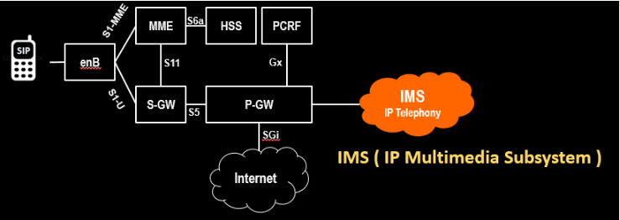
IMS Core

Slide 9
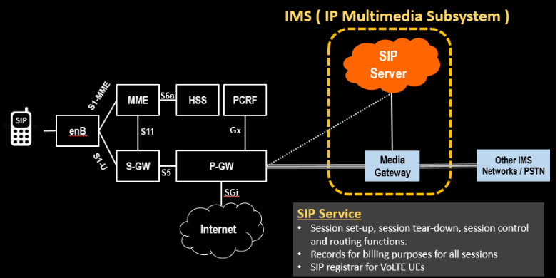
Cont..

Slide 10
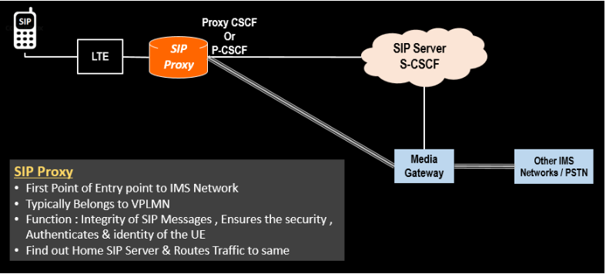
Cont..

Slide 11
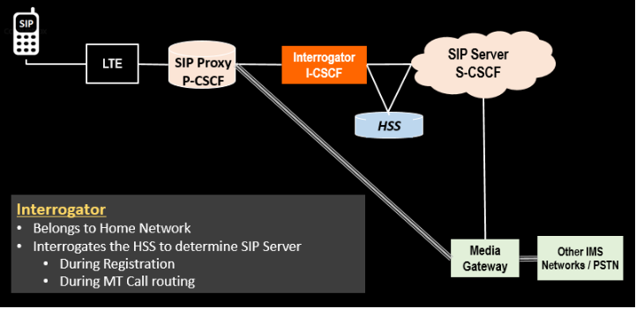

Slide 12
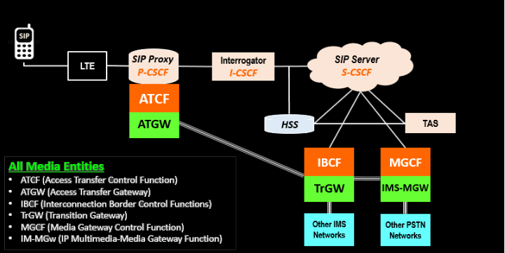

Slide 13
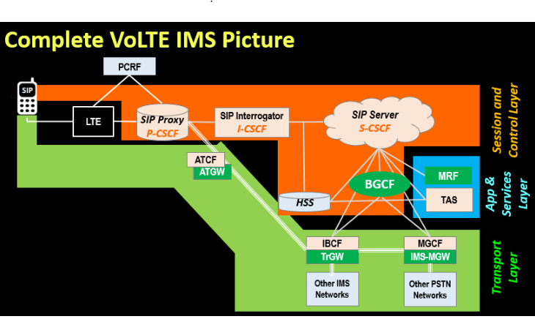

Slide 14
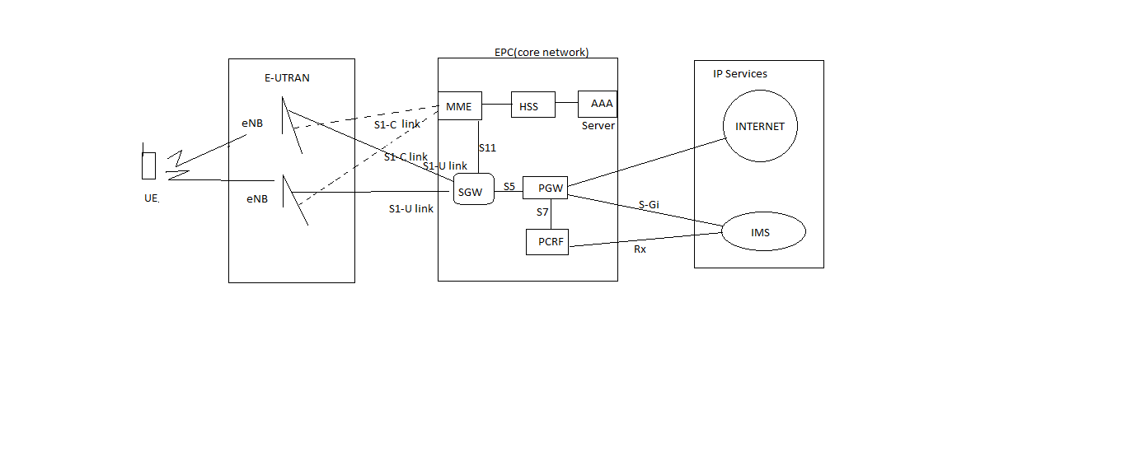
Basic view

Slide 15
What if congestion occurs?
PCRF QoS provides the priority bearer, since voice can’t be compromised , VOLTE is provided with highest priority over internet traffic using QCI.
QCI=5 : VOLTE IMS Signaling
QCI=1: Voice IMS call
Note: 6 to 9 for Internet (low priority)

Slide 16
References
https://www.youtube.com/watch?v=Y6w9VPD4zPM&list=PLAsc7YcX8FIdOReT6_DUXROf2XB6uB_ij&index=7 -WMC(VOLTE).

Slide 17
Thank You

