Slide 1
Modifying Pixel Properties In Adaptive Steganography Using Substitute Method
By
DADANNAGARI AKHILA (14831A0537)
ADICHERELA VENKATASAI (14831A0505)
JONNALAGADDA SRIKANTH (14831A0558)
Under the Guidance of
Mr. NUSRATH KHAN
Assistant Professor

Slide 2
Abstract
In steganography, the distortion purpose is used to explain the modification cost on cover elements ,which are definitely crucial to the security of current adaptive steganography.. In this project we suggest a novel cost reassignment rule that's implemented to not one but a batch of present distortion functions. We notice that the costs assigned on a few pixels by several steganographic strategies may be very dissimilar even though those strategies exhibit close security levels. Such pixels are named as “controversial pixel”. Experimental results display that steganalysis features are unresponsive to those pixels, therefore these pixels are appropriate to hold extra payloads. We name this rule as the Controversial Pixels Prior (CPP) rule. steganalysis features and cover databases, we exhibit that the CPP rule can enhance the security of state-of-the-art steganographic algorithms for spatial snapshots

Slide 3
Modules
Patient
Registration
Authentication
Admin
Authentication
Encrypt image
Embed the data
Reserve point
View details
Receiver
Extract original data

Slide 4
Patient Registration
If you are the new user going to login into the application then you have to register first by providing necessary details. After successful completion of sign up process, the user has to login into the application by providing username and exact password.
user
Necessary details
Database

Slide 5
Login
The user needs to enter exact username and password. If login success means it will take up to upload page else it will remain in the login page itself.
check
Proceed to next stage
Login

Slide 6
Admin Authentication
The Admin needs to enter exact username and password. If login success means it will take up to upload page else it will remain in the login page itself.
Check
Proceed to next stage
login

Slide 7
Encrypt Image
After login success admin can encrypt image for the user data, i.e. for the secret message of the user then he will encrypt the image along with the data.
Image encryption
admin
Get key

Slide 8
Embed the Data
After login success admin can get patient data, after that encrypted data embed into image and send to receiver side.
AES enc(data)
Embed data into image
admin
Data hiding key

Slide 9
Reserve Point
Admin send the reserve point of image to receiver, this is the key for the receiver to get the encrypted details of the patient.
login
Get reserve
admin
Send to receiver

Slide 10
View Details
In this module, after successful login of the admin the admin have rights to view all details, i.e. Admin can view the patient /doctor details.
View patient/doctor details
database
admin

Slide 11
Receiver Extract Data
In this module after success authentication of the receiver, he will extract the original data from embedded image that was provided by the admin.
Original data
Receiver
Extract (data hiding key)

Slide 12
Uml diagrams

Slide 13
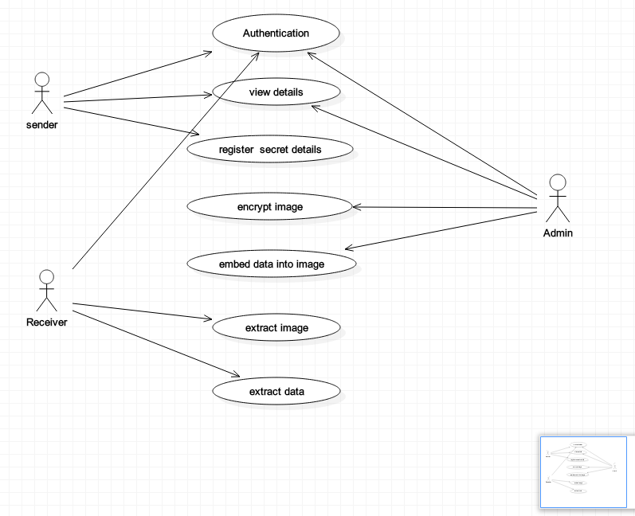
Use Case Diagram
The purpose of use case is to present overview of the functionality provided by the system in terms of actors, their goals and any dependencies between those use cases.

Slide 14
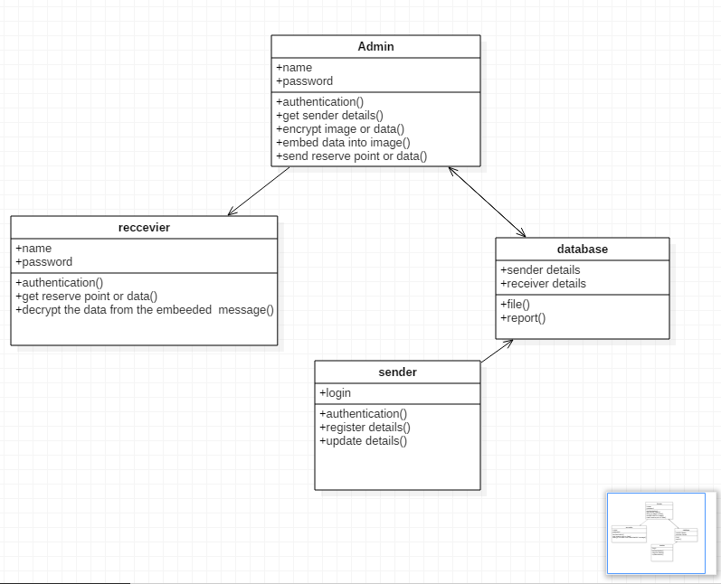
Class Diagram
A class diagram in the UML is a type of static structure diagram that describes the structure of a system by showing the system’s classes, their attributes, and the relationships between classes.

Slide 15
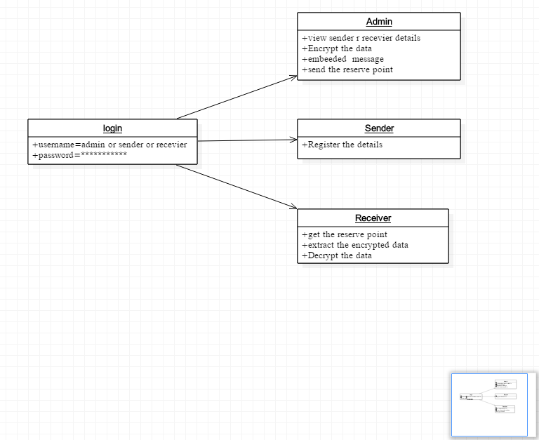
Object Diagram
An object diagram in the Unified Modeling Language (UML) is a diagram that shows a complete or partial view of the structure of a modeled system at a specific time.

Slide 16
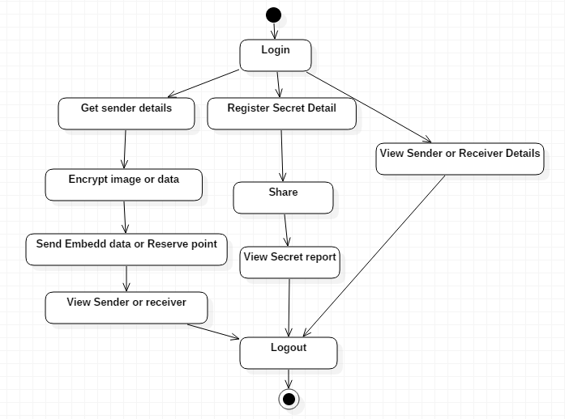
State Diagram
State diagrams require that the system described is composed of a finite number of states; sometimes, this is indeed the case, while at other times this is a reasonable abstraction.

Slide 17
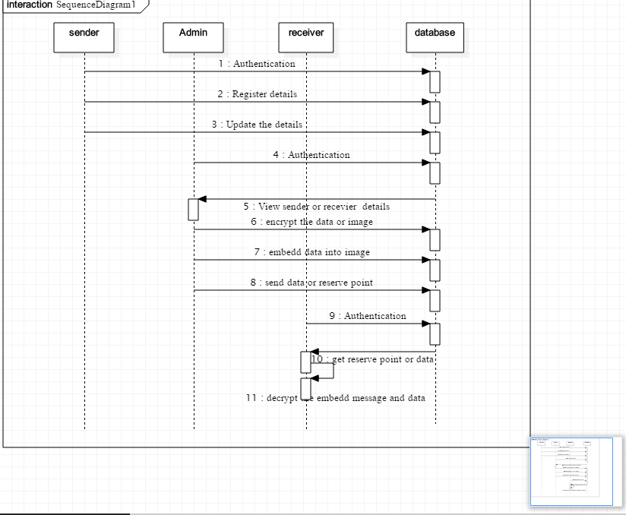
Sequence Diagramm
A sequence diagram in UML is a kind of interaction diagram that shows how the processes operate with one another and in what order.

Slide 18
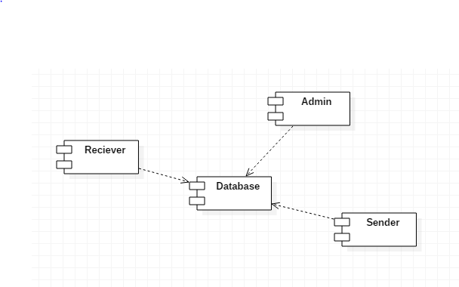
Component Diagram
Components are wired together by using an assembly connector to connect the required interface of one component with the provided interface of another component. This illustrates the service consumer - service provider relationship between the two components.

Slide 19
Data Flow Diagram
A data flow diagram (DFD) is a graphical representation of the “flow” of data through an information system.
View sender/ receiver detail
Admin
/Receive/Sender
LOGIN
DATABASE
Receiver
View Secret details
View Secret details
Extract data
Get data/encrypt image data
Send secret data
Embed data into image
Share
Send data/reserve point

Slide 20
System Architecture
RECEIVER
Extract data/image
SENDER
Data hiding key
3DES decryption
View Secret details
Register/Send secret details
Get embed data/reserve point
DATABASE
ADMIN
Encryption
SEND
View Sender/Receiver details
Get reserve point
Histogram shift (Encrypted domain-image)
Reserve point
Get image/data
Data hiding key
Embedded data
3DES encryption (data)

