Slide 1

Telecom Data Analytics: From Raw Data to Business Recommendation
An End-to-End AI/ML, Data Engineering, Monitoring and Decision System
ADVANCED AI & ML — FINAL CAPSTONE PROJECT
Team Name · Aditya Kumar, Kashish Yadav, Pankaj Sagar, Vivek Kumar, Manya Verma

Slide 2
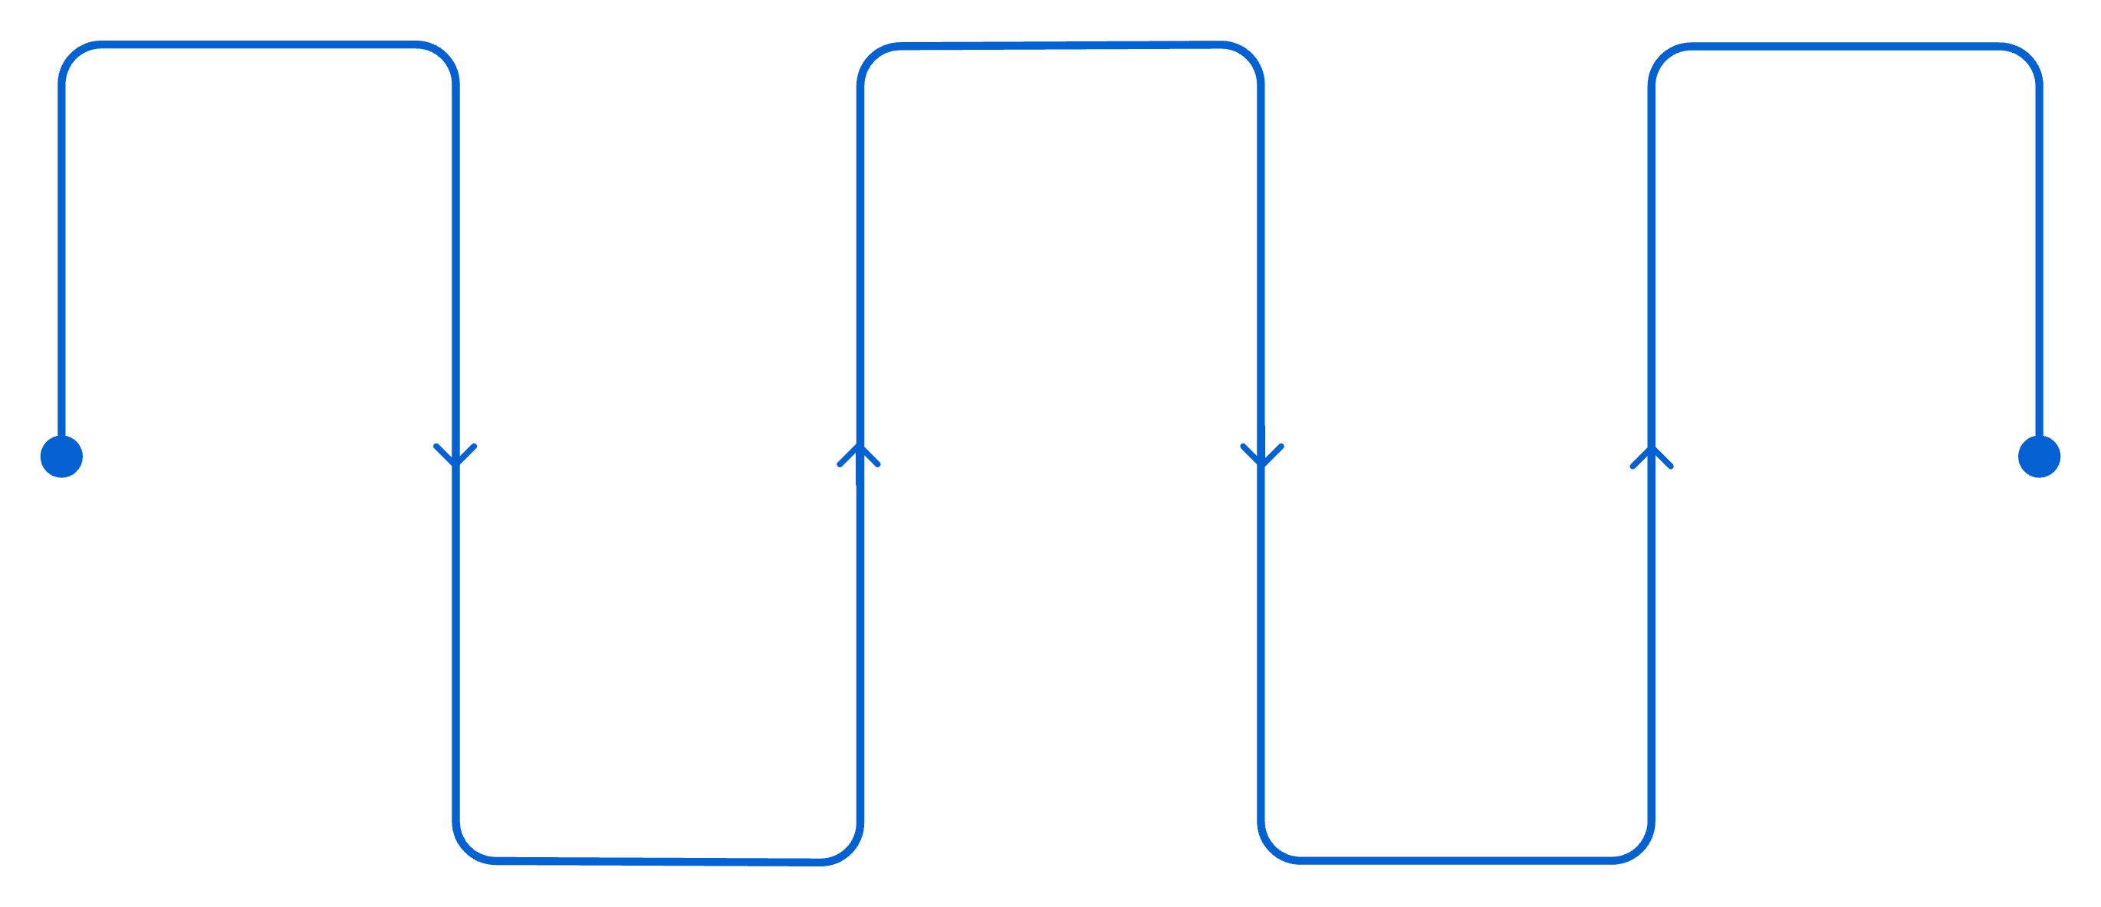

Executive Summary
This project converts messy telecom operational data into reliable insights and actionable business decisions — combining data engineering, ML, forecasting, NLP, and costed recommendations.
Data Ingest
Governed Dataset
Insights to Action
Raw telecom operational data
Validated, cataloged, and lineage-traced
Dashboards, alerts, costed recommendations
Profiling & Cleaning
AI/ML & Analytics
Assess quality and sanitize records
Models, forecasting, and NLP
Core message: This is not only an ML model — it is an end-to-end telecom analytics decision system.

Slide 3

What Problem Are We Solving?
A telecom operator generates massive volumes of subscriber, usage, network, and customer-care data — but raw data contains duplicates, missing values, and operational noise that prevent reliable decisions.
Subscriber Risk
Who will churn? Who is worth retaining?
Network Quality
Which cells are degrading? Which degradation affects revenue?
Customer Care
Which messages are negative? Which tickets route automatically?
Business Value
Where should investment go? Which action creates the greatest value?
Objective: Move from data → insight → action → measurable value.

Slide 4

Telecom Data Used in the Capstone
Dataset
Content
Track
capstone_subscribers.csv
Subscriber profile, 6-month behavior, churn outcome
A, C
capstone_usage_monthly.csv
Usage and revenue per subscriber per month
A
capstone_network_kpi.csv
15-min cell readings, 18 cells
B
capstone_maintenance_windows.csv
Planned outages and change tickets
B
capstone_cell_traffic_monthly.csv
30 months of cell traffic and capacity
B
capstone_messages.csv
Customer messages with true sentiment labels
C
capstone_tickets.csv
Support tickets with handling team
C
Data Grain: Subscriber (per subscriber) · Usage (per subscriber/month) · Network KPI (per cell/15 min) · Traffic (per cell/month) · Message (per message) · Ticket (per ticket)

Slide 5
Why Data Governance Comes Before Modelling
Raw Data Quality Problems
Guiding Principle
Subscribers: Duplicates, missing usage/recharge, inconsistent region spellings
Usage: Duplicate records, missing revenue, zero revenue despite real usage
Network: Duplicate readings, blank latency, negative throughput, maintenance outages, collector losses
Messages: Messages without matching subscriber records
Do not blindly delete bad data. Understand what the value means before repairing it.

Slide 6
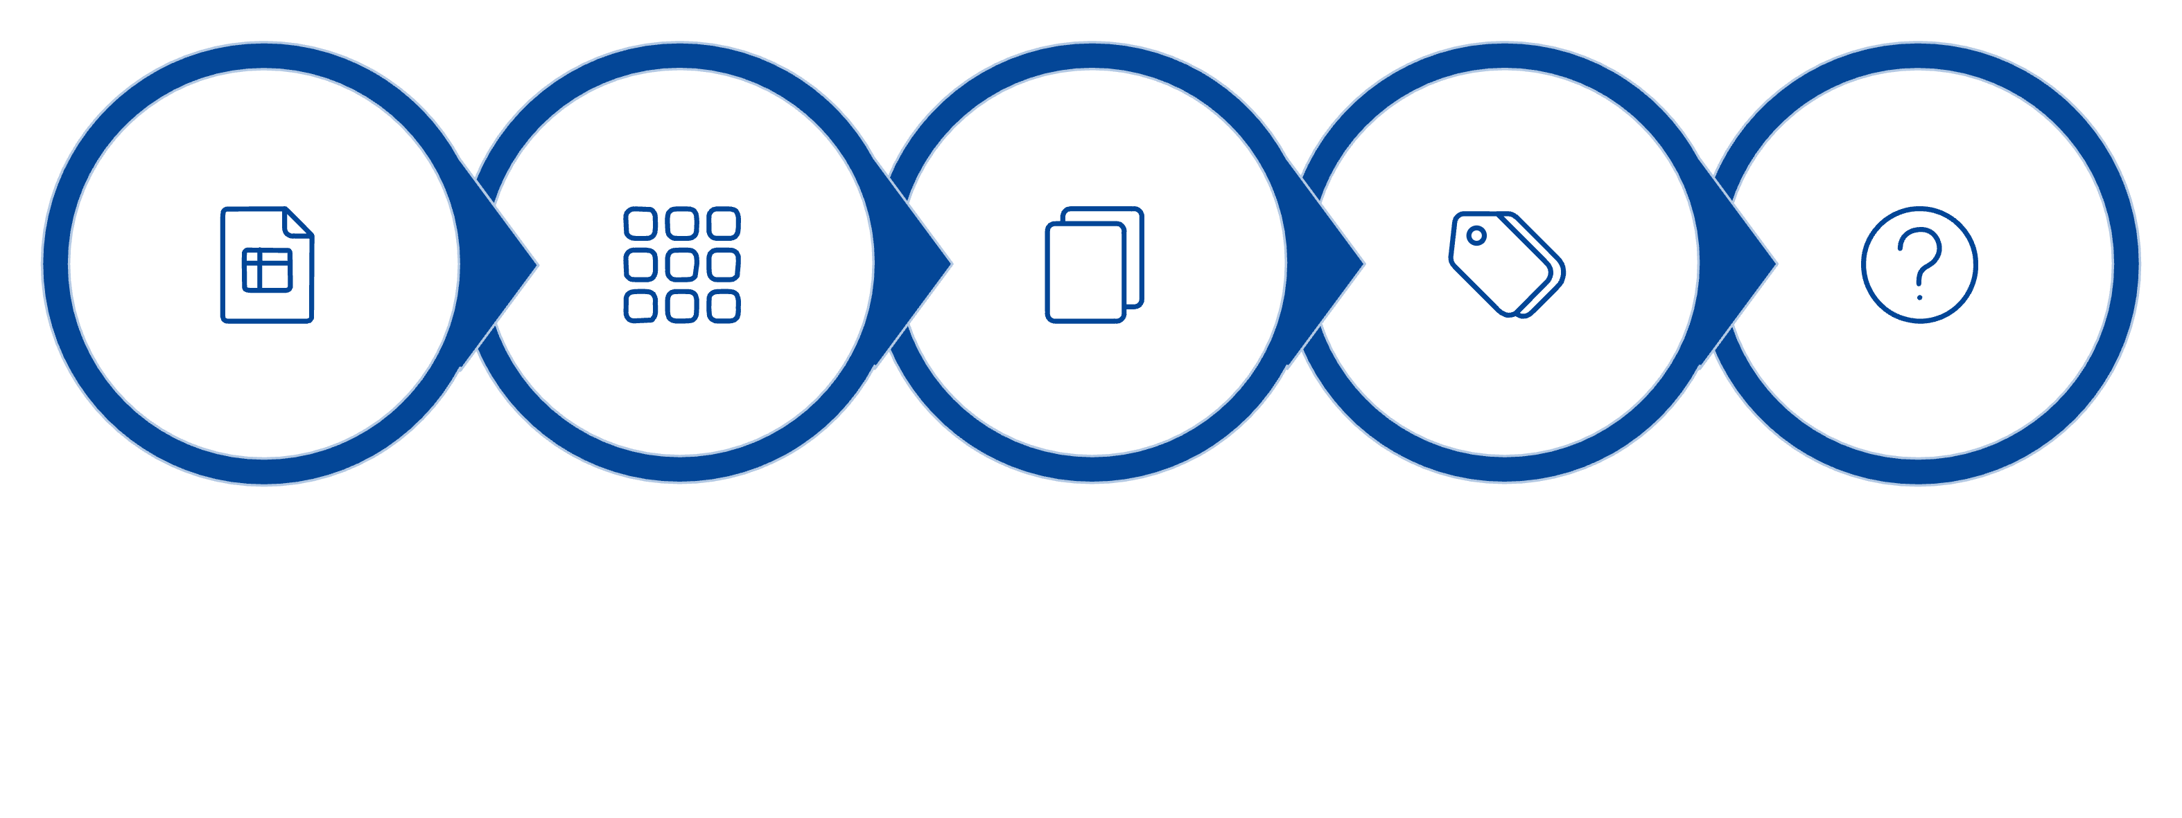
From Raw Data to a Governed Dataset
Detect Duplicates
Standardize Categories
Classify Missing
Raw CSV
Identify Grain
Key governance rules: duplicates removed at correct grain; missing values classified before imputation; imputed values receive _was_missing flags; negative throughput treated as counter rollover; planned maintenance NULL latency preserved; pipeline is idempotent (running twice produces identical row counts).

Slide 7
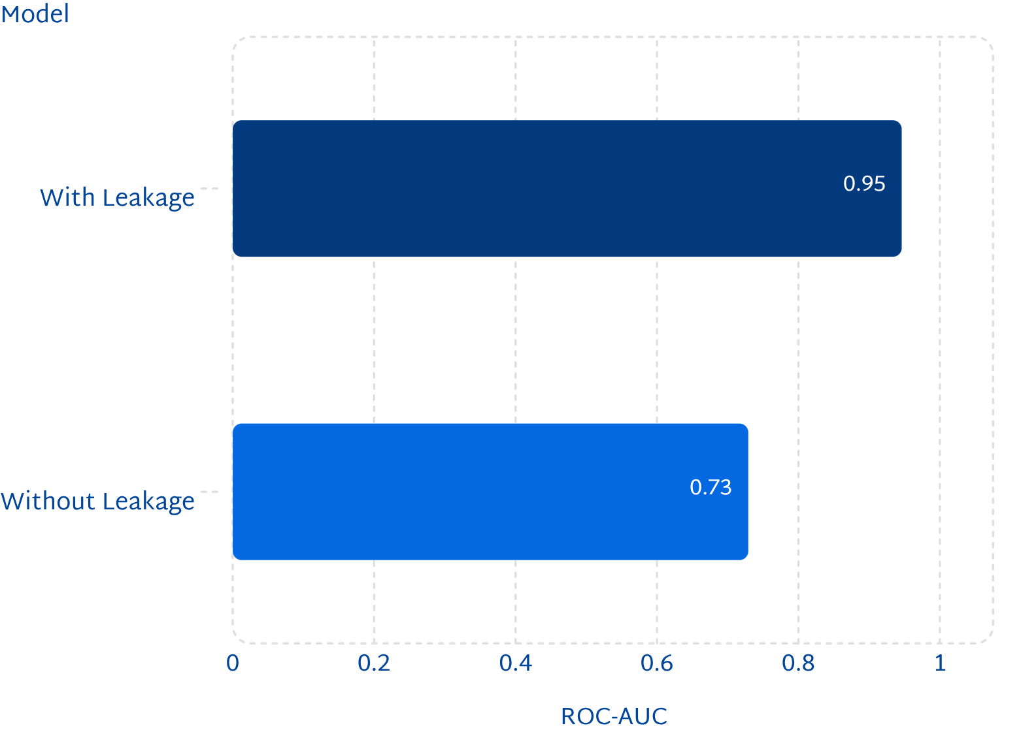

Preventing Data Leakage: The Day-Before Test
For every predictive feature, ask: "Would this value have existed the day before the event I am trying to predict?" If no — it is leakage.
Problematic Features Removed
retention_offer_sent — consequence of an existing churn-risk decision
total_charges — effectively ARPU × tenure; can directly reveal the target
A high model score is not useful if the model learns information unavailable at prediction time.

Slide 8



Three Business Problems, Three Analytical Tracks
Track A — Churn & Retention
Track B — Network & Revenue
Track C — Customer Care Copilot
Question: Which subscribers will leave, and what should we spend to retain them?
Behavioral feature engineering, churn classification, segmentation, expected loss, anomaly detection
Question: Which cells are degrading, what revenue is exposed, and where should capacity go?
KPI cleaning, alert engineering, forecasting, revenue exposure, capacity planning
Question: Which messages matter, who should handle them, and what is the value of prioritizing?
Sentiment analysis, ticket routing, confidence thresholds, human escalation, customer-value prioritization

Slide 9
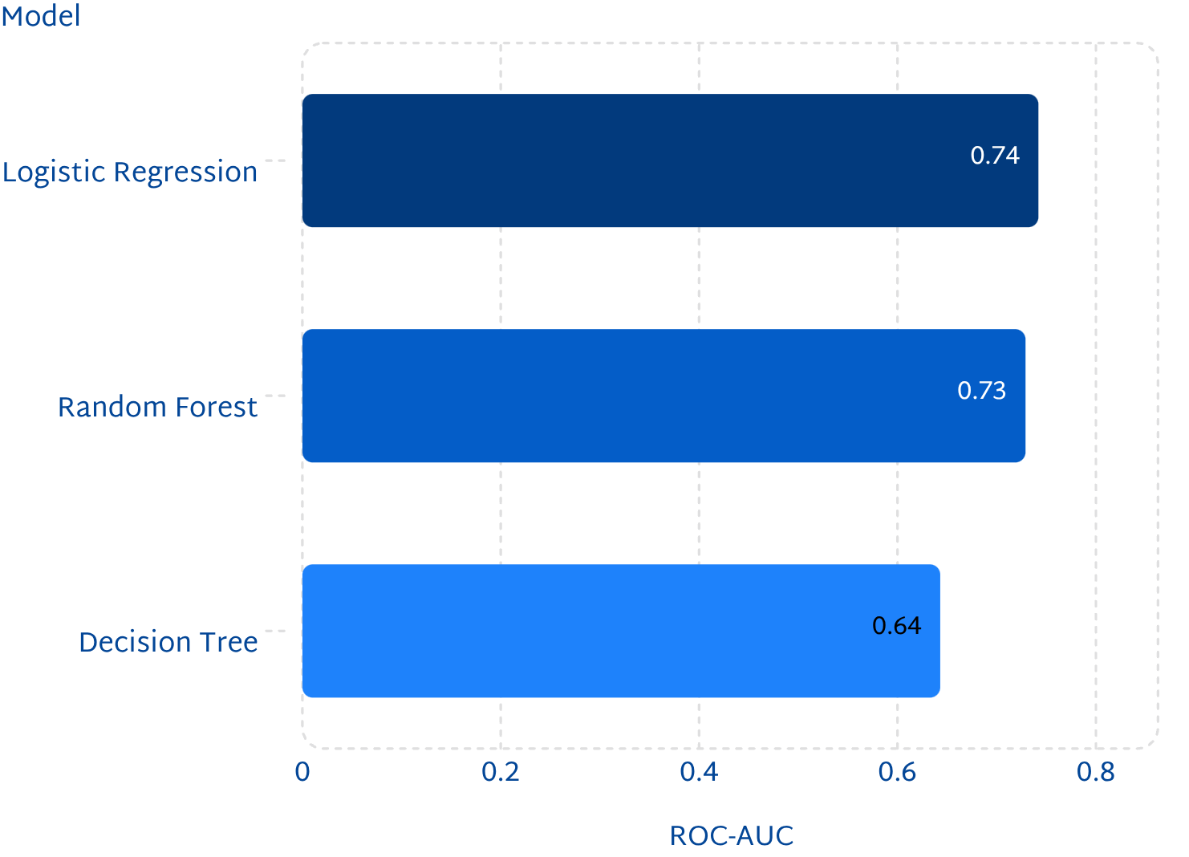

Track A — Churn Prediction & Segmentation
Segment 0 — Priority Retention Target
392 subscribers · 12.2% of base
40% churn rate vs. 24.1% overall
Driven by complaints, not high spend
Expected Loss = Churn Risk × ARPU × 12
Prioritize by risk + value, not accuracy alone.
Fraud & Leakage Detection: Isolation Forest identifies bypass fraud, subscription fraud, and billing faults. Anomaly flags require investigation — they are not automatic conclusions.

Slide 10
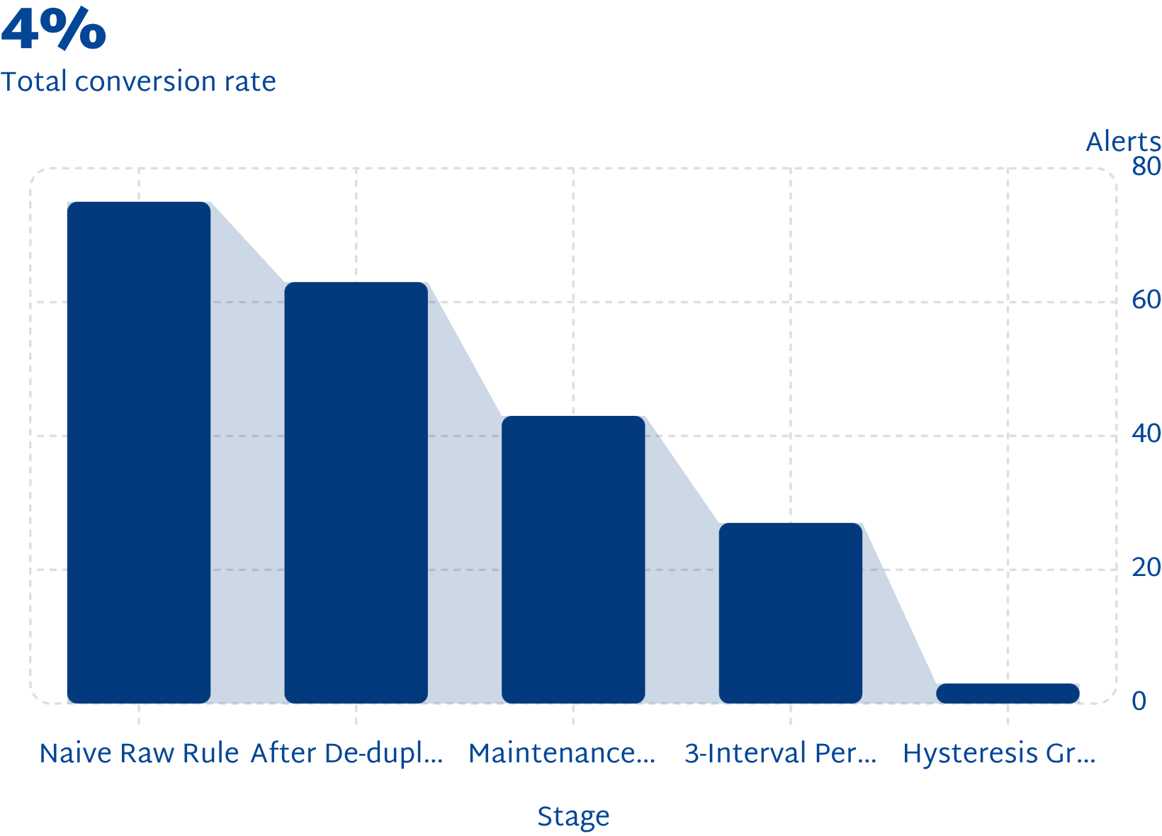

Track B — Network Quality & Revenue Optimization
Alert Engineering Funnel
Network Data Quality
8,681 raw rows → 8,640 after de-duplication
97 blank latency: 20 planned, 7 outage, 63 collector loss
9 negative throughput (counter rollover), 27 downtime rows
Cells Above 85% Utilization
CELL-HYD-03 · CELL-KOL-03 · CELL-MUM-01
Prioritize by customer/revenue exposure, not only by milliseconds.

