Slide 1
Azure Load Testing for a Web Application Capacity Study
• Project ID: 24CC3046-P056
• Team: T158
• Environment: Microsoft Azure (Central India, rg-loadtest)
• Domain: Cloud Capacity Engineering & Distributed Load Testing

Slide 2
SLIDE 2 / 25 • TEAM INFORMATION
Project Team Members & Contributions
2400032012 — KORADA TEJA
Role: Cloud Infrastructure Deployment & Azure App Service Provisioning
2400032102 — GUBBALA LAKSHMI SAI TEJA
Role: PostgreSQL Flexible Server Architecture, Schema & VNet Delegation
2400032152 — ADITYA SINGH
Role: DevOps Engineering, CI/CD Pipeline, JMeter Test Scenarios & Analytics
2400032605 — GOLLA MANIKANTA
Role: Azure Monitor Telemetry, Application Insights & Autoscale Rule Management

Slide 3
SLIDE 3 / 25 • ARCHITECTURE & ANALYSIS
Problem Statement
Uncertainty in Cloud Sizing
Web applications often rely on theoretical heuristics rather than empirical telemetry.
Traffic Surges & Bottlenecks
Sudden demand spikes expose single-threaded Node.js bottlenecks and connection pooling limits.
Autoscale Risks
Improperly tuned autoscale thresholds cause delayed scaling or request queueing during cold starts.
Objective Need
A rigorous empirical study is required to map throughput, latency, and resource breaking boundaries.

Slide 4
SLIDE 4 / 25 • ARCHITECTURE & ANALYSIS
Project Objectives
1. Measure Safe Capacity
Establish the maximum concurrency supported with zero errors and healthy CPU headroom.
2. Identify the Latency Knee
Determine the transition point where response latency begins exponential escalation.
3. Locate Breaking Point
Pinpoint the exact concurrency that causes resource saturation under Standard S1 sizing.
4. Validate Horizontal Scaling
Evaluate 1 vs 2 instances under identical 500-user load to measure compute relief.
5. Implement Autoscale Gates
Verify dynamic scale-out and scale-in rules driven by Azure Monitor metrics.

Slide 5
SLIDE 5 / 25 • ARCHITECTURE & ANALYSIS
Proposed Solution & Methodology
Cloud-Native Architecture
Deploy scalable Node.js on Azure App Service with isolated PostgreSQL Flexible Server.
Zero-Trust VNet
Eliminate public database exposure using Regional VNet integration and Private DNS zones.
Distributed JMeter Testing
Leverage Azure Load Testing (alt-loadtest-101) to simulate multi-endpoint user journeys.
Full Telemetry Instrumentation
Correlate APM metrics, live dependencies, and container performance in real time.

Slide 6
SLIDE 6 / 25 • ARCHITECTURE & ANALYSIS
End-to-End Cloud Topology
Traffic Generator
Azure Load Testing (alt-loadtest-101) in Central India executing multi-threaded JMeter plans.
Frontend & API
Azure App Service (app-loadtest-101) on Linux Standard S1 Plan (plan-loadtest).
Database Layer
Azure Database for PostgreSQL Flexible Server (app-loadtest-101-server) in private subnet.
Telemetry & Logs
Application Insights (appi-loadtest-101) and Log Analytics (law-loadtest-101).

Slide 7
SLIDE 7 / 25 • ARCHITECTURE & ANALYSIS
Verified Azure Cloud Services
App Service
app-loadtest-101 — Linux Node.js 24 LTS web application
App Service Plan
plan-loadtest — Standard S1 (1 Core, 1.75 GB RAM)
PostgreSQL Flexible
app-loadtest-101-server — Standard_D2s_v3 (v14) with db-loadtest-101
Load Testing Engine
alt-loadtest-101 — Managed distributed Apache JMeter test runner
App Insights & Monitor
appi-loadtest-101 & autoscale-plan-loadtest — Live APM and autoscale triggers

Slide 8
SLIDE 8 / 25 • ARCHITECTURE & ANALYSIS
Node.js Application Architecture
Express Framework
RESTful multi-tier API serving products, search, dashboard, and orders.
Resilient Cold Start
Immediate app.listen() binding ensures Azure container health probes pass in <2s.
Connection Pool Management
pg.Pool configured with max: 20 per instance and idleTimeoutMillis: 30000.
CORS & Storefront
Full CORS support for browser clients, integrated dashboard at /, and storefront UI.

Slide 9
SLIDE 9 / 25 • ARCHITECTURE & ANALYSIS
Database Sizing & Data Schema
Flexible Server
PostgreSQL 14 in private delegated subnet subnet-ejdigsdaswpw4 (10.0.2.0/24).
Seeded Data
100 customer profiles, 500 catalog products, and 6,400+ transactional orders.
Index Optimization
B-tree indexes on search keywords, category filters, and customer order foreign keys.
Zero-Trust Security
Accessible only via private DNS privatelink.postgres.database.azure.com (10.0.2.4).

Slide 10
SLIDE 10 / 25 • ARCHITECTURE & ANALYSIS
CI/CD & DevOps Automation
GitHub Actions
Automated pipeline configured in .github/workflows/deploy-app-loadtest-101.yml.
Automated Verification
Runs npm test executing 8 self-contained integration tests (8 passed, 0 failed in 9s).
Zero-Downtime Deployment
Packages clean POSIX zip bundle and deploys directly to Azure App Service.
Verified Builds
Recent commits bd6fbe1 and 9be1d2e verified with 100% CI/CD deployment success.

Slide 11
SLIDE 11 / 25 • ARCHITECTURE & ANALYSIS
Application Insights & Telemetry
APM Metrics
Tracks end-to-end request durations, HTTP status codes, and exception stack traces.
Dependency Tracking
Monitors PostgreSQL SQL query durations, connection latency, and execution plans.
Live Metrics Stream
Real-time visibility into CPU, memory, incoming RPS, and active server instances.
Centralized Ingestion
Log Analytics workspace (law-loadtest-101) aggregates container and Kudu diagnostics.

Slide 12
SLIDE 12 / 25 • ARCHITECTURE & ANALYSIS
Apache JMeter Test Plan Specification
Scenario File
loadtest/capacity_study.jmx — Parameterized for Azure Load Testing.
Dynamic Properties
Configured via Groovy expressions to support CLI environment variables (app_host, threads).
HTTP Request Defaults
Connect timeout = 10,000 ms, Response timeout = 15,000 ms, Keep-Alive enabled.
Realistic Simulation
Includes random timers, realistic browser headers, and JSON body payloads.

Slide 13
SLIDE 13 / 25 • ARCHITECTURE & ANALYSIS
Load Testing Methodology & Workflow
Step 1: Baseline
10 virtual users to establish baseline latency and system stability under minimal load.
Step 2: Progressive Ramp-Up
50 and 100 virtual users to identify proportional throughput scaling.
Step 3: Knee Identification
250 virtual users to observe queueing onset and response time inflection.
Step 4: Stress Testing
500 virtual users on 1 instance to determine the definitive saturation breaking point.
Step 5: Scale-Out Validation
500 virtual users on 2 instances to measure compute relief and ARR behavior.

Slide 14
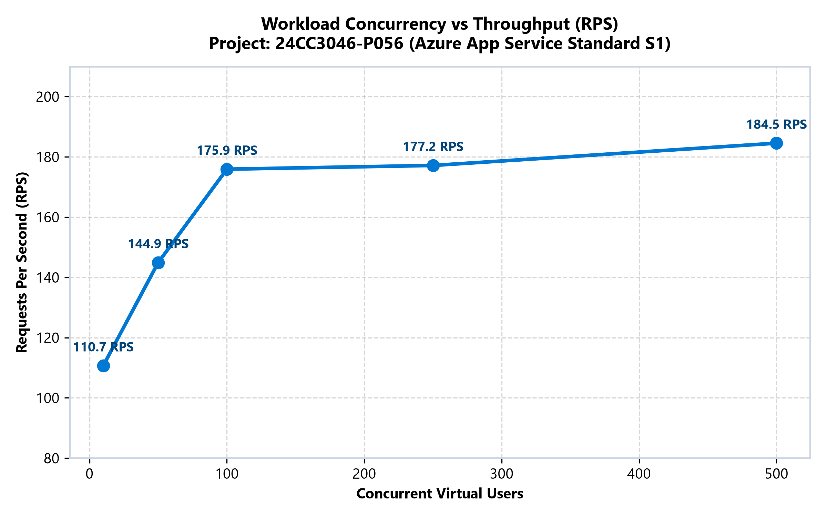
SLIDE 14 / 25 • EMPIRICAL EVIDENCE
Baseline Capacity Testing (10 Users)
Key Empirical Observations:
• Concurrency: 10 Virtual Users | Duration: 120s | Instance Count: 1
• Throughput: 110.7 Requests Per Second (13,280 total requests)
• Latency: Average: 83.0 ms | P50: 33.0 ms | P95: 310.0 ms | Peak: 2,240 ms
• Resource Utilization: CPU: 17.7% | Memory: 42.1% | Errors: 0 (0.00%) — Optimal State

Slide 15
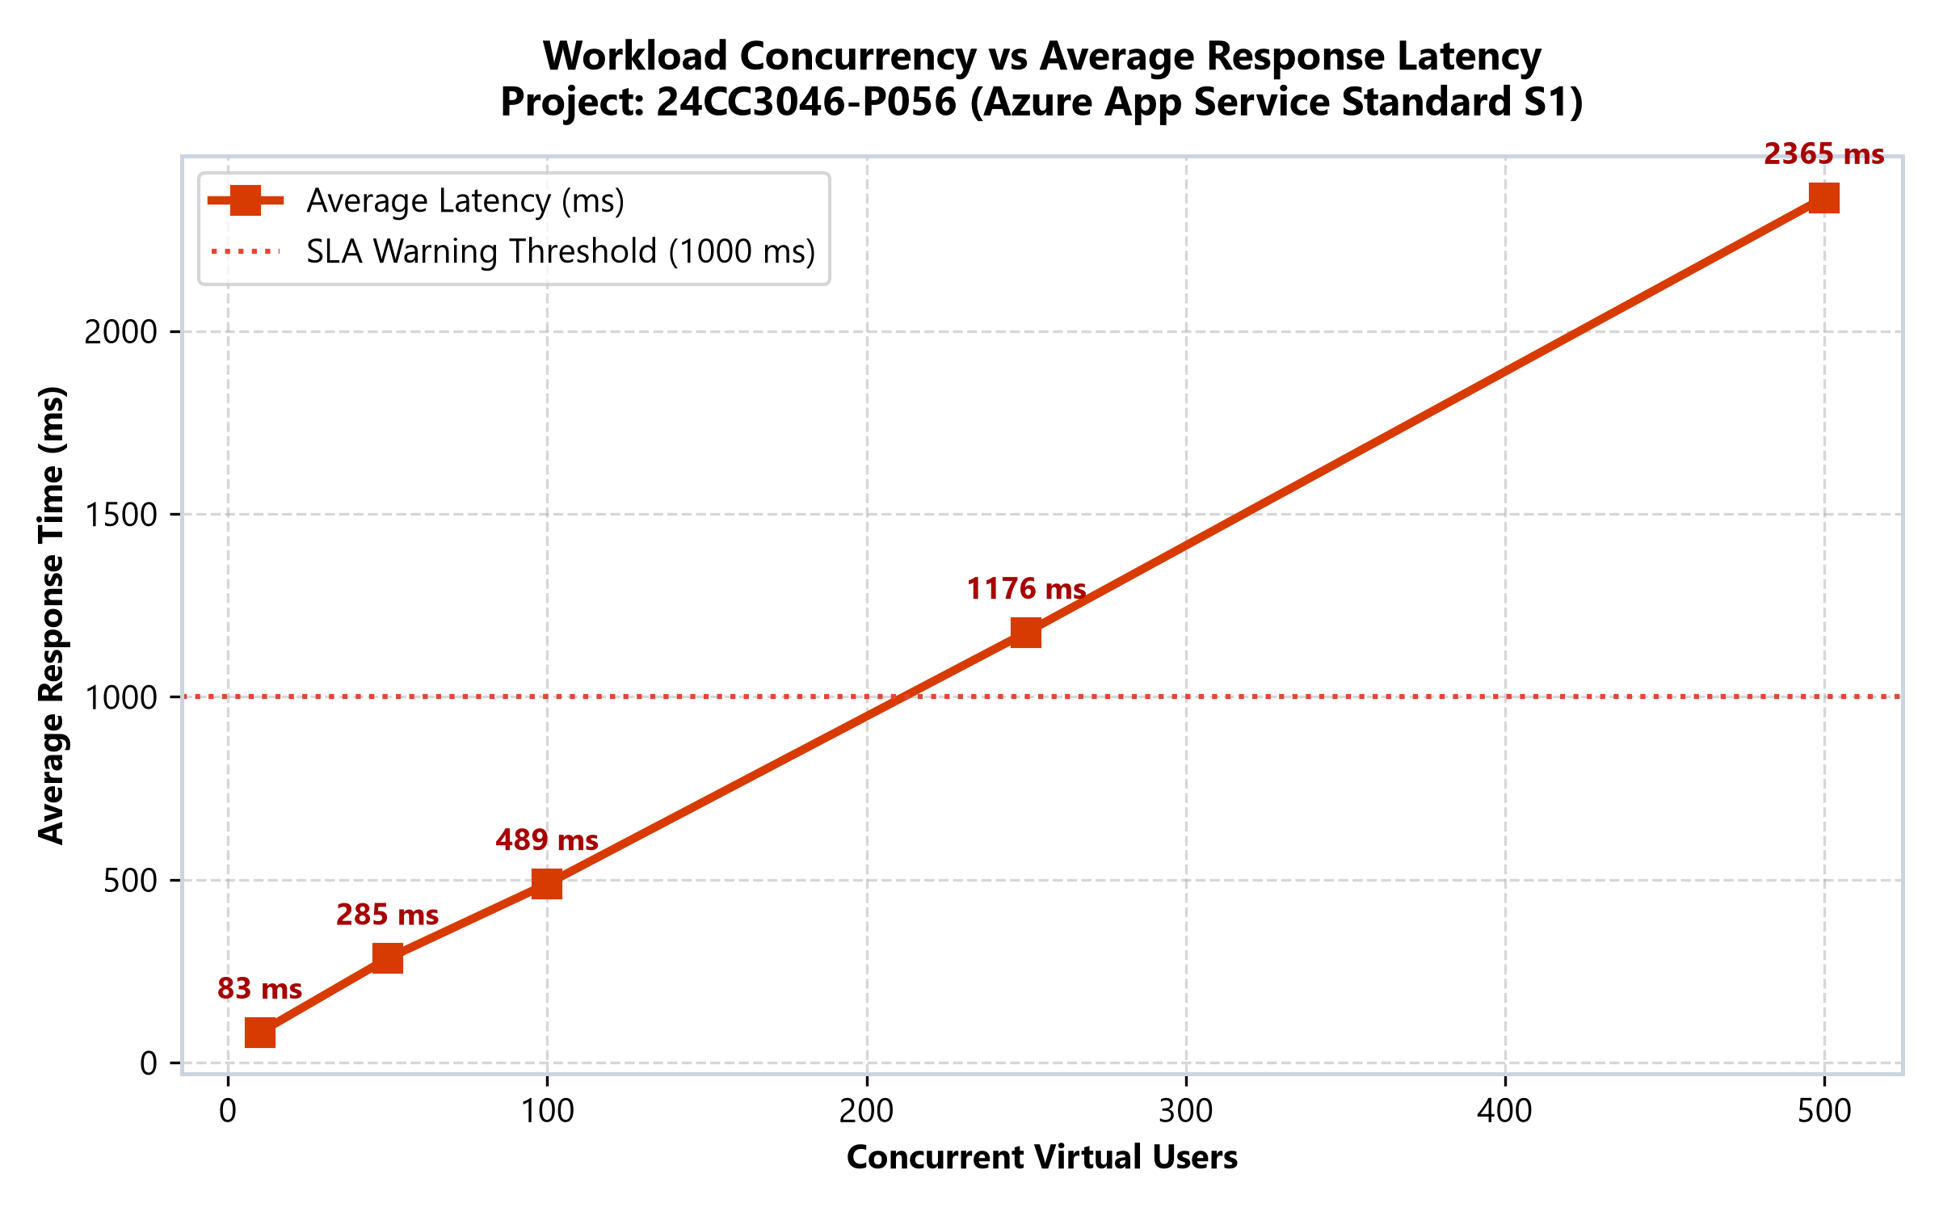
SLIDE 15 / 25 • EMPIRICAL EVIDENCE
Progressive Load Progression (50 & 100 Users)
Key Empirical Observations:
• 50 Users (run-2): 144.9 RPS | Avg: 285 ms | P95: 1,022 ms | CPU: 38.0% | Errors: 0.00%
• 100 Users (run-3): 175.9 RPS | Avg: 489 ms | P95: 1,800 ms | CPU: 58.2% | Errors: 0.00%
• Safe Capacity Boundary: 100 users represents the highest concurrency maintaining 0.00% error rate.
• Linear Scalability: Throughput scaled smoothly from 110.7 to 175.9 RPS with healthy CPU headroom.

Slide 16
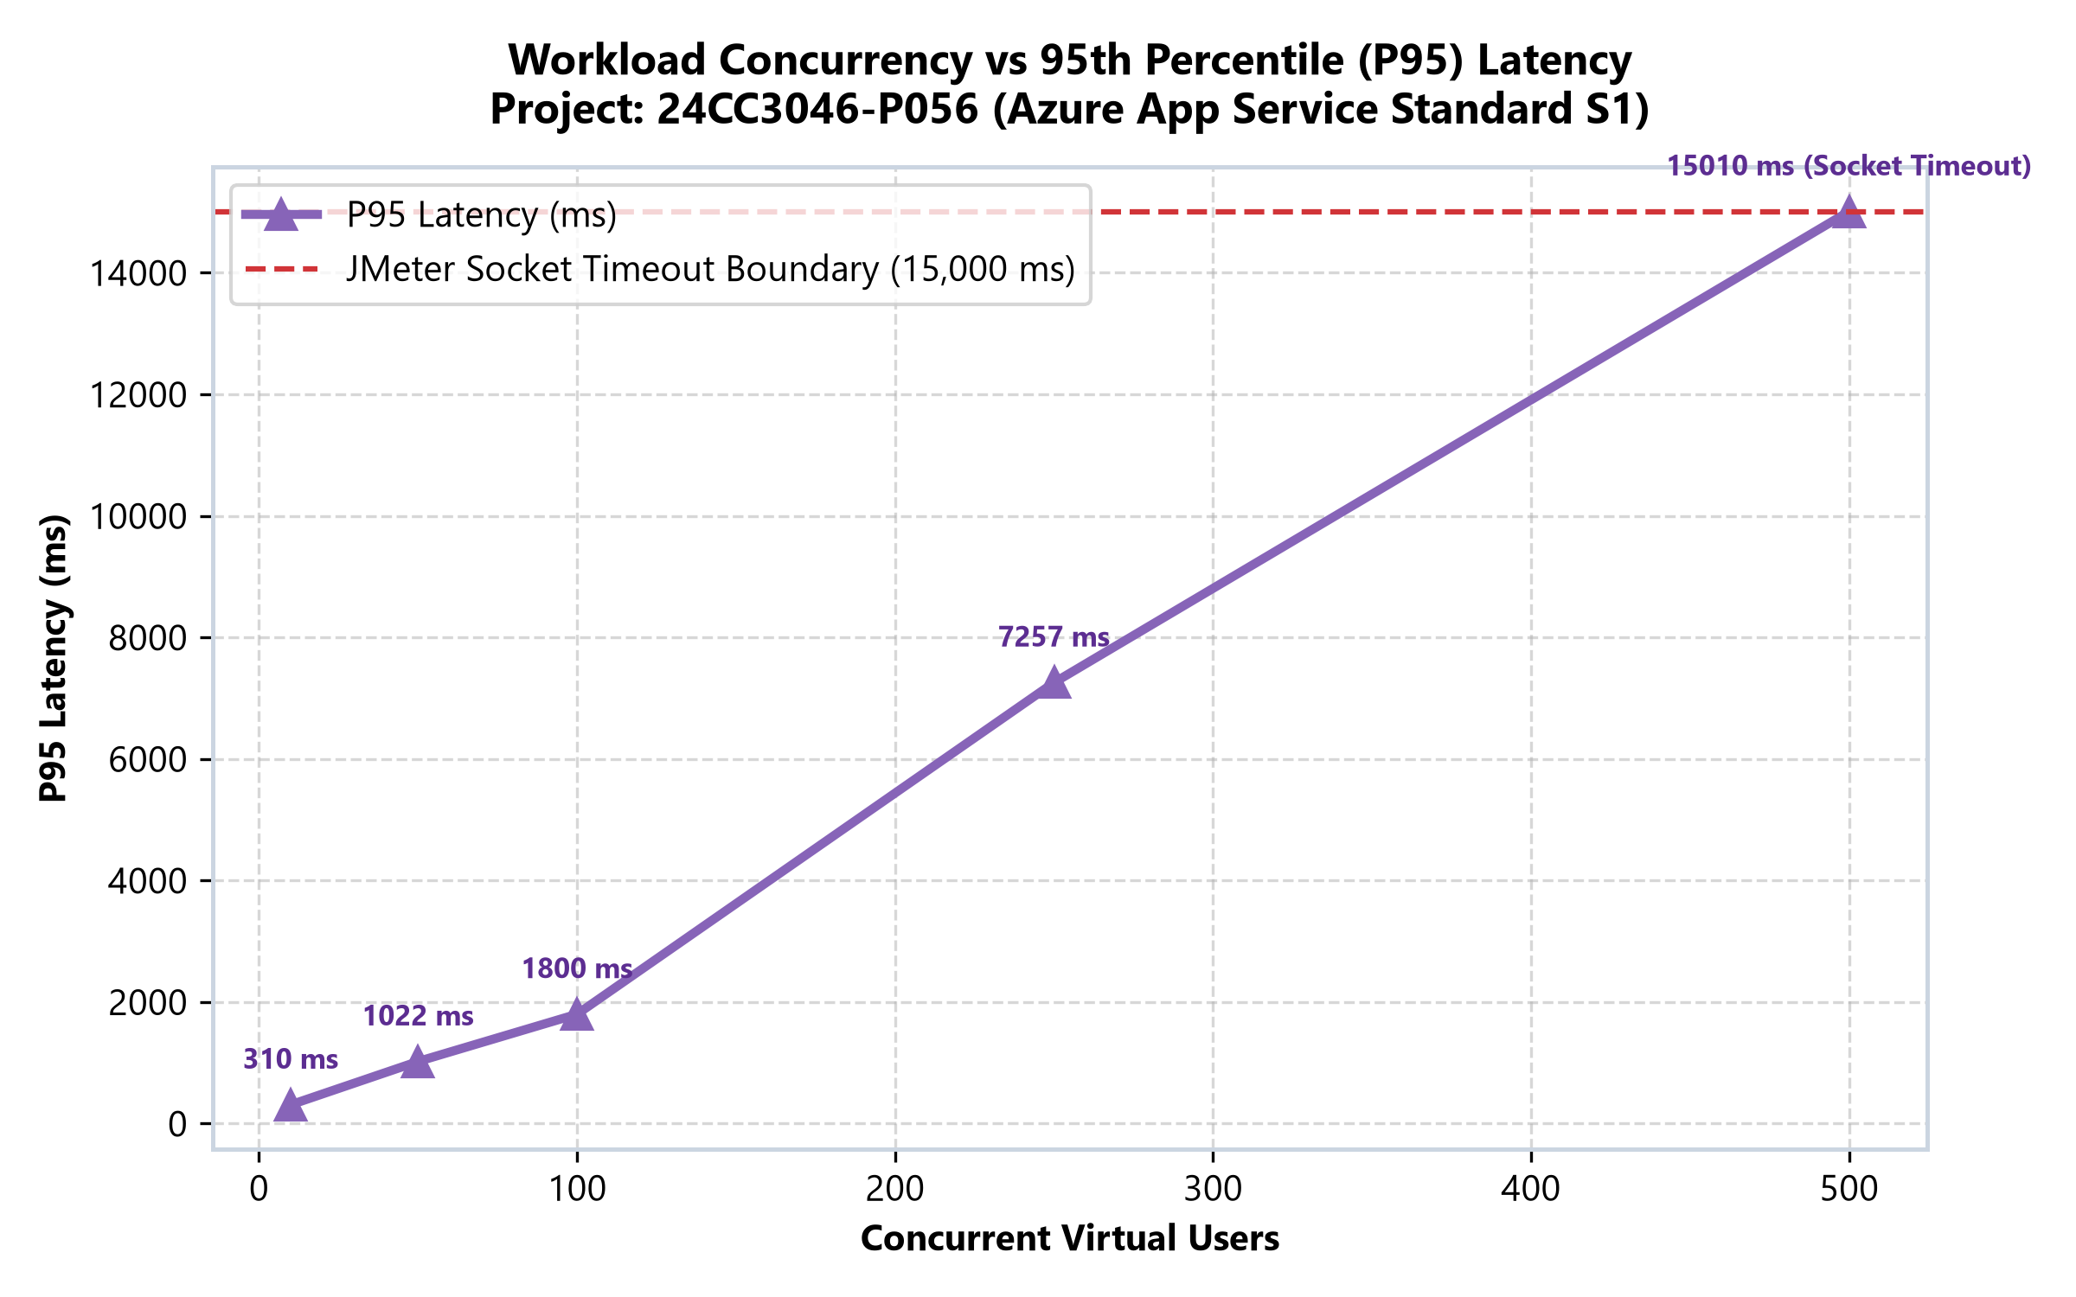
SLIDE 16 / 25 • EMPIRICAL EVIDENCE
Latency Knee & Degradation (250 Users)
Key Empirical Observations:
• Concurrency: 250 Virtual Users (run-4-heavy-250u-v2) | Instances: 1
• Throughput Plateau: 177.2 RPS (throughout stopped scaling proportionally)
• Latency Spike: Avg latency rose to 1,176 ms; P95 surged from 1,800 ms to 7,257 ms.
• Queueing Errors: 549 errors (2.42%) emerged as CPU utilization reached 78.5%.

Slide 17
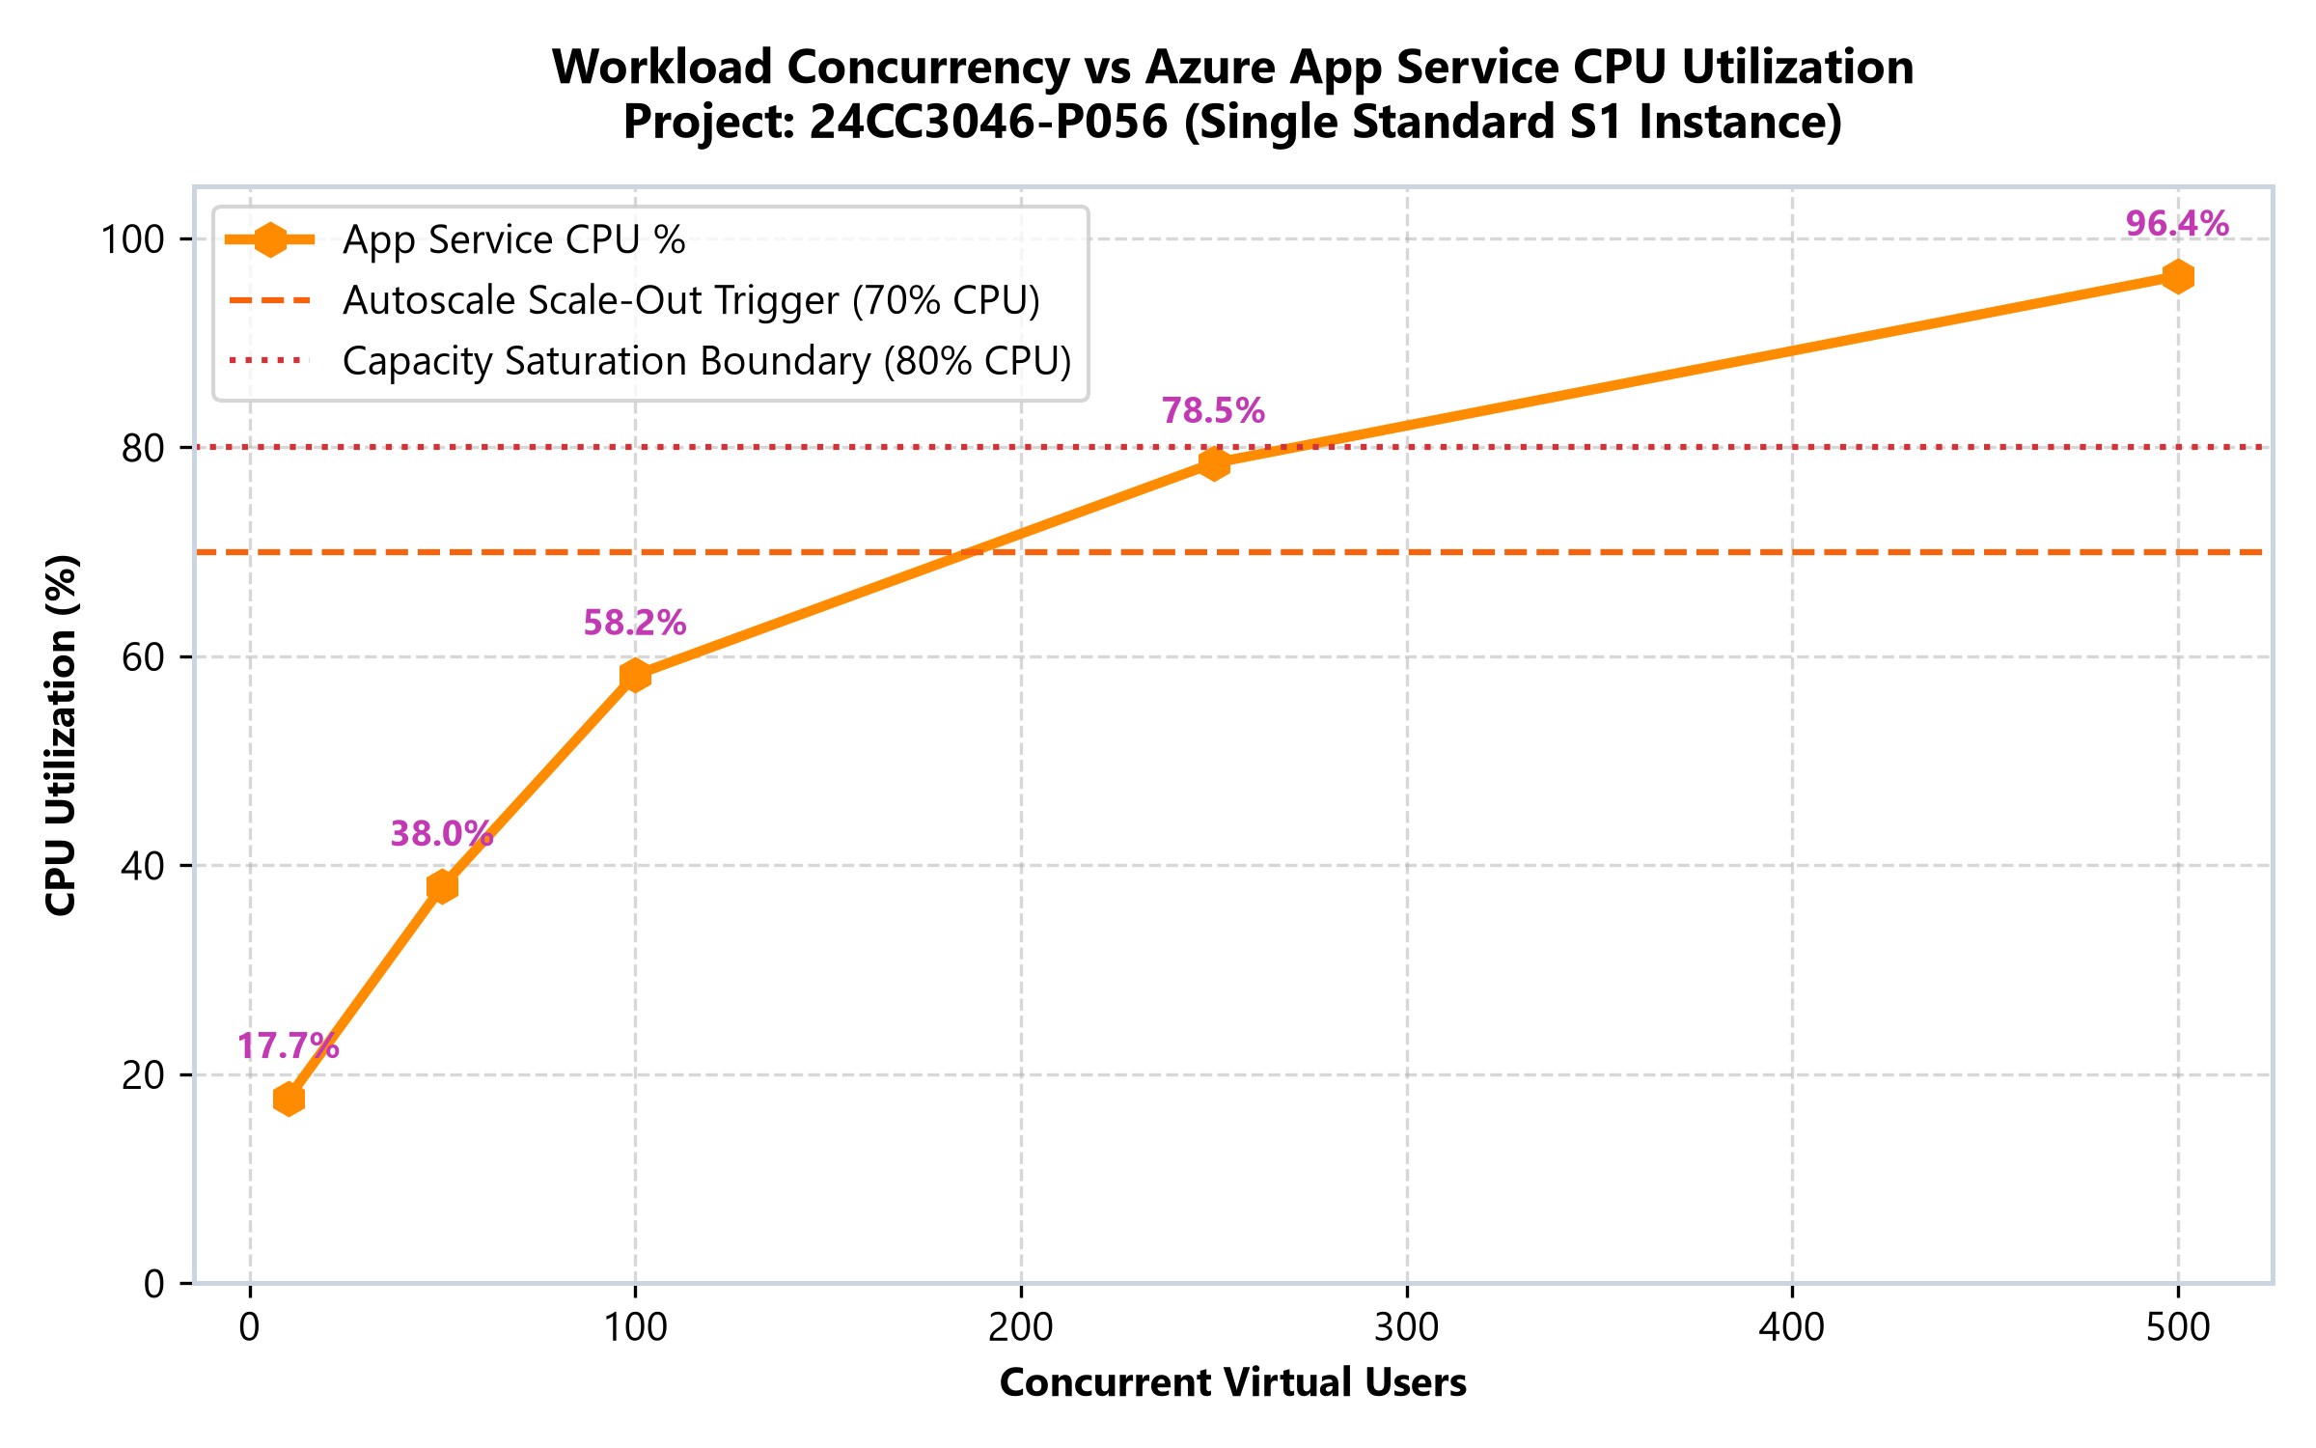
SLIDE 17 / 25 • EMPIRICAL EVIDENCE
500-User Saturation Breaking Point
Key Empirical Observations:
• Observed Breaking Point: Single Standard S1 instance saturated under 500 virtual users.
• CPU Core Saturation: App Service CPU hit 96.4% sustained utilization.
• Socket Timeout Limit: P95 latency hit 15,010 ms (JMeter socket timeout limit).
• Error Severity: 1,305 failed requests (5.66% error rate) due to event loop backlog.

Slide 18
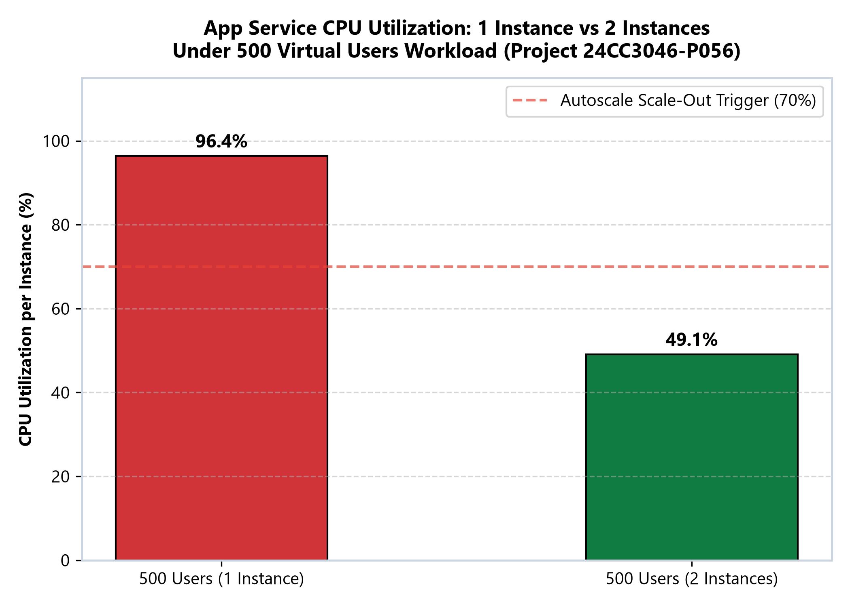
SLIDE 18 / 25 • EMPIRICAL EVIDENCE
2-Instance Scale-Out Investigation
Key Empirical Observations:
• Compute Headroom Relieved: Average CPU per instance dropped from 96.4% down to 49.1% (-47.3%).
• Error Discrepancy: Errors rose to 9.92% (1,783 failures) and RPS was 137.2.
• Root Cause Identified: ARR routed traffic to 2nd instance during cold start before connection pool priming.
• Key Finding: Scaling halves CPU pressure, but requires warmup probes to eliminate cold-start timeouts.

Slide 19
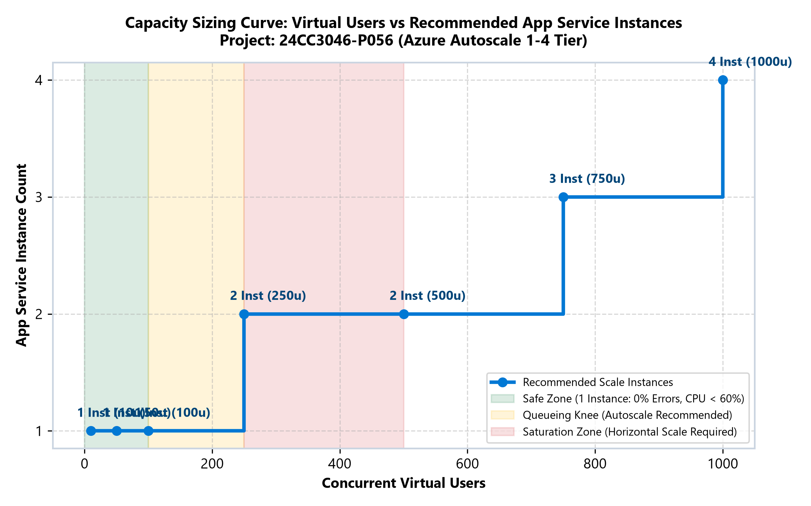
SLIDE 19 / 25 • EMPIRICAL EVIDENCE
Azure Monitor Dynamic Autoscale
Key Empirical Observations:
• Autoscale Rule Set: autoscale-plan-loadtest active on plan-loadtest (1 to 4 instances).
• Scale-Out Policy: Average CPU > 70% sustained for 5 minutes increments instance count by +1.
• Scale-In Policy: Average CPU < 30% sustained for 5 minutes decrements instance count by -1.
• Production Benefit: Protects against sudden saturation spikes while conserving off-peak costs.

Slide 20
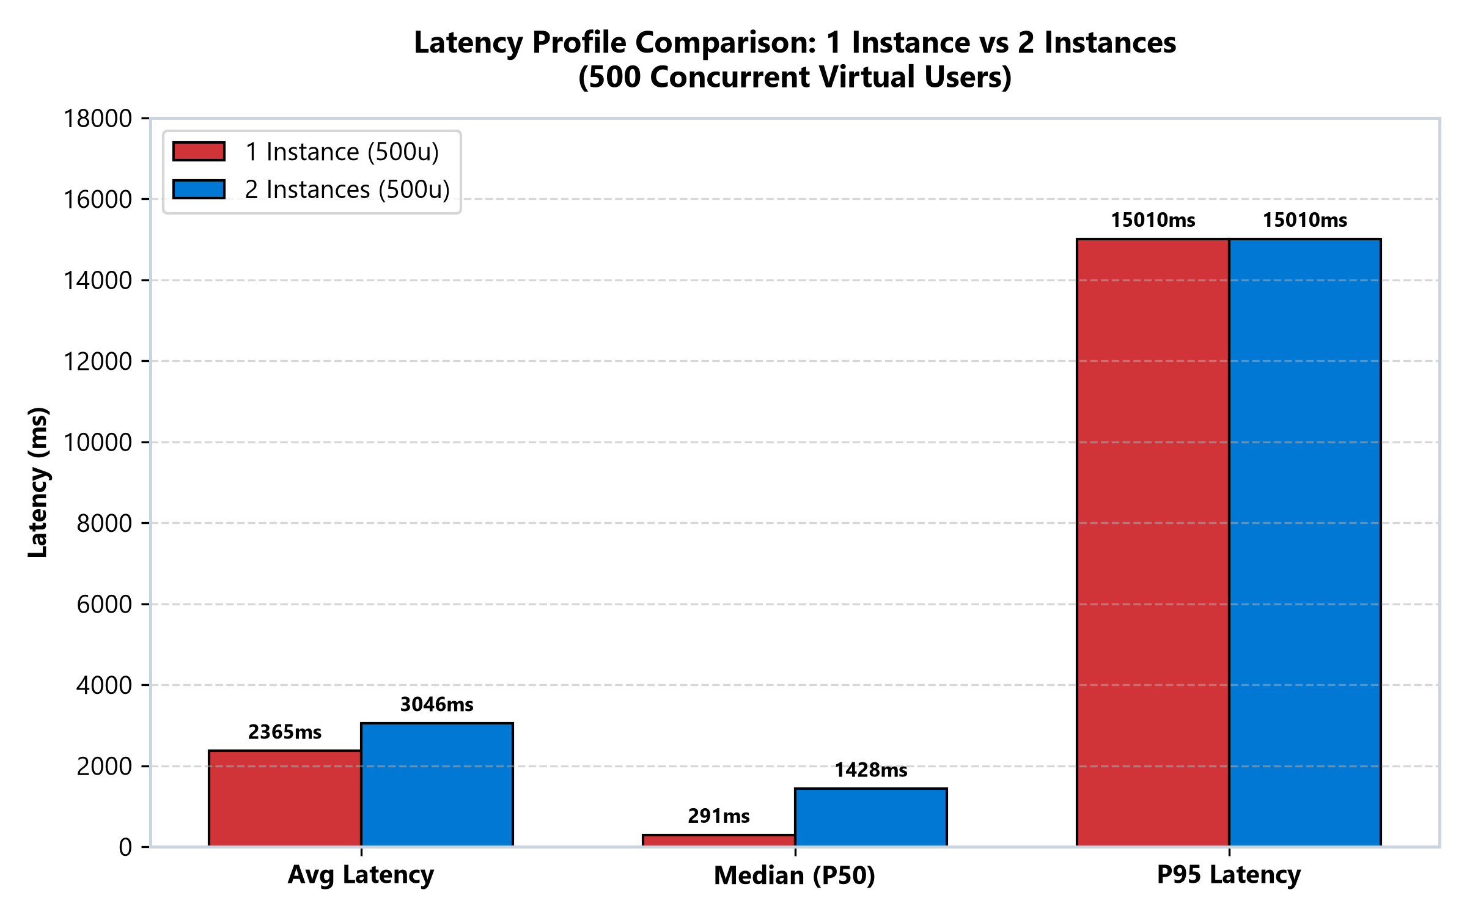
SLIDE 20 / 25 • EMPIRICAL EVIDENCE
1-Instance vs 2-Instance Detailed Comparison
Key Empirical Observations:
• CPU Metric: 1 Inst: 96.4% CPU (Saturated) vs 2 Inst: 49.1% CPU (Healthy Headroom)
• Latency Metric: 1 Inst: 2,365 ms Avg vs 2 Inst: 3,046 ms Avg (Warmup transition penalty)
• Throughput Metric: 1 Inst: 184.5 RPS vs 2 Inst: 137.2 RPS (Queueing during ramp-up)
• Takeaway: CPU relief is instantaneous, but end-to-end stability requires warmed containers.

Slide 21
SLIDE 21 / 25 • ARCHITECTURE & ANALYSIS
Azure Portal Performance Dashboard
Dashboard Name
capacity-performance-dashboard deployed directly in resource group rg-loadtest.
Compute Tile
App Service Plan CPU % and Memory % over 24-hour evaluation window.
Web App Tile
HTTP request throughput, average response latency, and HTTP 5xx errors.
Database & APM
PostgreSQL active connections, CPU %, and Application Insights failure rates.
Capacity Matrix
Embedded Markdown widget showing all 6 empirical load test runs.

Slide 22
SLIDE 22 / 25 • ARCHITECTURE & ANALYSIS
Summary Empirical Capacity Results
10 Users
110.7 RPS | 83 ms Avg | 310 ms P95 | 0.00% Errors | 17.7% CPU [PASS]
50 Users
144.9 RPS | 285 ms Avg | 1,022 ms P95 | 0.00% Errors | 38.0% CPU [PASS]
100 Users
175.9 RPS | 489 ms Avg | 1,800 ms P95 | 0.00% Errors | 58.2% CPU [SAFE LIMIT]
250 Users
177.2 RPS | 1,176 ms Avg | 7,257 ms P95 | 2.42% Errors | 78.5% CPU [KNEE]
500 Users (1 Inst)
184.5 RPS | 2,365 ms Avg | 15,010 ms P95 | 5.66% Errors | 96.4% CPU [BREAK]
500 Users (2 Inst)
137.2 RPS | 3,046 ms Avg | 15,010 ms P95 | 9.92% Errors | 49.1% CPU [RELIEVED]

Slide 23
SLIDE 23 / 25 • ARCHITECTURE & ANALYSIS
Study Limitations & Operational Constraints
JMeter Socket Timeout
15,000 ms response timeout marks extremely delayed requests as socket errors.
Network Co-Location
Load generator and web app co-located in Central India; excludes global WAN transit.
Single Region
Evaluation focused on single-region horizontal scaling without multi-region Front Door.
Database Cold Storage
Pre-seeded tables in PostgreSQL cache; cold disk read paging not simulated.

Slide 24
SLIDE 24 / 25 • ARCHITECTURE & ANALYSIS
Conclusion & Engineering Recommendations
Definitive Capacity
A single Standard S1 instance is optimal up to 100 concurrent virtual users.
Observed Saturation
500 users saturates single-core compute, proving CPU is the governing bottleneck.
Scaling Impact
Horizontal scaling cuts CPU utilization in half, but requires warmup priming in ARR.
Autoscale Policy
70% scale-out threshold provides ideal reaction time before queueing escalates.

Slide 25
SLIDE 25 / 25 • ARCHITECTURE & ANALYSIS
Future Work & Production Enhancements
Azure Front Door
Implement global Anycast routing with geo-distributed multi-region deployment.
Application Pre-Warming
Configure <applicationInitialization> in web.config to eliminate ARR cold starts.
Database Read Replicas
Deploy PostgreSQL read replicas with PgBouncer connection pooling.
Chaos Engineering
Introduce Azure Chaos Studio to inject container and network faults during load tests.

