Slide 1


Slide 2
What is Firebase?
Firebase is a backend service that provides developers to-
Build better Apps
Improve App Quality
Grow your business

Slide 3


Benefits of using Firebase?
Authentication Database Storage Analytics
Testing
ML
Web Hosting
etc.
Android
iOS

Slide 4





Benefits of using Firebase?
Android SDK
iOS SDK

Slide 5
Building Better Apps
Cloud FireStore
Firebase ML
Cloud Functions
Authentication
Hosting
Cloud Storage

Slide 6
Improving App Quality with Firebase
Crashlytics
Performance Monitoring
Test Lab

Slide 7
Growing your Business with Firebase
Google Analytics
Predictions A/B Testing
Cloud Messaging
Remote Config

Slide 8
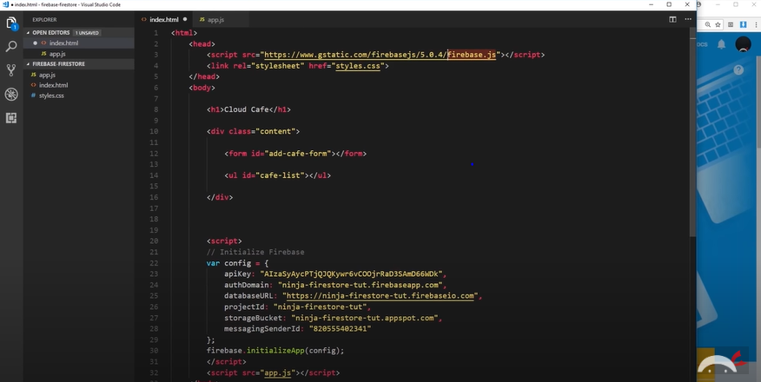
Setting up Firebase

Slide 9
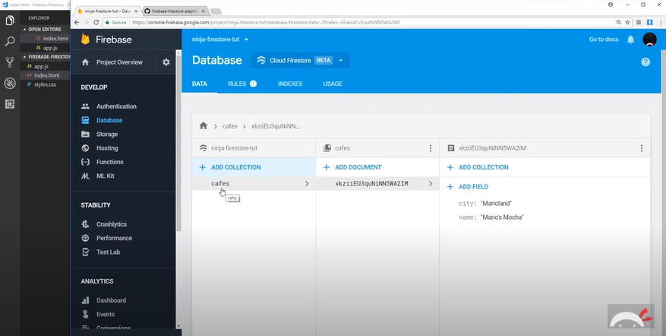
Setting up Firebase FireStore

Slide 10
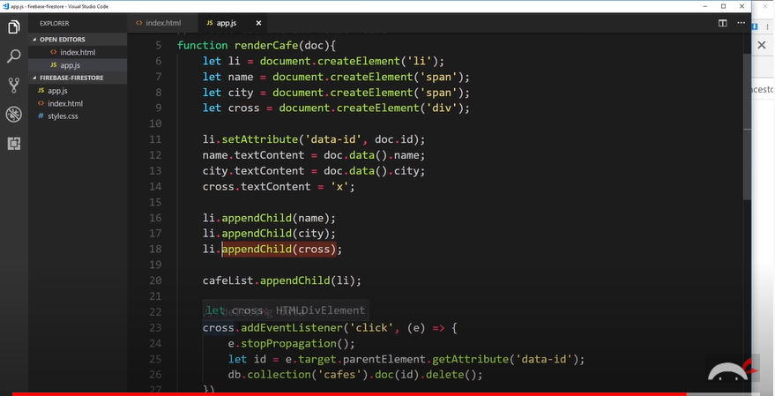
Setting up Firebase FireStore

Slide 11
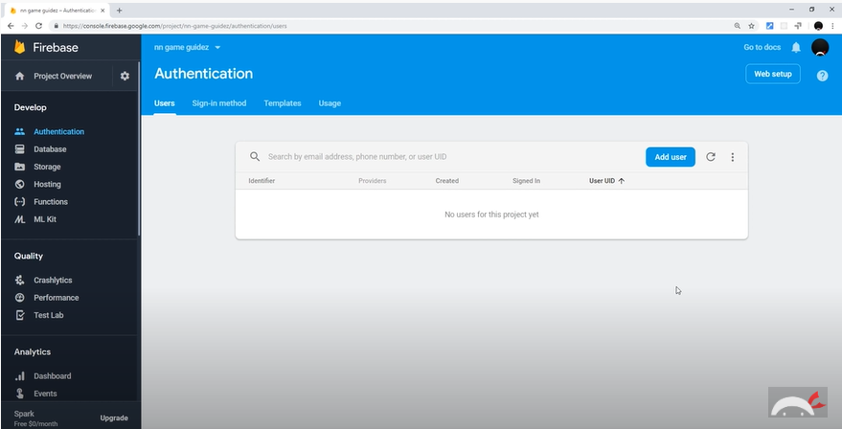
Setting up Firebase Auth

Slide 12
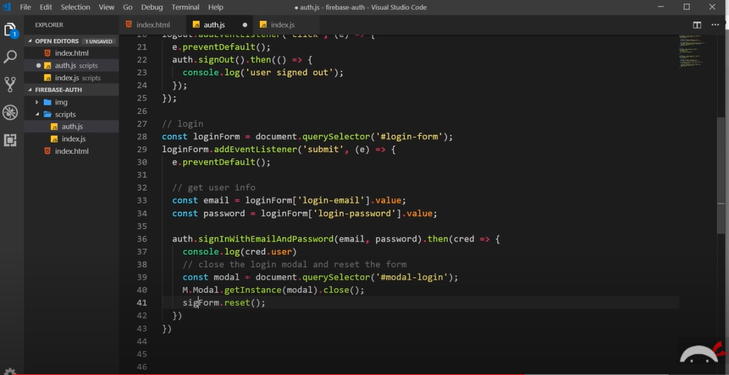
Setting up Firebase Auth

Slide 13
THANK YOU!

