Slide 1
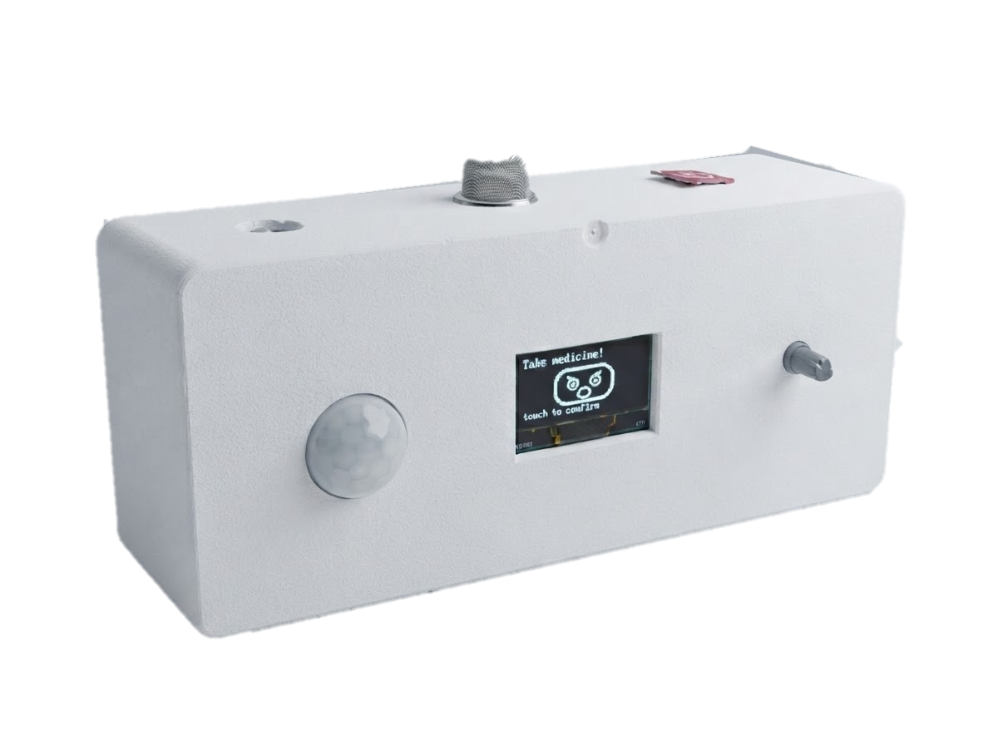
GROUP PROJECT · ROBOTICS
Smart Medicine
Companion Robot
PicoBot
Your Smart Reminder, Your Health Partner
Medicine Reminder
Voice Assistant
Face Reaction
Movement Detection
Emergency SMS
PRESENTED BY
Sultan Ruhul Kuddus Nayan · ID: 23101159
01

Slide 2
OVERVIEW
Executive Summary
Why We Built It
Our Goal
My Contribution
Many elderly and chronically ill patients forget their medicine, and many skip it on purpose. Reminder apps only fight forgetting, and caregivers cannot always be present. We built PicoBot to close this gap.
Raise medication adherence with a low-cost companion robot that tackles both forgetting and unwillingness, and keeps the user safe with an instant emergency SMS alert.
Workflow diagram (flowchart)
5 code logics from the robot code
Conclusion with live demo video
3
4 s
800
30 s
daily medicine alarms, saved in flash memory
gap between voice reminders until the user touches
gas reading that triggers the SMS and call alert
PIR warm-up before movement is detected
PicoBot · Group 2
02

Slide 3
WHAT I WORKED ON
My Contribution
Workflow Diagram
Flowchart of the main loop: gas check, medicine time, reminder and touch.
1
Code: PIR & Alarm Setting
Movement detection, and setting 3 daily alarms with the rotary encoder.
2
Code: RTC Time
Reading the real time from the DS3231 RTC module over I2C.
3
MY ROLE
Code: OLED & Voice
Drawing each OLED screen, and loading the Bangla voice clips.
I mapped PicoBot’s main loop as a flowchart, and explained five of its code logics.
4
PicoBot · Group 2
03

Slide 4
MAIN LOOP
Robot Workflow Diagram
Gas > 800?
START
Initialize sensors, RTC, voice & SIM800L
Read time (RTC) & check motion (PIR)
Yes
Gas warning voice + SMS & call caregiver
No
Every loop checks gas first, so a gas alert overrides the clock and the reminder. Without a touch, the reminder voice repeats every 4 s.
Medicine time?
Show clock screen (+ “Movement”)
No
Yes
Sad face + “take medicine” voice
User touched?
Happy face + “thank you” voice
Yes
No
PicoBot · Group 2
04

Slide 5
FROM THE PICOBOT CODE
Code Logic 1: PIR Movement Detection
Logic 1
PIR Movement Detection
HOW IT WORKS
1
For the first 30 s after power-on the PIR is ignored, while the sensor warms up.
// ignore PIR for 30 s after boot
if (millis() - bootMs < PIR_WARMUP_MS)
return;
bool motionNow =
digitalRead(PIN_PIR) == HIGH;
if (motionNow) // hold 3 s
motionUntil = millis() + MOTION_HOLD_MS;
// clock screen: show the label
if (millis() < motionUntil)
u8g2.drawStr(dateW + 6, 10, "Movement");
2
Every loop reads the PIR pin. HIGH means someone is moving.
3
On movement, “Movement” stays on the clock screen for 3 s.
IN SHORT
Motion shows “Movement” on the clock for 3 s.
PicoBot · Group 2
05

Slide 6
FROM THE PICOBOT CODE
Code Logic 2: Alarm Setting
Logic 2
Alarm Setting
HOW IT WORKS
1
Turning the rotary encoder changes the hour (0–23), then the minute (0–59).
case SCR_SET_HOUR:
if (steps)
editHour = wrap(editHour, steps, 24);
if (press) screen = SCR_SET_MIN; // next
case SCR_SET_MIN:
if (steps)
editMin = wrap(editMin, steps, 60);
if (press) { // save
alarmHour[editingSlot] = editHour;
alarmMin[editingSlot] = editMin;
prefs.putUChar(keyH, editHour); // flash
prefs.putUChar(keyM, editMin);
screen = SCR_SELECT_ALARM;
}
2
Pressing it moves from hour to minute, then saves the alarm.
3
The time is stored in flash memory, so it stays after power-off.
IN SHORT
Up to 3 daily alarms, set with one knob.
PicoBot · Group 2
06

Slide 7
FROM THE PICOBOT CODE
Code Logic 3: RTC Time (DS3231)
Logic 3
RTC Time (DS3231)
HOW IT WORKS
1
The ESP32 asks the DS3231 for 7 bytes of time data over I2C.
bool rtcRead(RtcTime &t) {
Wire.beginTransmission(DS3231_ADDR);
Wire.write(DS3231_REG_TIME);
if (Wire.endTransmission() != 0) return false;
Wire.requestFrom((uint8_t)DS3231_ADDR, (size_t)7);
t.sec = bcd2dec(Wire.read() & 0x7F); // BCD
t.min = bcd2dec(Wire.read() & 0x7F);
t.hour = bcd2dec(Wire.read() & 0x3F); // 24 h
}
if (rtcLostPower()) { // battery died
RtcTime c;
if (compileTime(c)) rtcSet(c);
}
2
Each byte is in BCD, so bcd2dec() turns it into a normal number.
3
If the RTC lost power, the time is reset to when the code was compiled.
IN SHORT
Gives the robot the real time, every 0.2 s.
PicoBot · Group 2
07

Slide 8
FROM THE PICOBOT CODE
Code Logic 4: OLED Screens
Logic 4
OLED Screens
HOW IT WORKS
1
The robot is always in one screen state: clock, set alarm, reminder, happy or gas.
void draw() {
u8g2.clearBuffer();
switch (screen) {
case SCR_CLOCK: drawClockScreen(); break;
case SCR_SELECT_ALARM: drawSelectAlarm(); break;
case SCR_SET_HOUR: drawSetScreen(true); break;
case SCR_SET_MIN: drawSetScreen(false); break;
case SCR_RINGING: drawAlertFace(); break;
case SCR_HAPPY: drawHappyFace(); break;
case SCR_GAS_WARNING: drawGasWarning(); break;
}
u8g2.sendBuffer(); // to OLED
}
2
draw() clears the display and calls the matching draw function.
3
sendBuffer() sends the new picture to the OLED.
IN SHORT
One function shows the right screen.
PicoBot · Group 2
08

Slide 9
FROM THE PICOBOT CODE
Code Logic 5: Bangla Voice Clips
Logic 5
Bangla Voice Clips
HOW IT WORKS
1
Opens the Bangla .wav file (reminder, thank you or gas) from LittleFS.
File f = LittleFS.open(path, "r");
size_t len = f.size();
uint8_t *buf = (uint8_t *)heap_caps_malloc(len,
MALLOC_CAP_SPIRAM | MALLOC_CAP_8BIT); // PSRAM
f.read(buf, len);
int16_t *pcm = (int16_t *)(buf + 44); // skip header
for (size_t i = 0; i < numSamples; i++) {
int32_t boosted = pcm[i] * VOICE_GAIN; // x1.5
if (boosted > INT16_MAX) boosted = INT16_MAX;
if (boosted < INT16_MIN) boosted = INT16_MIN;
pcm[i] = (int16_t)boosted;
}
2
Loads it into PSRAM, the extra 8 MB memory of the ESP32-S3.
3
Makes every sample 1.5× louder, capped so the sound does not distort.
IN SHORT
Clear, louder Bangla voice messages.
PicoBot · Group 2
09

Slide 10
PROJECT PLAN
Project Timeline: Gantt Chart
Task
W1
W2
W3
W4
W5
W6
W7
W8
W9
W10
W11
W12
1. Literature review & survey
3 wk
2. Problem statement & objectives
2 wk
3. Concept model & system design
3 wk
4. Component selection & procurement
2 wk
5. Circuit design & wiring
2 wk
6. Reminder module: RTC, voice, button
3 wk
7. Emotional engagement: OLED face, persuasion
3 wk
8. Presence (PIR) & gas-leak SMS alert
3 wk
9. Integration, SD logging & enclosure
2 wk
10. Testing & refinement
5 wk
11. Paper & report
2 wk
Phases:
Plan
Design
Build
Test & Report
PicoBot · Group 2
10

Slide 11
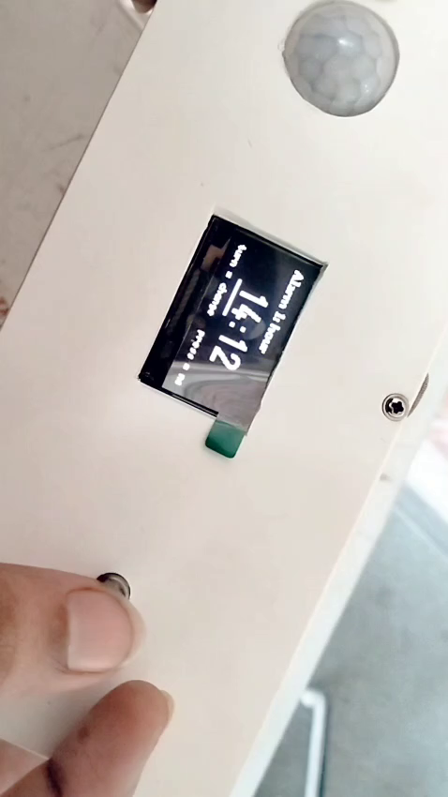
WRAPPING UP
Conclusion
✓
The Smart Medicine Companion Robot is a compact, intelligent and interactive solution for medicine management.
✓
It improves medication adherence, ensures safety, and brings peace of mind to users and caregivers.
✓
It combines robotics, IoT, voice interaction and emotional engagement in one platform.
✓
This project has strong potential to make a real-world impact in healthcare.
“Technology with Care, Health Everywhere.”
Project Demonstration
Click the video to play · 0:53
PicoBot · Group 2
11

Slide 12
Thank You
For Your Attention
Questions are welcome.
Sultan Ruhul Kuddus Nayan · PicoBot, Group 2
12

