Slide 1
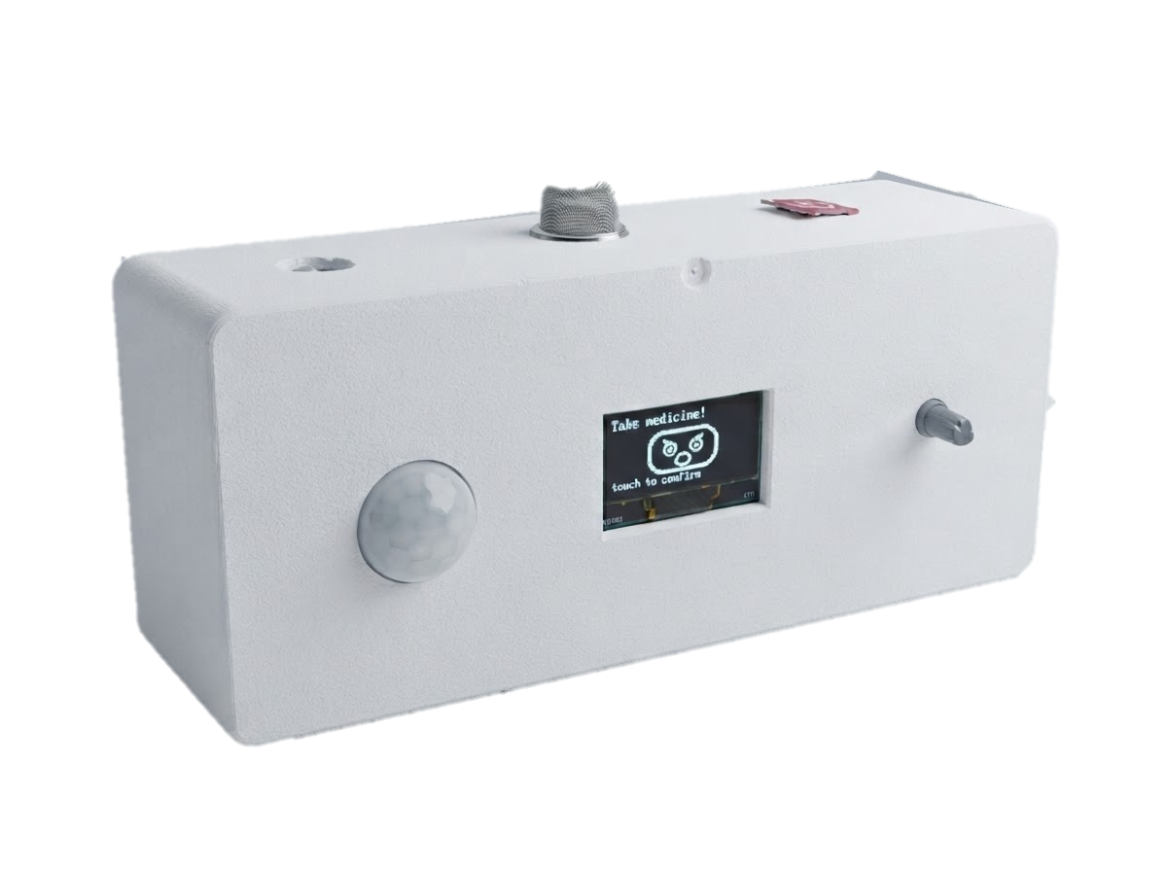
INTRODUCTION
Smart Medicine Companion Robot
PicoBot
Your Smart Reminder, Your Health Partner
Presented by Sadia Shahrin Sharna - 23101161

Slide 2
Executive Summary
1
Why We Built It
2
Our Goal
3
My Contribution
Many elderly and chronically ill patients forget medicine or skip it on purpose. Reminder apps only fight forgetting, and caregivers cannot always be present.
Raise medication adherence with a low-cost companion robot that tackles forgetting and refusal, and keeps the user safe with an instant gas-leak SMS alert.
50% Literature Review , 50% Survey Analysis , Proposed Solution Objectives , Embedded Diagram , 50% Hardware Implementation, Gantt Chart, Video
53.8%
12
4
of respondents rank confirmed reminders first
weeks planned from 50% literature review to final report
objectives: remind, engage, detect and protect

Slide 3



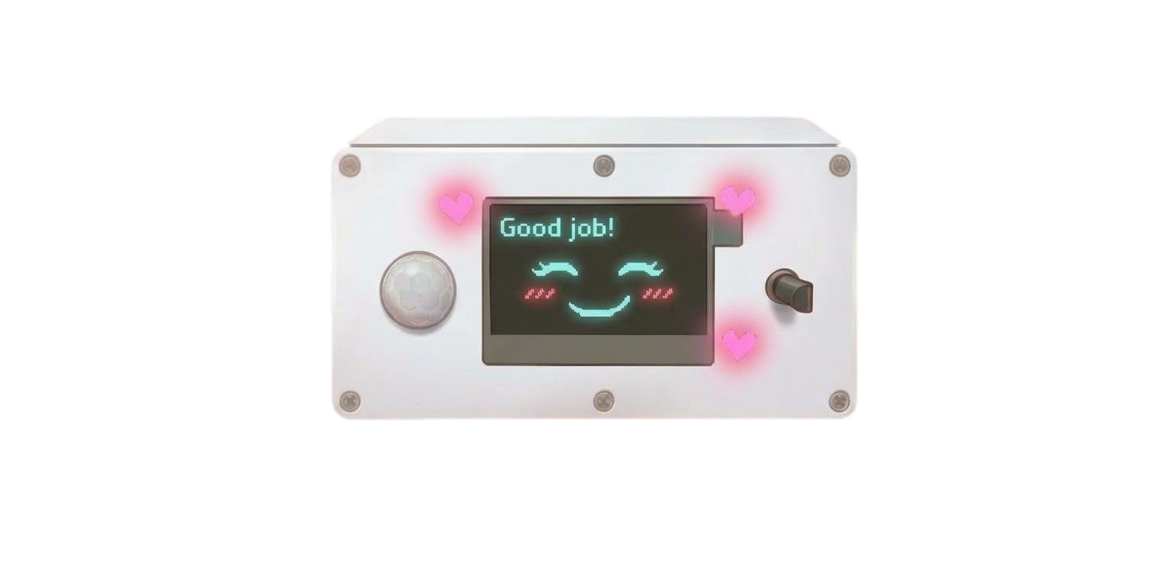





My Contribution
Literature Review
Survey Analysis
Proposed Solution
2 reminder-app papers read and compared.
Q10–Q16: alerts, privacy, adoption, budget.
Reminder, persuasion and SMS in one robot.
Objectives
Embedded Diagram
Four goals: remind, engage, detect, protect.
Input, ESP32-S3 processing and output flow.
Circuit Diagram
Hardware Implementation
Gantt Chart
50% ESP32-S3 wiring 5 module.
RTC, encoder, speaker, OLED, SIM800L on 5 V.
12-week plan from review to final report.

Slide 4

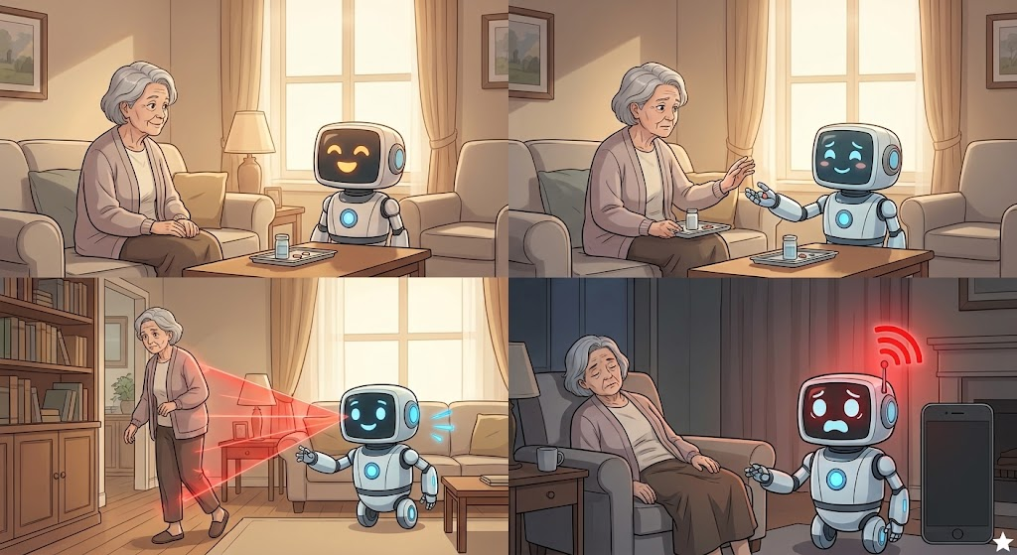



Proposed Solution
Reminds on schedule with a warm voice alert and expressive face, not just a beep.
Reads the user's mood and persuades gently when medicine is ignored or refused .
Detects presence and movement, engaging even when the user tries to avoid it.
Detects gas leaks and sends an emergency SMS instantly to pre-defined numbers.

Slide 5
Literature Review: Existing Reminder Apps
Study | Reminder & Confirmation | Emotional Refusal | Safety Net | Limitation
Yimer et al. (2025)— An Efficient and Cost-Effective Medicine Reminder and Dispenser System | Yes — Offline reminders, audio/visual alerts, and user acknowledgment before dispensing. | Not addressed — No emotional interaction or persuasion for patients refusing medicine. | Partly — Medication schedules and dispensing are supported, but emergency alerts are not reported. | Reports 98% dispensing accuracy and a $30 cost, but focuses on dispensing rather than emotional engagement.
Tkela et al. (2025) — Implementation of Alarm and Pill Reminder for Medication Adherence in Tuberculosis Patients | Yes — Alarm and pill reminder application; medication adherence improved after implementation. | Partly — Addresses patients who forget or are reluctant to take medicine, but does not use emotional persuasion. | Not addressed — No emergency alert or environmental safety monitoring is described. | Only two TB patients were studied over a short period, limiting generalizability.
PicoBot (Ours) | Yes — RTC-based alarm, voice reminders, and button confirmation. | Yes — Empathetic voice and mood-aware facial expressions to encourage medication adherence. | Yes — MQ-2 gas detection, SMS alerts, and SD-card logging. | Prototype stage; real-world evaluation is planned for future work.

Slide 6
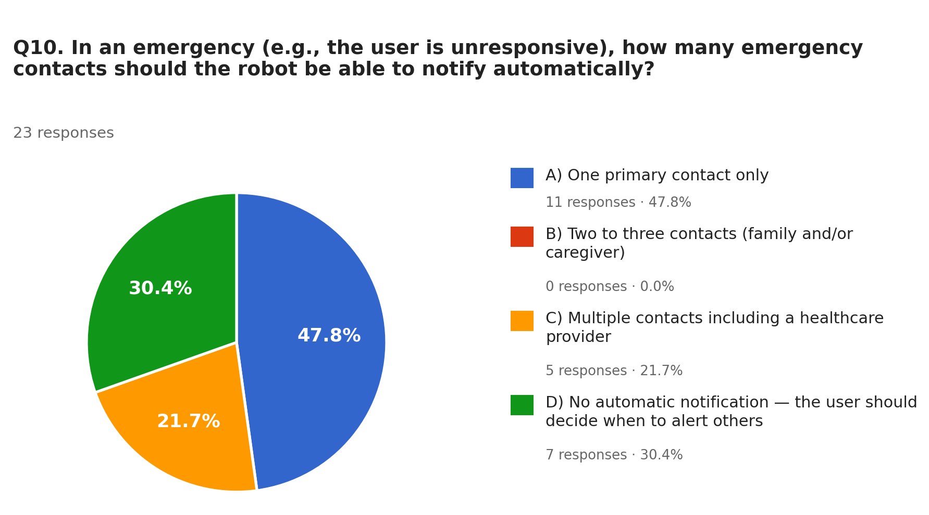
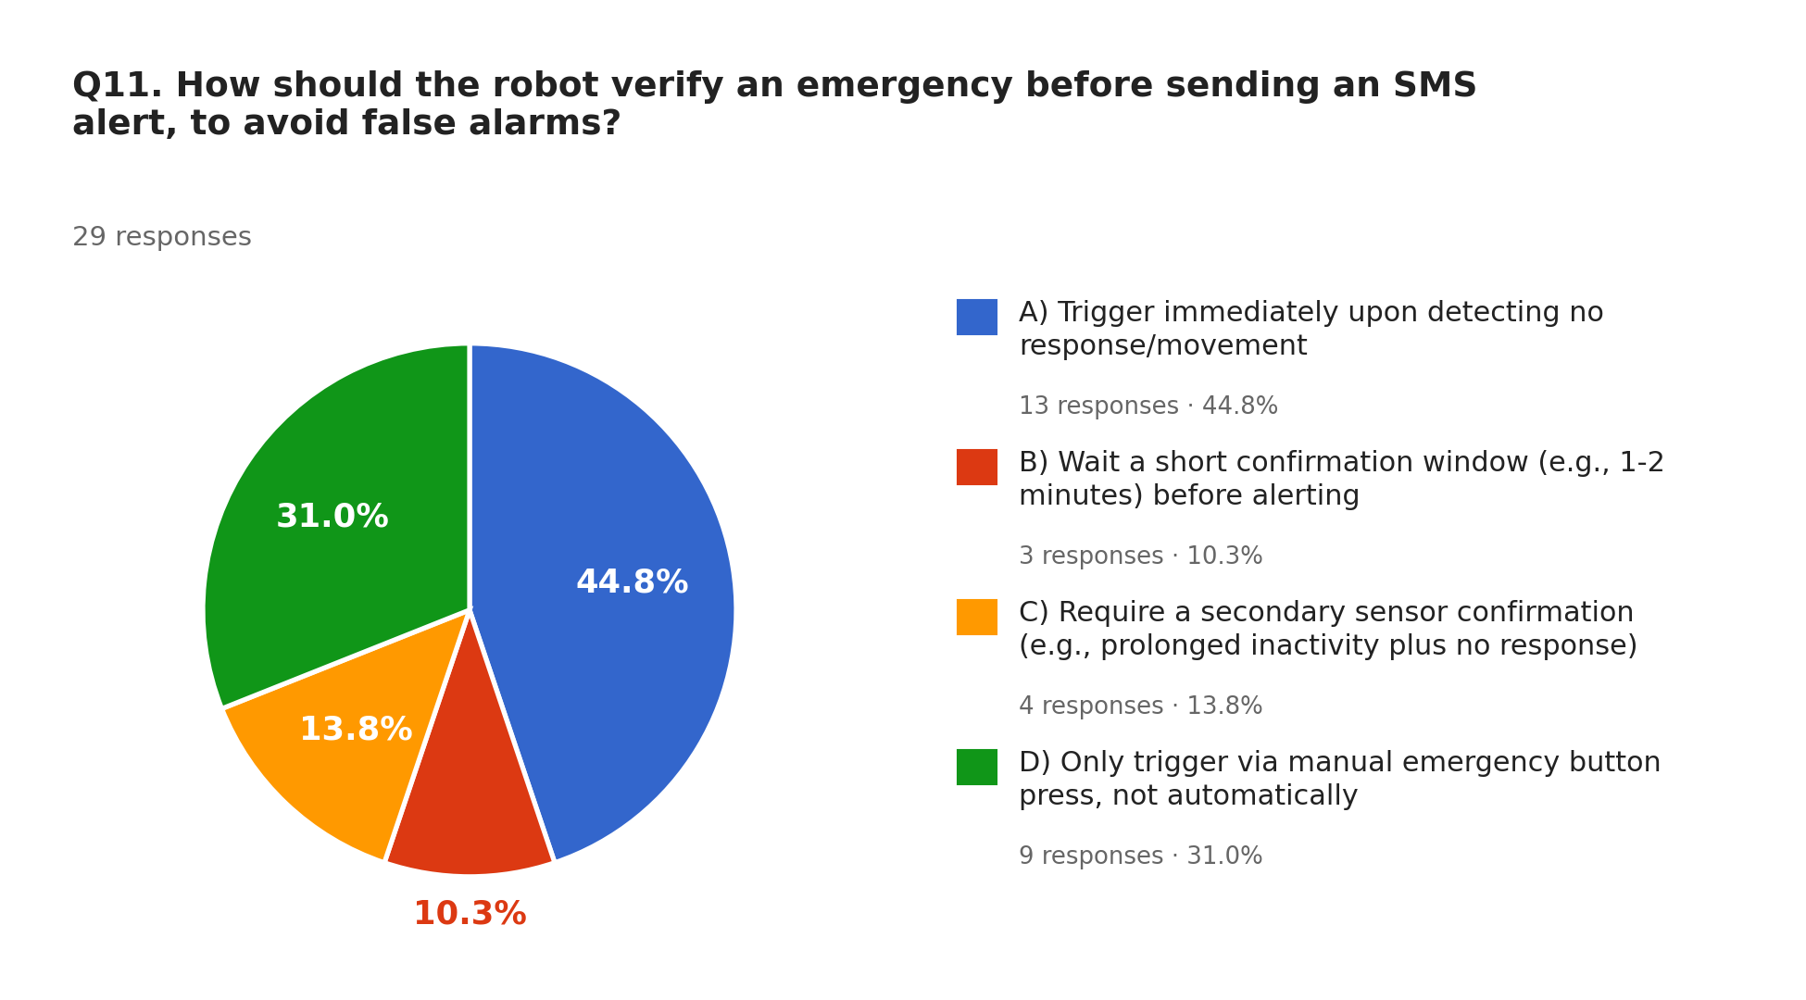
Survey: Emergency Alerts (Q10–Q11)
47.8%
want one primary contact; 30.4% want no automatic notification and 21.7% want several contacts incl. a healthcare provider.
44.8%
want the alert immediately on no response; 31.0% prefer a manual button only, 13.8% a second sensor, 10.3% a short confirmation window.
Q10
23 responses
Q11
29 responses

Slide 7
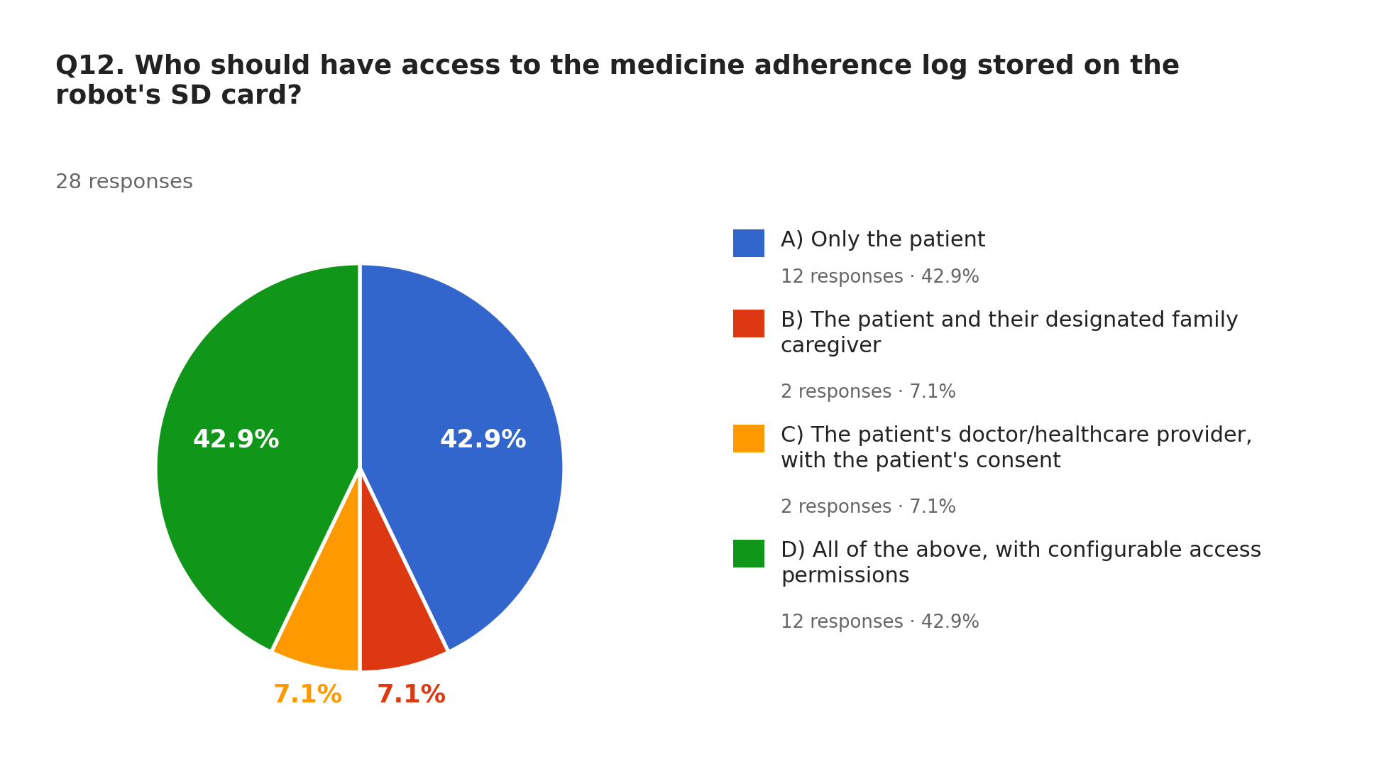
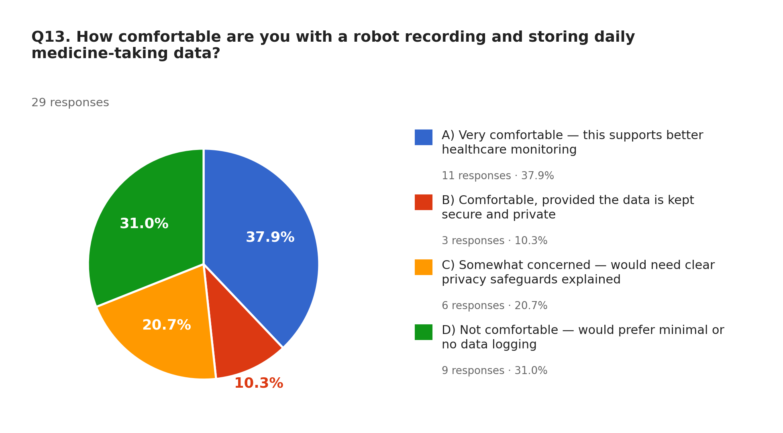
Survey: Data Access & Privacy (Q12–Q13)
42.9%
want patient-only access to the log; another 42.9% want all parties with configurable permissions. Caregiver-only and doctor-with-consent: 7.1% each.
37.9%
are very comfortable with daily data logging; 31.0% are not comfortable, 20.7% somewhat concerned, 10.3% comfortable if secure.
Q12 · 28 responses
Q13 · 29 responses

Slide 8
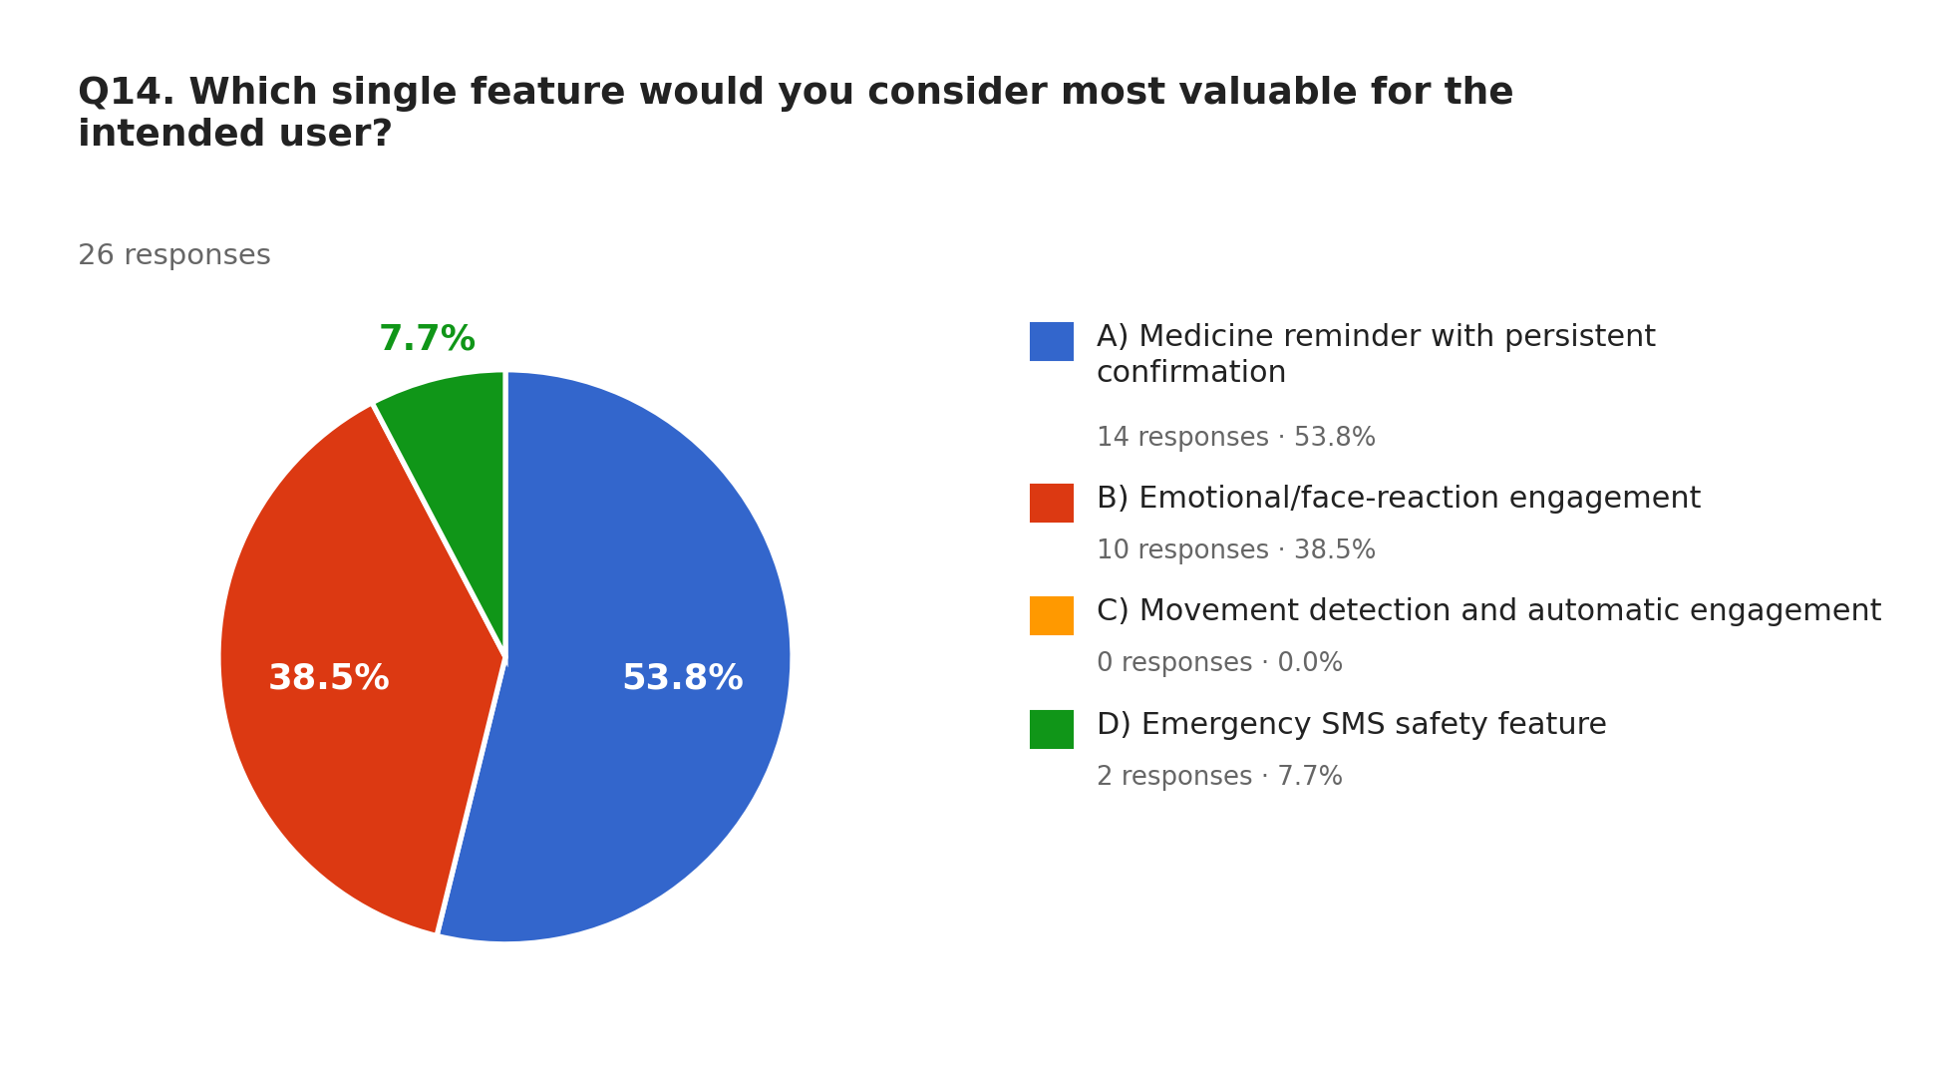
Survey: Most Valuable Feature (Q14)
53.8%
pick the medicine reminder with persistent confirmation as the single most valuable feature.
Q14 · 26 responses
38.5%
pick emotional / face-reaction engagement, so both core ideas are validated.
Q14 · 26 responses
7.7%
pick the emergency SMS feature; nobody picked movement detection as the top feature.
Q14 · 26 responses

Slide 9
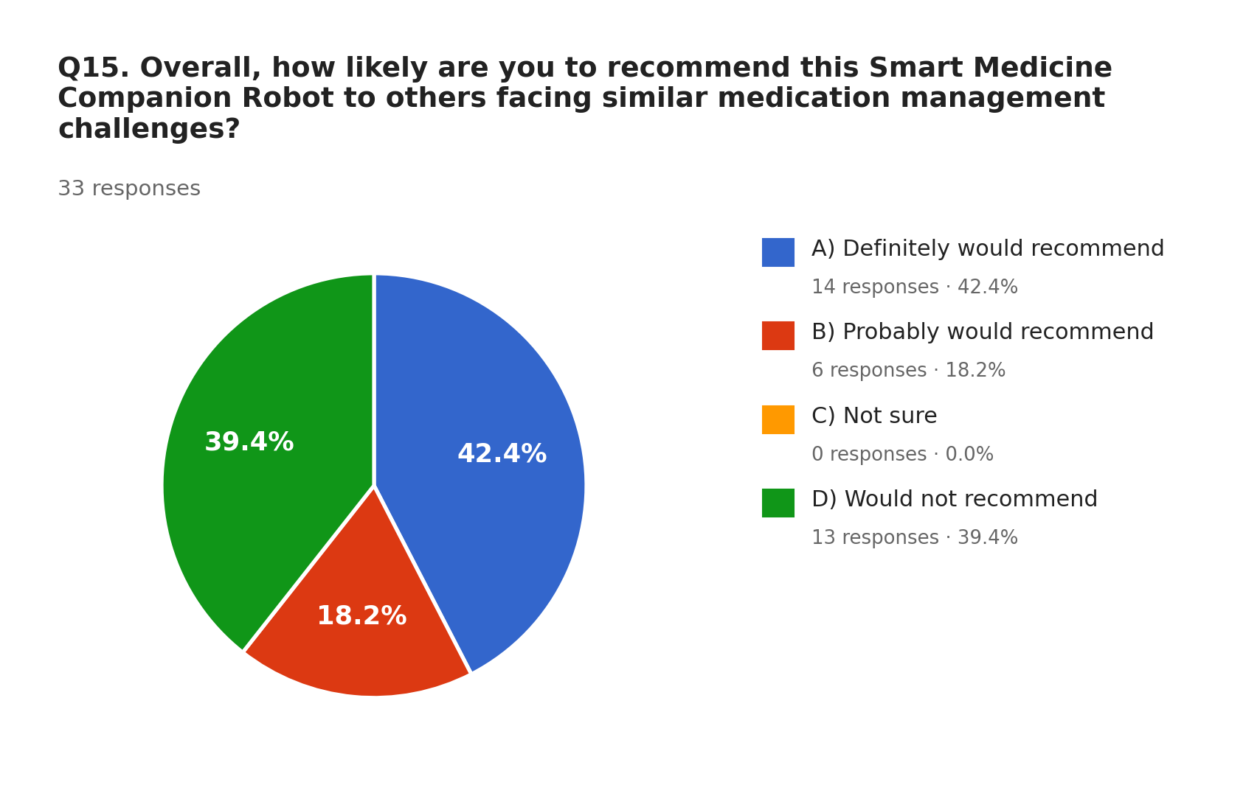
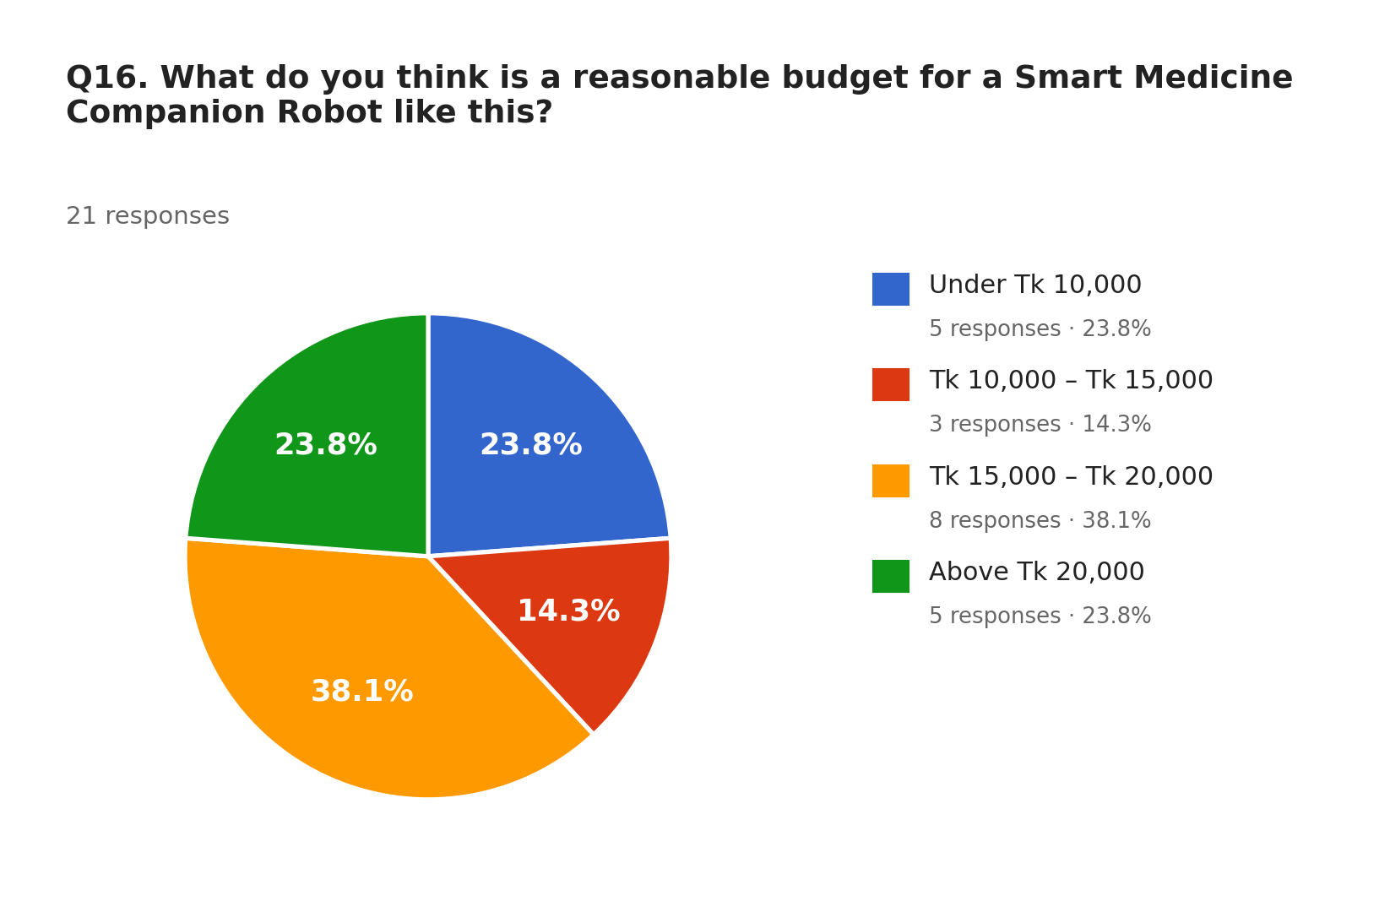
Survey: Recommendation & Budget (Q15–Q16)
60.6%
would recommend PicoBot (42.4% definitely, 18.2% probably); 39.4% would not.
38.1%
see ৳15,000–20,000 as reasonable; 23.8% say under ৳10,000, 23.8% above ৳20,000, 14.3% ৳10,000–15,000.
Q15
33 responses
Q16
21 responses

Slide 10

Objectives
Reminder & Confirmation
01
Emotional Engagement
02
Design a reliable reminder and confirmation system using RTC scheduling, voice alerts and button-press verification to counter forgetting.
Develop an emotionally intelligent voice assistant that detects reluctance and uses empathetic persuasion and mood-aware expressions.
Movement Detection
03
Emergency Safety Net
04
Integrate presence and movement detection so the robot proactively engages users who try to avoid or ignore reminders.
Build gas-leak detection with instant SMS alerts and SD-card records to support caregivers and ensure user safety.

Slide 11
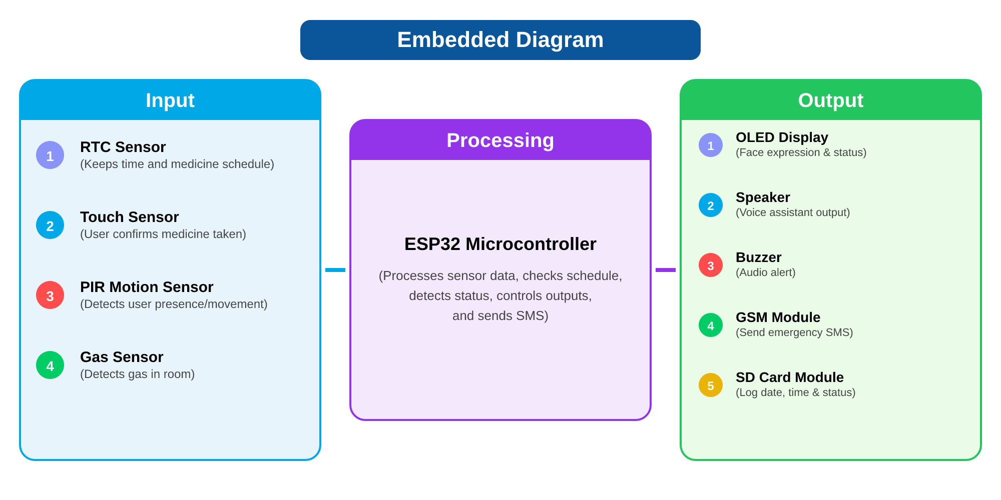


Robot Embedded Diagram
Input
RTC · Touch · PIR · MQ-2 gas sensor · Microphone
Processing
ESP32-S3 reads sensors, checks the schedule, controls outputs and sends SMS
Output
OLED · Buzzer · GSM module
· SD card

Slide 12
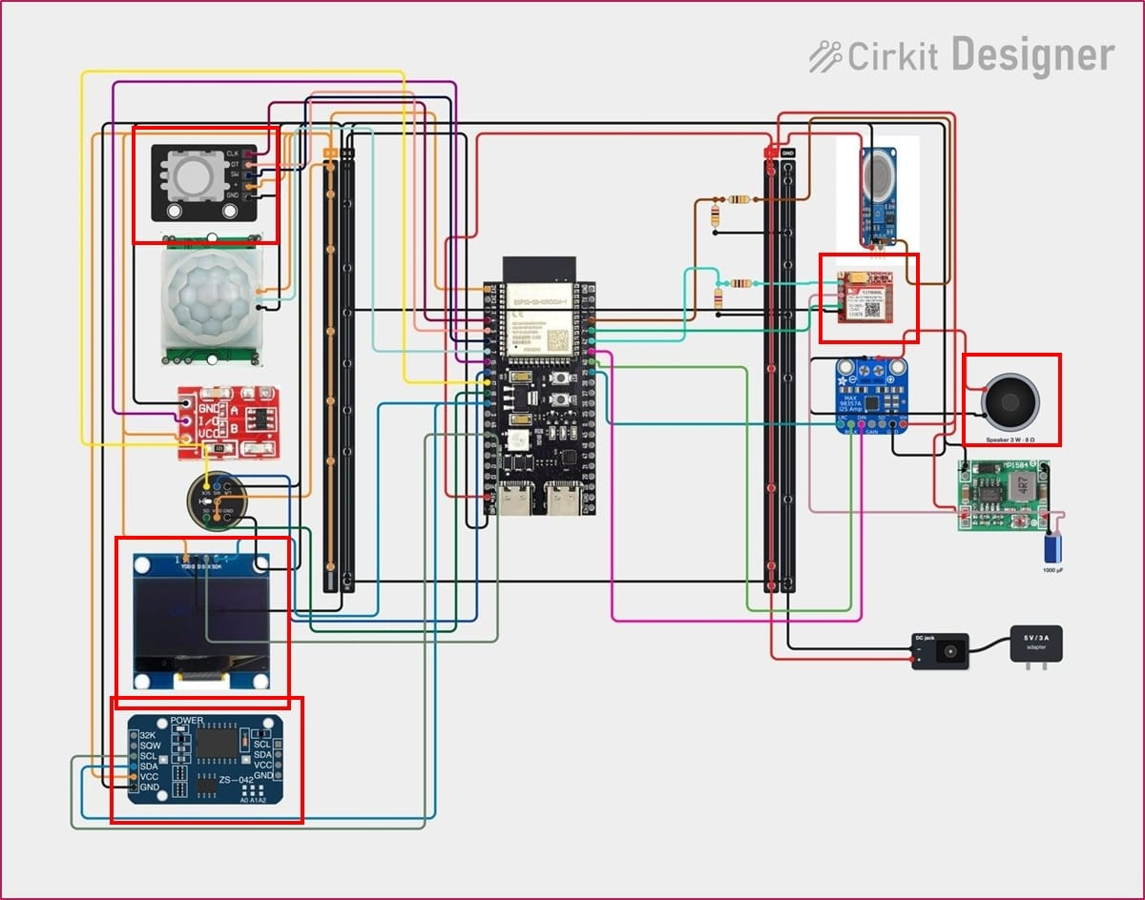
Robot Circuit Diagram

Slide 13




Hardware Implementation: Updated
DS3231 RTC (ZS-042)
KY-040 Rotary Encoder
Speaker (3 W, 8 Ω)
Keeps real time and triggers the medicine alarm.
User sets time, medicine name and frequency.
Voice reminder played through the MAX98357A I²S amplifier.
0.96″ OLED Display
SIM800L GSM Module
5 V Power Rail
Shows face reactions: sad at reminder, happy when confirmed.
Sends the emergency SMS to pre-set numbers.
5 V/3 A adapter → MP1584 buck → every module.

Slide 14
Project Timeline: Gantt Chart
Task
W1
W2
W3
W4
W5
W6
W7
W8
W9
W10
W11
W12
1. Literature review & survey
3 wk
2. Problem statement & objectives
2 wk
3. Concept model & system design
3 wk
4. Component selection & procurement
2 wk
5. Circuit design & wiring
2 wk
6. Reminder module: RTC, voice, button
3 wk
7. Emotional engagement: OLED face
3 wk
8. Presence (PIR) & gas-leak SMS alert
3 wk
9. Integration, SD logging & enclosure
2 wk
10. Testing & refinement
5 wk
11. Paper & report
2 wk
Phases:
Plan
Design
Build
Test & Report

Slide 15
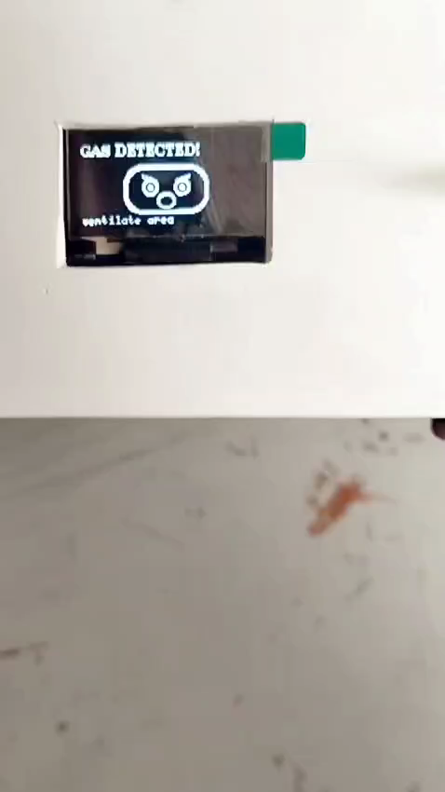

Conclusion
The Smart Medicine Companion Robot is a compact, intelligent and interactive solution for medicine management.
It improves medication adherence, ensures safety, and brings peace of mind to users and caregivers.
It combines robotics, IoT, voice interaction and emotional engagement in one platform.
This project has strong potential to make a real-world impact in healthcare.

Slide 16
References: Reminder-App Papers
[1]
Yimer et al., “An Efficient and Cost-Effective Medicine Reminder and Dispenser System.” https://ejournal.seaninstitute.or.id/index.php/healt/article/view/6289
[2]
Tkela, M. Y., Sambriong, M., & Kapitan, M. (2025). “Implementation of Alarm and Pill Reminder for Medication Adherence in Tuberculosis Patients.” Jurnal EduHealth. https://ejournal.seaninstitute.or.id/index.php/healt/article/view/6289

Slide 17
