Slide 1
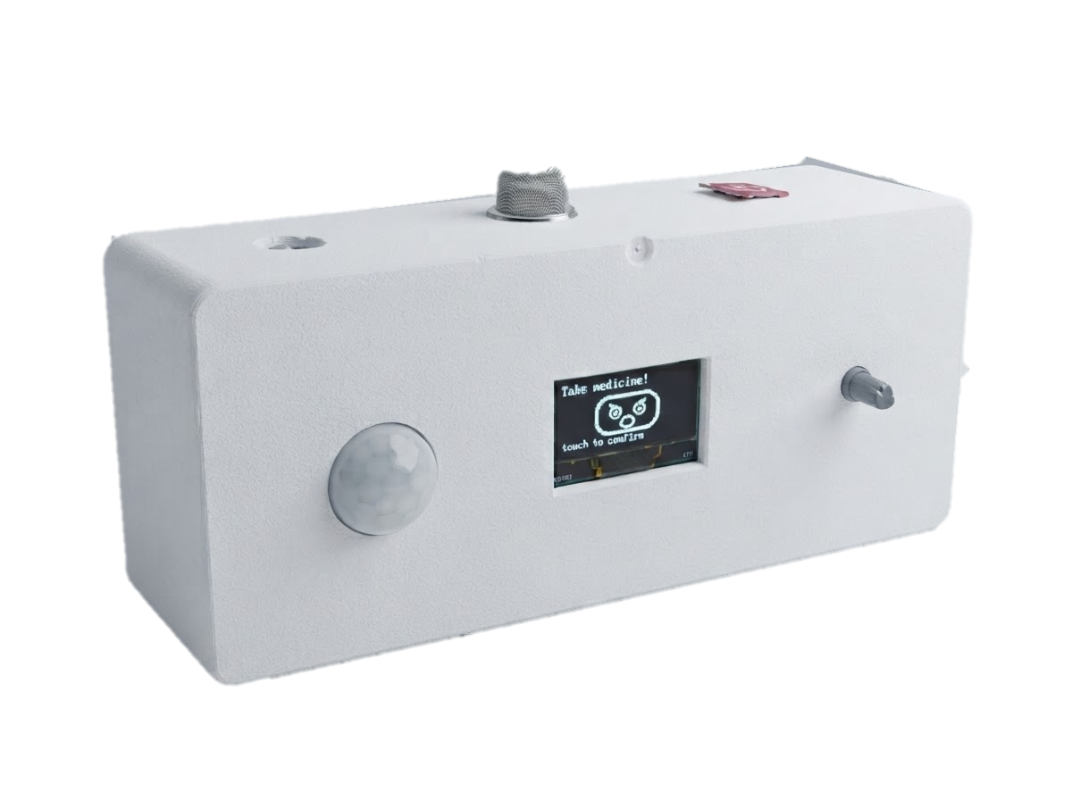
GROUP PROJECT · ROBOTICS
Smart Medicine
Companion Robot
PicoBot
Your Smart Reminder, Your Health Partner
Medicine Reminder
Voice Assistant
Face Reaction
Movement Detection
Emergency SMS
Presented by: Tashnimul Hasan Shifat
01

Slide 2
OVERVIEW
Executive Summary
1
Why We Built It
2
Our Goal
3
My Contribution
Many elderly and chronically ill patients forget their medicine, and many skip it on purpose. Reminder apps only fight forgetting, and caregivers cannot always be present. We built PicoBot to close this gap.
Raise medication adherence with a low-cost companion robot that tackles both forgetting and unwillingness, and keeps the user safe with an instant emergency SMS alert.
Pseudocode of the full robot logic
Code snippet: Medicine Reminder logic
Code snippet: Gas Alert logic
Performance analysis from the user survey
83.3%
67.6%
3.7/5
34
said the robot saved time or effort vs. managing medicine manually
rate it moderately or extremely beneficial for elderly patients
average rating for the robot's response speed
people took part in the performance survey
02

Slide 3
WHAT I WORKED ON
My Contribution
Pseudocode
Step-by-step logic of the full robot loop: sensors, alarms, reminder and gas alert.
1
Code Logic 1
Medicine reminder: the alarm fires once and repeats every 4 s until touched.
2
Code Logic 2
Gas alert: MQ-2 threshold, emergency SMS and call, 5-minute cooldown.
3
My role
I wrote PicoBot's logic as clear pseudocode, explained its two core code modules, and measured how real users rated it.
Performance Analysis
User survey on reminder, speed, time saved and overall benefit.
4
03

Slide 4
ROBOT LOGIC IN SIMPLE STEPS
Pseudocode
1
START
1
Setup
2
Turn ON the display, clock, sensors, speaker and SIM module
Starts all parts and loads the saved medicine times.
3
LOAD the 3 saved medicine times
4
REPEAT forever:
5
READ the time, motion and gas level
2
Gas safety
6
IF gas level is too high THEN
If gas is above the safe level, it warns and alerts the caregiver.
7
SHOW "GAS DETECTED!" and PLAY a warning voice
8
SEND an SMS and CALL the caregiver
3
Medicine reminder
9
IF it is medicine time THEN
10
SHOW a sad face and SAY "Please take your medicine"
At medicine time it keeps reminding until the user touches it.
11
REPEAT every 4 seconds UNTIL the user touches the sensor
12
SHOW a happy face and SAY "Thank you"
Clock screen
4
13
SHOW the clock, date and medicine times
14
END REPEAT
Otherwise it shows the time, then checks everything again.
04

Slide 5
FROM PICOBOT.INO
Code Snippets: 2 Core Logics
Logic 1
Medicine Reminder
Logic 2
Gas Detection & Alert
// alarm time reached -> start reminder
if (now.hour == alarmHour[i] &&
now.min == alarmMin[i]) {
screen = SCR_RINGING; // alert face
}
case SCR_RINGING:
if (digitalRead(PIN_TOUCH) == HIGH) {
screen = SCR_HAPPY; // "thank you"
} else if (ms >= nextReminderAt) {
playBuf(clipBuf, clipLen); // reminder
nextReminderAt = millis() + 4000;
}
int gasRaw = analogRead(PIN_MQ2);
if (gasRaw > GAS_THRESHOLD) { // > 800
gasWarning = true;
screen = SCR_GAS_WARNING; // alert
if (millis() - lastEmergencyAt
>= GAS_CALL_COOLDOWN_MS) {
sendEmergencySMS(); // caregiver
placeEmergencyCall();
lastEmergencyAt = millis(); // 5 min
}
}
Repeats the voice reminder every 4 s until the user touches the sensor.
Gas above 800 shows an alert and texts + calls the caregiver.
05

Slide 6
USER SURVEY · PART 1 OF 2
Performance Analysis
Q1 · RESPONDENTS
Q2 · REMINDER
What is your age group?
How effective was the robot in reminding you to take medicine on time?
27 responses
34 responses · 1 = lowest, 5 = highest
06

Slide 7
USER SURVEY · PART 2 OF 2
Performance Analysis
Q3 · TIME & EFFORT
Q4 · RESPONSE SPEED
Q5 · OVERALL BENEFIT
Did the robot save you time or effort vs. managing medicine manually?
How would you rate the robot's response speed when you interacted with it?
How beneficial is this robot for elderly patients who forget medicine?
30 responses
34 responses · 1 = lowest, 5 = highest
34 responses
07

Slide 8
PERFORMANCE ANALYSIS
Key Findings
83.3%
67.6%
67.6%
3.2/5
saved time or effort compared to manual medicine schedules
rated response speed 4 or 5 out of 5 (average 3.7)
find it moderately or extremely beneficial for elderly users
average rating for on-time medicine reminders
What works well
What to improve
✓
Saves effort: 43.3% said significantly and 40% said slightly.
!
Slow cases: 7 of 34 users rated response speed only 1 or 2.
✓
Fast response: 23 of 34 users gave speed a 4 or 5.
!
Reminder rating: average 3.2/5; 35.3% rated it 1 or 2.
✓
Clear benefit: only 11.8% said it is not beneficial.
!
Wider testing: most users were aged 40–49; test more 70+ users.
08

Slide 9
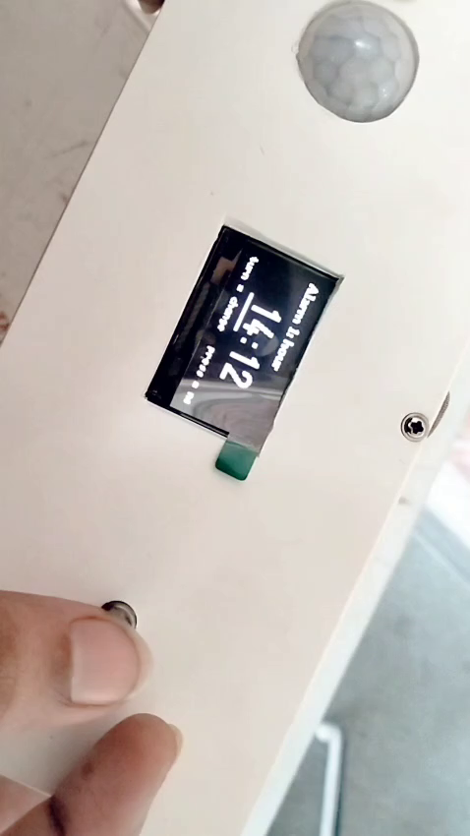
SEE IT WORKING
Live Demo: PicoBot in Action
Click the video to play · 0:53
09

Slide 10
PROJECT PLAN
Project Timeline: Gantt Chart
Task
W1
W2
W3
W4
W5
W6
W7
W8
W9
W10
W11
W12
1. Literature review & survey
3 wk
2. Problem statement & objectives
2 wk
3. Concept model & system design
3 wk
4. Component selection & procurement
2 wk
5. Circuit design & wiring
2 wk
6. Reminder module: RTC, voice, button
3 wk
7. Emotional engagement: OLED face, persuasion
3 wk
8. Presence (PIR) & gas-leak SMS alert
3 wk
9. Integration, SD logging & enclosure
2 wk
10. Testing & refinement
5 wk
11. Paper & report
2 wk
Phases:
Plan
Design
Build
Test & Report
10

Slide 11
Thank You
For Your Attention
Questions are welcome.
Tashnimul Hasan Shifat · PicoBot, Group 2
11

