Slide 1

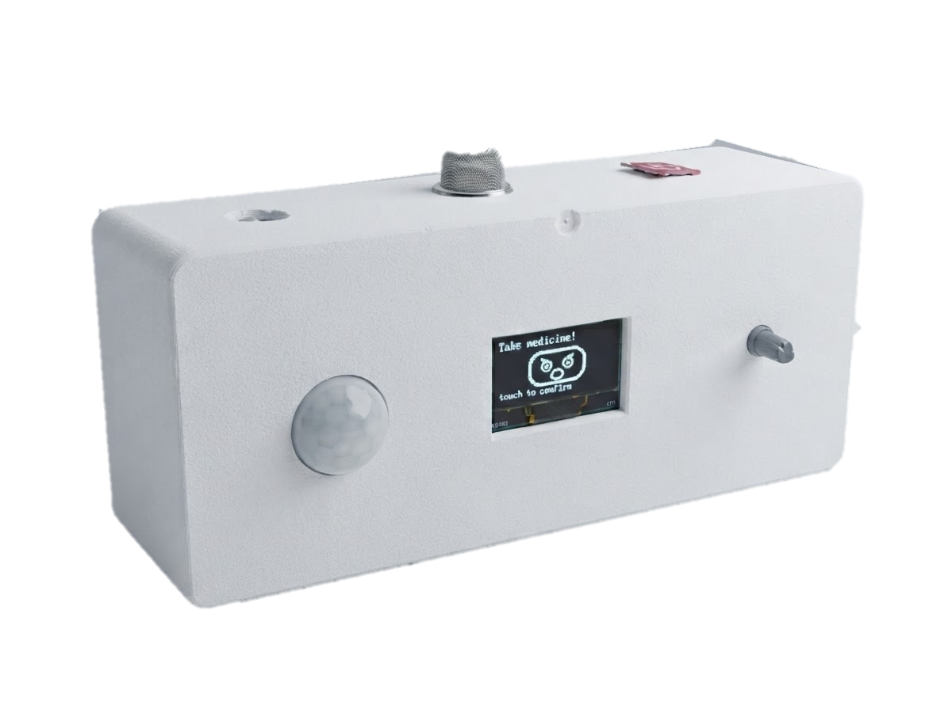





Smart
Medicine
Companion
Robot
PicoBot
Your Smart Reminder, Your Health Partner
Medicine
Reminder
Voice
Assistant
Face
Reaction
Movement
Detection
Emergency
SMS
Presented by: Adika Sultana-23101162
01

Slide 2
Executive Summary
1
Why We Built It
2
Our Goal
3
My Contribution
Many elderly and chronically ill patients forget their medicine, and many skip it on purpose. Reminder apps only fight forgetting, and caregivers cannot always be present. We built PicoBot to close this gap.
Raise medication adherence with a low-cost companion robot that tackles both forgetting and unwillingness, and keeps the user safe with an instant emergency SMS alert.
50% Literature Gap · 50% Survey · Problem Statement · Why This Topic · Conceptual Model · Hardware & Budget · Fully Circuit Design · 50% Hardware Implementation · Gantt Chart · Video
75%
79%
2
Tk 4,236
of 28 older adults want daily medication reminders [15]
want emergency assistance from a caregiving AI [15]
causes of non-adherence: forgetting and unwillingness
total cost of the PicoBot prototype
02

Slide 3
My Contribution
✓
✓
✓
✓
✓
Literature Gap
Survey
Problem Statement
Why This Topic
Conceptual Model
Read 2 papers and built the literature gap from them.
50% of the survey is done, based on the literature gap.
Forgetting, refusal, no confirmation and absent caregivers.
Most tools fix only forgetting; we join robotics, AI voice and IoT.
Forgetting: reminder + confirmation. Unwillingness: emotional engagement.
✓
✓
✓
✓
✓
Hardware & Budget
Hardware Implementation
Circuit Design
Gantt Chart
Video
15 components selected, total cost tk 4,236.
Wired MQ-2, PIR, touch, voltage divider, I2S amplifier, buck converter and capacitor.
ESP32-S3 wiring for all modules and power.
12-week plan; the last 2 weeks are for the paper and report.
Project video showing how PicoBot works.
03

Slide 4




Problem Statement
Many elderly or chronically ill patients simply forget medicine timing, dosage, or whether they already took it.
Even when reminded, many skip medicine on purpose low mood, denial, or simply not feeling like it.
Reminder apps only fight forgetting they can't sense reluctance or confirm the dose was truly taken.
Caregivers can't always be present, leaving emergencies or emotional low points without easily accessible help.
04

Slide 5



Why We Choose This
Topic?
Non-adherence has two causes forgetting and unwillingness yet most tools fix only the first.
Combines robotics, AI voice, affective computing, and IoT to address both memory and motivation.
Supports independent living and emotional well-being, not just pill-time alerts.
Backed by recent adherence and social-robotics research scalable, research-grounded design.
05

Slide 6
Literature Gap
Study | Reminder & Confirmation | Emotional Refusal | Safety Net | Limitation
Tamantini et al. (2025) [14] Virtual agent that switches between enthusiastic and neutral style from the user’s facial emotion (20 participants) | Not addressed Questionnaire task, not medicine | Yes Adapts speaking style to the user’s emotion | Not addressed | Not medicine-specific; needs a camera and GPT-4; no significant experience gain over a static form
Wolfe et al. (2025) [15] Mixed-method study of older adults’ views on caregiving AI chatbots (medication reminders, companionship) | Interest only 75% (21/28) want daily medication reminders | Partly Users split into adapters, wary and resisters | Interest only 79% (22/28) want emergency assistance | Attitude study, not a built system; usability barriers remain for older adults
PicoBot (Ours) Reminder + persuasion + emergency alert in one low-cost ESP32-S3 robot | Yes RTC alarm, voice, button confirmation | Yes Empathetic voice + mood-aware face | Yes MQ-2 gas alert, SMS, SD log | Prototype stage field evaluation is proposed future work
06

Slide 7
Survey Analysis
Q1 · Respondent Background
Q2 · Respondent Background
Q3 · Reminder & Alert Design
What is your relationship to the intended user of the robot?
How often does the intended user forget to take medicine on time?
Which reminder method would be most effective for the user?
38 responses
37 responses
38 responses
07

Slide 8
Survey Analysis
Q4 · Reminder & Alert Design
Q5 · Reminder & Alert Design
Q6 · Emotional Engagement
If the first reminder is ignored, how should the robot respond?
How long should the robot keep reminding before a dose is logged as missed?
How useful would a facial expression feature be for the user?
36 responses
38 responses
32 responses
08

Slide 9
Survey Analysis
Q7 · Emotional Engagement
Q8 · Emotional Engagement
Q9 · Safety & Monitoring
When the user shows reluctance, what robot response is most appropriate?
What tone of voice would be most acceptable for spoken reminders?
How important is the movement / presence detection feature?
27 responses
28 responses
29 responses
09

Slide 10
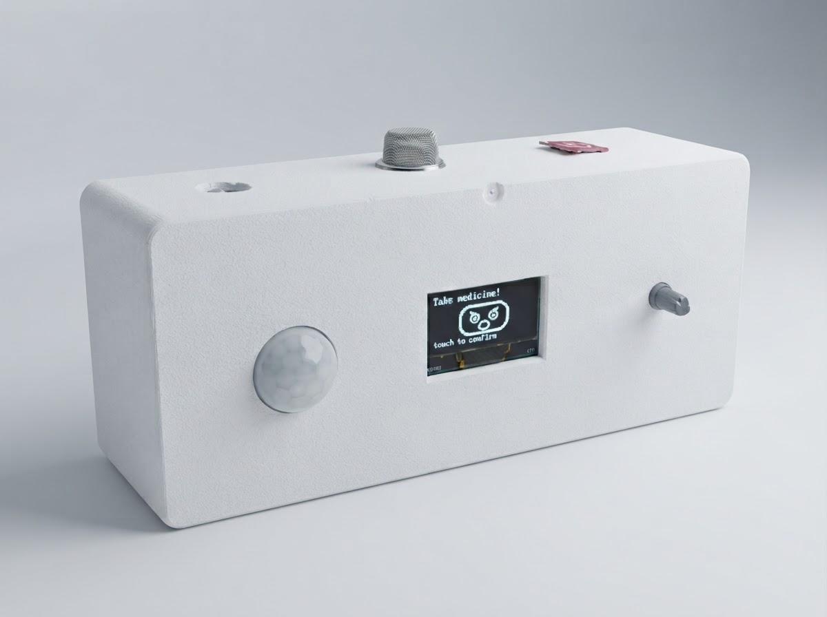
Concept Model: Solving Both Sides of Non-Adherence
Forgetting
Wrong time, wrong dose, or no memory of taking it at all
Unwillingness
Low mood, denial, or simply not feeling like it today
Reminder + Confirmation
Voice alarm, RTC schedule, persistent alerts until the button is pressed
Emotional Engagement
Empathetic voice persuasion and mood-aware facial expressions
Smart Medicine Companion Robot
Medicine Actually Taken
Caregiver Peace of Mind
Emergency Safety Net
10

Slide 11

Hardware Components
ESP32-S3-WROOM-1 (N16R8)
0.96″ I2C OLED Display
HC-SR501 PIR Sensor
DS3231 RTC (ZS-042)
MAX98357A I2S Amplifier
3W 8Ω Speaker
KY-040 Rotary Encoder
MQ-2 Gas Sensor
TTP223 Touch Module
SIM800L GSM Module
MP1584 Buck Converter
1000 µF Capacitor
DC Jack
5V/3A Adapter
Resistors ×4 (SIM800L divider)
11

Slide 12
Components Budget
1 | ESP32-S3-WROOM-1 (N16R8) Board | 1 | Tk 950
2 | KY-040 Rotary Encoder | 1 | Tk 110
3 | HC-SR501 PIR Sensor | 1 | Tk 95
4 | TTP223 Touch Module | 1 | Tk 40
5 | 0.96″ I2C OLED Display | 1 | Tk 350
6 | DS3231 RTC Module (ZS-042) | 1 | Tk 345
7 | MQ-2 Gas Sensor Module | 1 | Tk 160
8 | SIM800L GSM Module | 1 | Tk 650
9 | MAX98357A I2S Amplifier | 1 | Tk 601
10 | 3 W, 8 Ω Speaker | 1 | Tk 450
11 | MP1584 Buck Converter | 1 | Tk 90
12 | 1000 µF Capacitor | 1 | Tk 15
13 | DC Jack | 1 | Tk 20
14 | 5 V / 3 A Adapter | 1 | Tk 350
15 | Resistors (SIM800L divider) | 4 | Tk 10
 | Total |  | Tk 4,236
12

Slide 13
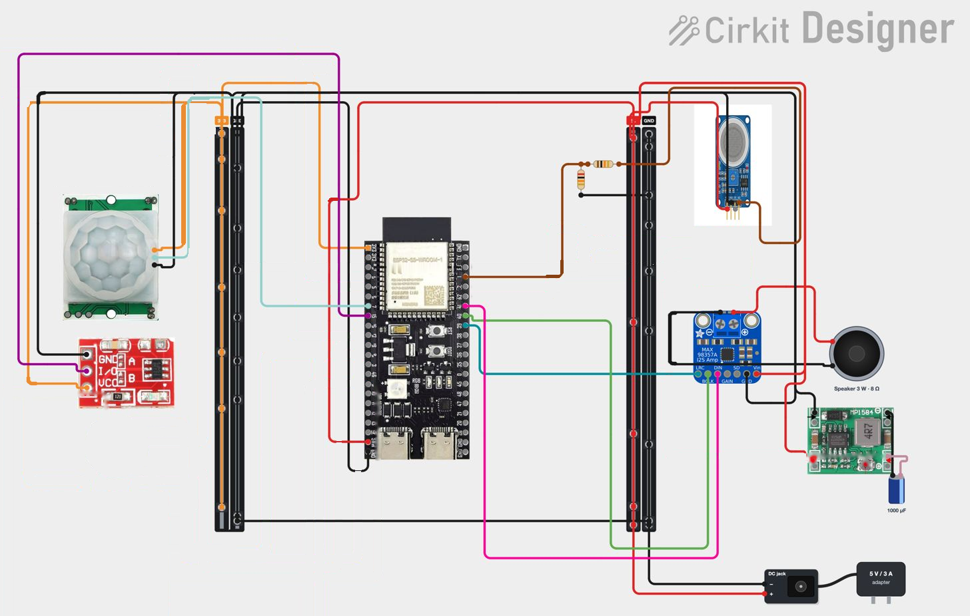
Robot Circuit Diagram
13

Slide 14
Hardware Implementation
MQ-2 Gas Sensor
Emergency SMS
detects gas leaks in the room and triggers the alert
PIR Sensor
Movement Detection
senses user presence and engages automatically
Touch Module
Persistent Alarm
user touches to confirm medicine taken and stop it
Buck Converter
Power Supply
steps the 5V/3A adapter down to a steady supply for every module
Voltage Divider
Safe Input Level
two resistors scale the MQ-2 output down for the ESP32-S3
I2S Amplifier
Voice Reminder MAX98357A drives the 3 W speaker for spoken reminders
1000 µF Capacitor
Power Filtering
smooths voltage spikes so the modules stay stable
14

Slide 15
Project Timeline: Gantt Chart
Task
W1
W2
W3
W4
W5
W6
W7
W8
W9
W10
W11
W12
1. Literature review & survey
3 wk
2. Problem statement & objectives
2 wk
3. Concept model & system design
3 wk
4. Component selection & procurement
2 wk
5. Circuit design & wiring
2 wk
6. Reminder module: RTC, voice, button
3 wk
7. Emotional engagement: OLED face, persuasion
3 wk
8. Presence (PIR) & gas-leak SMS alert
3 wk
9. Integration, SD logging & enclosure
2 wk
10. Testing & refinement
5 wk
11. Paper & report
2 wk
Phases:
Plan
Design
Build
Test & Report
15

Slide 16
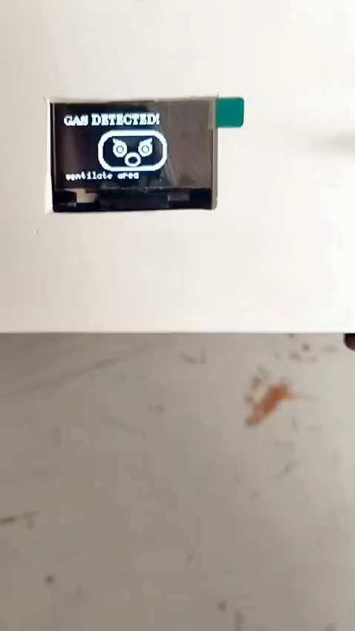
Conclusion
The Smart Medicine Companion Robot is a compact, intelligent, and interactive solution for medicine management.
It improves medication adherence, ensures safety, and brings peace of mind to users and caregivers.
It combines robotics, IoT, voice interaction, and emotional engagement in one platform.
This project has strong potential to make a real-world impact in healthcare.
“Technology with Care, Health Everywhere.”
Project Demonstration
16

Slide 17
Our Reference Papers
Caregiving Artificial Intelligence Chatbot for Older Adults and Their Preferences, Well-Being, and Social Connectivity: Mixed-Method Study
Adapting Virtual Agent Interaction Style with Reinforcement Learning to Enhance Affective Engagement
Frontiers in Digital Health
Journal of Medical Internet Research, 27, e65776
Tamantini, C., Umbrico, A., Fracasso, F., Beraldo, G., Cortellessa, G., & Orlandini, A. (2025)
Wolfe, B. H., Oh, Y. J., Choung, H., Cui, X., Weinzapfel, J., Cooper, R. A., Lee, H.-N., & Lehto, R. (2025)
Link: https://doi.org/10.3389/fdgth.2025.1680605
Link: https://doi.org/10.2196/65776
17

Slide 18

Thank You For Your Attention
18

