Slide 1
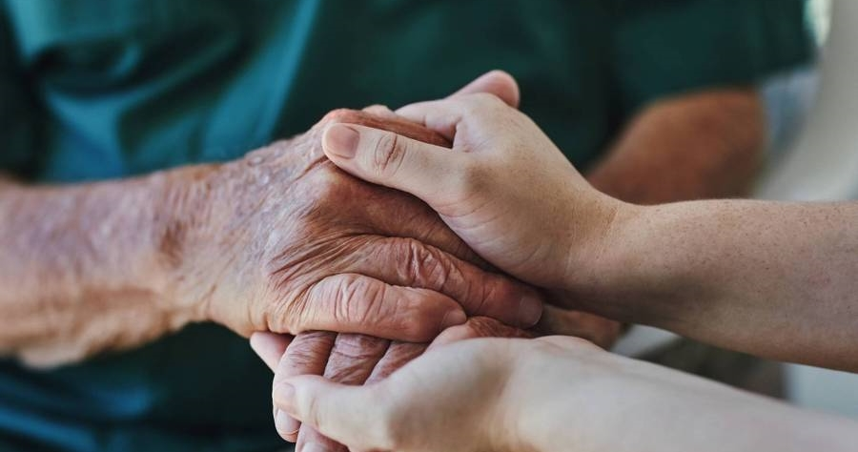

EDGE BP AFRICA

Slide 2
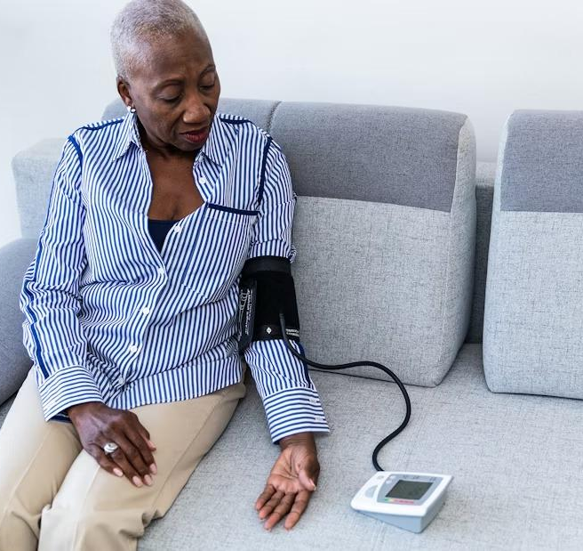
INTRODUCTION
​High blood pressure is a leading cause of heart disease, kidney failure, and early death worldwide. Millions of deaths each year are linked to uncontrolled hypertension. Many of these deaths are preventable with early detection and monitoring

Slide 3




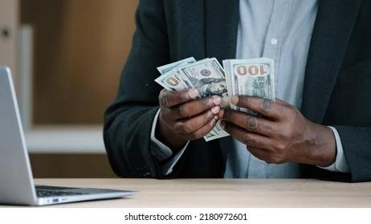
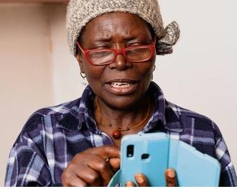
PROBLEM
Health crises may go unnoticed until it is too late
MARKET GAP
COSTS
TARGET USERS
Elderly African parents live alone due to urban migration of their children resulting in no health support
Missed medication and lack of emergency support
Medical facilities are often far or hard to access
Health devices are designed for European target markets
High costs make these inaccessible to African countries
Adults aged 40+ or at risk of hypertension in semi-urban or rural areas
Smartphone access with support from the community

Slide 4

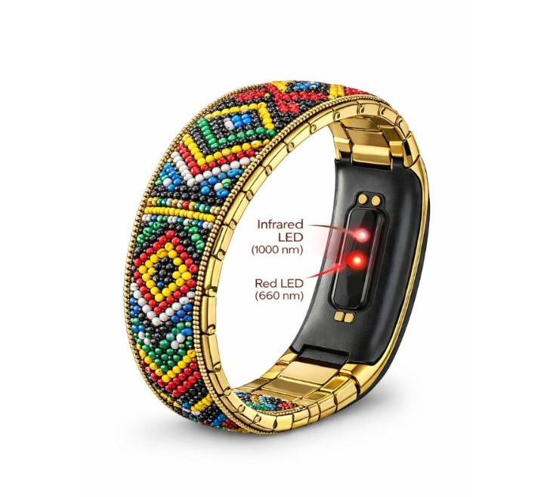
SOLUTION
SMART & SIMPLE
An African bead–inspired smart bracelet that captures accurate heart rate and blood pressure data using skin-optimized optical sensors. The band streams raw data to a smartphone for offline AI processing and safety monitoring, ensuring reliable alerts even in low-connectivity environments

Slide 5
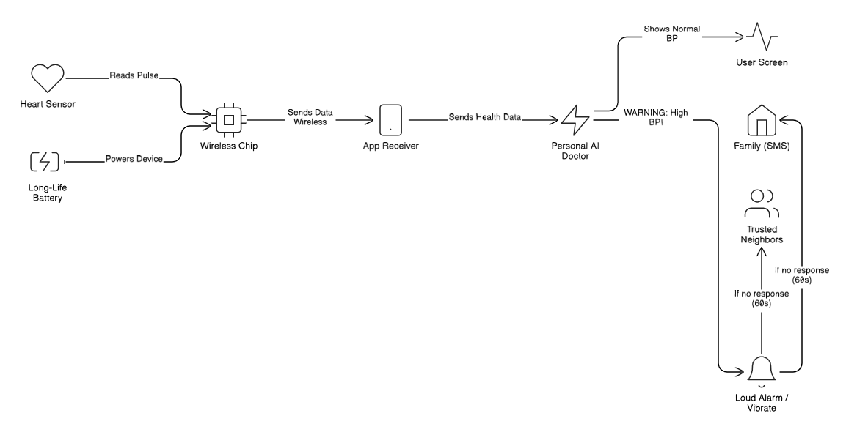
TECHNICAL OVERVIEW

Slide 6
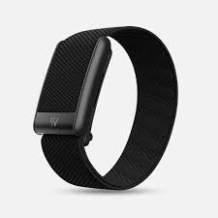
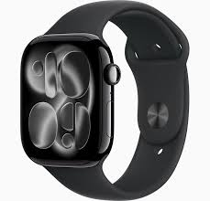
OUR COMPETITION
Area | Existing US/European Solutions | Our Africa-First Solution
Connectivity & AI Processing | Cloud-based AI requiring constant internet | Edge-based AI works offline with SMS/GSM fallback
Power & Charging | Assumes daily charging and stable grid power | Ultra-low-power design with solar and power-bank charging
Cost & Hardware Design | Expensive, imported, proprietary devices , annual subscription fee (Whoop) or initial high cost outlay (Apple) | Low-cost, modular devices built and repaired locally
Care & Emergency Response | Hospital-centric, doctor-heavy workflows | Community-based escalation with AI patient triage
WHOOP 4.0
APPLE WATCH

Slide 7
COMPETITION
CONVENIENT​
WHOOP 4.0
EDGE BP AFRICA
EXPENSIVE
AFFORDABLE
D
APPLE WATCH
E
INCONVENIENT​

Slide 8
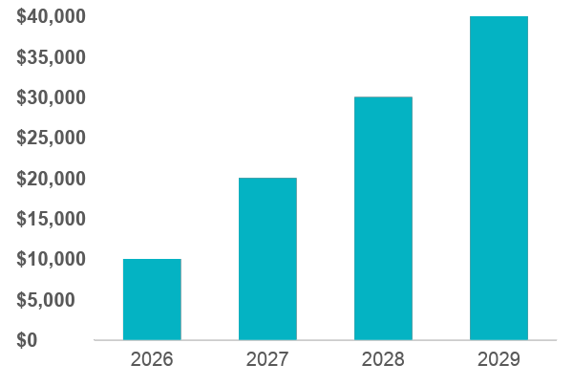
FINANCIAL FEASIBILITY
Forecasting for success​
Metrics
Revenue by year
 | CLIENTS | GROSS AVENUE | NET REVENUE
2026 | 8 | $10,000​ | $7,000​
2027​ | 20​ | $20,000​ | $16,000​
2028​ | 30​ | $30,000​ | $25,000​
2029​ | 40​ | $40,000​ | $30,000​

Slide 9




FUNDING SOURCES
FEASIBILITY
$8 per Bracelet
Initial supply 8000 units
50% by insurance, 31.25% investors, 18.75% by individuals
$12,000
$20,000
$32,000
INVESTMENTS​
INSURANCE
SELF FUNDING​
​ Based on the Target market capable of affording the device
Amount obtained through other investors​
Revenue obtained from medical insurance payments

Slide 10
TWO-YEAR ACTION PLAN
Impact for Success​
Emergency response improvement
2-4 countries
Gather feedback
2027
Jan
Feb
Mar
Apr
May
Jun
Jul
Aug
Sep
Oct
Nov
Dec
60-120 Jobs created​
Savings $1.5 -$3M
35k- 50 k users served​
2028
Jan
Feb
Mar
Apr
May
Jun
Jul
Aug
Sep
Oct
Nov
Dec

Slide 11

CONCLUSION
At Edge BP Africa, we believe in giving 110%. Elders are the foundation of African society. They deserve accessible, dignified healthcare. This solution offers continuous monitoring at low cost. It keeps families connected—just as easily as social media

Slide 12

THANK YOU

