Slide 1
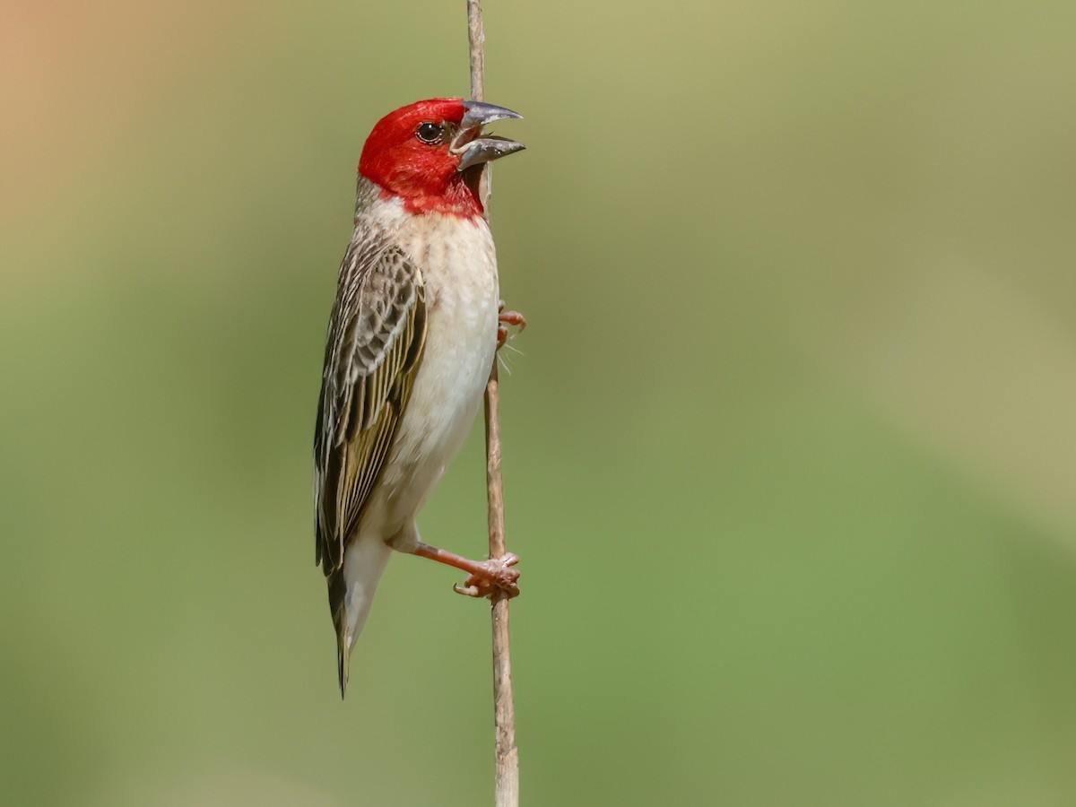

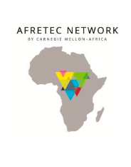

AI-Based Bird Detection and Deterrence Using Acoustic and Vision-Based Decision Fusion For Crop Protection In Agricultural Farms
Nathaniel Adika, Salma Guennoun, Grace Njogu, Gift Vundla, Thuwaybah Mohammad
September 16th, 2026
Notes:
ads
- localize (by africa, for africa)

Slide 2
Presentation Outline
Search
01
Introduction
06
Research Contributions
02
Background and Context
07
Research Objectives
Problem Statement
08
03
Methodology
04
09
Identified Gaps
Expected Results
05
10
Research Questions
Conclusion and Recommendations

Slide 3

Introduction
  Smart agriculture technologies are increasingly proposed as a way to improve farmer livelihoods [1]
  Many solutions are built and priced for, large-scale, well-resourced farming operations
  Sub-Saharan Africa, agriculture is overwhelmingly practiced by smallholder farmers [1]
    Distinction that matters enormously for what kind of technology can realistically reach the people who need it
  Among the many pressures, bird predation on crops is a threat that is massive in scale and under-addressed by modern, accessible technology [4].
AFRICANS MUST SOLVE AFRICAN PROBLEMS

Slide 4
Background
  Smallholder farms in the sub-Saharan Africa region are around 33 million, represent 80% of all farms, and contribute up to 90% of food production in some countries [2].
  At the individual level, close to 70% of the population is involved in agriculture as smallholder farmers, with land averaging less than 2 hectares [2].
  Cereal crops: sorghum, millet, rice, and wheat are the main crops produced and heavily targeted by flocking granivorous birds: the red-billed quelea and several weaver species.
  Crop losses to quelea alone are estimated to cost the continent around $88.6 million annually [3].
  A study of rice farmers in Senegal`s River Valley found that bird damage reduced potential rice production by about 13.2% causing an estimated €7.1 million in annual economic losses. Farmers themselves estimated their losses even higher, at 15.2% [5].

Slide 5

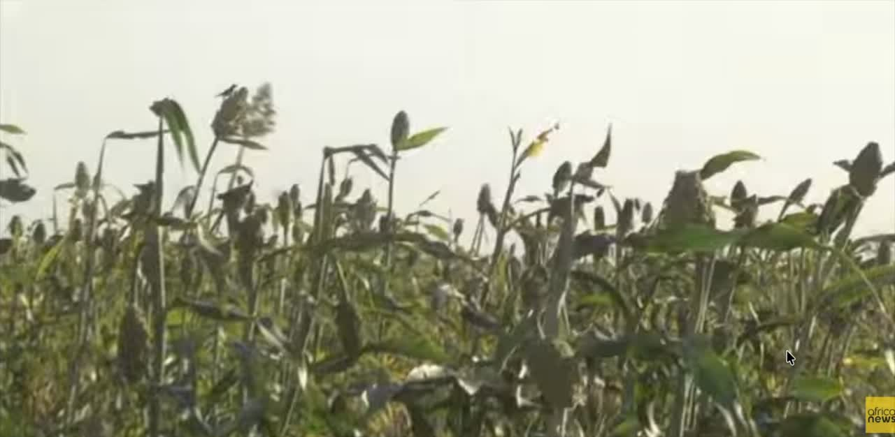

Slide 6
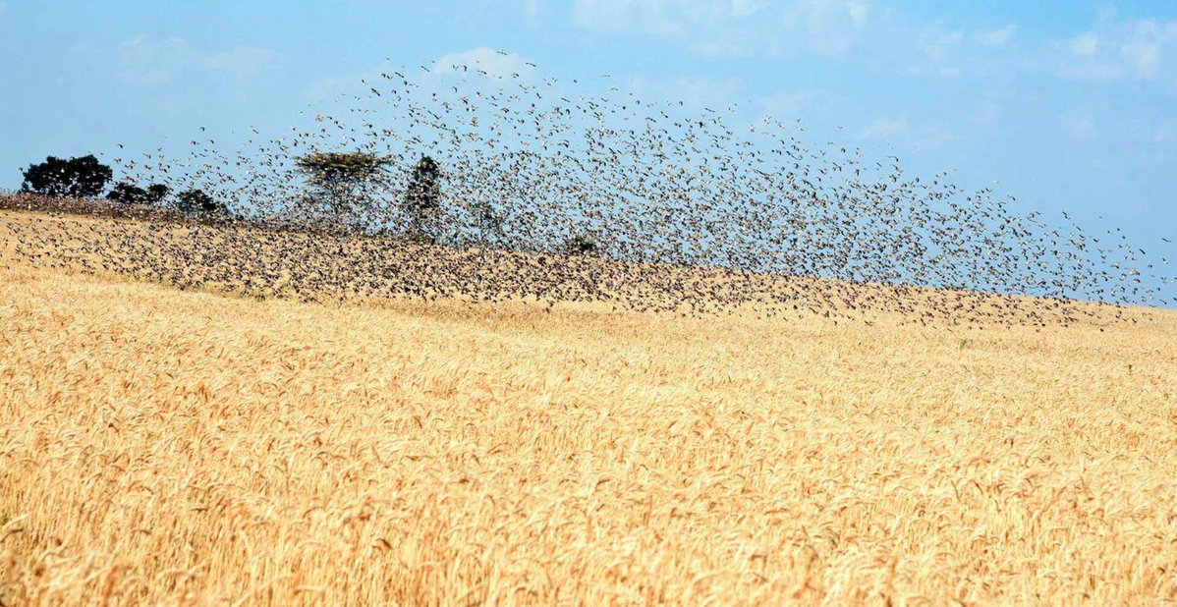


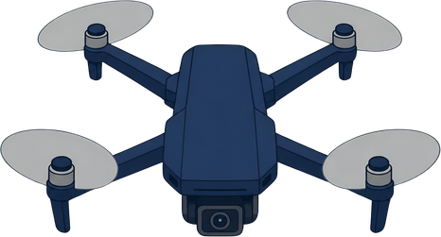
Problem Statement
  In East Africa, bird infestations cause small-scale farmers to lose over 20% of their cereal crops [1]
  The dominant existing responses such as manual scaring, which is labor-intensive and diverts household labor from other income-generating activity [4].
  Modern deterrent technologies exist, but their high cost and infrastructure requirements make them inaccessible to small-scale farmers [4].

Slide 7
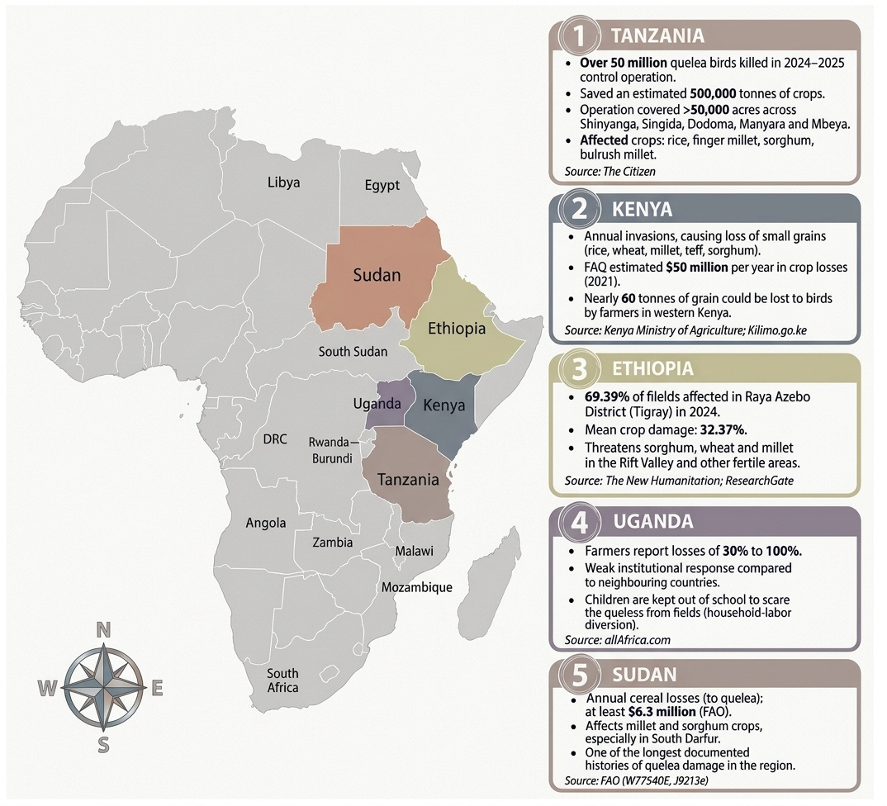
Top 5 East African States Affected By Red-Billed Quelea

Slide 8
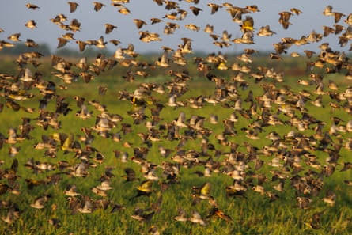
Search
Research Gaps
Many advanced bird-control technologies are still too expensive for small-scale African farmers[4].
01
Existing smart systems are often too complex or designed for larger farms rather than simple smallholder use [4].
02
Birds can get used to repeated sounds and traditional deterrents, making them less effective over tim [6].
03

Slide 9
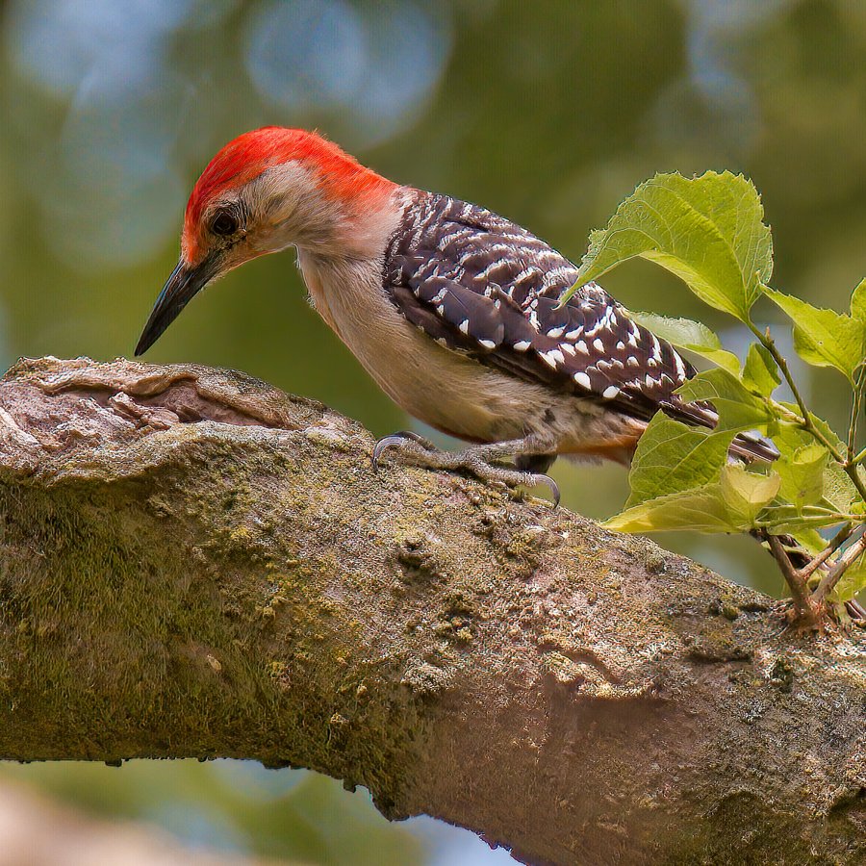
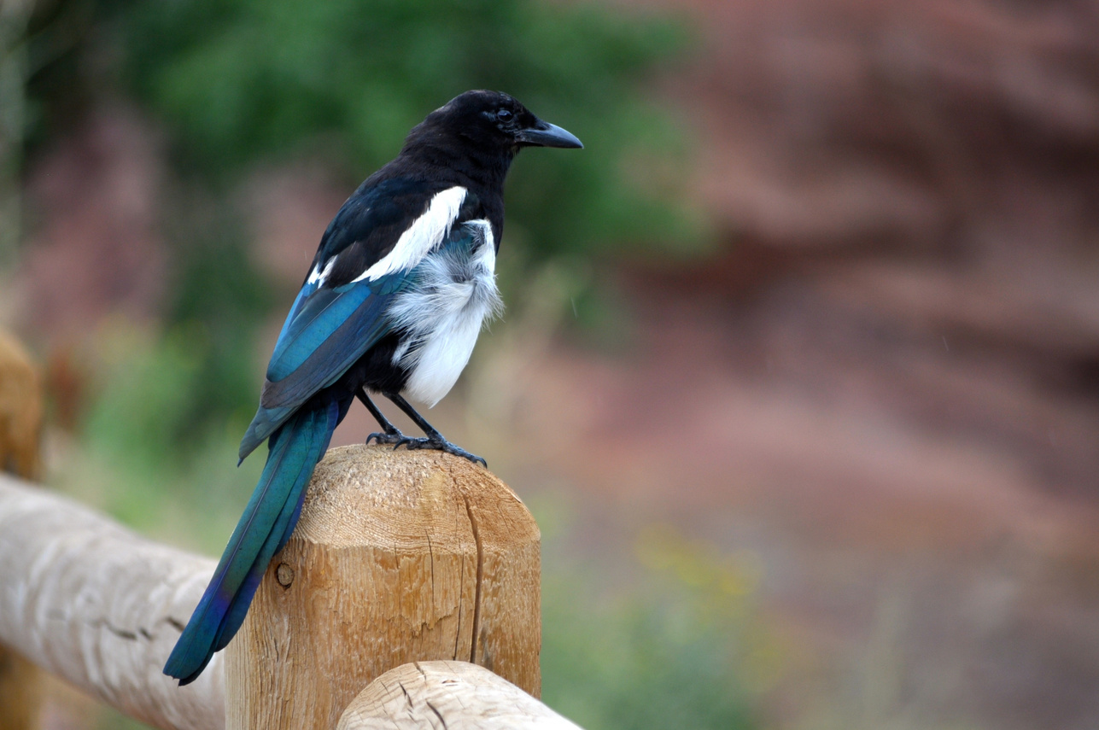
Research Questions
01. Deterrence Effectiveness
Does combining the camera and microphone results make bird detection more accurate and reduce false alarms compared to using only one?
02. Model Optimisation
How can we make the camera and sound models small and efficient enough to detect birds accurately on low-cost farm devices?
03. Affordability
How can we design a low-cost, energy-efficient deterrent that responds to the bird detection results?

Slide 10
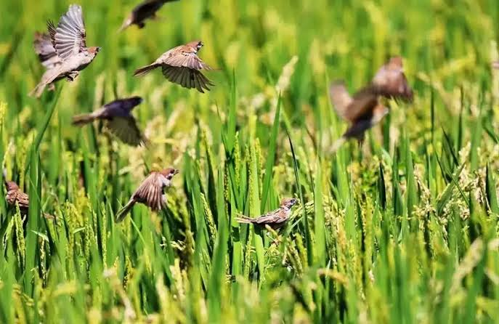
Research Contributions
01. Models Develpment
Develop small, efficient camera and sound models that can detect important crop-raiding birds on low-cost farm devices.
02. Improved Accuracy
Create a simple fusion method that combines camera and sound results to make bird detection more accurate and reduce false alarms.
03. Effective Detterence
An affordable, energy-efficient sound-based deterrent that varies acoustic signals to prevent bird habituation.

Slide 11
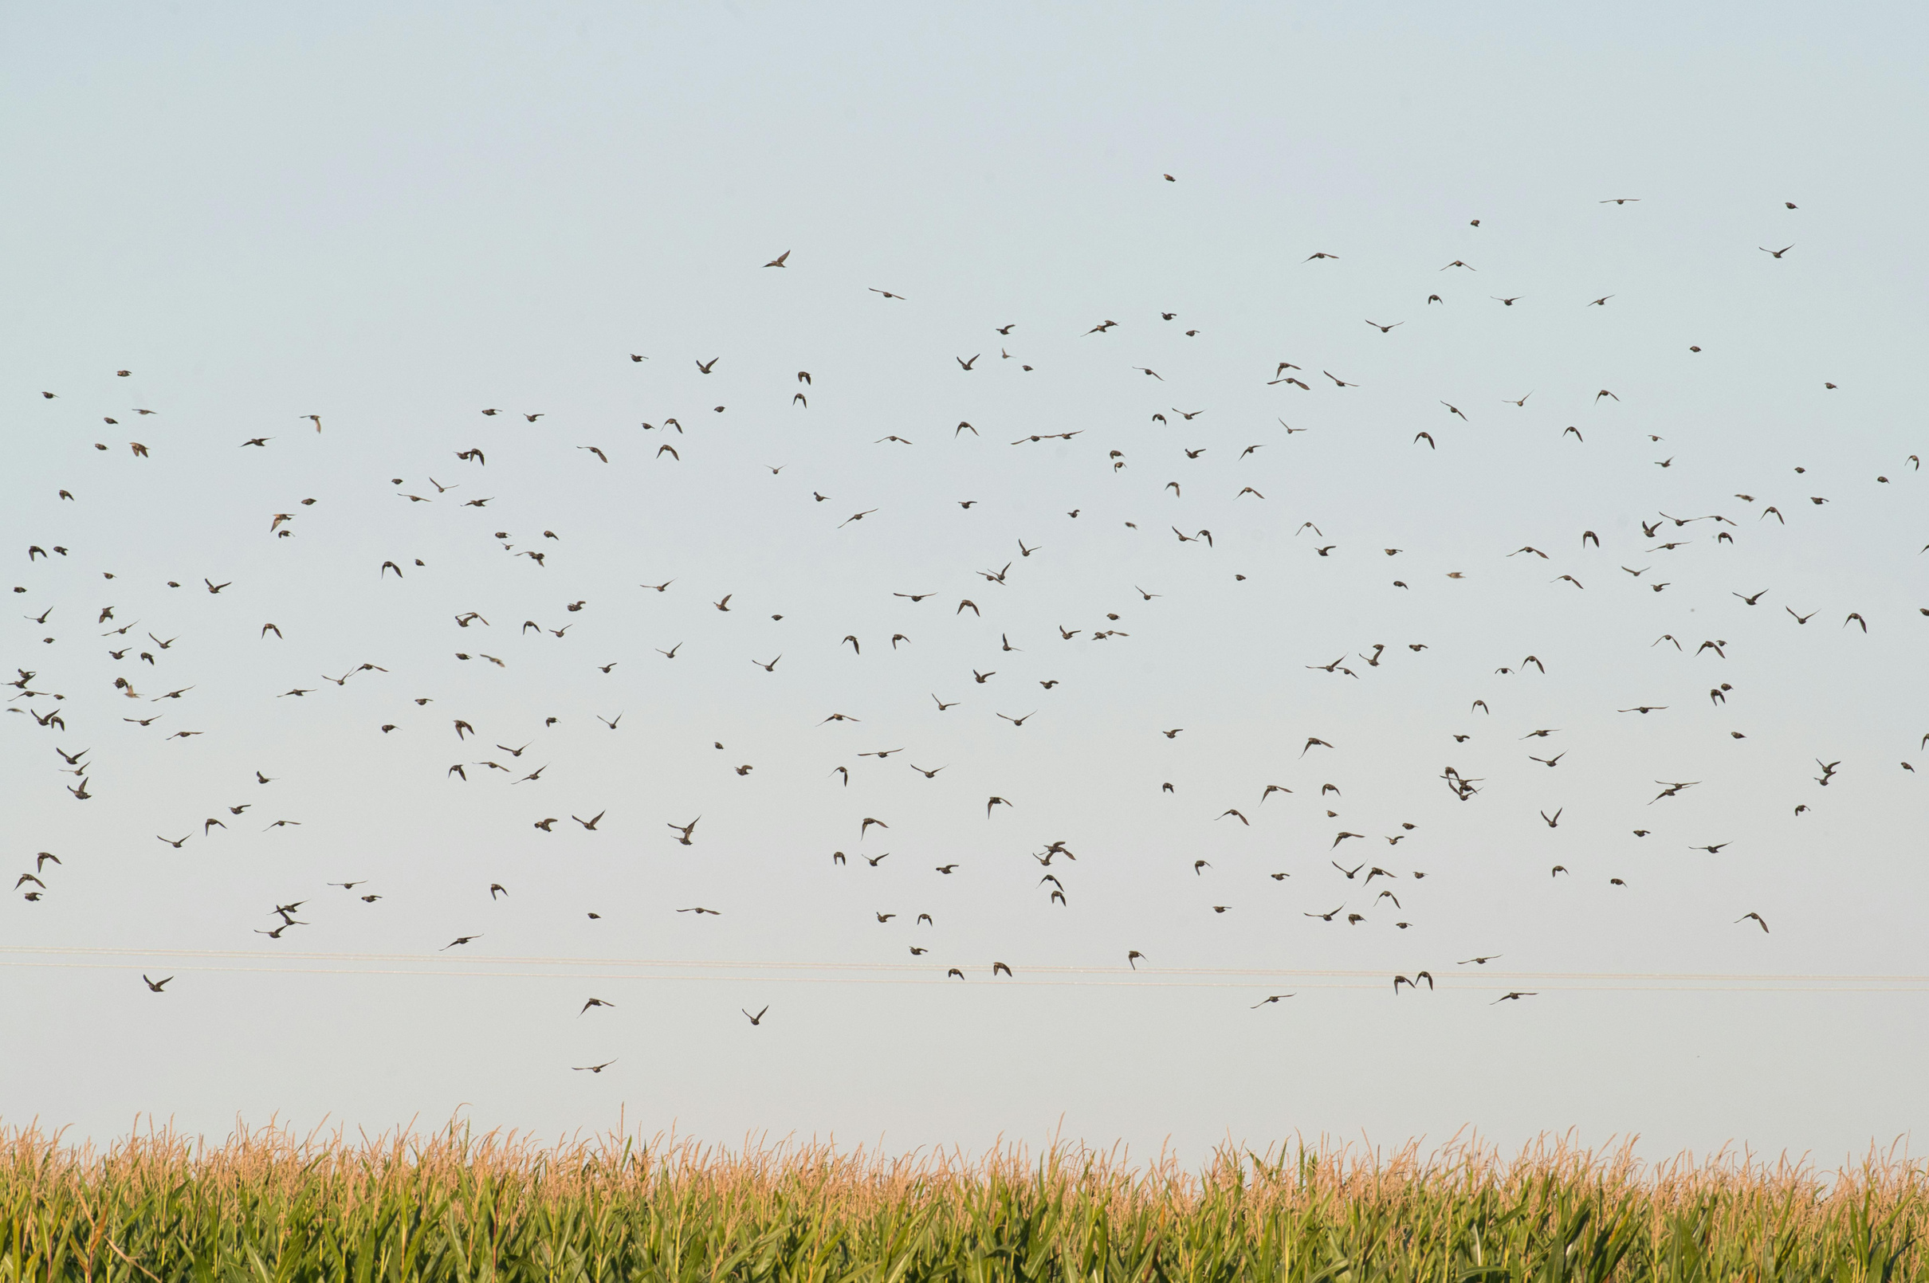
Search
Research Objectives
To develop a decision-level fusion framework that combines the acoustic information for reliable bird identification.
01
To design and optimize lightweight vision and acoustic machine learning models for reliable bird detection on low-cost edge devices.
02
To integrate and evaluate the complete multimodal system for real-time bird deterrence, assessing detection reliability, response time, and deterrence effectiveness in agricultural environments.
03

Slide 12
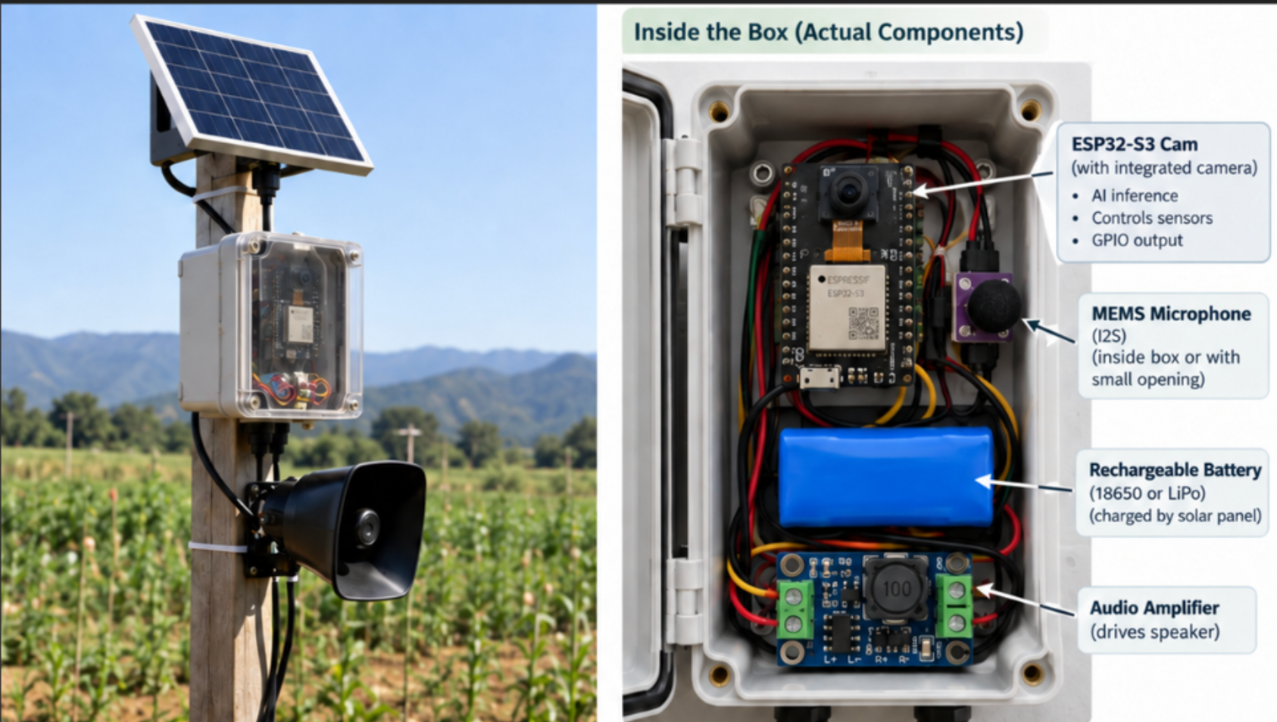
Our Solution
  Our solution is a smart, low-cost bird deterrence system designed for small-scale African farms.
  It automatically detects when birds enter the field and responds, helping farmers protect their crops without constant manual monitoring.
  The system is designed to work offline, run on solar power, and operate autonomously
    Practical for areas with limited infrastructure.

Slide 13
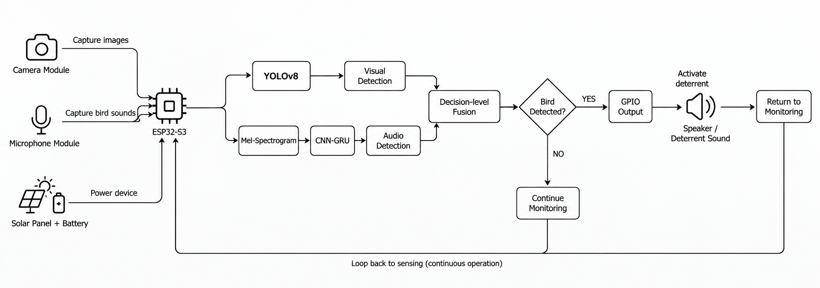
Overview

Slide 14
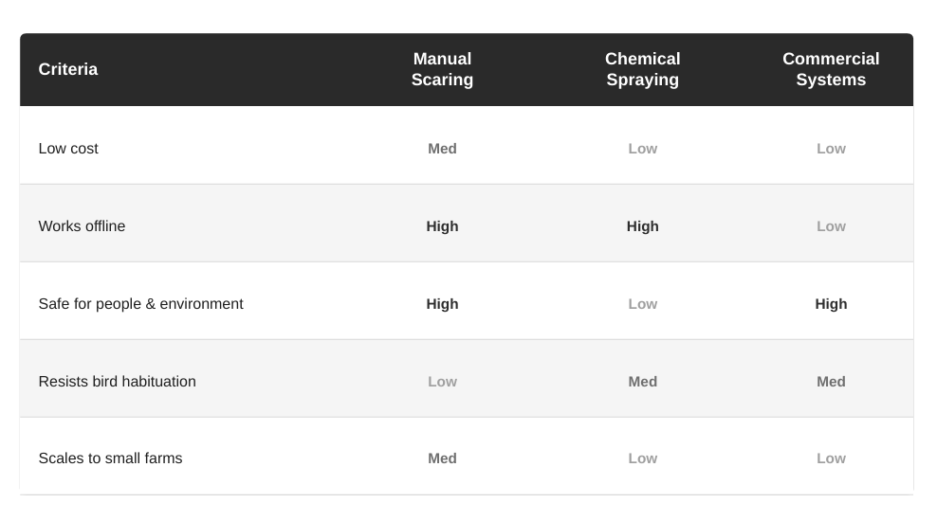

Estimated Cost
~$50 per node
Estimated prototype
< $40
Target cost with bulk sourcing

Slide 15
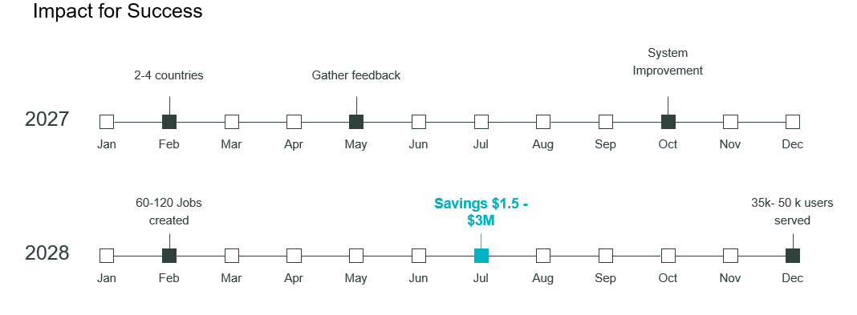
Action Plan

Slide 16
Expected Results
  Fewer birds destroying crops and therefore lower crop losses.
  Birds react collectively. If a few birds at the edge of a flock are startled, the escape response can spread through the rest of the flock.
  More accurate detection by combining camera and microphone information.
  Less bird habituation by using short and varied deterrent signals instead of continuous noise.
  Fully offline operation, so the system can work in rural areas without internet access.
  Affordable and simple deployment for small-scale farmers.
  A scalable solution, where additional units can be added if a larger area needs to be protected.

Slide 17
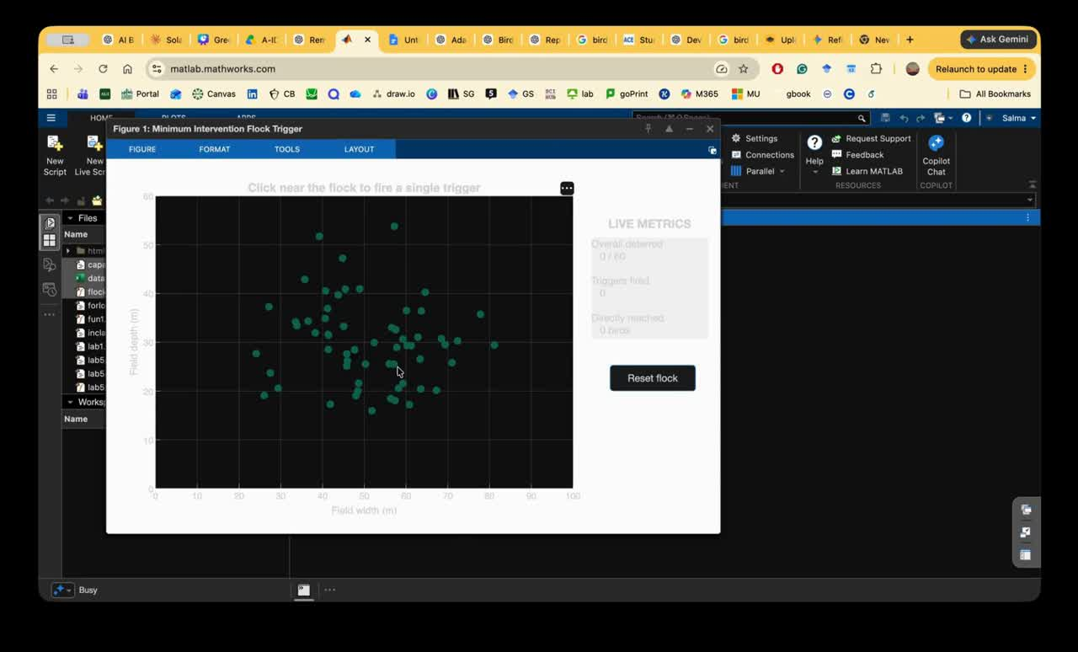
The Contagion Effect Simulated In Matlab

Slide 18
Conclusion and Recommendations
Conclusion
  This research proposes AI-powered system which combines combines acoustic sensing, camera-based detection, and solar power to provide a low-cost, intelligent, as well as sustainable approach to crop protection.
  Targeted bird detection and deterrence can reduce crop loss and preserve revenue while making the system more adaptable to different field conditions.
Recommendation
  Future experiments should measure whether detecting birds actually reduces their presence or prevents crop damage. Different deterrence responses could be tested, such as audio signals, visual signals, or other non-harmful deterrence mechanisms
  The system should be tested during day and night, different weather conditions, different bird distances, and varying levels of background noise.

Slide 19
References
[1] S. O. Ooko, E. Ndashimye, E. Twahirwa, and M. Busogi, “IoT and machine learning for smart bird monitoring and repellence: Techniques, challenges, and opportunities,” IoT, vol. 6, no. 3, Art. no. 46, Aug. 2025, doi: 10.3390/iot6030046.
[2] H. Ritchie, “Smallholders produce one-third of the world’s food, less than half of what many headlines claim,” Our World in Data, Aug. 6, 2021. [Online]. Available: https://ourworldindata.org/smallholder-food-production
[3] Food and Agriculture Organization of the United Nations, “One pest, many risks: Quelea birds and the case for safer control,” Jun. 23, 2025. [Online]. Available: https://www.fao.org/one-health/highlights/quelea-birds-and-the-case-for-safer-control/en. [Accessed: Sep. 16, 2026].
[4] S. Heo, N. Baumann, C. Margelisch, M. Giordano, and M. Magno, “Low-cost smart raven deterrent system with tiny machine learning for smart agriculture,” in Proc. 2023 IEEE Int. Instrum. Meas. Technol. Conf. (I2MTC), Kuala Lumpur, Malaysia, May 2023, pp. 1–6, doi: 10.1109/I2MTC53148.2023.10175902.
[5] Y. de Mey, M. Demont, and M. Diagne, “Estimating bird damage to rice in Africa: Evidence from the Senegal River Valley,” J. Agric. Econ., vol. 63, no. 1, pp. 175–200, Feb. 2012, doi: 10.1111/j.1477-9552.2011.00323.x.
[6] S. Heo, N. Baumann, C. Margelisch, M. Giordano, and M. Magno, “Low-cost smart raven deterrent system with tiny machine learning for smart agriculture,” in Proc. 2023 IEEE Int. Instrum. Meas. Technol. Conf. (I2MTC), Kuala Lumpur, Malaysia, May 22–25, 2023, pp. 1–6, doi: 10.1109/I2MTC53148.2023.10175902.

Slide 20
Thank You!

