Slide 1


DEVELOPMENT OF INTEGRATED WEARABLE DEVICE FOR REMOTE MONITORING OF PREGNANT WOMEN IN GHANA
Project Supervisor
Dr. Godfrey Mills
Co-Supervisor
Prof. Elsie Effah Kaufmann
Group Members
Owoh Einsteina Ofunne - 10943874
Anane George Nyarko – 10947340
Adika Nathaniel - 10957036
DATE: 27th June 2025
UNIVERSITY OF GHANA

Slide 2

COLLABORATORS
Nathaniel Sakyi Adibuer, IT Consortium
Dr. Frank Amegah, Korle-Bu Teaching Hospital

Slide 3
PRESENTATION OUTLINE
BACKGROUND
PROBLEM STATEMENT
RELEVANCE OF WORK
PROJECT OBJECTIVES
EXISTING SOLUTIONS
DESIGN METHODOLOGY
PROJECT TIMELINE
TASK DELEGATION
PROGRESS SO FAR
NEXT STEPS
CONCLUSION
REFRENCES

Slide 4
BACKGROUND
Monitoring of pregnant women is an important issue in maternal care due to possibility of complications.
Pregnant women are required to attend antenatal care a minimum of four times and a maximum of fourteen times during the gestational period.
Pregnant women are monitored for critical parameters like; body
temperature, blood pressure, protein in the urine, heart rate, blood
glucose values and oxygen saturation which help in assessing the
health of both mother and baby.
Potential dangers of not monitoring can lead to critical challenges such as;
preeclampsia, anemia, low birth weight and developmental delays and
ultimately lead to death.

Slide 5
PROBLEM STATEMENT
According to World Health Organization(WHO), over 40% of pregnancies in
developing countries face significant health risks, making pregnancy
Complications a major public concern.^{[2]}
Reports ^{[2]} reveal that, in Ghana, 12% of female deaths (ages 15-49) in the previous 5 years stem from pregnancy complications, with 62% due to late or poor medical intervention
Barriers of distance, transportation cost and time constraints hinder pregnant women from undergoing regular antenatal care, hence increasing maternal risks.

Slide 6
RELEVANCE OF WORK
Early detection of pregnancy complications hence reducing maternal mortality
Equip pregnant women with tools to monitor and manage their health
Continuous data collection and visualization empower doctors to make informed,
data-driven decisions rather than relying solely on periodic observations
Ease of pressure on antenatal clinics due to reduced visitations

Slide 7
PROJECT OBJECTIVES
To develop an integrated system consisting of a wearable device and a mobile application to continuously monitor, detect and trigger alerts in event of anomalies.
To train a machine learning model for risk prediction of pregnancy complications like preeclampsia and anemia long before standard detection window.
To develop a user-friendly interface system to acquire and visualize information for processing by the system.

Slide 8
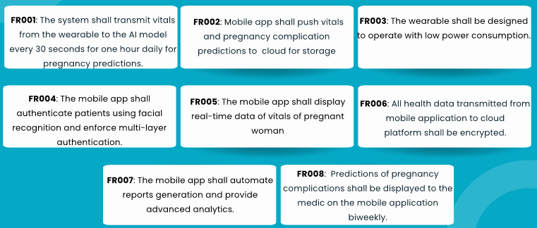
FUNCTIONAL REQUIREMENTS

Slide 9
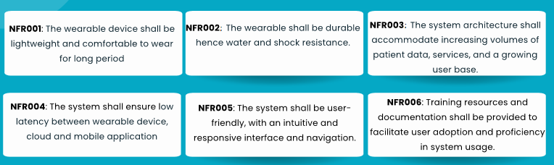
NON-FUNCTIONAL REQUIREMENTS

Slide 10
EXISTING SOLUTIONS
[1] A Comprehensive Framework for Wearable Module for Prenatal Health Monitoring and Risk Detection (2024) ^{[1]}
GOAL: A system to continuously monitor vitals of pregnant women throughout pregnancy and send SMS to healthcare providers in event of any anomaly
TECHNIQUE: Threshold values are set in the ESP-32 microcontroller and comparison is done with values captured by the wearable device. Body temperature, blood glucose, blood pressure, oxygen saturation, heart rate, fetal movement and falls of pregnant woman were monitored.
RESEARCH GAP: No mechanism for predictive analysis of patient's vitals to forewarn a risk of complication or possible illness of mother

Slide 11
EXISTING SOLUTIONS
[2] Explainable Early Prediction of Gestational Diabetes Biomarkers by Combining
Medical Background and Wearable Devices: A Pilot Study With a Cohort Group in South Africa(2024) ^{[5]}
GOAL: A wrist-worn device that forecasts biomarkers 13 to 16 weeks prior to the
Gestational Diabetes Mellitus(GDM) screening test done 24-28 weeks in pregnancy.
TECHNIQUE: Glucose monitoring devices, a wristband for activity detection, and medical background data were fed into a ML model to predict possible occurrence of GDM.
RESEARCH GAP: Limited scope to GDM

Slide 12
EXISTING SOLUTIONS
[3] Health Monitoring Of Expecting Mothers Using Multiple Sensor Approach: "Preg Care" (2020) ^{[6]}
GOAL: A hand/wrist-worn system comprising provides complete health monitoring
during the pregnancy period.
TECHNIQUE: Body temperature, glucose rate detection, heart rate, sudden fall
detection and anemia status(using python-based image processing) are monitored
throughout gestational period. Alert systems are implemented.
RESEARCH GAP: No data security measures are implemented

Slide 13

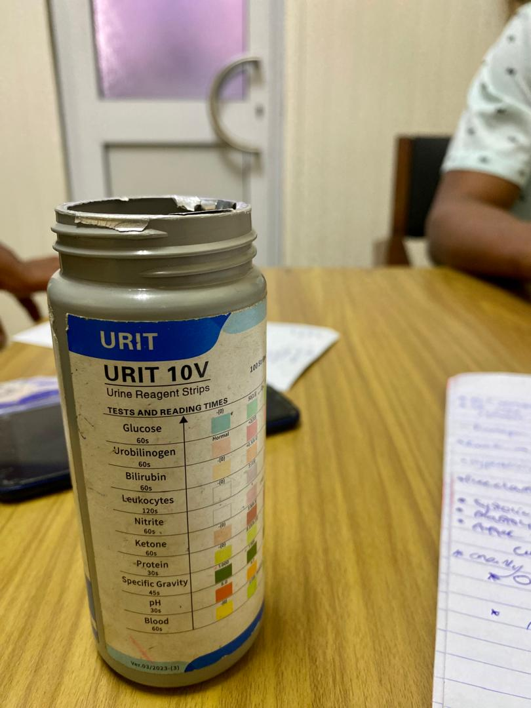
FIELD VISIT TO KORLE-BU TEACHING HOSPITAL

Slide 14
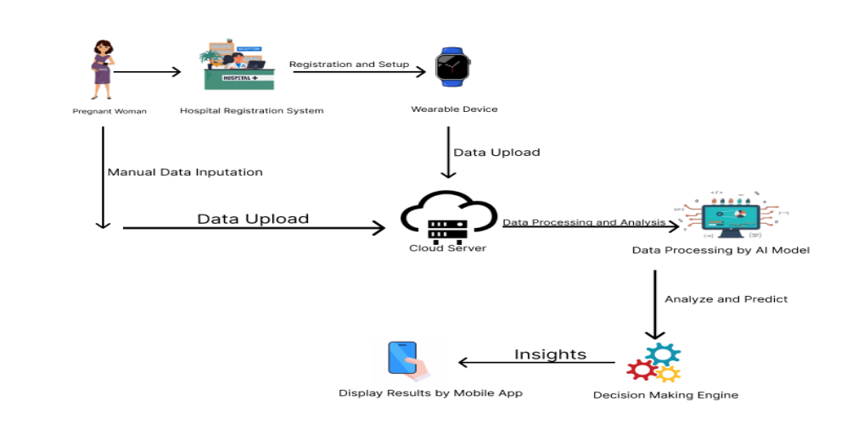
PROPOSED SYSTEM ARCHITECTURE

Slide 15
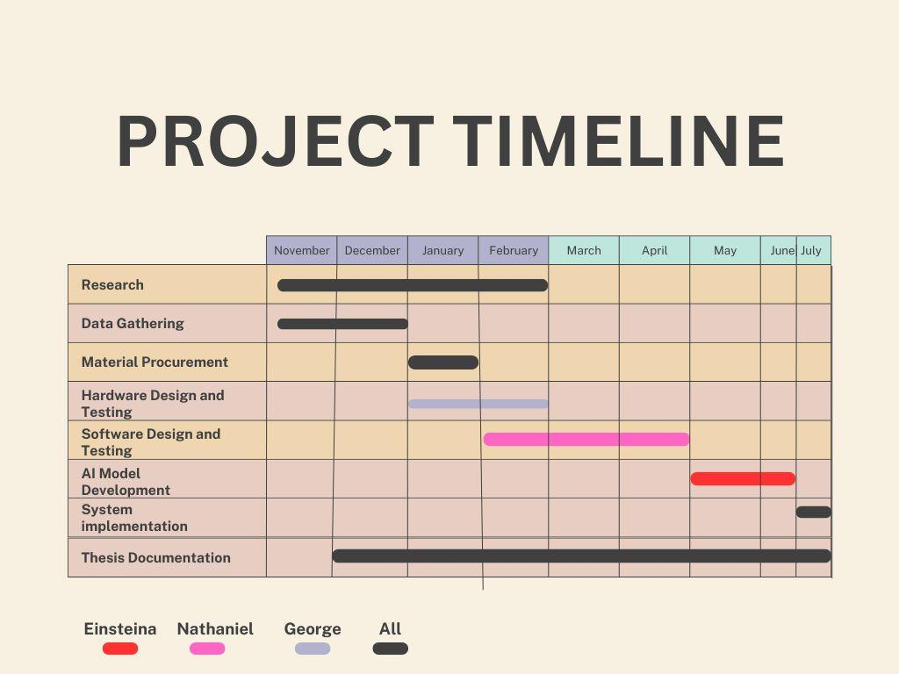

Slide 16
MACHINE LEARNING MODEL PROGRESS

Slide 17
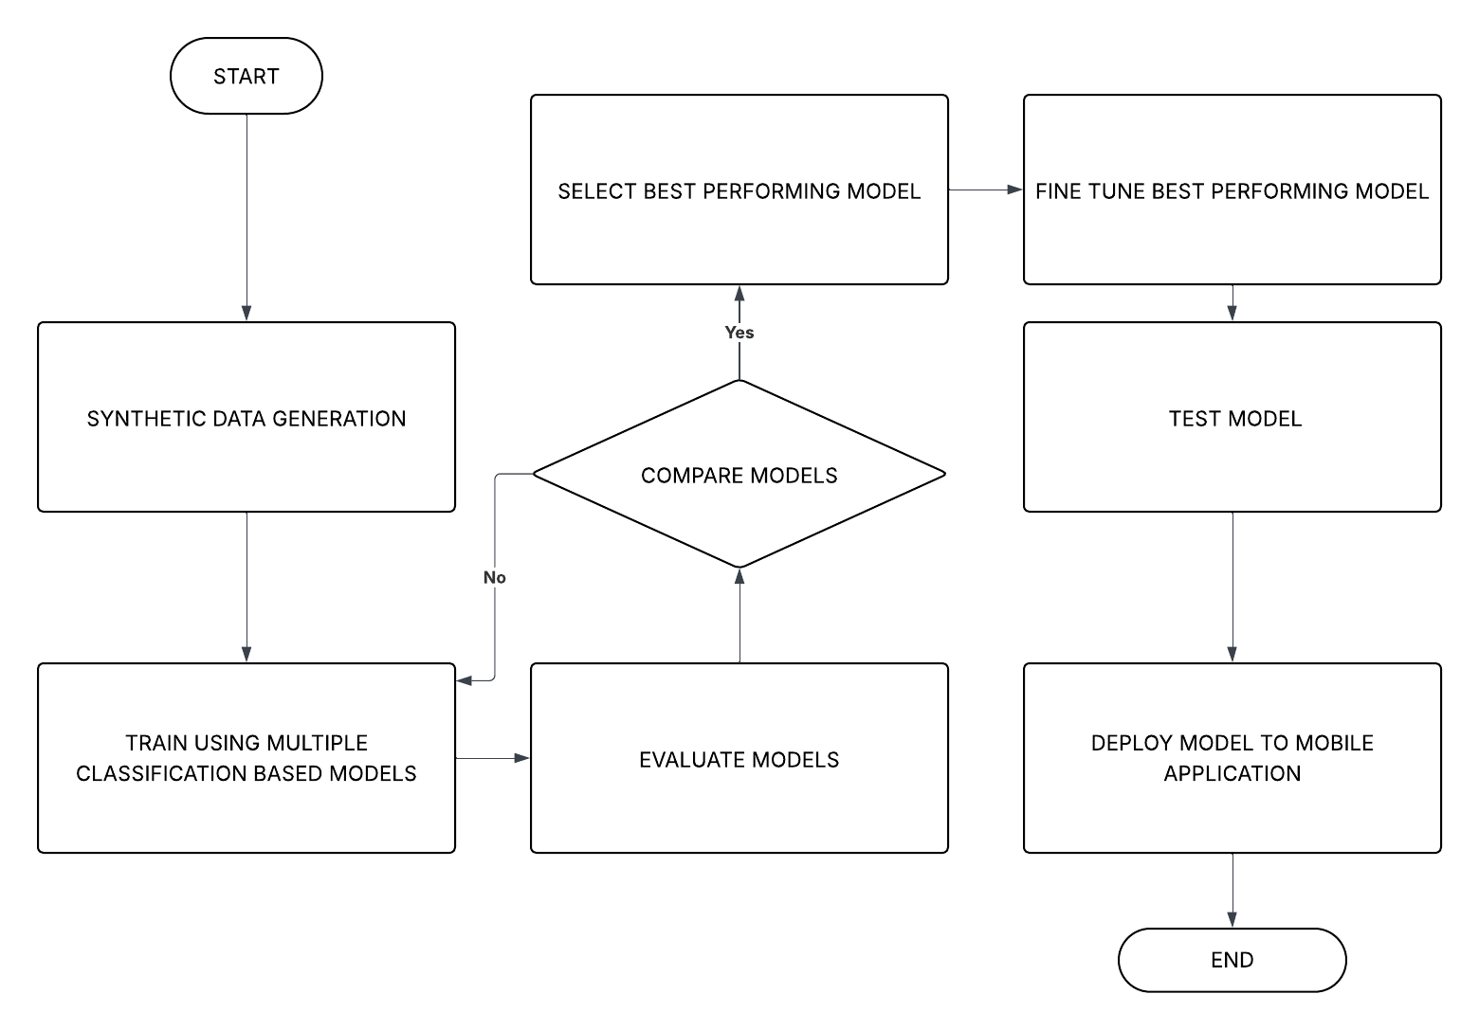
MACHINE LEARNING WORKFLOW

Slide 18
PREECLAMPSIA DATASET OVERVIEW
Dataset Name: preeclampsia_dataset.csv
Source: Synthetic Data Generation
Number of Samples: 10,000
Input Features: Systolic blood pressure, Diastolic blood pressure , MAP, Protein in urine
Output States: No_Preeclampsia, Mild, Moderate and Severe
Description: Dataset of 10,000 records generated to predict preeclampsia risk based on MAP and urine protein levels, with added noise to simulate real-world variability.

Slide 19
PREECLAMPSIA FEATURES
 | PROTEIN IN URIA | BLOOD PRESSURE
LOW | NIL | 70-106
MILD | 1+ | 107-113
MODERATE | 2+ OR > | 114-129
HIGH | 2+ OR > | 130 OR >

Slide 20
PREECLAMPSIA MODEL SELECTION
Metrics | Logistic Regression | K-Nearest Neighbour | Support Vector Machine | Decision Tree Classifier | Random Forest Classifier | Gradient Boosting Classifier | MLP Classifier
Precision | 0.9746 | 0.9569 | 0.9634 | 0.9305 | 0.9584 | 0.9545 | 0.9664
F1 Score | 0.9745 | 0.9567 | 0.9633 | 0.9305 | 0.9582 | 0.9548 | 0.9664
Recall | 0.9745 | 0.9568 | 0.9634 | 0.9305 | 0.9535 | 0.9549 | 0.9666
Training Accuracy | 0.9700 | 0.9700 | 0.9690 | 1.0000 | 1.0000 | 0.9600 | 0.9703
Test Accuracy | 0.9710 | 0.9650 | 0.9745 | 0.9680 | 0.9680 | 0.9645 | 0.9675
Validation Accuracy | 0.9724 | 0.9590 | 0.9635 | 0.9301 | 0.9585 | 0.9550 | 0.9665

Slide 21
TIME TAKEN (S)
Performance Metrics | Logistic Regression | K-Nearest Neighbour | Support Vector Machine | Decision Tree Classifier | Random Forest Classifier | Gradient Boosting Classifier | MLP Classifier
Training Time | 5.1027 | 0.0180 | 0.3880 | 0.0598 | 1.4372 | 7.0223 | 12.8828
Prediction Time | 0.0005 | 0.0004 | 0.4300 | 0.0010 | 0.0249 | 0.0300 | 0.0050

Slide 22
PREECLAMPSIA TESTING RESULTS
WE WILL INSERT TWO SCREENSHOTS HERE BEFORE FRIDAY

Slide 23
MOBILE APP PROGRESS

Slide 24
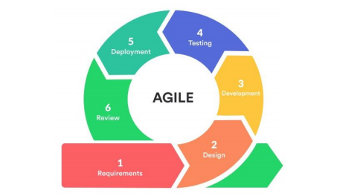
AGILE METHODOLOGY

Slide 25
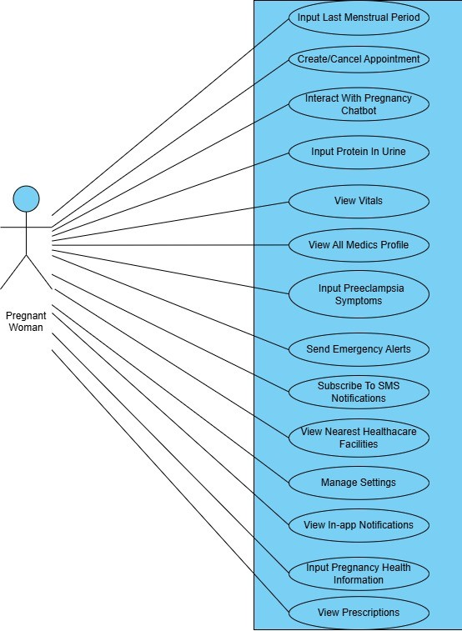
USE CASE DIAGRAM OF PREGNANT WOMAN

Slide 26
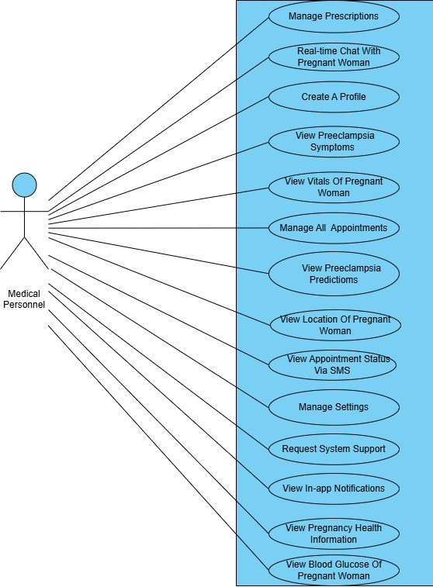
USE CASE DIAGRAM OF MEDICAL PERSONNEL

Slide 27
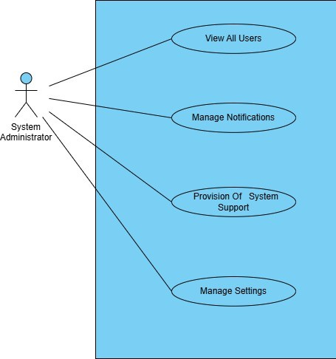
USE CASE DIAGRAM OF SYSTEM ADMIN

Slide 28
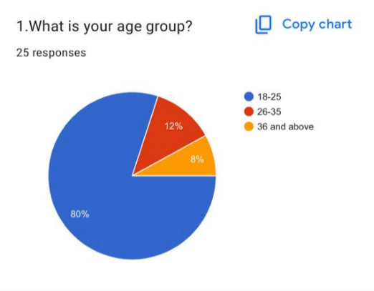
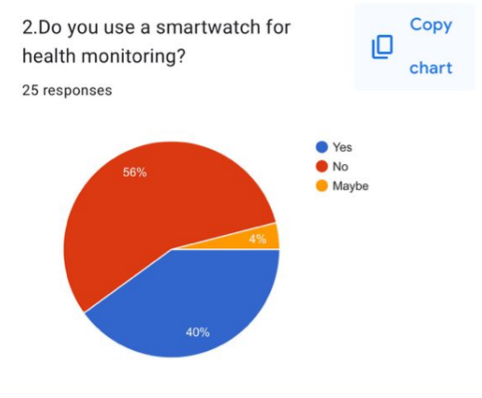
QUANTITATIVE DATA GATHERING

Slide 29
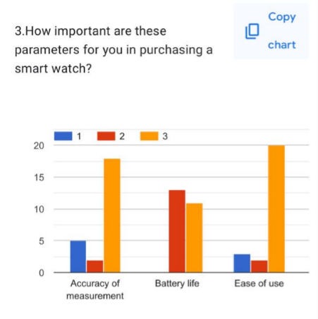
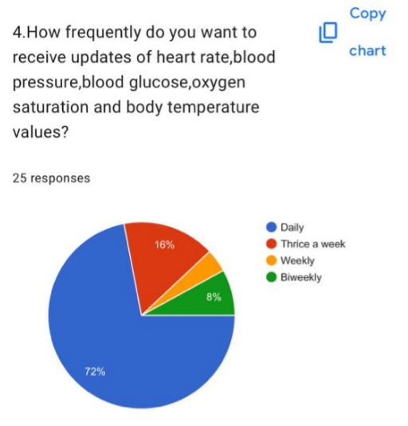
QUANTITATIVE DATA GATHERING

Slide 30
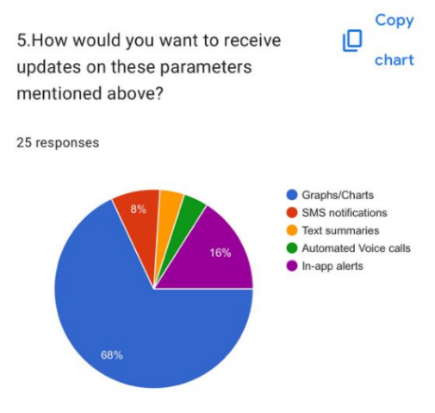
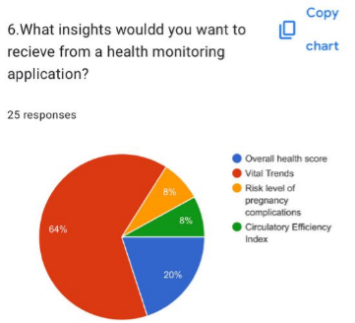
QUANTITATIVE DATA GATHERING

Slide 31
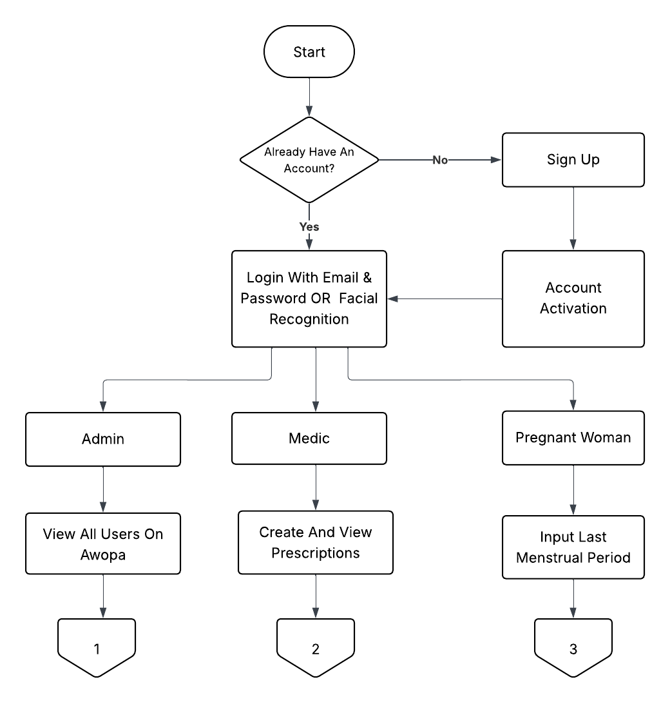
FLOW DIAGRAM OF MOBILE APP

Slide 32
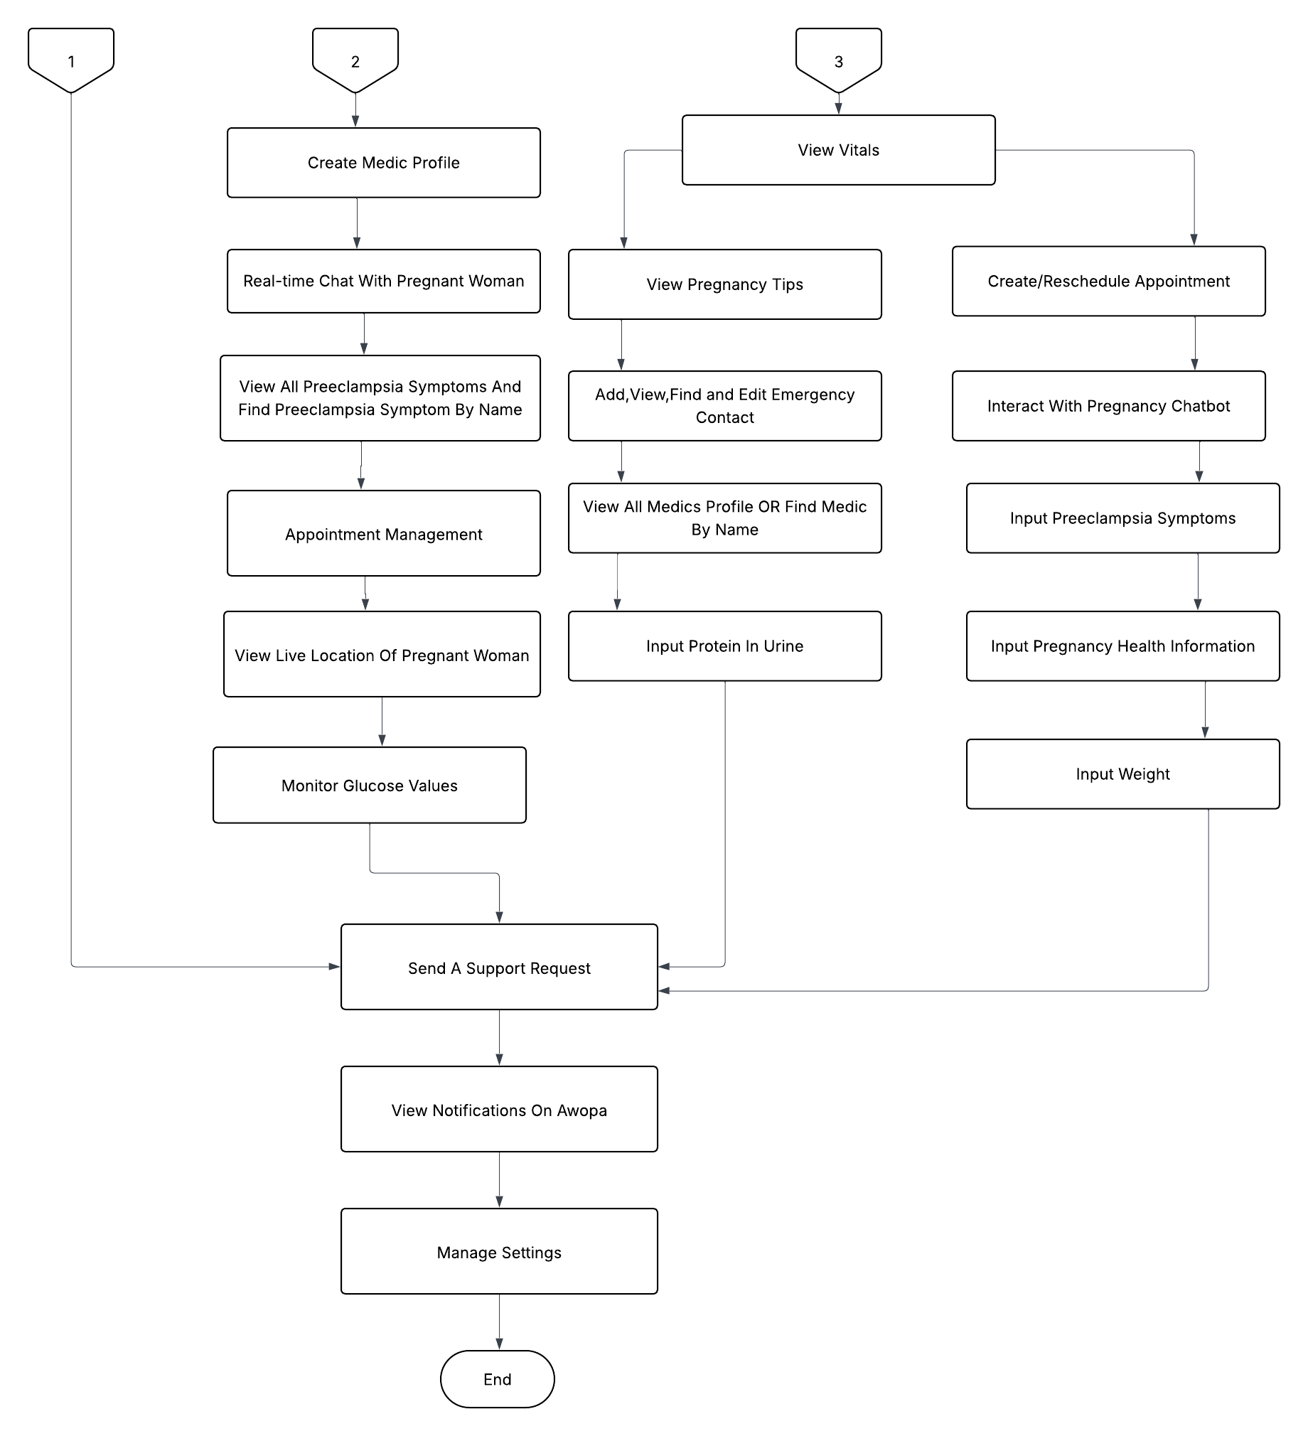
FLOW DIAGRAM OF MOBILE APP

Slide 33
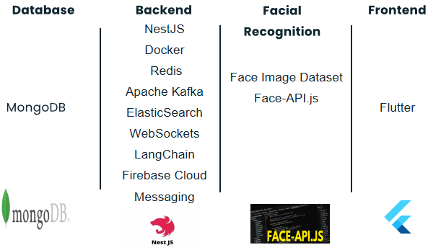
TOOLS AND TECHNOLOGIES USED

Slide 34
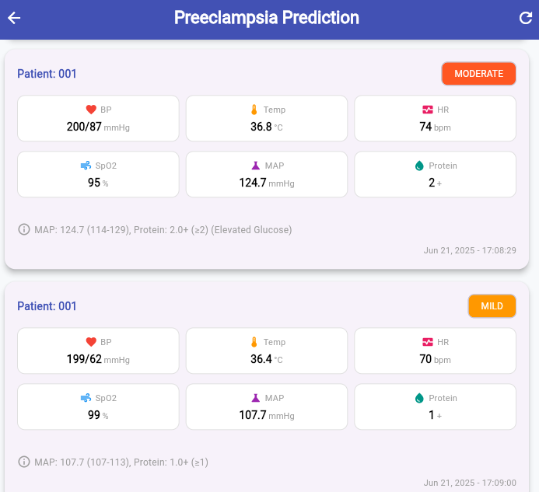
REAL-TIME PREECLAMPSIA PREDICTIONS

Slide 35
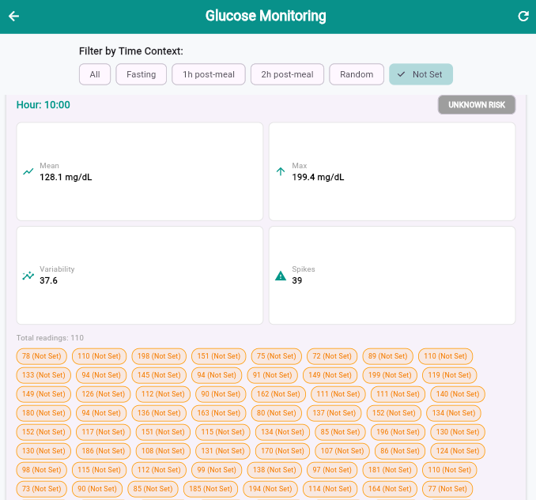
REAL-TIME GDM RISK ANALYSIS

Slide 36
HARDWARE PROGRESS

Slide 37
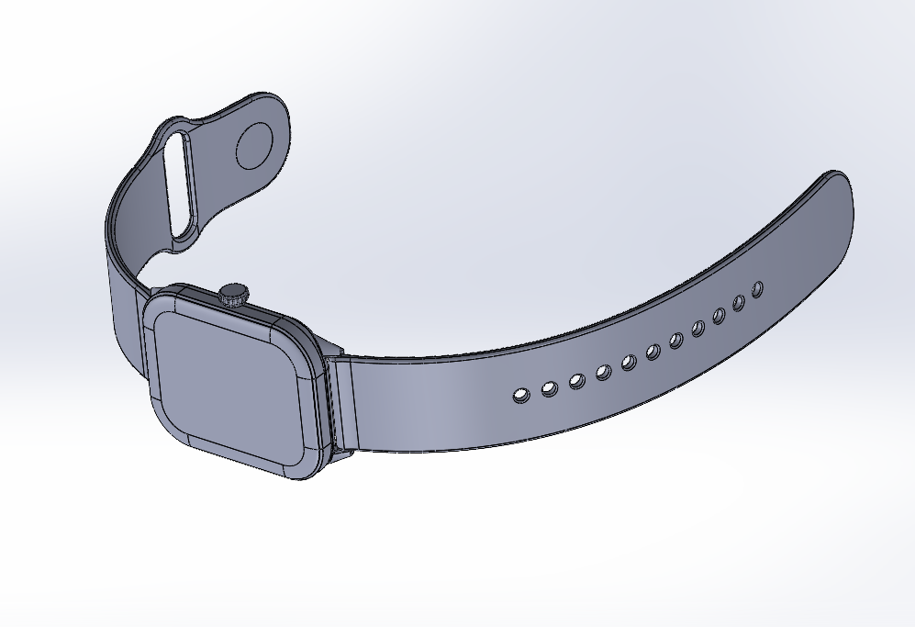
EXPECTED OUTCOME

Slide 38
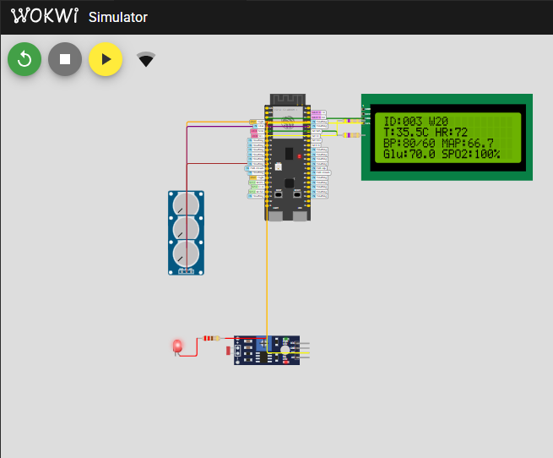
SIMULATION OF WRIST WEARABLE DEVICE

Slide 39
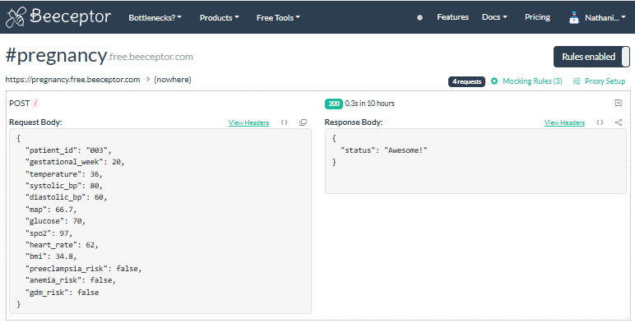
REAL-TIME DATA FROM SIMULATION

Slide 40
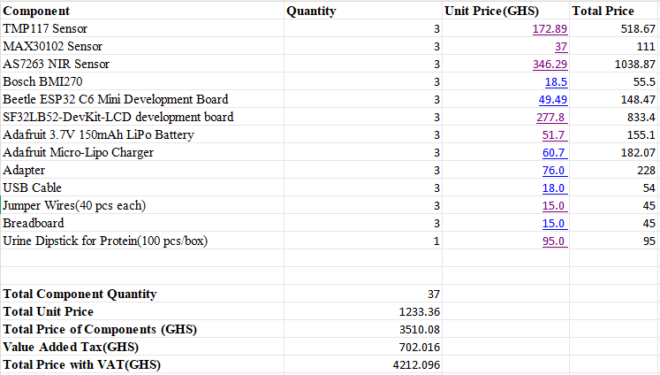
BILL OF MATERIALS

Slide 41
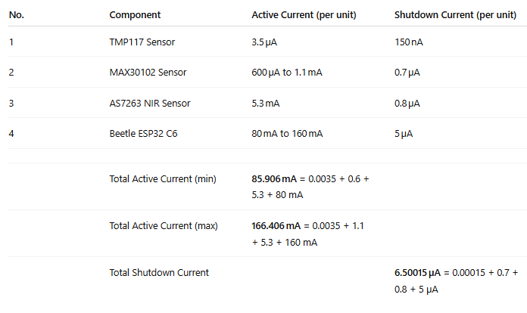
POWER CONSUMPTION

Slide 42
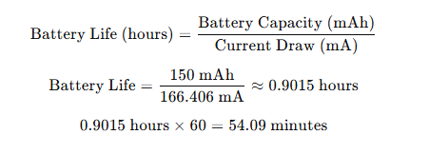
BATTERY LIFE CALCULATION

Slide 43
VIDEO DEMO

Slide 44
NEXT STEPS
Implementation Of Wrist Wearable Device
Broadening Scope Of Project To General Health Information From Vitals
Complete Training of AI model for Anemia Prediction

Slide 45
CONCLUSION
The wearable device provides a practical solution for monitoring pregnant women in Ghana, using advanced sensors and AI to track vital signs and detect complications like preeclampsia, anemia and gestational diabetes early.
The mobile app enhances care for pregnant women by offering real-time data, alerts about health risks, and appointment scheduling, ensuring better communication with healthcare providers.
This project addresses critical gaps in maternal healthcare and contributes to global efforts to reduce maternal and child mortality rates.

Slide 46
REFERENCES
[1] T. Tabassum, S. Podder, and S. T. S. Rafid, "A Comprehensive Framework for
Wearable Module for Prenatal Health Monitoring and Risk Detection," IEEE Int. Conf. Women Innov., Technol. Entrepreneurship (ICWITE), pp. 283-288, 2024.
[2] Y. K. Wiafe, A. Asamoah, P. Akweongo, and A. Kumah, "Factors Affecting Pregnancy Complications in Ghana," Global J. Quality Safety Healthcare, vol. 7, no. 4, pp. 156-161, 2024.
[3] B. D. B. Lopez, J. A. A. Aguirre, D. A. R. Coronado, and P. A. Gonzalez, "Wearable technology model to control and monitor hypertension during pregnancy," Proc. IEEE, Lima, Peru, 2017

Slide 47
REFERENCES
[4] T. Tabassum, S. Podder, and S. T. S. Rafid, "A Comprehensive Framework for
Wearable Module for Prenatal Health Monitoring and Risk Detection," IEEE Int. Conf. Women Innov., Technol. Entrepreneurship (ICWITE), pp. 283-288, 2024.
[5] A. F. Hernández-Castañeda, R. Pardo-Gómez, M. Sierra-Sosa, and A. García-Ramos, "Explainable Early Prediction of Gestational Diabetes Biomarkers by Combining Medical Background and Wearable Devices: A Pilot Study With a Cohort Group," Sensors, vol. 22, no. 15, p. 5793, 2022
[6] A. Kumar, D. Sharma, and V. Gupta, "Health Monitoring of Expecting Mothers using Multiple Sensor Approach: 'Preg Care'," in Proceedings of the 2nd International Conference on Advanced Information and Communication Technology (ICAICT), 2020, pp. 77-82

Slide 48
THANK YOU!
QUESTIONS/FEEDBACK

